Slide 1
Object-Oriented Programming Project
Hassan Attique
482073
BEE-15D
3rd Semester

Slide 2
Table of Contents
Motivation
Uses
Libraries Used
Flowchart

Slide 3
Motivation
Trains
Travelling by trains
Pak Railways website confusing

Slide 4
Uses
Easily book seats and tickets
Check which trains are available
Order food while in train
Cancel bookings

Slide 5
Libraries Used
#include <iostream>
#include <fstream>
#include <iomanip>
#include <string.h>
#include <cstdlib>
#include <ctime>

Slide 6


#include <iostream>
Standard input/output library
Mainly used for cin/cout
#include <fstream>
File input/output
Provides functions like ifstream, ofstream and fstream
#include <iomanip>
Manipulating format of input/output

Slide 7
#include <string.h>
Provides functions such as strlen, strcpy and etc.
#include <cstdlib>
Similar to stdlib.h, preferred library
#include <ctime>
Includes functions such as time

Slide 8
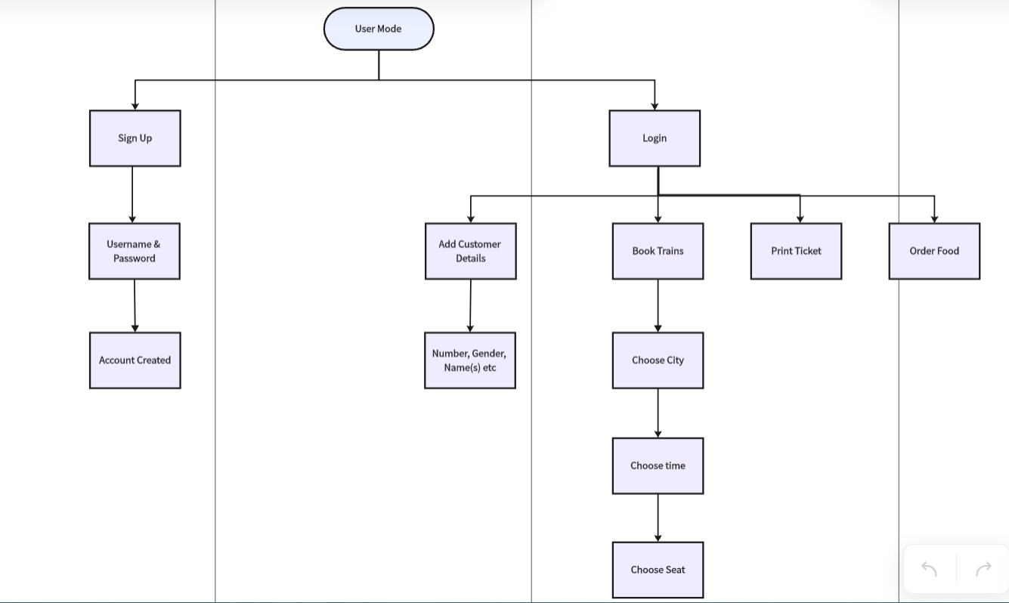
Flowchart

