Slide 1
Statistical Hypothesis Testing
Gladstone Institutes
Reuben Thomas
Staff Scientist @ Bioinformatics Core @ GIDB
09/25/2019

Slide 2
Terms one commonly encounters in hypothesis testing
Null hypothesis versus Alternative hypothesis
P-values
Two-sided test versus One-sided test
Test statistic
Sampling distribution
Type I and Type II errors (Power)
Multiple testing
Assumptions of different tests

Slide 3
Introduction to Hypothesis Testing
We would like to make generalizable claims about an entire target population with data from only a random subset of this population.
Random sampling, appropriate experimental design and Central Limit Theorem allows us to make generalizable claims
Hypothesis testing rests on assuming the skeptical point of view and testing for deviations from this assumption – Null versus Alternative Assumption

Slide 4
How do I choose which statistical test to use?
Response variable
Categorical
X
X
Continuous
X
X
Continuous
Categorical/Factor
Predictor variable

Slide 5
Response:Continuous Predictor: Continuous
Linear regression
Parameter/effect size: slope

Slide 6
How do I choose which statistical test to use?
Response variable
Categorical
X
X
Continuous
X
Continuous
Categorical
Predictor variable

Slide 7
Response:Continuous Predictor: Categorical
T-tests, ANOVA
Parameter/effect size: difference of
means

Slide 8
How do I choose which statistical test to use?
Response variable
Categorical
X
X
Continuous
Continuous
Categorical
Predictor variable

Slide 9
Response:Categorical Predictor: Categorical
Fisher’s test, Chiq-square test, 2x2 tables
Parameter/effect size: odds ratio

Slide 10
How do I choose which statistical test to use?
Response variable
Categorical
X
Continuous
Continuous
Categorical
Predictor variable

Slide 11
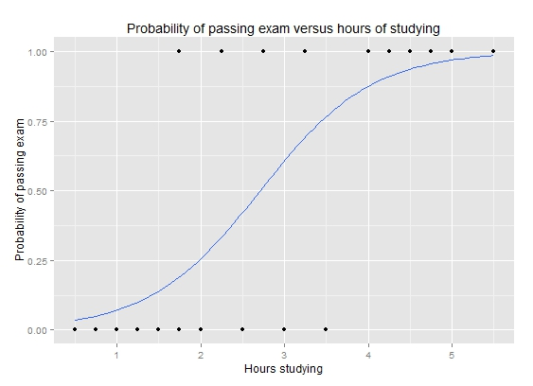
Response:Categorical Predictor: Continuous
Logistic regression
Parameter/effect size: odds ratio
https://upload.wikimedia.org/wikipedia/commons/6/6d/Exam_pass_logistic_curve.jpeg

Slide 12
How do I choose which statistical test to use?
Response variable
Categorical
Continuous
Continuous
Categorical
Predictor variable

Slide 13
Is gene differentially expressed between the two developmental time-points?

Slide 14
Convince a skeptic: Repeat this experiment 1000 times

Slide 15
Central limit theorem allows us to estimate the variation of the location of the distribution

Slide 16
Theoretical distribution of difference in means
Type I error and p-value

Slide 17
Alter underlying variation
sd=14
sd=24
sd=4

Slide 18
Alter the number of replicates
n=4
n=3
n=15

Slide 19
Power to detect a difference of means of -15
Type I and Type II error

Slide 20
Power to detect varying levels of difference in mean differences
Mean diff = -15
Mean diff = -25
Mean diff = -5

Slide 21
Expectations for this workshop

Slide 22
Outline for this workshop

