Slide 1
HyperLogLog
Trading accuracy for space

Slide 2

Let's say you want to count the number of unique viewers on a YouTube video
Naïve: keep track of past viewers with a set
counter c = 0
set S
for each element x_i:
if x_i not in S:
add x_i to S
c += 1
return c
Problem: This uses O(n) space!
For 4-byte usernames, this means 1B viewers = 4GB of memory

Slide 3

Solution: Get a probabilistic estimate of unique viewers using much less memory!
Begin by hashing usernames as bitstrings
Ex.
Dillan --> 001001
Eric --> 010100
Sebastian --> 110010
Insert: this guy

Slide 4
Think of each hash as a sequence of coin flips
…
H
T
H
H
H
T
0 1 ...
0 0 0 1
Prob = ¼
Expected flip sequences = 4
Exp. Distinct elements = 4
Prob = 1/16
Expected flip sequences = 16
Exp. Distinct elements = 16

Slide 5
Pseudocode
Eric
Dillan
Sebastian
Dillan
…
Jim Ryan
...
010001
100010
001010
100010
…
000010
...
2
1
3
1
…
5
...
max1 = 0
for each viewer in viewer_stream:
hashed_username = hash(viewer)
# get position of first 1 bit
p = position(hashed_username)
max1 = max(p + 1, max1)
estimated_viewers: 2**max1
max = 5
For n viewers:
(position of first 1)
max ~ log(n)
store max with log(max) bits
∴ use log(log(n)) memory
We expect 2^5 = 32 viewers

Slide 6
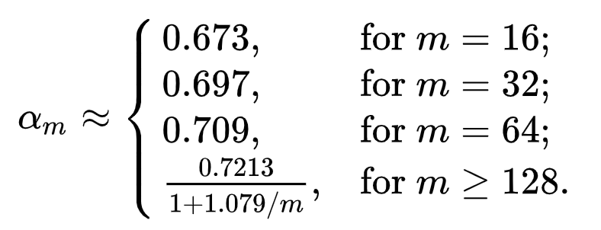
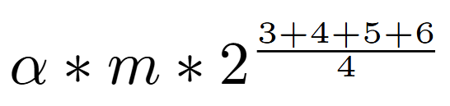
But how accurate is this?
Recall estimated_viewers: 2**max1
Solution: average many estimates!
Eric
Dillan
Sebastian
Dillan
Jim Ryan
...
010001
100010
001010
100010
000010
...
00
max = 5
01
max = 4
10
max = 6
11
max = 3
estimate =

Slide 7
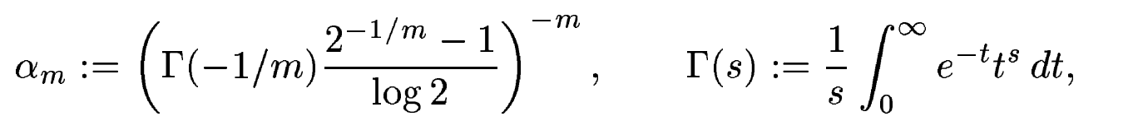
Why alpha?
Our approximation is biased above the end result.
Mathematical analysis that exceeds the scope of an undergraduate algorithms class...
Why?
Multiplying by alpha counteracts this bias.

Slide 8
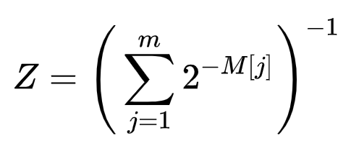



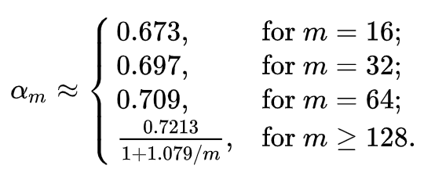
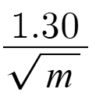
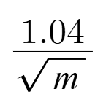
LogLog
Arithmetic mean
HyperLogLog
Harmonic mean
std. error = ​
std. error = ​
ex. 16384 buckets = 0.8125% error (HLL)

Slide 9
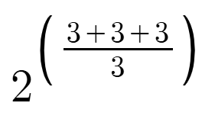
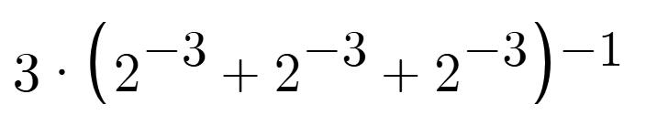
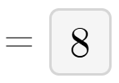
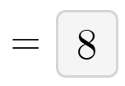
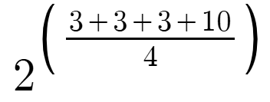
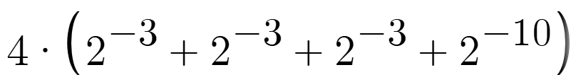


Why a harmonic mean?
Consider the following bucket maxes:
{3, 3, 3}
Harmonic
Arithmetic
Now add an outlier:
{3, 3, 3, 10}

Slide 10
Add Function
add(element):
hash_val = hash(element)
bucket_index = hash_val >> (64 – p)
remaining_bits = hash_val & (1 << (64 – p)) - 1
pos = (64 – p) -
remaining_bits.bit_length() + 1
buckets[bucket_index] =
max(buckets[bucket_index], pos]
Choose some hash function that uniformly distributes values
Assuming 64-bit hash values and 2^p buckets
+1 because we really want the 1-indexed position (like 0001 -> 4)

Slide 11
Count Function
count():
if all registers == 0:
return 0
for reg_max in registers:
sum += (2^-reg_max)
Z = 1/sum
E = alpha*m^2*Z
v = (registers == 0).sum()
if E <= 2.5 * m and v > 0:
E = m * log(m/v)
if E > ((1 << 64) / 30):
E = -(1 << 64) * log(1 – E /1<<64)
return(int(E + 0.5))
If all registers are 0, no elements have been added
Compute estimate using alpha & harmonic mean as shown earlier
Get number of registers that are still zero
Use "linear counting" for very small estimates
Use this approximation for very large estimates
Round up if you approximated

Slide 12
Merge Function
merge(other):
h = hyperloglog(p)
h.registers = max(registers, other.registers)
return h
Think: we're pouring the buckets of the other HLL algorithm into our algorithm's buckets.

Slide 13
Final Analysis
m = register ("bucket") count, n = number of elements to count
 | Time | Space | Error
Native | O(n) | O(n) | 0
LogLog | O(n+m) ~ O(n) | O(m)
HyperLogLog | O(n+m) ~ O(n) | O(m)
 | Time | Space
Add | O(1) | O(m)
Count | O(m) | O(1)
Merge | O(m) | O(m)

