Slide 1
Segment Tree
Range Updates
By: Ilia, Grady, and Edward

Slide 2



Recall: segment Trees
Goal: Efficient queries and updates on an array
Traditional Segment Tree:
Range Queries:
Point Updates:
Range Updates:
Need to do a point update for entire range
Now: Can we support update queries on entire ranges in time as well?

Slide 3
Solution: “lazy propagation”
Key Idea:
Don’t update every node, update only the topmost segments
Defer updates to their children until needed (lazily)

Slide 4
Three Variants
Assignment
Addition
Max
Ranged Assignment Updates with Point Queries
Ranged Addition Updates with Point Queries
Ranged Addition Updates with Ranged Max Queries

Slide 5
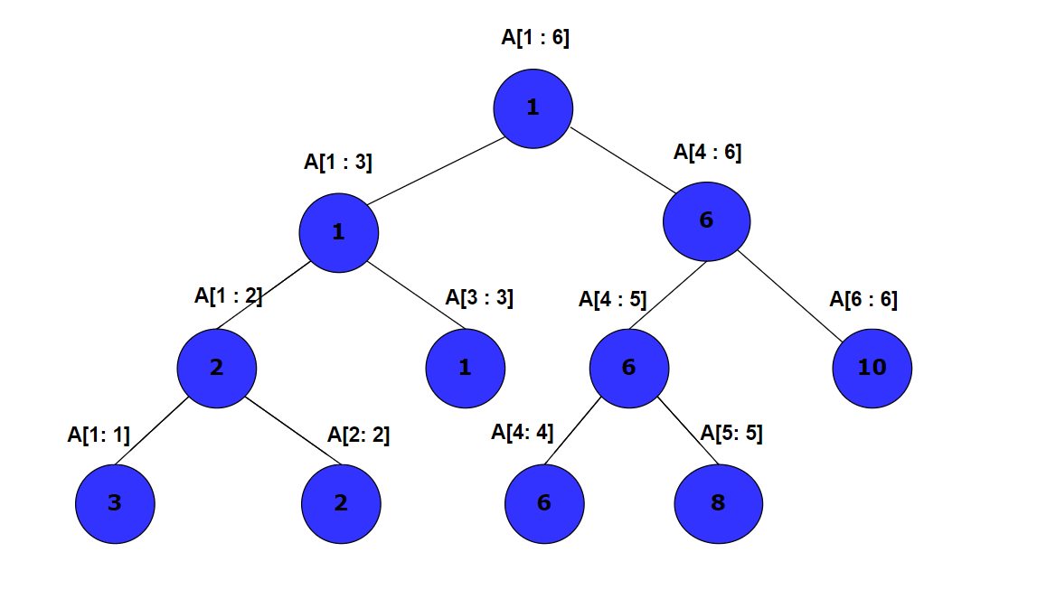
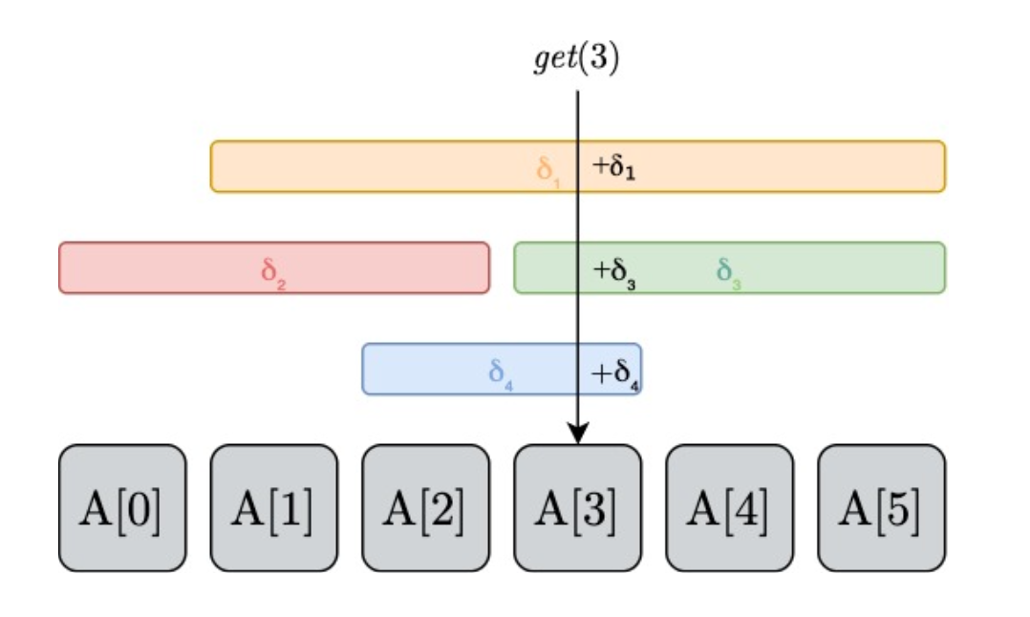
Variant 1: Adding to a range, getting a specific index
When updating, store the value to be added to the highest segments that are inside the range, instead of each leaf
When getting the value at an index, as you return up the tree, add the value stored at each vertex

Slide 6
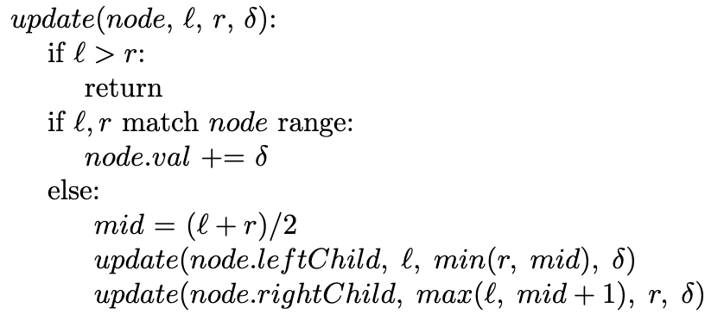
Variant 1: Update
Store value to be added to highest segments in the range to be updated

Slide 7
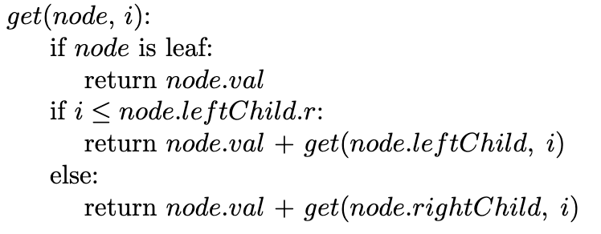
Variant 1: Get
Stored values are added when returning up the tree

Slide 8
Variant 2. Assigning to a range, getting a specific index
When updating, store the value to be assigned to the highest segments that are inside the range, instead of each leaf
Mark these segments, indicating that all the values below are equal to the value stored at the vertex
If encountering a marked vertex, push:
mark the two child vertices and update the values
unmark current vertex
Getting the value at an index by traversing down the tree
when traversing down the tree, when encountering a marked vertex, push

Slide 9
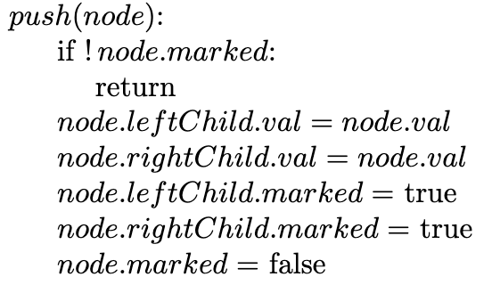
New method: push
Push propagates the pending changes to the two immediate children
In variant 2, a marked node has pending changes
All children of the marked node share its value
“Push” new value from parent to children nodes
Changes no longer pending

Slide 10
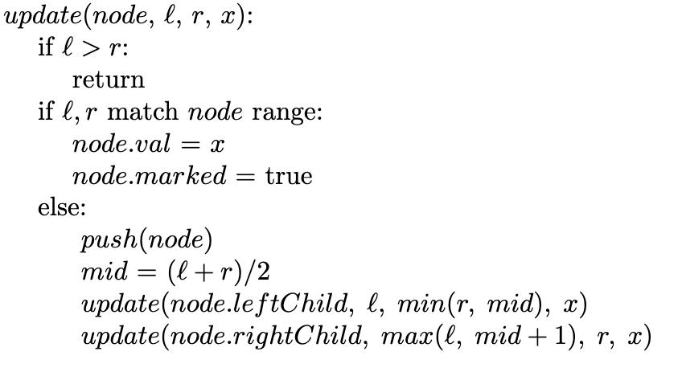
Variant 2: Update
Store value to be inserted in highest segments within range
Mark that children share its value
Propagate changes while traversing tree

Slide 11
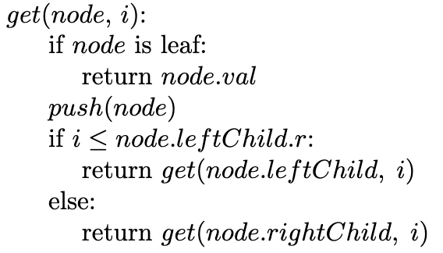
Variant 2: Get
Propagate changes while traversing tree down to leaf node

Slide 12
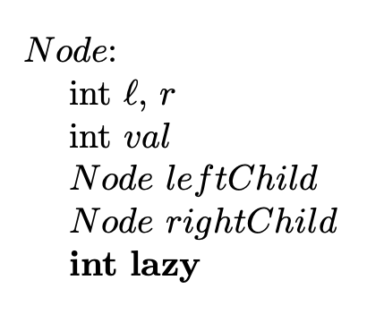
Variant 3:
Supports the following queries:
update(l,r,δ) – add δ to each value in the range A[l...r]
max(l,r) – return the maximum value in the range A[l...r]
While keeping the original O(log n) runtime.
Each node will store the maximum over its range as its value, but will have a new field, lazy, that stores the additions that need to be propagated.

Slide 13
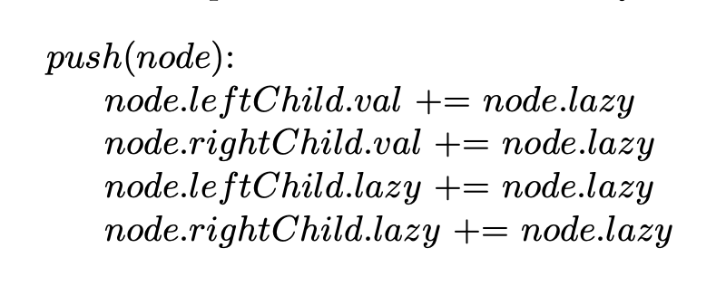
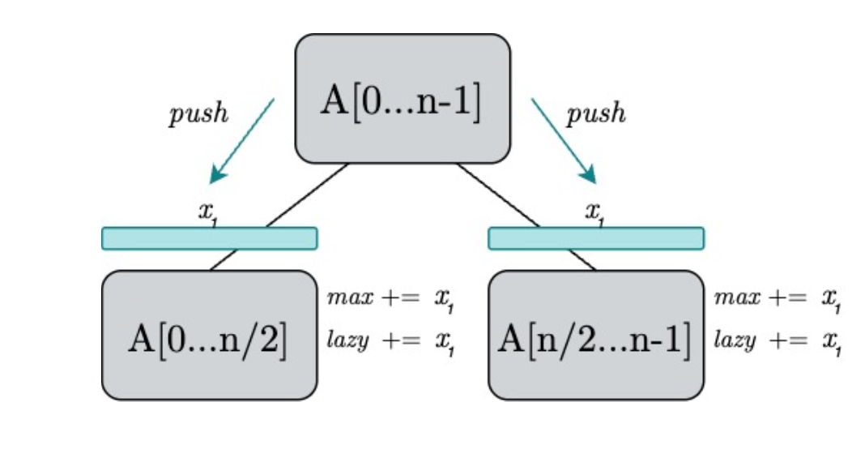
Push for variant 3
The push method for this variant is similar to the previous
When called on a node, push simply passes down the node’s lazy addition to its children
Note: Along with the children’s values, we also need to update their own lazy fields for future lazy propagation

Slide 14
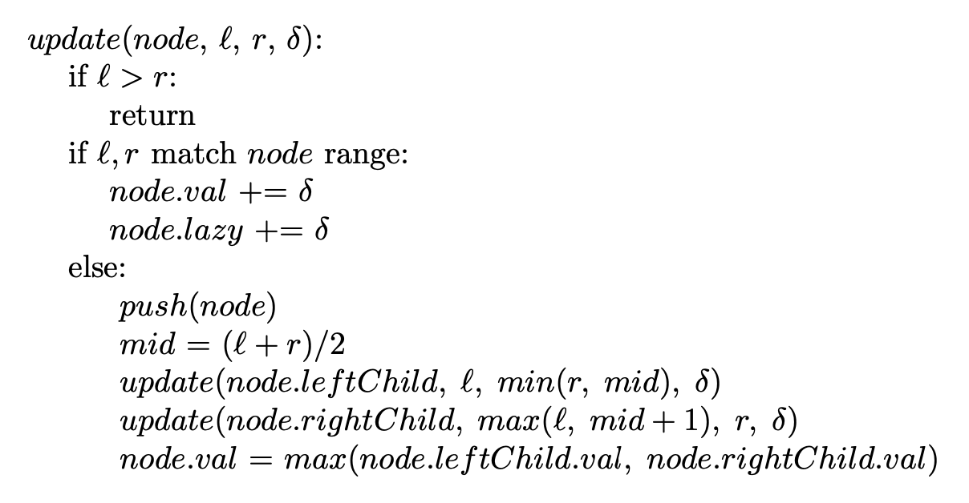
Update
With the new push method, our update method is relatively standard
If the query range matches the node’s, add δ to its value as well as its lazy value
Otherwise, call push on the current node to propagate any updates, recursively update our children, then update our own value by merging our children’s

Slide 15
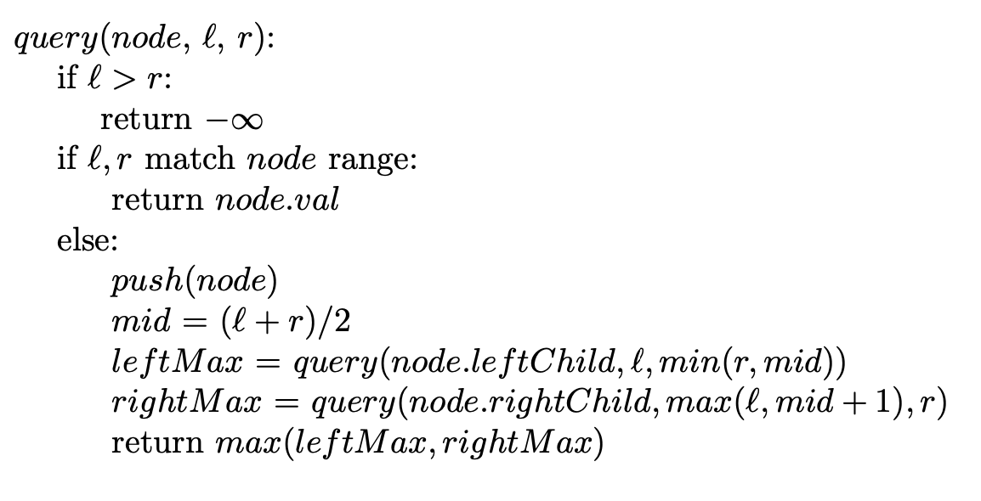
Query
Get the max of the highest-level segments that fall within a range
When reaching a segment that falls within a range, return the stored max value
Otherwise, push the pending changes down to the two children and continue to traverse the tree

Slide 16
Material From:
https://cp-algorithms.com/data_structures/segment_tree.html#range-updates-lazy-propagation

