Slide 1
TREAP
Huarui Liu, Jingzhou Qiu, Zicheng He

Slide 2
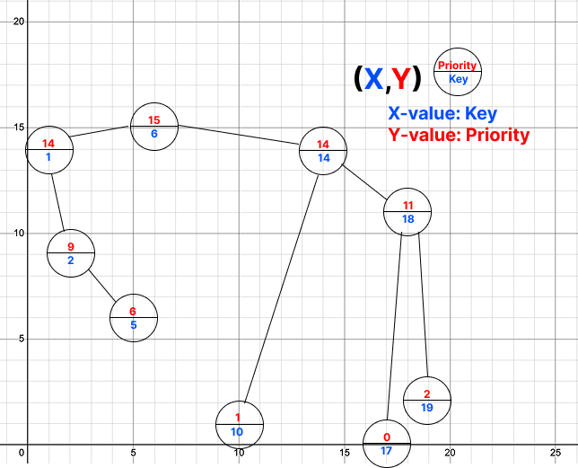
What is a Treap?
Keys in sorted order like a BST
Priorities follow the heap property
Randomized BST Combines BST and heap properties
A type of Cartesian Tree
lookup, insertion, and removal in O(logN)
Additional Operations:
Split: O(logN)
Merge: O(logN)
Notes:
Each node has
key: BST ordering
priority: heap ordering
Simplicity Balance
Compared to AVL or red-black trees (which are more commonly used for balancing), treaps are simpler.
No need for rotations or color flipping — probabilistic balancing through random priorities.
Page cache is implemented as address_space mappings.
Each file’s page cache is organized per file offset (logical page index).
These pages need fast lookup, insertion, and removal — especially under high concurrency or memory pressure.

Slide 3
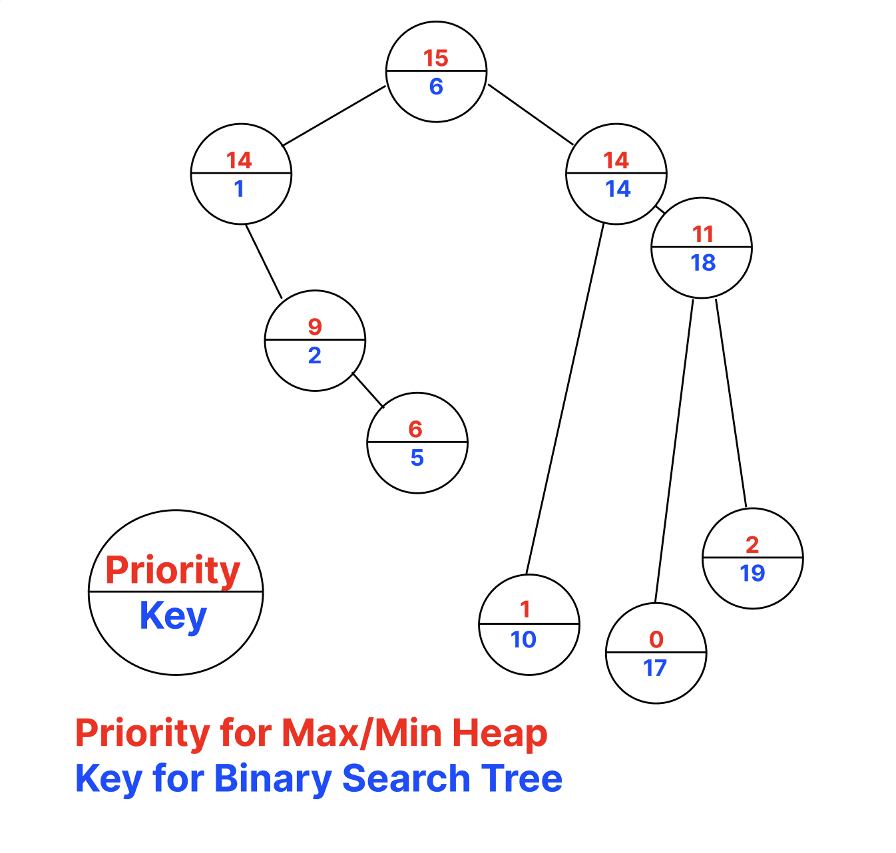
Why Treap?
Self-Balancing via random priorities
Simpler to implement than AVL or Red-Black trees
Can be modified to support segment tree operations and even more– all in O(logN)
Reverse on the interval.
Addition / painting on the interval.
Applications
Linux kernel page cache management
General Purpose Allocator (GPA)

Slide 4
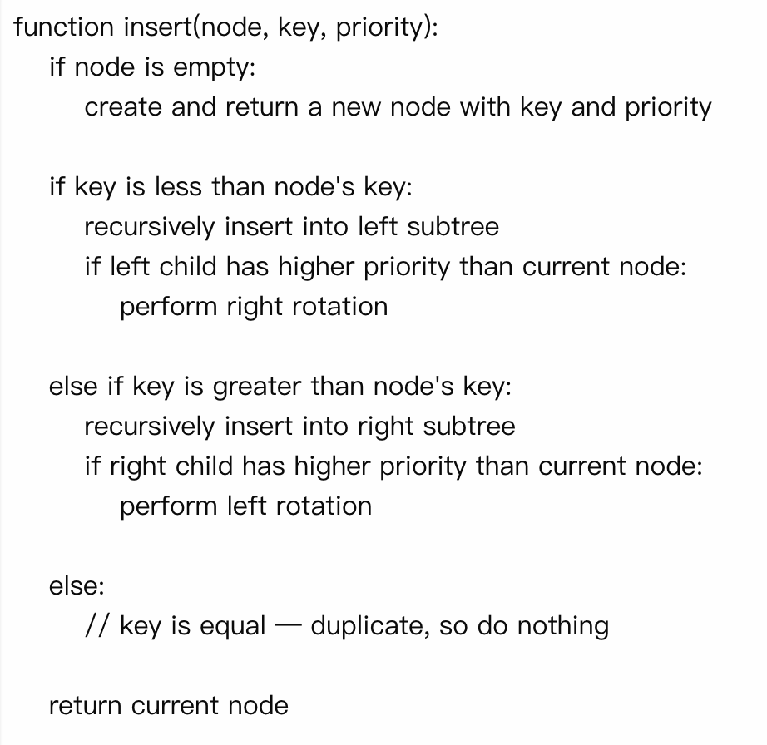
Insert (Min-heap)
Pick a random priority/specify a priority
Insert as inserting in BST
Rotate until the heap order is maintained
Runtime: O(logN)
Notes:
Min Heap

Slide 5
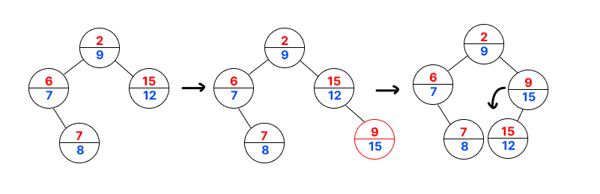

Insert-Example
Insert(15) ->Random priority=9

Slide 6
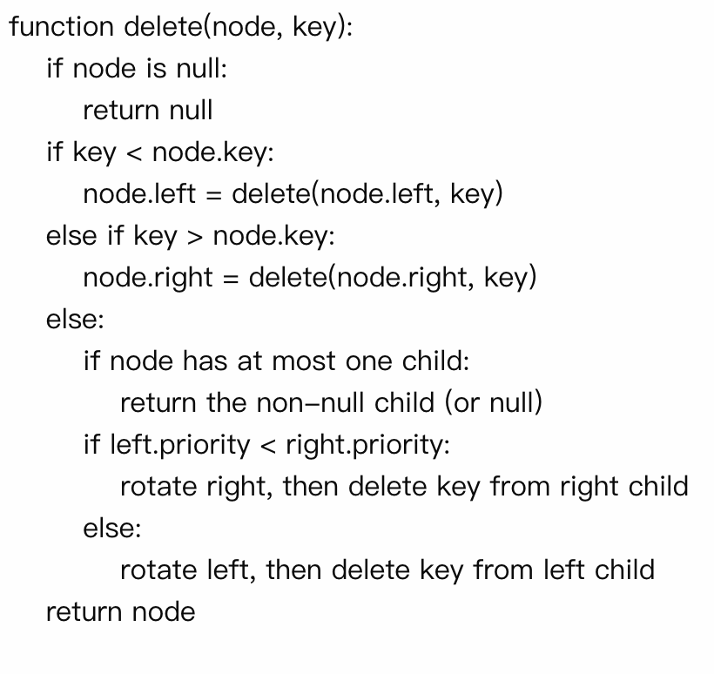
Delete(Min-heap)
Find the node by key (BST-style).
If the node has 0 or 1 child:
return non-null child or null
If the node has 2 children:
Rotate the child with the smaller priority up
Recurse on the same key to delete it
Runtime: O(logN)

Slide 7
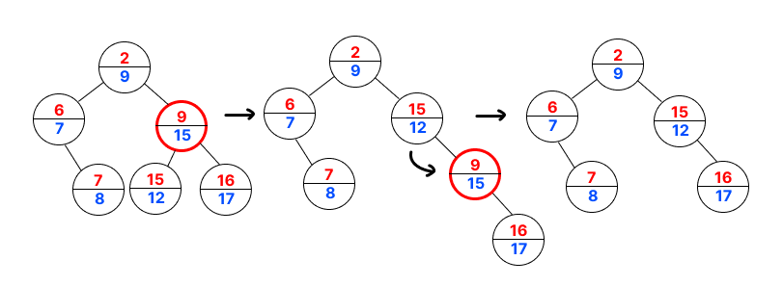
Delete-Example
Delete ( 15 )

Slide 8
Build
Heapify ensures the parent node has the highest/lowest priority by recursively swapping with the larger/smaller-priority child
Builds a tree from a list of values.
Case 1: Input Keys Are Sorted -> Build in O(N) time
Select the middle element to construct BST
Use heapify to ensure the heap property based on priorities
Case 2: Perform N insertions -> O(Nlog N) time

Slide 9
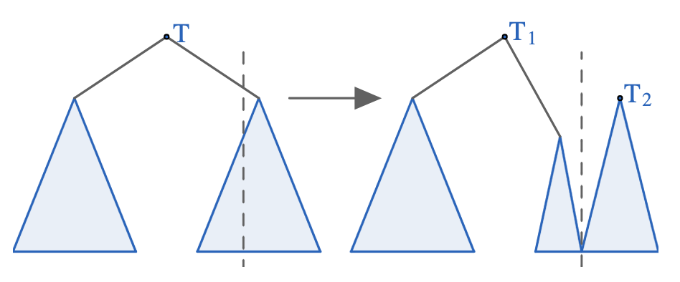
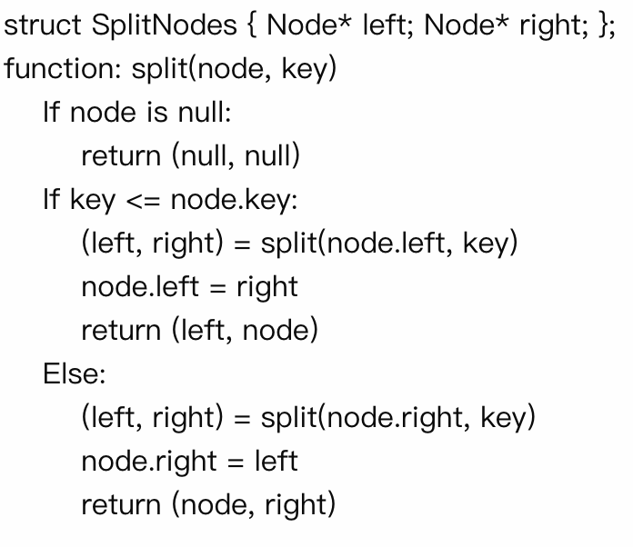
Split
Decide which subtree the root node would belong to (left or right)
Recursively call split on one of its children
Create the final result by reusing the recursive split call
Runtime: O(logN)

Slide 10
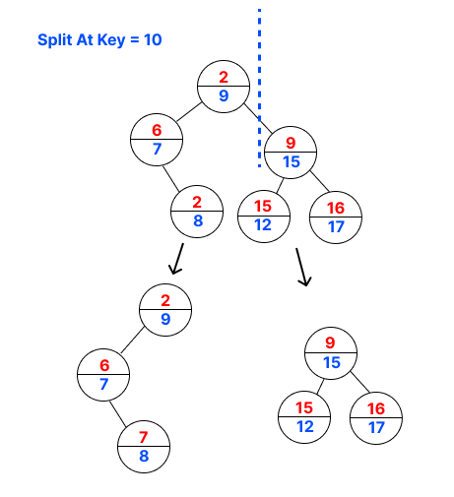
Split-Example

Slide 11
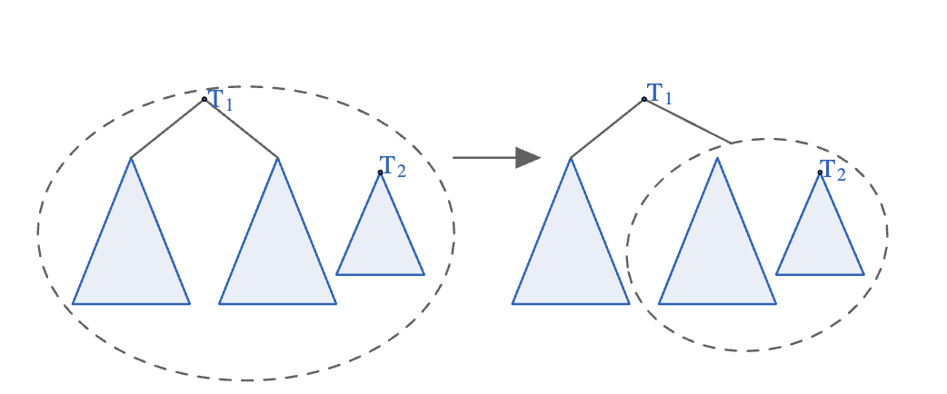
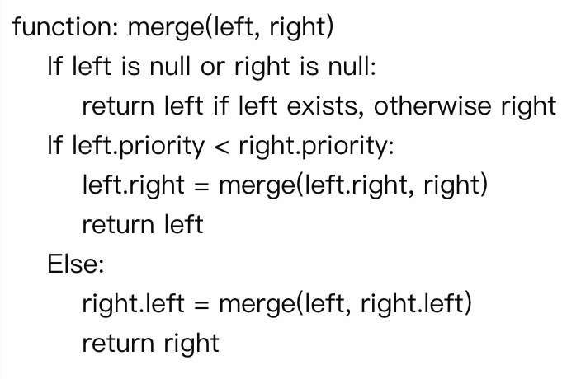
Merge(Min-heap)
Merges two treaps (left and right) assuming all keys in left are less than those in right.
Chooses the root with larger/smaller priority to maintain the heap property
Runtime: O(logN)

Slide 12
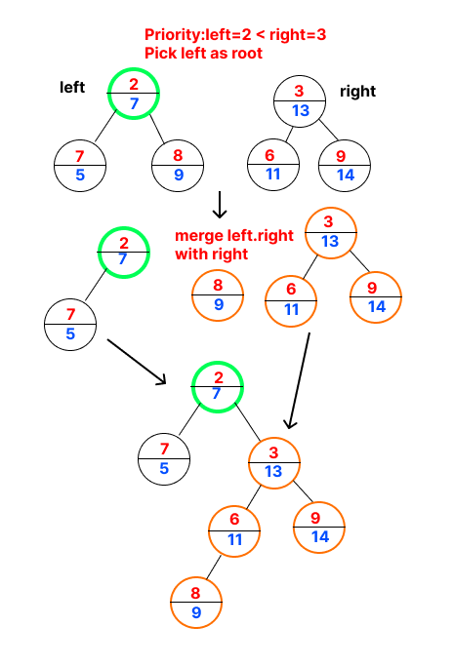
Merge-Example

Slide 13
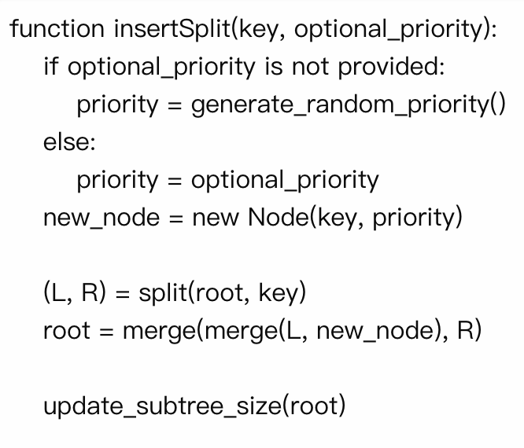
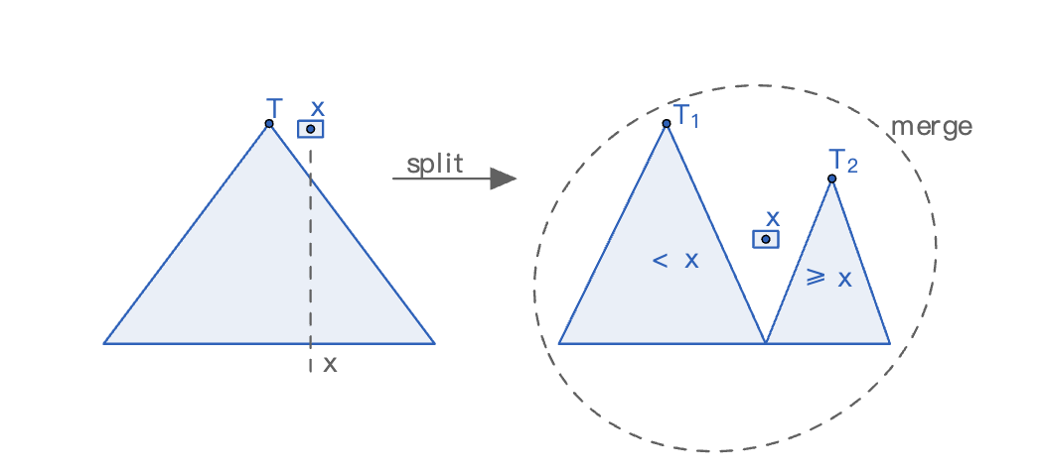
Insert-Using Split
Runtime: O(logN)
Pick a random priority/specify a priority
Insert as inserting in BST
Rotate until the heap order is maintained
Runtime: O(logN)

Slide 14
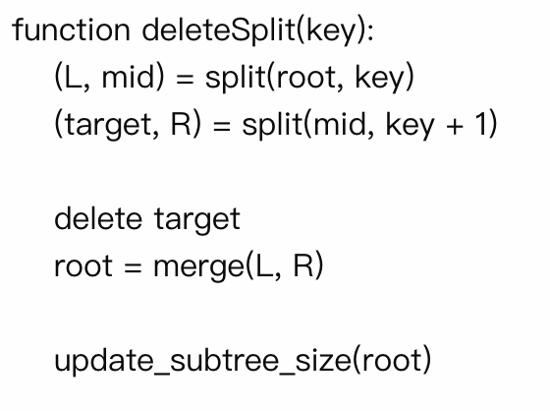
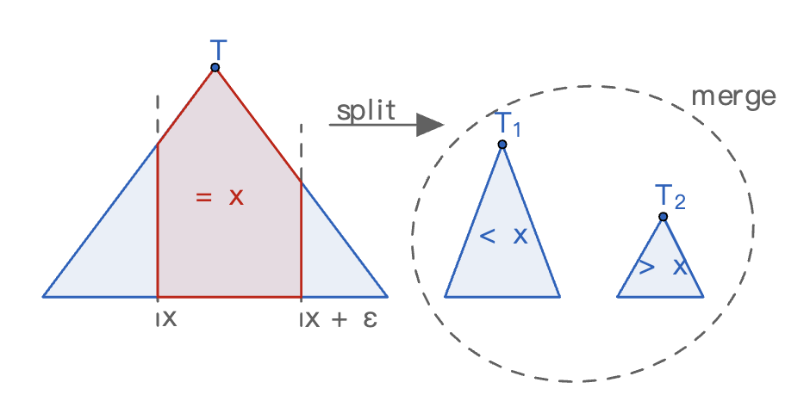
Delete-Using Split
The tree is split into three parts:
L: nodes with keys < key
target: node with key == key
R: nodes with keys > key
Delete the target node
Merge L and R back together
Runtime: O(logN)

Slide 15
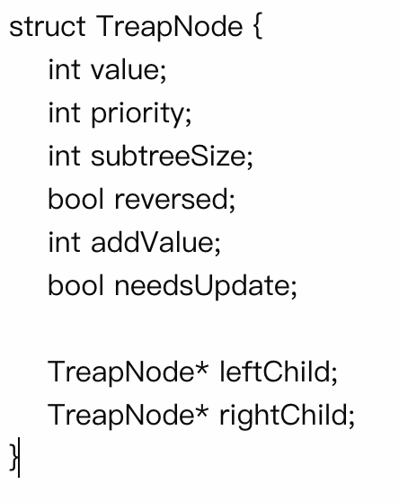
Extension on Treaps-Implicit Treap
Implicit Keys:
The position of each node is its key
Index is calculated using subtree sizes
Nodes store more info to support extra features
Allow fast range queries and updates
Flexible Operations: Allows insertions, deletions, and reversals
Notes:
struct TreapNode {
int value; // Value stored in the array at this position
int priority; // Heap priority (randomly generated)
int subtreeSize; // Size of the subtree rooted at this node
bool reversed; // Flag for lazy reversal of subtree
int addValue; // Lazy propagation value for addition operations
bool needsUpdate; // Flag indicating pending updates
TreapNode* leftChild;
TreapNode* rightChild;
}

Slide 16
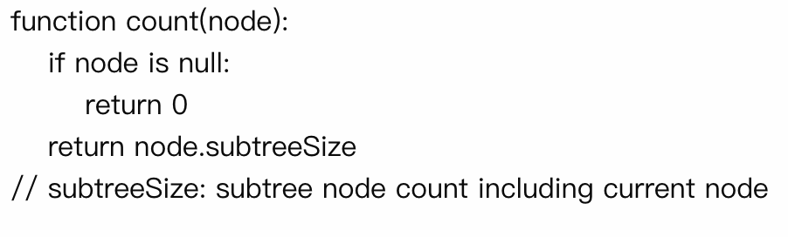
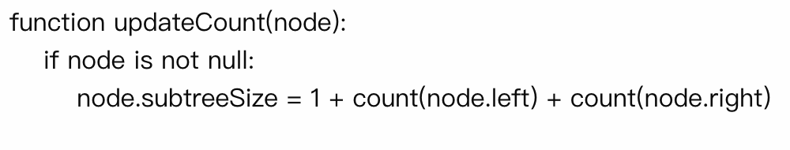
Utility functions
SubtreeSize serves as the node's position like an implicit index
updateCount function maintains accurate subtree sizes
We will implement an Implicit Treap with the reverse function

Slide 17
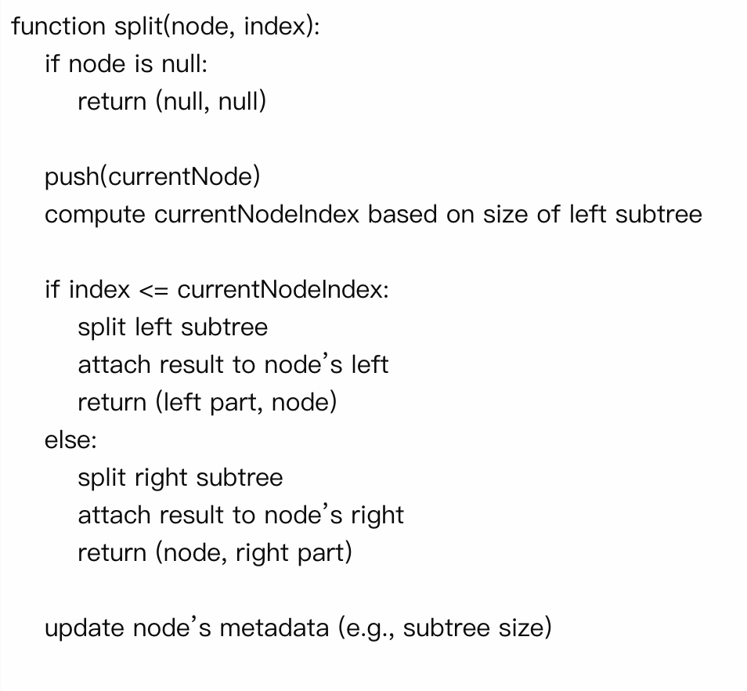
Updated Split
Runtime: O(logN)
calculates each node's position
split the nodes with into left and right subtree based on the given index
uses push()to apply any pending lazy updates (in our example, the reversal flag only)
use updateCount() to keep track of subtree sizes accurate
*push() function will be introduced later

Slide 18
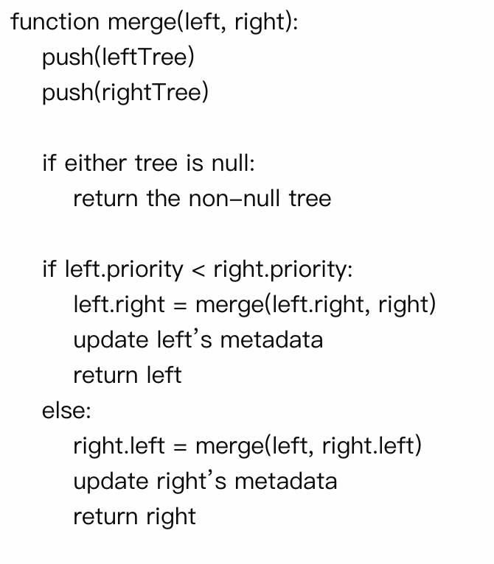
Updated Merge
uses push() to apply any pending lazy updates
same merging logic, except we need to keep track of subtree sizes and other metadata
Runtime: O(logN)

Slide 19
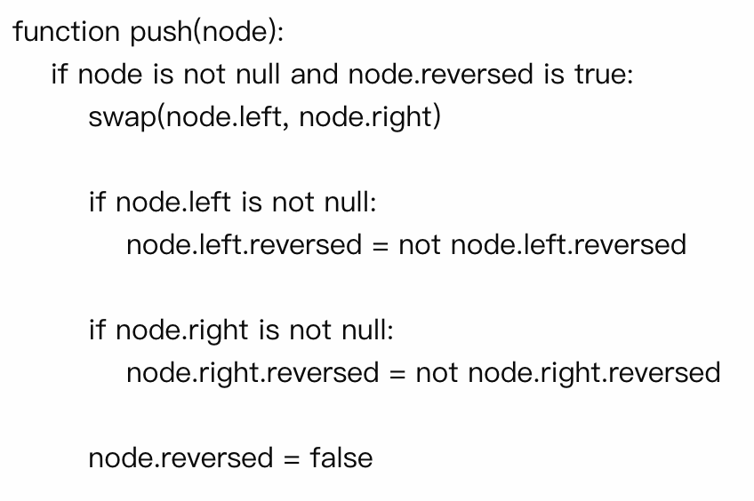
Lazy Propagation for Reverse
Instead of immediately swapping all left/right children(which would be O(N)), flip the reversed flag
Call push() when the Node is accessed
Runtime: O(logN)

Slide 20
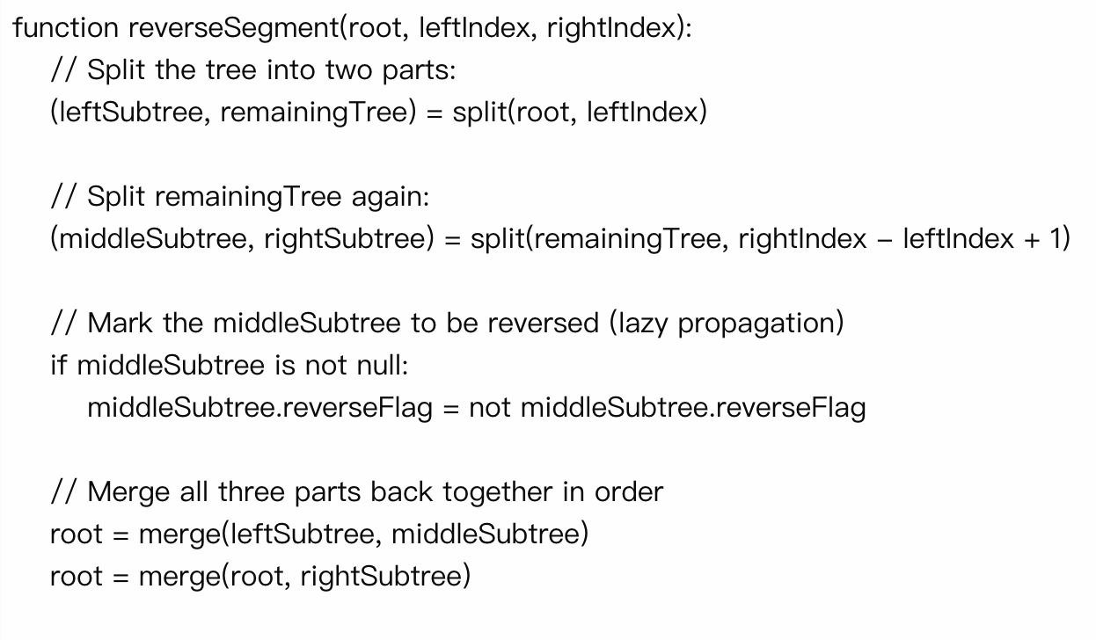
Reverse Function
Runtime: O(logN)

Slide 21
Conclusion
Treap combines the balanced BSTs with array-style indexing with most operations in O(log N) time
more powerful than segment trees
However:
They're mostly only used in competitive programming and academia:
developers favor other more commonly used structures like segment trees or balanced BST libraries

Slide 22
Reference
https://cp-algorithms.com/data_structures/treap.html
https://www.youtube.com/watch?v=6x0UlIBLRsc
https://courses.cs.washington.edu/courses/cse326/00wi/handouts/lecture19/sld017.htm

