Slide 1
AHO-CORASICK ALGORITHMs
Advanced Algorithms Brennen MULLER, NaTALIA WUNDER, DEEVENA SISTA
Some materials courtesy of Stanford CS 166, https://web.stanford.edu/class/archive/cs/cs166/cs166.1166/lectures/02/Slides02.pdf

Slide 2
MOTIVATION

Slide 3

PUBLISHING PROOFREADING
Imagine you work for a publishing company that wants to release a new novel. Your boss gives you one week to scan the 200,000 word manuscript for a list of 1,000 commonly misspelled or incorrect words. How would you solve this problem?
Patterns:
ab
about
ate
be
bed
edge
get
…

Slide 4

Motivation
Goal: Given a search string $S=s_{1}s_{2}…s_{m}$ and a dictionary of patterns $D=\{D_{1}, D_{2}, …D_{k}\}$, efficiently find every occurrence of every $D_{i}$ in $S$.
Support the following operations
Pre‑process the pattern set once in $O(\sum_{i=1}^{k}{|D_{i}}|)$ or $O(m)$time.
Search the text stream $S$ and report all matches in in $O(\left|S\right| +matches)$ or in $O(n+z)$ time, independent of the number of patterns $k$
Use only $O(\sum_{i=1}^{k}{|D_{i}}|)$ or $O(m)$memory—no more than the dictionary itself—while maintaining constant‑time transitions per character.
Note: We should be able to handle overlapping keywords, supports streaming input (character‑by‑character processing)

Slide 5
NAÏVE SOLUTION

Slide 6
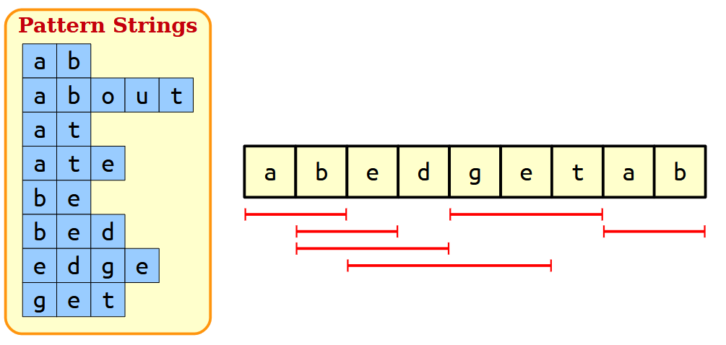
NAÏVE SOLUTION: ONE AT A TIME
Remember the problem statement:
Given a dictionary set D and a search string S, find all matches from D in S:
Note that dictionary strings may overlap!

Slide 7
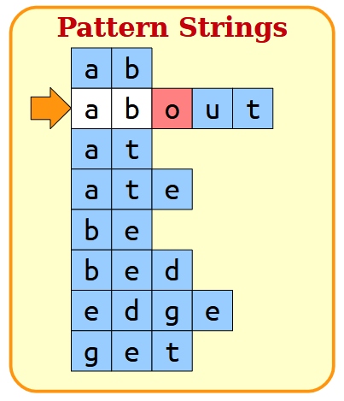
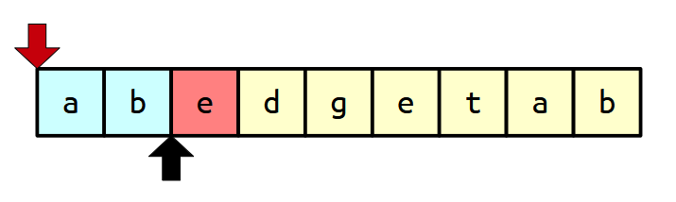
NAÏVE SOLUTION: ONE AT A TIME
Key Ideas
Search S character-by-character
Compare against each string in D

Slide 8
NAÏVE SOLUTION: ONE AT A TIME
Length: n
Key Ideas
Easily implemented with double for-loop
Overall Runtime: O(mn)
Combined length: m

Slide 9
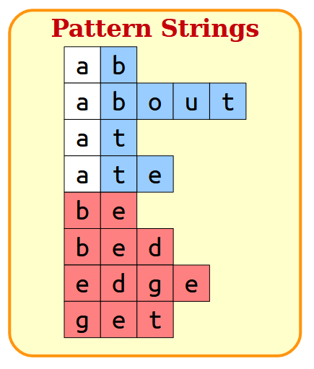
NAÏVE SOLUTION: ONE AT A TIME
At its worst, this algorithm might require checking each character many times. When dictionary strings share common substrings, this problem is particularly noticeable…
Ideally, we want a non-multiplicative runtime

Slide 10
WORKING TOWARDS A BETTER SOLUTION

Slide 11
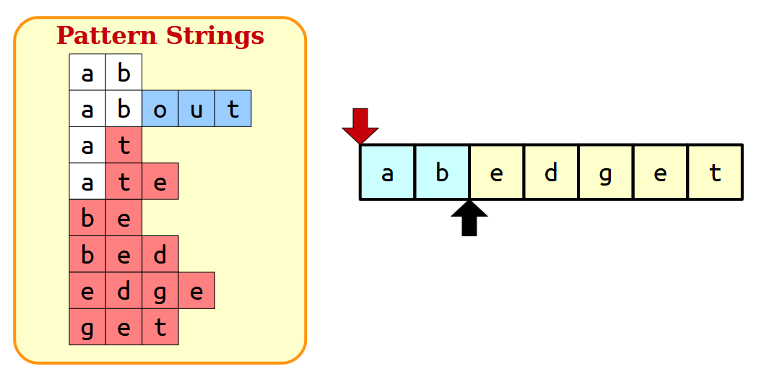
TOWARD A BETTER SOLUTION
Key Idea
As you advance the head, limit the remaining choices
Runtime: O(pn)
Longest string in dictionary D: p
Still multiplicative! We can do better!

Slide 12
TOWARD A BETTER SOLUTION
New Goal:
Read each character only once Seamlessly transition between possibilities
(e.g. “ab” to “be” to “bed”)
What ideas do you have?
Does this remind you of anything you’ve studied before? What about regular expressions and DFAs?

Slide 13
AHO-CORASICK

Slide 14

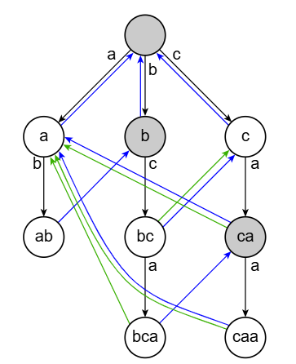
Aho-Corasick
Allows us to efficiency search for multiple patterns in any text
Preprocesses patterns into a single automaton
Combining the trie data structure with ideas of finite state automata!

Slide 15
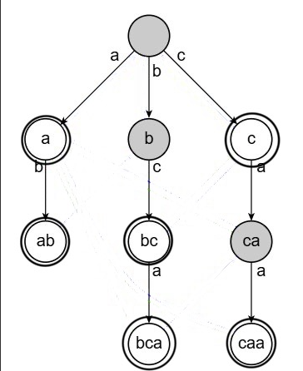
Creating the Trie
Trie: a data structure used for storing the pattern strings
Each node represents a prefix shared by one or more strings
Root node acts as a starting point with no character representation
Each pattern is inserted one character at a time

Slide 16

Creating the Trie

Slide 17
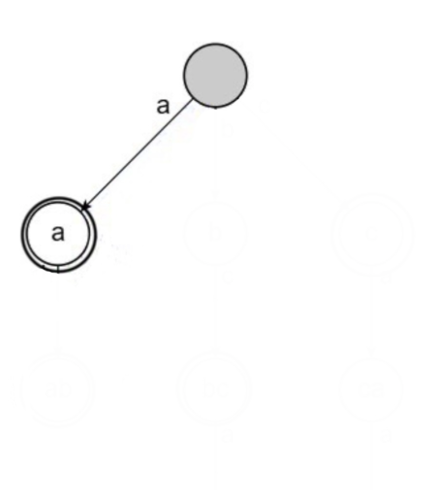
Creating the Trie

Slide 18
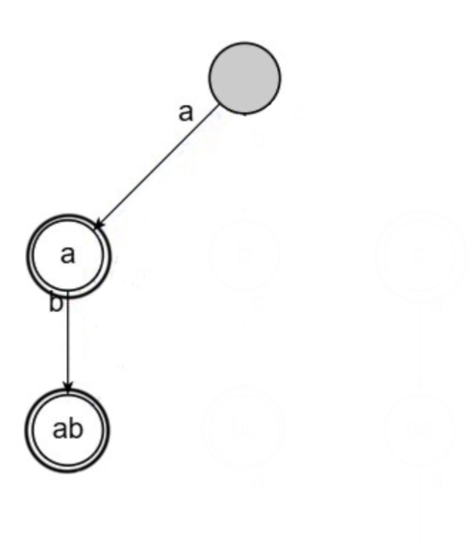
Creating the Trie

Slide 19
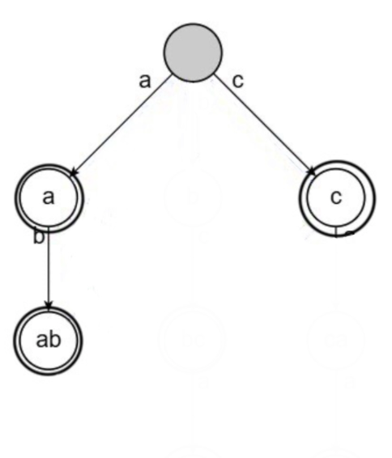
Creating the Trie

Slide 20
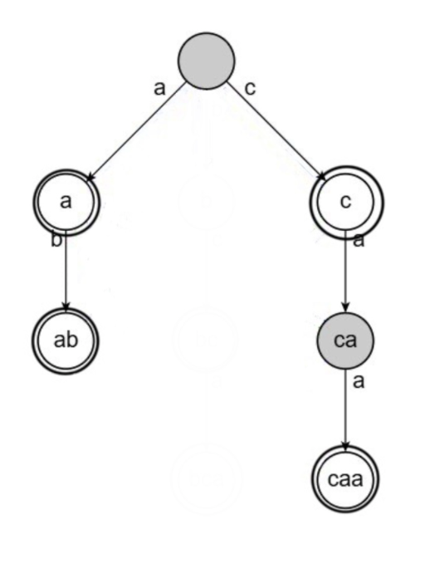
Creating the Trie

Slide 21
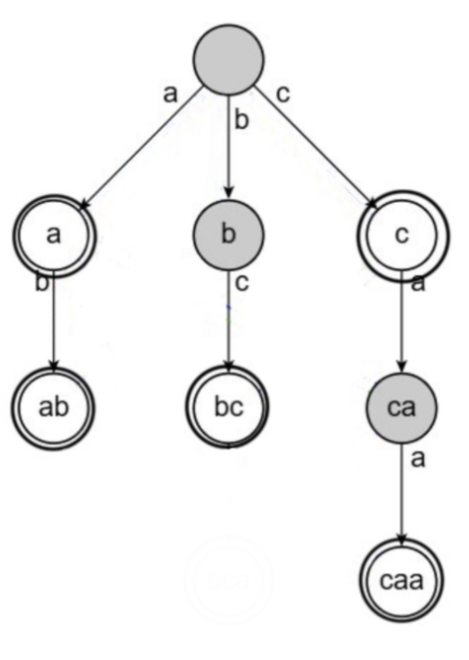
Creating the Trie

Slide 22
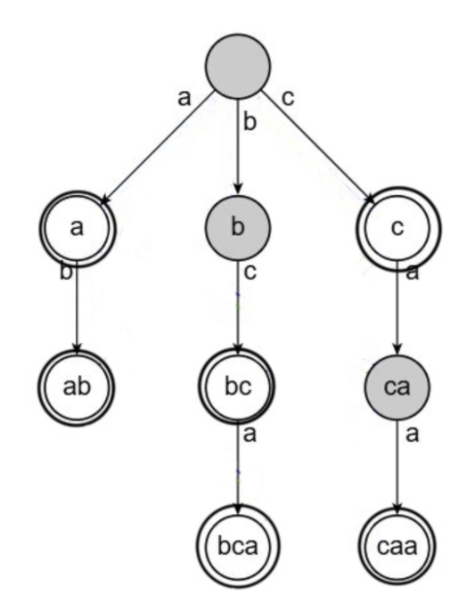
Creating the Trie

Slide 23
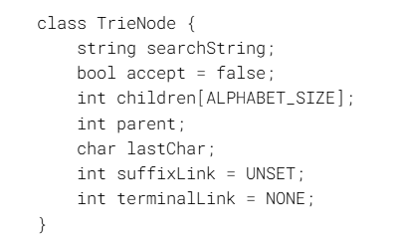
CREATING THE TRIE

Slide 24
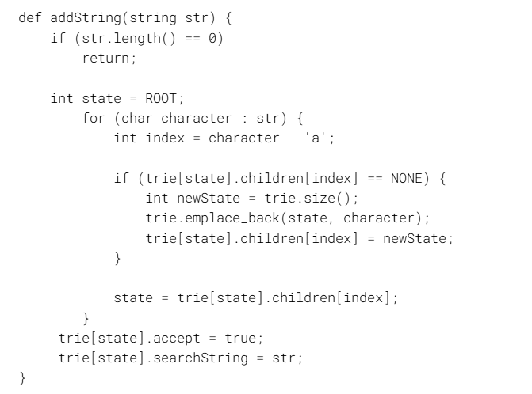
CREATING THE TRIE

Slide 25
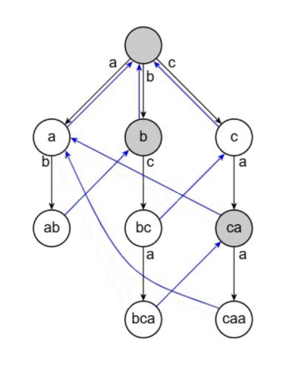
Adding Suffix links
Suffix links tell us where to go if a mismatch occurs while scanning the text
Suffix link points to the node that represents the longest possible proper suffix of the string that exists as a prefix in the tree
For the root node, suffix links will point to itself
Trying to preserve as much context as possible, reusing partial matches

Slide 26
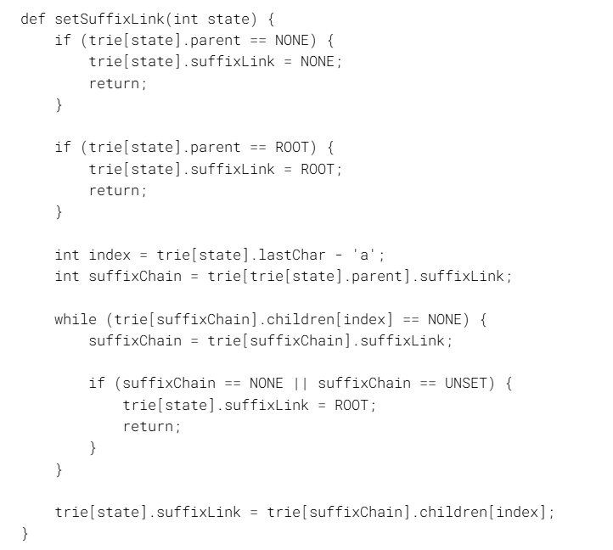
Adding suffix links

Slide 27
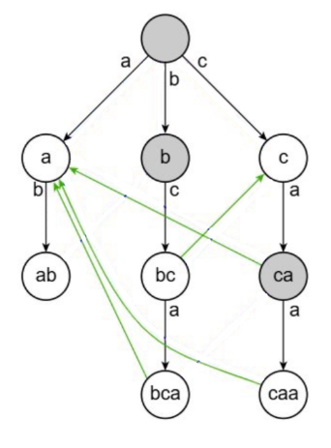
Adding Terminal links
Terminal links allow us to output the string represented by the node as well as extra patterns in the chain instantly
Report all matches that end at or before a certain position of input
If a node's suffix link points to an accepting state, it becomes a terminal link
Otherwise, it will inherit the terminal link of its suffix recursively
Useful for overlapping and nested patterns

Slide 28
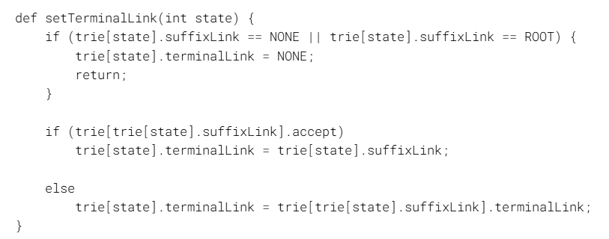
Adding terminal links

Slide 29
IMPLEMENTATION
Conduct the search by reading the input string character by character
Matching edge: transition normally
Non-matching edge: follow the suffix links until finding a match or returning to root
At each node, check if the node accepts or if there are terminal links

Slide 30
RUNTIME

Slide 31




Runtime
m: total pattern length
n: search string length
z: number of matches found
Pre-Processing Stage (Building the Automaton)
Dictionary of patterns $D=\{D_{1}, D_{2}, …D_{k}\}$ where its total length is n
Insert the patterns into a trie
Use BFS to build failure links
Search Phase
Search String $S=s_{1}s_{2}…s_{m}$ of length m
Loop each character
Follow trie if pattern exists, or jump to failure link
Report output list stored at current node
Overall Time Complexity: $O(m+n +z)$
Memory Complexity: : $O(m)$
$$O(m)$$
$$O(n+z)$$
*Note: $z≥n$ because we are searching overlapping patterns

Slide 32
Hints for the PROGRAMMING Challenge

Slide 33
UPDATING THE TRIE
What happens if we want to add new patterns? What about delete old ones?
Is there a way to update the trie without rebuilding it entirely?
Key Idea
Updating the nodes is easy, fixing the failure links is hard!
Each rebuild costs Θ(l)!

Slide 34
UPDATING THE TRIE
When creating each new node, we must find the failure links which need to be updated.
Note that “caa” and its parent “ca” originally pointed to “a” – the parent of the new node “aa”. Can this help us somehow?
Example: Add the pattern “aa”
The only failure link to update is “caa”!

Slide 35
UPDATING THE TRIE
Key Idea
We can create an inverse failure function – also called the inverse failure trie – that tracks prefix matches.
We can recursively follow the inverse failure links from the new node’s parent, checking each for a matching child.
This is the same process we used for the regular failure function – does it make sense why?

Slide 36
CONCLUSIONS

Slide 37
Conclusions
Strengths:
Efficient search time. Reduces the search time for the multiple pattern matching problem from quadratic O(mn) to O(n+z)
Handles overlapping patterns (Ex: “he” within “she”)
It can be used to process data steams
Weaknesses
Can be a bit memory dense when alphabet is large
Since the algorithm relies on pre-processing the patterns, modifying the dictionary of patterns once the AC automaton has been built can be expensive.
HINT: The Programming Challenge focuses on modifying the Aho-Corasick Algorithm to dynamically modify the list of patterns by building the trie incrementally.

