Slide 1
BURROWS-WHEELER TRANSFORM
Advanced Algorithms Luke Del giudice, Siddharth Premjith, eddie li

Slide 2
motivation
Goal: Given a string, rearrange the elements of the string to cluster similar characters together.
Why: Compression algorithms work best with redundant information.
Twist: How do we recover information? We need to be able to reverse the transform.
Original Text | Transformed with BWT
banana | annb$aa
Process: original string → BWT → compression

Slide 3
Forward transform
0.5) Add $ to the end:
1) Full list of rotated strings:
2) Alphabetically sorted list:
banana$
banana$
$banana
a$banan
na$bana
ana$ban
nana$ba
anana$b
$banana
a$banan
ana$ban
anana$b
banana$
na$bana
nana$ba
3) Extract each string’s last character:
annb$aa
Rotation: Move the last character to the front of the string
Final string: BWT attempts to create runs of similar characters (not perfect!)

Slide 4
how does clustering work?
2) Alphabetically sorted list:
Intuition: When a character is followed by a similar substring, those substrings will be next to each other in the sorted list.
$banana
a$banan
ana$ban
anana$b
banana$
na$bana
nana$ba
na
3) Extract each string’s last character:
Both n’s are followed by an a, so they will be next to each other in the final string. The same is true for the two a’s being followed by na.
annb$aa
ana

Slide 5
Reverse transform: Overview
F
L
“First”
“Last”
0
1
2
3
4
5
6
$banana
a$banan
ana$ban
anana$b
banana$
na$bana
nana$ba
T
BWT(T)
banana$
annb$aa
All rotations
Burrows-Wheeler Matrix
T-ranking: assign characters ranks by # times character occurred previously in T → $b_{0}a_{0}n_{0}a_{1}n_{1}a_{2}\$$

Slide 6
































































































Last-to-front mapping
F
L
F
L
$$\$$$
$$b_{0}$$
$$a_{2}$$
$$n_{1}$$
$$a_{2}$$
$$n_{1}$$
$$a_{2}$$
$$\$$$
$$b_{0}$$
$$a_{2}$$
$$n_{1}$$
$$a_{2}$$
$$n_{1}$$
$$a_{2}$$
$$a_{2}$$
$$\$$$
$$b_{0}$$
$$a_{2}$$
$$n_{1}$$
$$a_{2}$$
$$n_{1}$$
$$a_{2}$$
$$\$$$
$$b_{0}$$
$$a_{2}$$
$$n_{1}$$
$$a_{2}$$
$$n_{1}$$
Why are the a’s in this order relative to each other?
Why are the a’s in this order relative to each other?
$$a_{1}$$
$$n_{1}$$
$$a_{1}$$
$$\$$$
$$b_{0}$$
$$a_{1}$$
$$n_{0}$$
$$a_{1}$$
$$n_{1}$$
$$a_{2}$$
$$\$$$
$$b_{0}$$
$$a_{1}$$
$$n_{0}$$
$$a_{0}$$
$$n_{0}$$
$$a_{0}$$
$$n_{0}$$
$$a_{1}$$
$$\$$$
$$b_{0}$$
$$a_{0}$$
$$n_{0}$$
$$a_{1}$$
$$n_{0}$$
$$a_{1}$$
$$\$$$
$$b_{0}$$
$$b_{0}$$
$$a_{2}$$
$$n_{1}$$
$$a_{1}$$
$$n_{0}$$
$$a_{0}$$
$
$$b_{0}$$
$$a_{2}$$
$$n_{1}$$
$$a_{1}$$
$$n_{0}$$
$$a_{0}$$
$
$$n_{1}$$
$$a_{1}$$
$$\$$$
$$b_{0}$$
$$a_{0}$$
$$n_{0}$$
$$a_{1}$$
$$n_{1}$$
$$a_{1}$$
$$\$$$
$$b_{0}$$
$$a_{0}$$
$$n_{0}$$
$$a_{1}$$
$$n_{0}$$
$$a_{0}$$
$$n_{0}$$
$$a_{0}$$
$$\$$$
$$b_{0}$$
$$a_{0}$$
$$n_{0}$$
$$a_{0}$$
$$n_{0}$$
$$a_{0}$$
$$\$$$
$$b_{0}$$
$$a_{0}$$
They’re sorted by right context
They’re sorted by right context

Slide 7






















lf mapping definition/implication
F
LF Mapping: the i^{th} occurrence of a character c in L and the i^{th} occurrence of c in F correspond to the same occurrence of c in T.
L
F
L
$$\$$$
$$a_{2}$$
$$\$$$
$$a_{2}$$
$$a_{2}$$
$$n_{1}$$
$$a_{2}$$
$$n_{1}$$
We know L since it’s the result of BWT, and we can find F since it’s just L sorted with order preserved.
$$a_{1}$$
$$n_{0}$$
$$a_{1}$$
$$n_{0}$$
$$a_{0}$$
$$b_{0}$$
$$a_{0}$$
$$b_{0}$$
Start in first row. For F this will be $ (lowest rotated string by definition).
L will contain character just prior to $: $a_{2}$
By LF Mapping, this is the same $a$ as the first $a$ in F.
Next, we find $a_{2}$ in F to get the character that comes before $a_{2}$ in T. And repeat…
$$b_{0}$$
$
$$b_{0}$$
$
character before $ in T
$$n_{1}$$
$$a_{1}$$
$$n_{1}$$
$$a_{1}$$
$$n_{0}$$
$$a_{0}$$
$$n_{0}$$
$$a_{0}$$

Slide 8
Trace reverse path
F
F
L
F
F
L
F
F
L
L
F
L
L
L
$$\$$$
$$a_{2}$$
$$\$$$
$$a_{2}$$
$$\$$$
$$a_{2}$$
$$\$$$
$$a_{2}$$
$$\$$$
$$a_{2}$$
$$\$$$
$$a_{2}$$
$$\$$$
$$a_{2}$$
$$a_{2}$$
$$n_{1}$$
$$a_{2}$$
$$n_{1}$$
$$a_{2}$$
$$n_{1}$$
$$a_{2}$$
$$n_{1}$$
$$a_{2}$$
$$n_{1}$$
$$a_{2}$$
$$n_{1}$$
$$a_{2}$$
$$n_{1}$$
$$a_{1}$$
$$n_{0}$$
$$a_{1}$$
$$n_{0}$$
$$a_{1}$$
$$n_{0}$$
$$a_{1}$$
$$n_{0}$$
$$a_{1}$$
$$n_{0}$$
$$a_{1}$$
$$n_{0}$$
$$a_{1}$$
$$n_{0}$$
$$a_{0}$$
$$b_{0}$$
$$a_{0}$$
$$b_{0}$$
$$a_{0}$$
$$b_{0}$$
$$a_{0}$$
$$b_{0}$$
$$a_{0}$$
$$b_{0}$$
$$a_{0}$$
$$b_{0}$$
$$a_{0}$$
$$b_{0}$$
$$b_{0}$$
$
$$b_{0}$$
$
$$b_{0}$$
$
$$b_{0}$$
$
$$b_{0}$$
$
$$b_{0}$$
$
$$b_{0}$$
$
$$n_{1}$$
$$a_{1}$$
$$n_{1}$$
$$a_{1}$$
$$n_{1}$$
$$a_{1}$$
$$n_{1}$$
$$a_{1}$$
$$n_{1}$$
$$a_{1}$$
$$n_{1}$$
$$a_{1}$$
$$n_{1}$$
$$a_{1}$$
$$n_{0}$$
$$a_{0}$$
$$n_{0}$$
$$a_{0}$$
$$n_{0}$$
$$a_{0}$$
$$n_{0}$$
$$a_{0}$$
$$n_{0}$$
$$a_{0}$$
$$n_{0}$$
$$a_{0}$$
$$n_{0}$$
$$a_{0}$$
Trace path: $$a_{2}n_{1}a_{1}n_{0}a_{0}b_{0}$ → $b_{0}a_{0}n_{0}a_{1}n_{1}a_{2}$$ = T

Slide 9
Compression example
Run-Length Encoding (RLE)
Run-length encoding is a simple compression technique that replaces consecutive repeated characters with a single instance of the character followed by the number of times it repeats. This compression works best when the same characters appear many times in a row.
annnnb$aaa
an4b$a3
This reduction will be more significant for strings with MANY repeated substrings

Slide 10
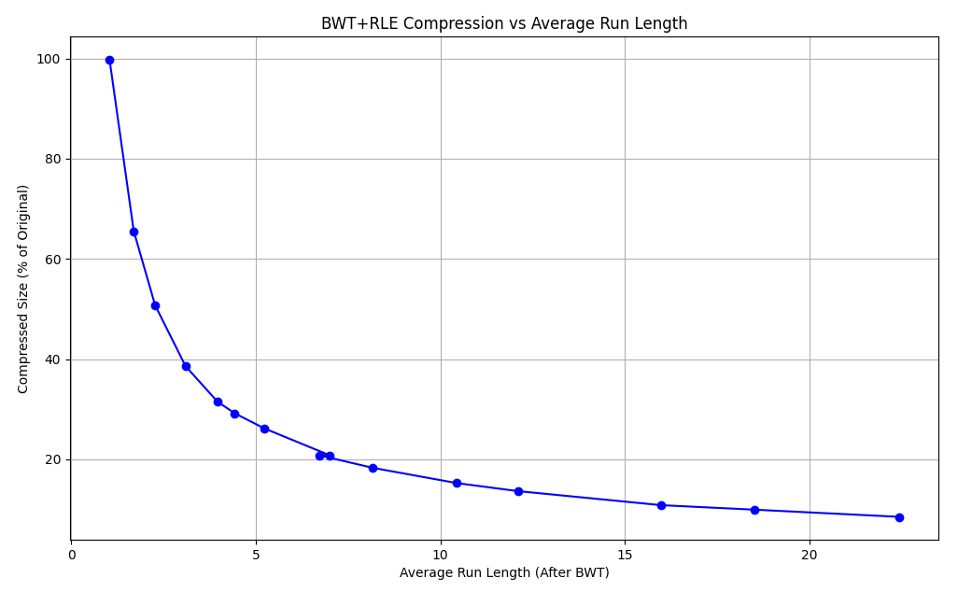

Redundancy visualized
$$\frac{compressed string length}{original string length}∗100$$
Basically, average number of redundant substrings

Slide 11

conclusions
$$\frac{compressed string length}{original string length}∗100$$
Burrows-Wheeler Transform is a reversible text transformation that rearranges characters in a string to group similar characters together, enabling more efficient compression.
Compexity: time is O(n²logn), space is O(n²)
When to use: For data containing frequent redundant substrings; otherwise, BWT is useless.
 | Uniform Selection |  | Substrings Likely Repeated
Compression Algorithm | Without BWT | With BWT | Without BWT | With BWT
Run-Length Encoding (RLE) | 99.85 | 99.85 | 99.87 | 6.61
Huffman Coding | 11416.55 | 11482.77 | 34375.87 | 34369.04
Move-to-Front Encoding | 62.50 | 62.51 | 62.50 | 62.51
Arithmetic Coding | 58.72 | 58.74 | 26.81 | 26.84
Lempel-Ziv (LZ77 / LZ78) | 62.45 | 62.50 | 5.49 | 5.21
Simulation: Compression algorithms run on 5,000 randomized strings (5,000 characters in length).

Slide 12
References
https://www.youtube.com/watch?v=4n7NPk5lwbI
https://nbviewer.org/github/BenLangmead/comp-genomics-class/blob/master/notebooks/CG_BWT_Reverse.ipynb
https://en.wikipedia.org/wiki/Burrows%E2%80%93Wheeler_transform
https://www.geeksforgeeks.org/burrows-wheeler-data-transform-algorithm/

