Slide 1
Gale-Shapley Algorithm
Arthur Wu, Ayaan Rahman, Ridge Redding, Artie Humphreys

Slide 2
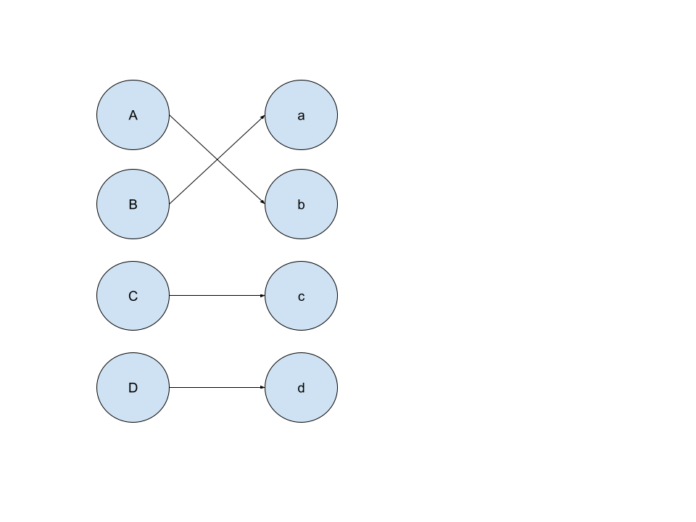
Motivation
Consider two sets of equal size, set X and Y. Each element in set X has an ordering of preferences for each element in set Y, and vice versa.
The Stable Matching Problem seeks to match each element in set X with an element in set Y, so that there does not exist a possible pair (A, b) where A prefers b more than their current match, and b prefers A more than their current match.

Slide 3
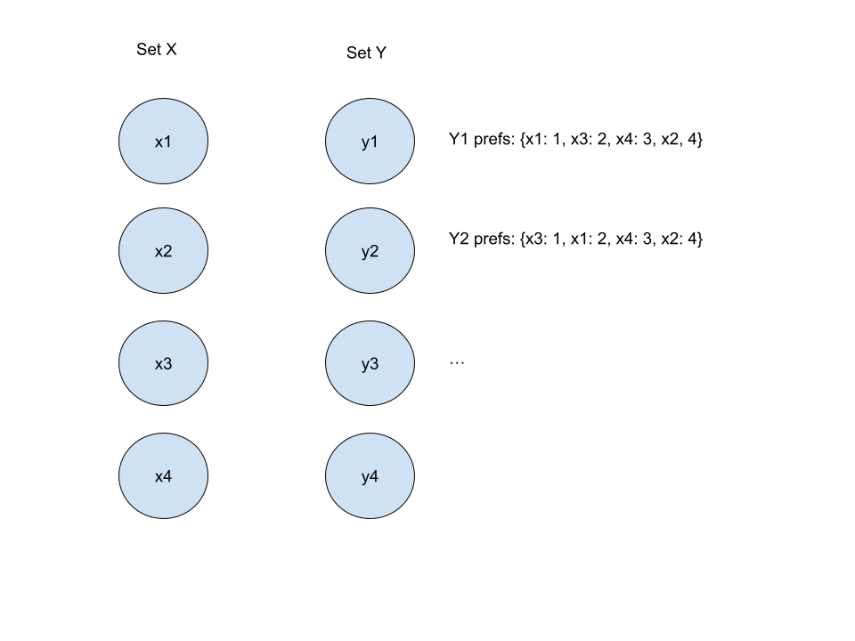
Gale-Shapley Algorithm Input
Ensure that the input is given as follows
Two equally-sized sets, X and Y
Each element in X (x) has a ranking of preferences for each element in Y
Each element in Y (y) has a ranking of preferences for each element in X
Label all elements of X, as well as all elements of Y, as unmatched

Slide 4
Algorithm Description
While there exists an unmatched element in X denoted as "x":
Have x propose a match. Propose in order of x's preferences of set Y, with x proposing to the most-preferred element of Y first that he has not proposed to yet, until a match is found.
Call the element of Y which was proposed to, "y". If y is labeled unmatched, then match y with x. If y is labeled matched, then check if y prefers x to y's previous match p.
If y prefers x, label p as unmatched and un match p with y, and match y with x. Label x matched.
Otherwise, have x move onto its next-preferred element in set Y.
Repeat the above process until there is no element of X which is still unmatched.

Slide 5
Sample Run Input
Suppose we are given the following input:
X set: x1, x2, x3
X preferences of Y: {x1: [y1, y2, y3], x2: [y1, y2, y3], x3: [y2, y1, y3]}
Y set: y1, y2, y3
Y preferences of X: {y1: [x2, x1, x3], y2: [x1, x2, x3], y3: [x3, x1, x2]}

Slide 6
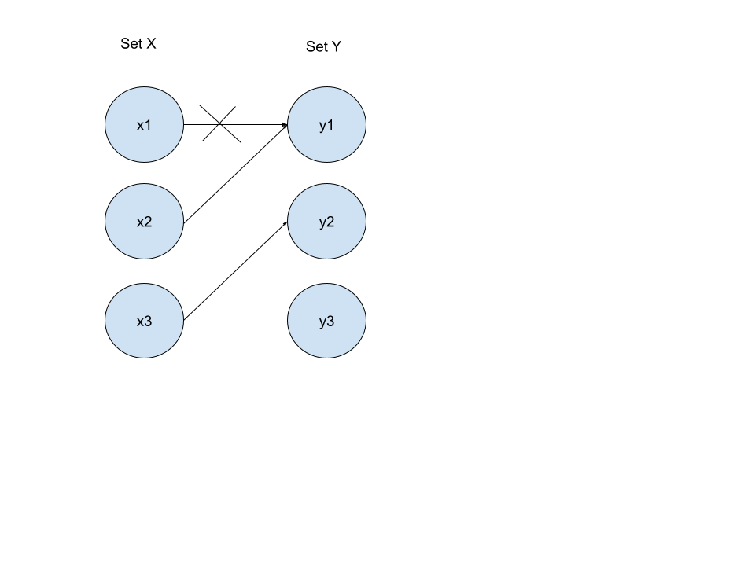
Sample Run
All elements of X start unmatched. Go to the first X, x1:
x1's preferences are [y1, y2, y3]. x1 proposes to y1. As y1 is free, x1 and y1 match.
x2's preferences are [y1, y2, y3]. x2 proposes to y1. y1 prefers x2 to x1, so y1 and x2 match while x1 is unmatched.
x3's preferences are [y2, y1, y3]. x3 proposes to y2. As y2 is free, x3 and y2 match.

Slide 7

Sample Run Cont.
x3 and x2 are matched, whereas x1 is unmatched.
x1 proposes to y2. y2 prefers x1 to its current partner x3, so x3 is unmatched and x1 is matched.

Slide 8

Sample Run Results
x1 and x2 are matched, whereas x3 is unmatched.
x3 proposes to y1. y1 prefers its current partner x2 to x3, so x3 remains unmatched.
x3 moves on to propose to y3. As y3 is free, x3 and y3 match.
As after this, x1, x2, and x3 are all matched, the matching of {x1, y2}, {x2, y1}, and {x3, y3} is the final output.

Slide 9
Time & Space Complexity
The time complexity for the Gale-Shapley Algorithm is O(n²), where n is the number of participants in the matching
Each of the n members of set X can propose to as many as n members of set Y, which set Y members accept or reject on the spot, upper-bounding runtime to O(n²)
Our implementation has a space complexity is O(n²). O(n²) space is needed to keep track of the preferences of each member of set X and set Y, which has a preference for each member of the opposing set

Slide 10
Pseudocode
Initialize the 2 input sets to a "X" set and a "Y" set
While there exists an unmatched member of X, denoted as x:
For each element of Y, denoted as y, in the order of x's preferences:
Move beyond y in x's preference list, for future use.
If y is free:
Match y and x, mark y and x as matched
Exit the for-loop
Else:
If y prefers x to y's existing partner p:
Un-match y and p, and mark p as unmatched.
Match y and x and mark x as matched.
Exit the for-loop.

Slide 11
Proof of Stability
Gale-Shapley algorithm is stable, meaning that there is no potential pair (x, y) that is not already matched, where x prefers y to its existing match and y prefers x to its existing match
Proof (by contradiction):
Suppose there does exist a potential pair (x, y) where x and y prefer each other to their current partners in the Gale-Shapley matching. This means one of two things must have happened:
x never proposed to y. If that's the case, then x cannot prefer y to its current partner. Members of the X set, such as x, propose to Y set members such as y in the order of most preferred Y set members first.
x proposed to y, but was rejected, or got unmatched later by y after y found a better match. If that's the case, then y cannot prefer x to its current partner. Members of the y set do not reject members of the x set unless they have found a better match.
In both cases, either x or y prefers its existing match. This contradicts the assumption that there is a potential pair (x, y) which causes instability.

Slide 12


Applications
The dating app Hinge uses a modified version of the Gale-Shapley Algorithm
The National Resident Matching Program (matching med school students) is also based on the Gale-Shapley Algorithm

