Slide 1
HyperLogLog
Trading accuracy for space
Notes:
dillan

Slide 2

Let's say you want to count the number of unique viewers on a YouTube video
Naïve: keep track of past viewers with a set
counter c = 0
set S
for each element x_i:
if x_i not in S:
add x_i to S
c += 1
return c
Problem: This uses O(n) space!
For 4-byte usernames, this means 1B viewers = 4GB of memory
Notes:
dillan

Slide 3

Solution: Get a probabilistic estimate of unique viewers using much less memory!
Begin by hashing usernames as bitstrings
Ex.
Dillan --> 001001
Eric --> 010100
Sebastian --> 110010
Insert: this guy
Notes:
dillan

Slide 4
Think of each hash as a sequence of coin flips
…
H
T
H
H
H
T
0 1 ...
0 0 0 1
Prob = ¼
Expected flip sequences = 4
Exp. Distinct elements = 4
Prob = 1/16
Expected flip sequences = 16
Exp. Distinct elements = 16
Notes:
ME ME ME (eric)

Slide 5
Pseudocode
Eric
Dillan
Sebastian
Dillan
…
Jim Ryan
...
010001
100010
001010
100010
…
000010
...
2
1
3
1
…
5
...
max1 = 0
for each viewer in viewer_stream:
hashed_username = hash(viewer)
# get position of first 1 bit
p = position(hashed_username)
max1 = max(p + 1, max1)
estimated_viewers: 2**max1
For n viewers:
max = 5
(position of first 1)
max ~ log(n)
store max with log(max) bits
∴ use log(log(n)) memory
We expect 2^5 = 32 viewers
Notes:
eric

Slide 6
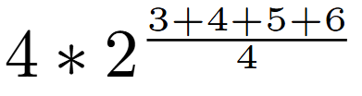

But how accurate is this?
Recall estimated_viewers: 2**max1
Solution: average many estimates!
Eric
Dillan
Sebastian
Dillan
Jim Ryan
...
010001
100010
001010
100010
000010
...
00
max = 5
01
max = 4
10
max = 6
11
max = 3
estimate =
Notes:
sebastian

Slide 7
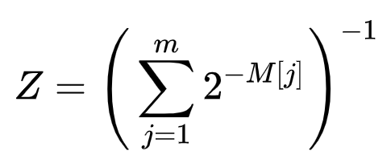



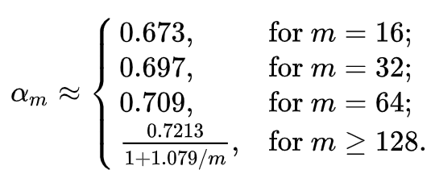
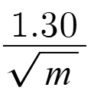
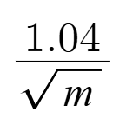
But how accurate is THIS?
LogLog
Arithmetic mean
HyperLogLog
Harmonic mean
std. error = ​
std. error = ​
ex. 16384 buckets = 0.8125% error (HLL)
Notes:
sebastian

Slide 8
Final Analysis
m = register ("bucket") count, n = number of elements to count
 | Time | Space | Error
Native | O(n) | O(n) | 0
LogLog | O(n+m) ~ O(n) | O(m)
HyperLogLog | O(n+m) ~ O(n) | O(m)
per element in stream
 | Time | Space
Add | O(1) | O(m)
Count | O(m) | O(1)
Merge | O(m) | O(m)
Notes:
Dillan or sebastian

