Slide 1
Knuth-Morris-Pratt Algorithm
Aleesha Khurram, Tanush Siotia, Alex Suh

Slide 2
Content Overview
01
Core Problem
04
Knuth-Morris-Pratt Algorithm
02
Naïve Approach
05
Examples of KMP
03
Prefix Matching

Slide 3
01
Core Problem

Slide 4

In Summary: Ctrl + F
String matching is fundamental computer science problem
Used in data retrieval systems, text editing software, and network security
Also used in bioinformatics to match DNA sequences
Core Problem: Searching for Occurrences of a Word “W” within the Main String “S”

Slide 5
02
Naïve Approach

Slide 6
High Level Idea: Check for string occurrence at every point
vector<int> find_substrings(string haystack, string needle) {
int n = needle.length;
vector<int> solution;
if (haystack.length < needle.length) {
return {};
}
for (int i = 0; i < haystack.length; i++) {
if (haystack.substr(i, n) == needle) {
solution.push_back(i);
}
}
return solution;
}
Naïve Approach

Slide 7
High Level Idea: Check for string occurrence at every point
Naïve Example

Slide 8
High Level Idea: Check for string occurrence at every point
Naïve Example

Slide 9
High Level Idea: Check for string occurrence at every point
Naïve Example

Slide 10
High Level Idea: Check for string occurrence at every point
Naïve Example

Slide 11
High Level Idea: Check for string occurrence at every point
Naïve Example

Slide 12
High Level Idea: Check for string occurrence at every point
Time Complexity?
target substring is length n, total string is length m
String comparison is O(n)
In the worst case, perform this m times
Overall Complexity: O(n*m)
Example “Bad” Case: AAAAAAAAAAAAAAAAAAAAAAAAAAAAB
AAAAAAAAAAAAAAB
Note: Even if string equals returns early on mismatch, it might have to check the entire substring every time!
Naïve Example

Slide 13

High Level Idea: Check for string occurrence at every point
How can we make improvements?
In this bad case, we know that the first 11 characters are going to match again (because in the previous check, the A was repeated).
No need to check those again - just compare the last two characters!
Example “Bad” Case:
Naïve Example

Slide 14
03
Prefix Matching

Slide 15






Input: string of length
Output: array of length
is length of longest proper prefix of substring that is also a suffix
By definition,
Prefix Function: Definition

Slide 16
Prefix Function: Example

Slide 17
Prefix Function: Example

Slide 18
Prefix Function: Example

Slide 19
Prefix Function: Example

Slide 20
Prefix Function: Example

Slide 21
Prefix Function: Example

Slide 22
Prefix Function: Example

Slide 23
Prefix Function: Example

Slide 24
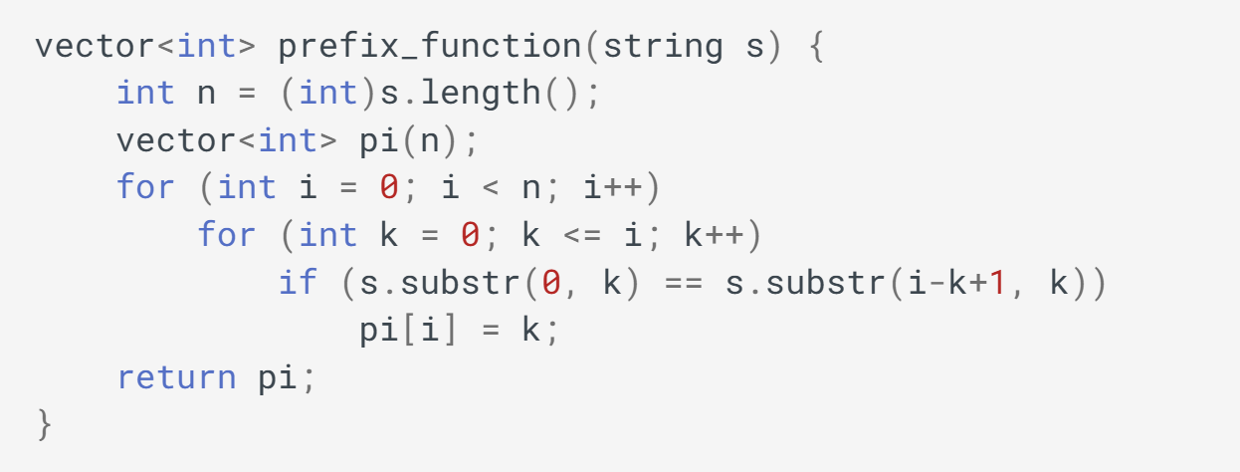
Prefix Function: Naïve Approach
Notes:
Credit: CP-Algorithms

Slide 25








Naive approach time complexity:
Optimization 1: Note that value of prefix function can increase by at most one
Optimization 2: We can reduce string comparisons based on previously computed values
Optimized time complexity:
Prefix Function: Optimizations
If , suppose we remove the last character from the suffix ending at index . Results in suffix of length ending at index (Contradiction).
Otherwise, move to longest length such that
. Then,
. Otherwise, continue process until .

Slide 26
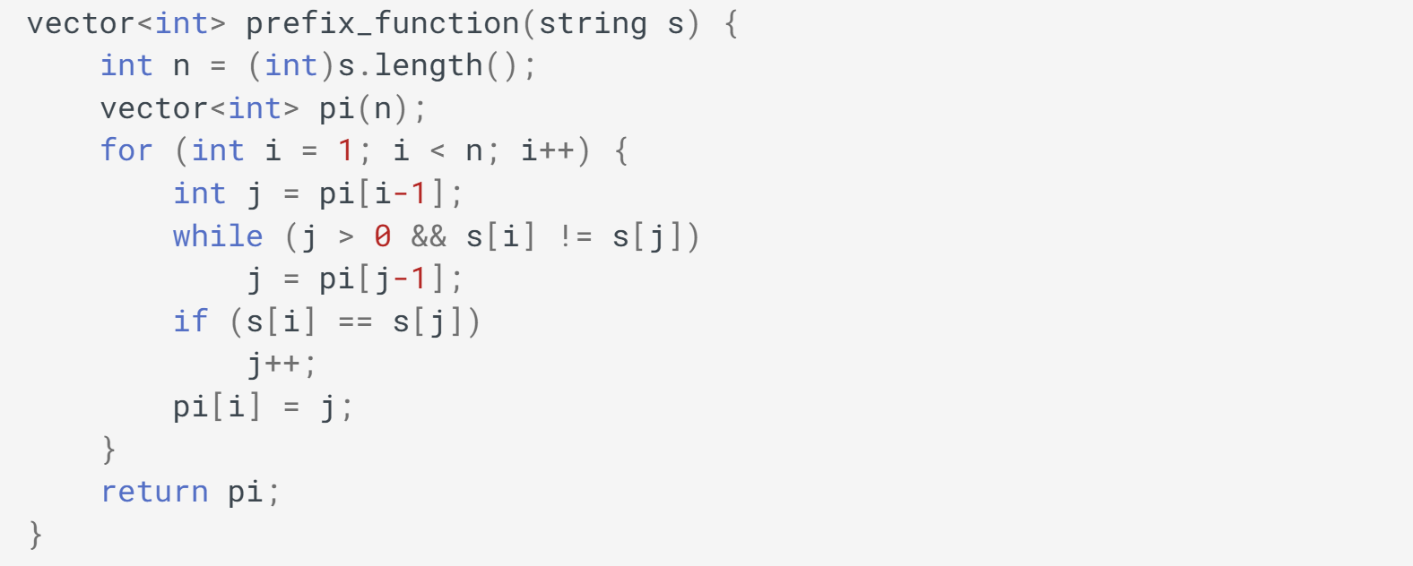
Prefix Function: Optimized Approach
Even with a nested while loop, it is still since total number of iterations of the while loop over the entire run is at most
Notes:
Credit: CP-Algorithms

Slide 27



Prefix Function: Algorithm Walkthrough
Notes:
Credit: CP-Algorithms

Slide 28





Prefix Function: Algorithm Walkthrough
Notes:
Credit: CP-Algorithms

Slide 29






Prefix Function: Algorithm Walkthrough
Notes:
Credit: CP-Algorithms

Slide 30






Prefix Function: Algorithm Walkthrough
Notes:
Credit: CP-Algorithms

Slide 31






Prefix Function: Algorithm Walkthrough
Notes:
Credit: CP-Algorithms

Slide 32





Prefix Function: Algorithm Walkthrough
Notes:
Credit: CP-Algorithms

Slide 33


Prefix Function: Algorithm Walkthrough
Notes:
Credit: CP-Algorithms

Slide 34



Prefix Function: Algorithm Walkthrough
Notes:
Credit: CP-Algorithms

Slide 35






Prefix Function: Algorithm Walkthrough
Notes:
Credit: CP-Algorithms

Slide 36
04
Knuth-Morris-Pratt Algorithm

Slide 37
Key Question: How can we use prefix matching to search for a substring in a string?
Insight: Where does this algorithm perform string matching? (In the naive implementation of the prefix function, at what points does it check for equal characters)
Knuth-Morris-Pratt Algorithm

Slide 38
Key Question: How can we use prefix matching to search for a substring in a text?
Insight: Where does this algorithm perform string matching? (In the naive implementation of the prefix function, at what points does it check for equal characters)
The prefix matching algorithm compares the strings at the start (the prefix) and the end (the suffix) at the current position.
Each occurrence of the substring will be a suffix at some position - so put the substring before the text!
Knuth-Morris-Pratt Algorithm

Slide 39
Place the substring before the text, separated by a separator that is present in neither string.
Example (substring is needle, separator is #):
Knuth-Morris-Pratt Algorithm

Slide 40
Place the substring before the text, separated by a separator that is present in neither string.
Example (substring is needle, separator is #):
Knuth-Morris-Pratt Algorithm

Slide 41
Place the substring before the text, separated by a separator that is present in neither string.
Example (substring is needle, separator is #):
π[18] = 6, so the first 6 letters (the full substring) matches the last 6 letters (the occurrence of the substring). Therefore, i=18-6+1=13 must be the starting index of an occurrence of the substring.
Knuth-Morris-Pratt Algorithm

Slide 42
Because of the separator, π[i] must always be <= n (there is no way the # could be part of the prefix and suffix because it only occurs once and the prefix/suffix must not overlap).
If π[i] = n, we must have found the substring!
Knuth-Morris-Pratt Algorithm

Slide 43

What would the prefix function of this string be?
Knuth-Morris-Pratt Algorithm: Walkthrough Example

Slide 44

What would the prefix function of this string be?
Knuth-Morris-Pratt Algorithm: Walkthrough Example

Slide 45
From earlier:
If we know the prefix values never are higher than m, we don’t need to store the entire string/function but only beginning.
We store:
s (with separator character) - O(m)
Values of prefix function for last m+1 characters O(m)
Space complexity is O(m)
Still need to build prefix for equivalent of entire string m+n+1 length
Time complexity is O(m+n)
Knuth-Morris-Pratt Algorithm: Complexity

Slide 46
05
Extra Examples of KMP

Slide 47
Text = “abababcababc”
Pattern = “ababc”
Corresponding LPS = [0,0,1,2,0]
i keeps track of the text index
j keeps track of the patterns index
Knuth-Morris-Pratt Example

Slide 48
Text = “abababcababc”
Pattern = “ababc”
Corresponding LPS = [0,0,1,2,0]
Since the two match we iterate i and j
Knuth-Morris-Pratt Example

Slide 49
Text = “abababcababc”
Pattern = “ababc”
Corresponding LPS = [0,0,1,2,0]
Since the two continue to match we iterate i and j
Knuth-Morris-Pratt Example

Slide 50
Text = “abababcababc”
Pattern = “ababc”
Corresponding LPS = [0,0,1,2,0]
Since the two continue to match we iterate i and j
Knuth-Morris-Pratt Example

Slide 51
Text = “abababcababc”
Pattern = “ababc”
Corresponding LPS = [0,0,1,2,0]
Since the two mismatch we set j = lps[i-1] = 2
Knuth-Morris-Pratt Example

Slide 52
Text = “abababcababc”
Pattern = “ababc”
Corresponding LPS = [0,0,1,2,0]
Knuth-Morris-Pratt Example

Slide 53
Text = “abababcababc”
Pattern = “ababc”
Corresponding LPS = [0,0,1,2,0]
Since the two continue to match we iterate i and j
Knuth-Morris-Pratt Example

Slide 54
Text = “abababcababc”
Pattern = “ababc”
Corresponding LPS = [0,0,1,2,0]
Since the two match completely we append 2 to our results array: Result = [2] and repeat form the next index
Knuth-Morris-Pratt Example

Slide 55
06
Comparisons with other Algorithms

Slide 56
Rabin-Karp String Matching
Uses hash values of individual characters and strings
Requires being able to hash sequential elements
Might produce spurious hits (equal hashes but not equal substrings)
Similar Algorithms

Slide 57
Aho-Corasick Algorithms
Builds a search trie to keep track of suffix/prefix patterns
Requires high initial overhead to build trie
Similar Algorithms

Slide 58
Knuth-Morris-Pratt
Does not require being able to hash objects (only testing for equality)
Relatively low memory overhead
Doesn’t produce spurious hits (no need to check substring again)
Cannot natively handle matching multiple patterns
Key Differences

Slide 59
07
Conclusions

Slide 60
The Knuth-Morris-Pratt algorithm identifies substrings of a string
It uses an efficient way of finding the prefix function of a string
Runs in O(n+m) time and uses O(m) space
Conclusions

