Slide 1
Segment Tree
Range Updates
By: Ilia, Grady, and Edward

Slide 2



Recall: segment Trees
Goal: Efficient queries and updates on an array
Traditional Segment Tree:
Range Queries:
Point Updates:
Range Updates:
Need to do a point update for entire range
Now: Can we support update queries on entire ranges in time as well?
Notes:
let’s quickly recall what a segment tree is and why we use it.
The main goal is to perform efficient queries and updates on an array, especially for ranges.
In a traditional segment tree setup:"
Range queries like sum, min, or max can be done in O(log n) time.
Point updates—changing a single value—can also be done in O(log n).
But range updates, like adding 5 to every element from index l to r, don’t work efficiently by default.
Without any optimization, we’d have to do a point update for every element in that range, which turns into O(n) in the worst case.
So the natural question is: Can we somehow support range updates in O(log n) time, just like we do for point updates and range queries?

Slide 3
Range updates
New Goal: Create a segment tree variant that supports the following queries:
update(l,r,δ) – add δ to each value in the range A[l...r]
max(l,r) – return the maximum value in the range A[l...r]
While keeping the original O(log n) runtime.
Our overall structure is still the same – each node will store the maximum over its range, as usual
Challenge: manually updating each seg-tree node that falls within the query range takes O(n log n) time!

Slide 4
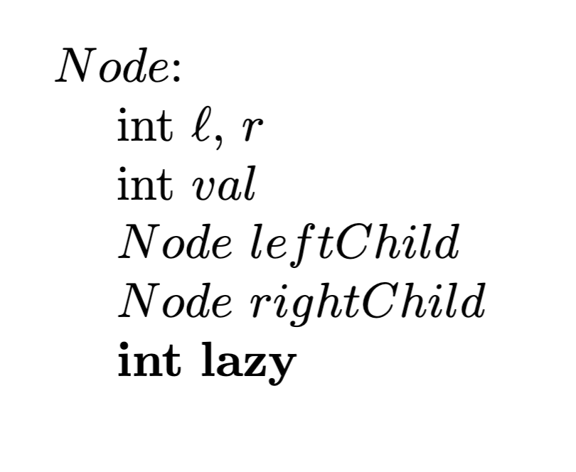
Solution: “lazy propagation”
Key Idea:
Don’t update every node, update only the topmost segments
Defer updates to their children until needed (lazily)
Add a new lazy field to our nodes that stores pending additions that need to be applied to the range
Updates occur when traversing down the tree and encountering pending changes
Only immediate children are updated through “push mechanism”

Slide 5
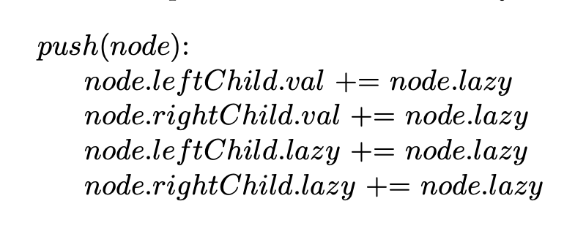
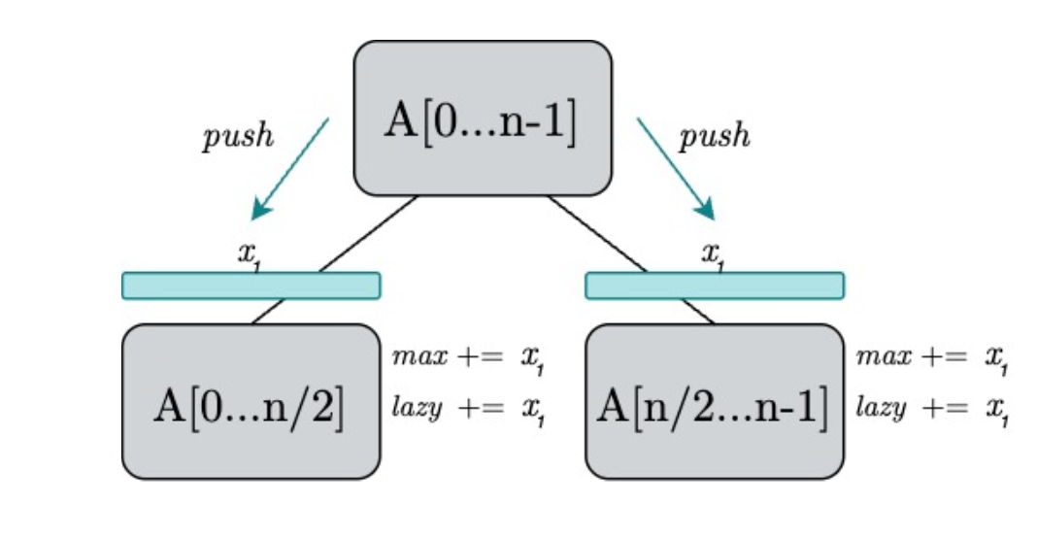
Key new method: push
Our segment tree needs a new method to perform the lazy propagation
When called on a node, push simply passes down the node’s lazy addition to its children
Note: Along with the children’s values, we also need to update their own lazy fields for future lazy propagation
Notes:
Lazy propagation helps us defer updates to segments until absolutely necessary, improving performance. But to make that work, we need a way to apply those delayed updates at the right time.
That’s where `push` comes in. Whenever we access a node that might have pending updates, we call `push` to 'push' the update down to its children.
This does two things: first, it updates the children's values based on the parent’s lazy value; second, it transfers that lazy value to the children’s own lazy fields. That way, the propagation continues correctly as we go deeper into the tree.
It’s important to remember: we’re not just updating the children’s values, we’re also updating their lazy tags so they can later push the update further if needed.
This is the key mechanic that allows us to efficiently handle range updates without needing to traverse every individual index.

Slide 6
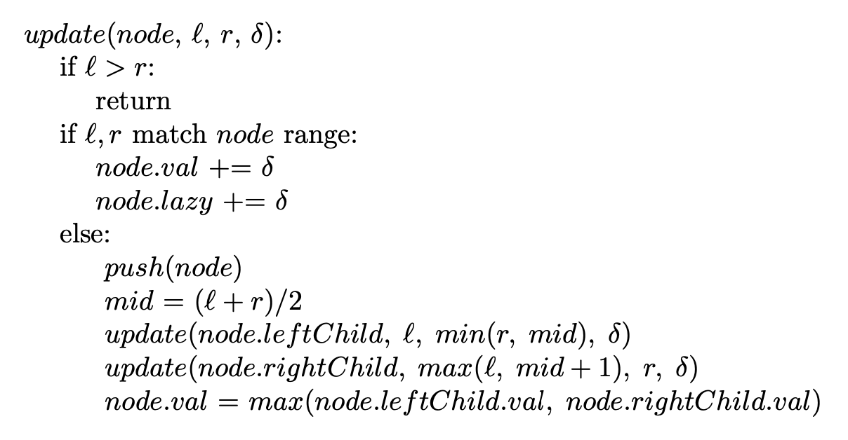
Update
With the new push method, our update method is relatively standard
If the query range matches the node’s, add δ to its value as well as its lazy value
Otherwise, call push on the current node to propagate any updates, recursively update our children, then update our own value by merging our children’s

Slide 7
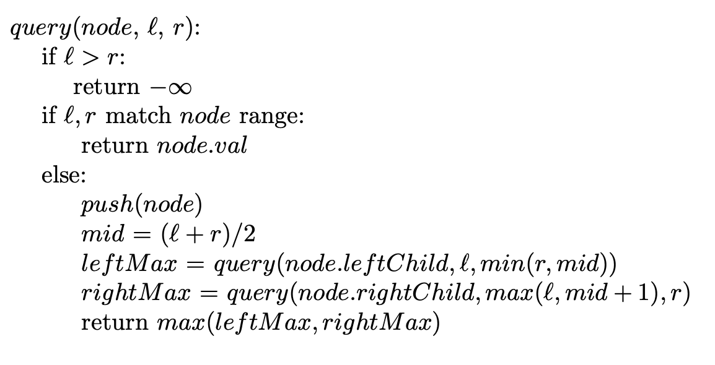
Query
Get the max of the highest-level segments that fall within a range
When reaching a segment that falls within a range, return the stored max value
Otherwise, push the pending changes down to the two children and continue to traverse the tree

Slide 8
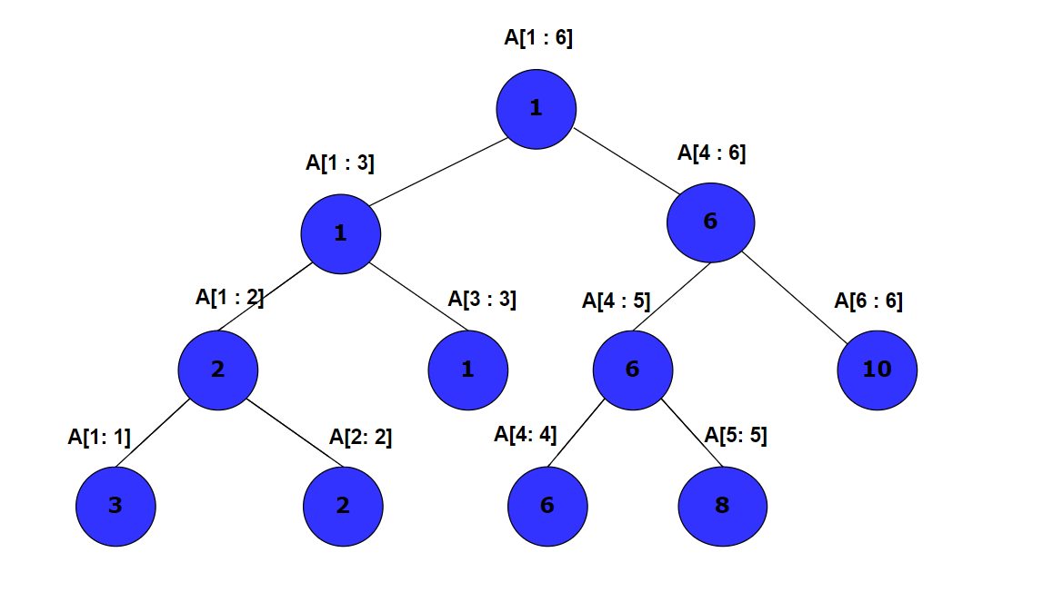
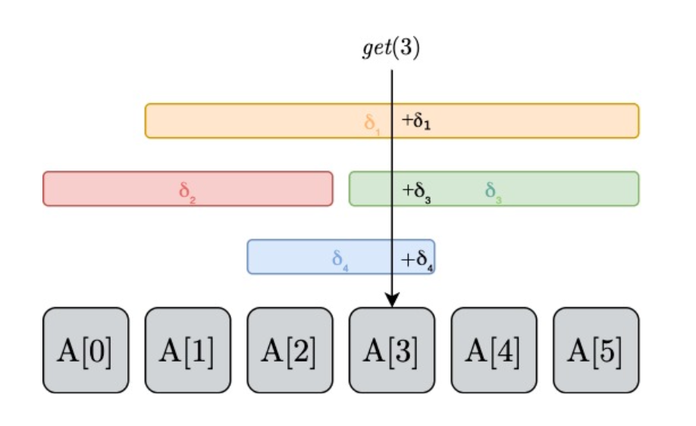
Briefly: Adding to a range, getting a specific index
When updating, store the value to be added to the highest segments that are inside the range, instead of each leaf
When getting the value at an index, as you return up the tree, add the value stored at each vertex
Notes:
When performing a range update, instead of updating each individual leaf node, which would be inefficient, we store the value to be added at the highest nodes that fully lie within the range.
This is what makes it 'lazy'—we’re deferring the actual update to the children until it’s needed.
Later, when we want to get the value at a specific index, we go down to the corresponding leaf node. But then as we return up the tree, we accumulate all the values that were lazily stored at each segment along the path.
That way, we reconstruct the final value for that index by summing all the contributions from ancestor nodes.

Slide 9
Briefly: Assigning to a range, getting a specific index
When updating, store the value to be assigned to the highest segments that are inside the range, instead of each leaf
Mark these segments, indicating that all the values below are equal to the value stored at the vertex
If encountering a marked vertex, push:
mark the two child vertices and update the values
unmark current vertex
Getting the value at an index by traversing down the tree
when traversing down the tree, when encountering a marked vertex, push

Slide 10
Material From:
https://cp-algorithms.com/data_structures/segment_tree.html#range-updates-lazy-propagation

