Slide 1
TREAP
Huarui Liu, Jingzhou Qiu, Zicheng He

Slide 2
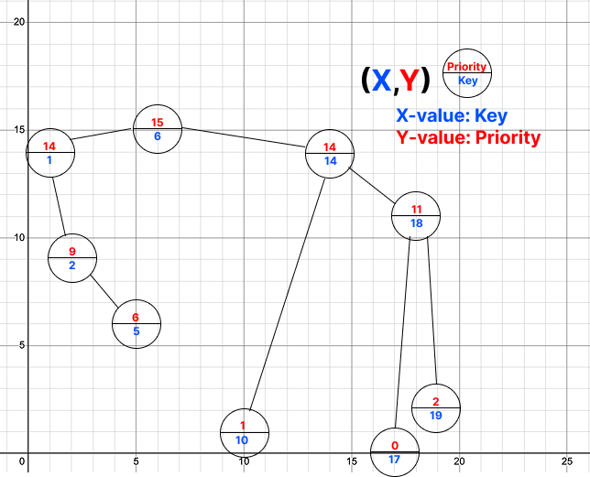
What is a Treap?
Keys in sorted order like a BST
Priorities follow the heap property
Randomized BST Combines BST and heap properties
A type of Cartesian Tree
lookup, insertion, and removal in O(logN)
Additional Operations:
Split: O(logN)
Merge: O(logN)
Notes:
Each node has
key: BST ordering
priority: heap ordering
Simplicity Balance
Compared to AVL or red-black trees (which are more commonly used for balancing), treaps are simpler.
No need for rotations or color flipping — probabilistic balancing through random priorities.
Page cache is implemented as address_space mappings.
Each file’s page cache is organized per file offset (logical page index).
These pages need fast lookup, insertion, and removal — especially under high concurrency or memory pressure.

Slide 3
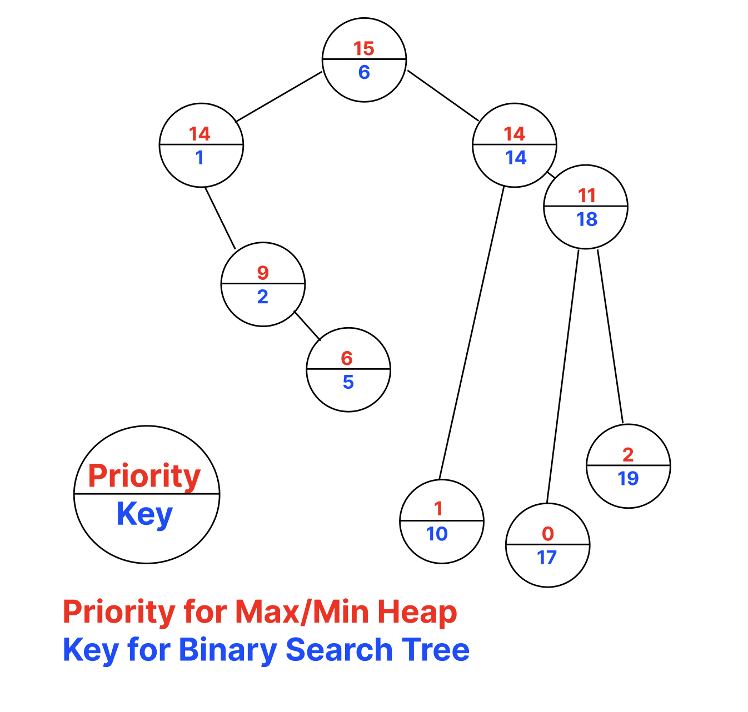
Why Treap?
Self-Balancing via random priorities
Simpler to implement than AVL or Red-Black trees
Can be modified to support segment tree operations and even more– all in O(logN)
Reverse on the interval.
Addition / painting on the interval.
Applications
Linux kernel page cache management
General Purpose Allocator (GPA)

Slide 4
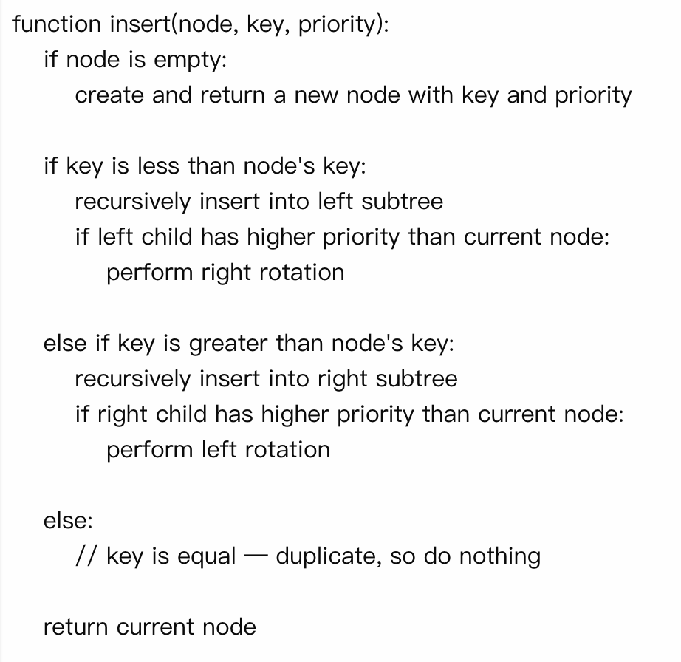
Insert (Min-heap)
Pick a random priority/specify a priority
Insert as inserting in BST
Rotate until the heap order is maintained
Runtime: O(logN)
Notes:
Min Heap

Slide 5
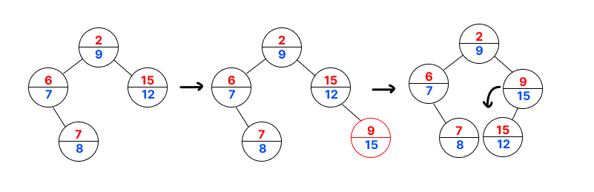

Insert-Example
Insert(15) ->Random priority=9

Slide 6
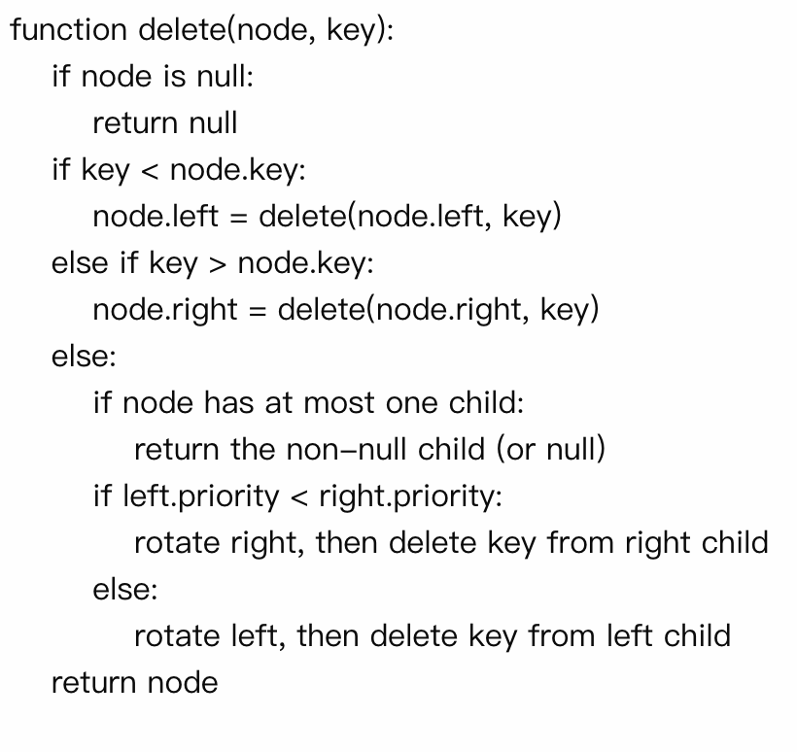
Delete(Min-heap)
Find the node by key (BST-style).
If the node has 0 or 1 child:
return non-null child or null
If the node has 2 children:
Rotate the child with the smaller priority up
Recurse on the same key to delete it
Runtime: O(logN)

Slide 7
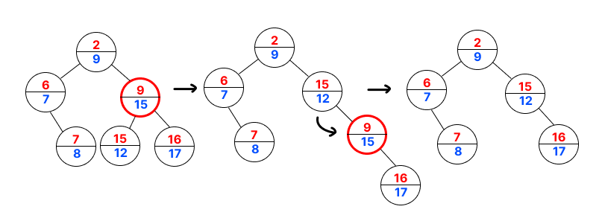
Delete-Example
Delete ( 15 )

Slide 8
Build
Heapify ensures the parent node has the highest/lowest priority by recursively swapping with the larger/smaller-priority child
Builds a tree from a list of values.
Case 1: Input Keys Are Sorted -> Build in O(N) time
Select the middle element to construct BST
Use heapify to ensure the heap property based on priorities
Case 2: Input Keys Are NOT Sorted -> O(N log N) time
N insert calls

Slide 9
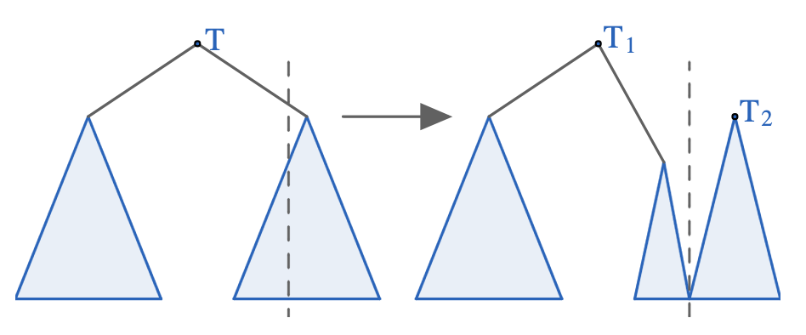
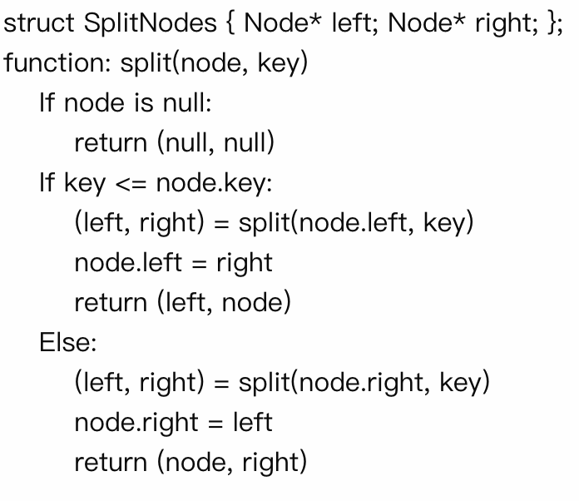
Split
Decide which subtree the root node would belong to (left or right)
Recursively call split on one of its children
Create the final result by reusing the recursive split call
Runtime: O(logN)

Slide 10
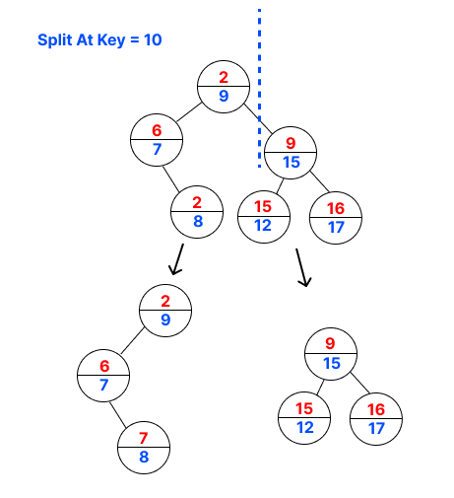
Split-Example

Slide 11
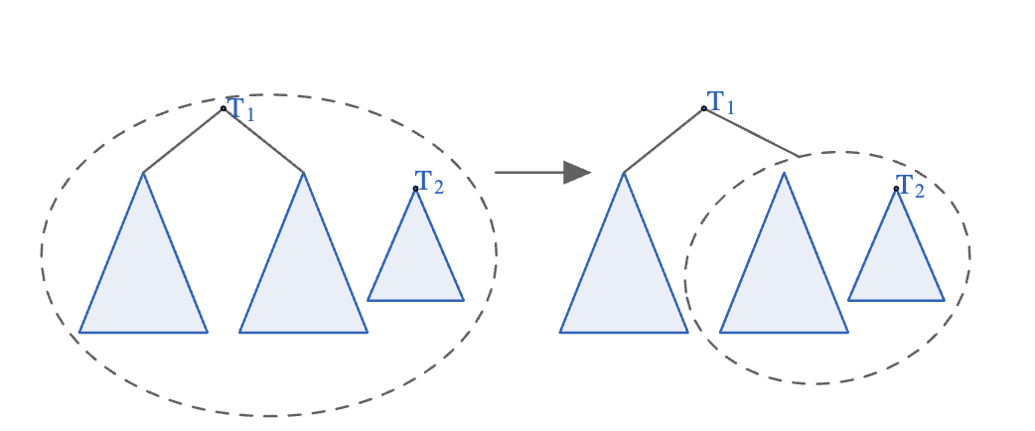
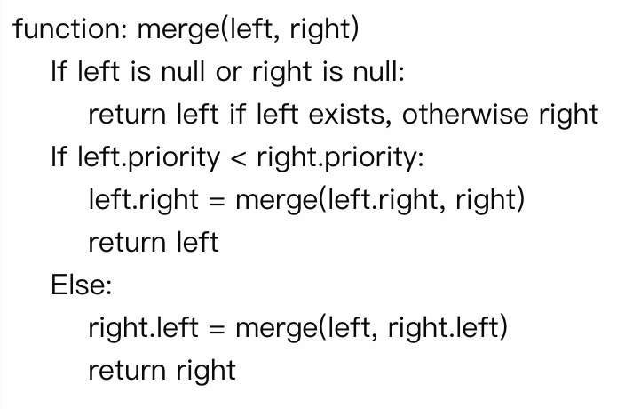
Merge(Min-heap)
Merges two treaps (left and right) assuming all keys in left are less than those in right.
Chooses the root with larger/smaller priority to maintain the heap property
Runtime: O(logN)

Slide 12
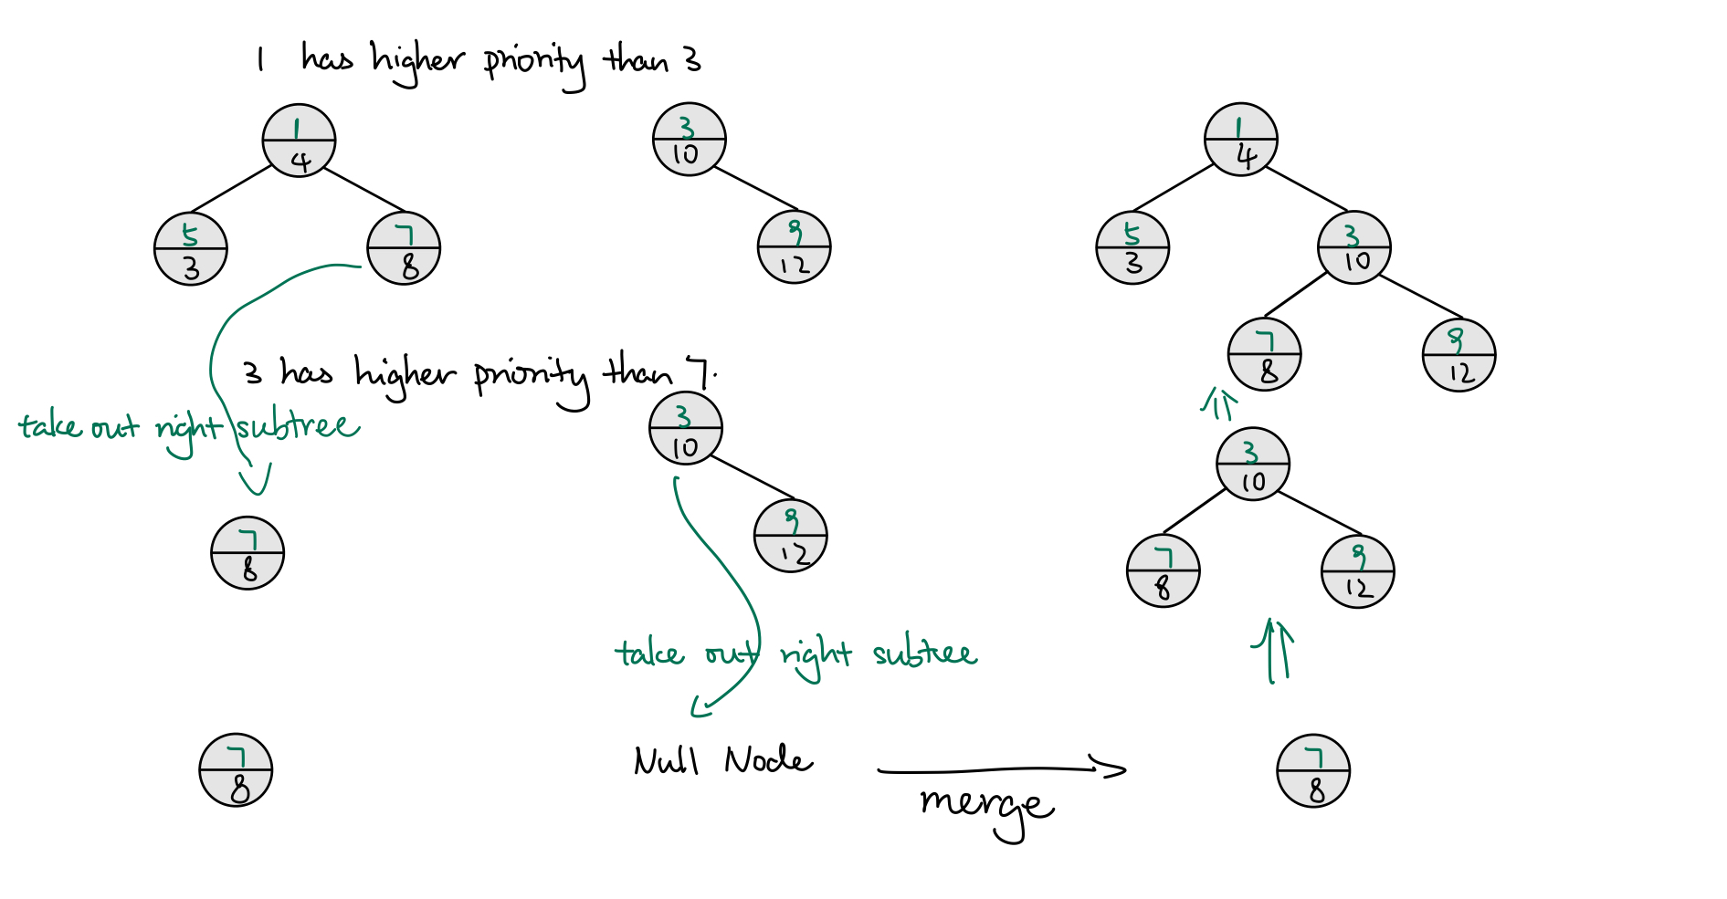
Merge-Example

Slide 13
Reference
https://cp-algorithms.com/data_structures/treap.html
https://www.youtube.com/watch?v=6x0UlIBLRsc
https://courses.cs.washington.edu/courses/cse326/00wi/handouts/lecture19/sld017.htm

