Slide 1
Knuth-Morris-Pratt Algorithm
Aleesha Khurram, Tanush Siotia, Alex Suh

Slide 2
Content Overview
01
Core Problem
04
Knuth-Morris-Pratt Algorithm
02
Naïve Approach
05
Examples of KMP
03
Prefix Matching

Slide 3

In Summary: Ctrl + F
String matching is fundamental computer science problem
Used in data retrieval systems, text editing software, and network security
Also used in bioinformatics to match DNA sequences
Core Problem: Searching for Occurrences of a Word “W” within the Main String “S”

Slide 4
High Level Idea: Check for string occurrence at every point
vector<int> find_substrings(string haystack, string needle) {
int n = needle.length;
vector<int> solution;
if (haystack.length < needle.length) {
return {};
}
for (int i = 0; i < haystack.length; i++) {
if (haystack.substr(i, n) == needle) {
solution.push_back(i);
}
}
return solution;
}
Naïve Approach

Slide 5
High Level Idea: Check for string occurrence at every point
Naïve Example

Slide 6
High Level Idea: Check for string occurrence at every point
Time Complexity?
target substring is length n, total string is length m
String comparison is O(n)
In the worst case, perform this m times
Overall Complexity: O(n*m)
Example “Bad” Case: AAAAAAAAAAAAAAAAAAAAAAAAAAAAB
AAAAAAAAAAAAAAB
Note: Even if string equals returns early on mismatch, it might have to check the entire substring every time!
Naïve Example

Slide 7

High Level Idea: Check for string occurrence at every point
How can we make improvements?
In this bad case, we know that the first 11 characters are going to match again (because in the previous check, the A was repeated).
No need to check those again - just compare the last two characters!
Example “Bad” Case:
Naïve Example

Slide 8






Input: string of length
Output: array of length
is length of longest proper prefix of substring that is also a suffix
By definition,
Prefix Function: Definition

Slide 9
Prefix Function: Example

Slide 10








Naive approach time complexity:
Optimization 1: Note that value of prefix function can increase by at most one
Optimization 2: We can reduce string comparisons based on previously computed values
Optimized time complexity:
Prefix Function: Optimizations
If , suppose we remove the last character from the suffix ending at index . Results in suffix of length ending at index (Contradiction).
Otherwise, move to longest length such that
. Then,
. Otherwise, continue process until .

Slide 11
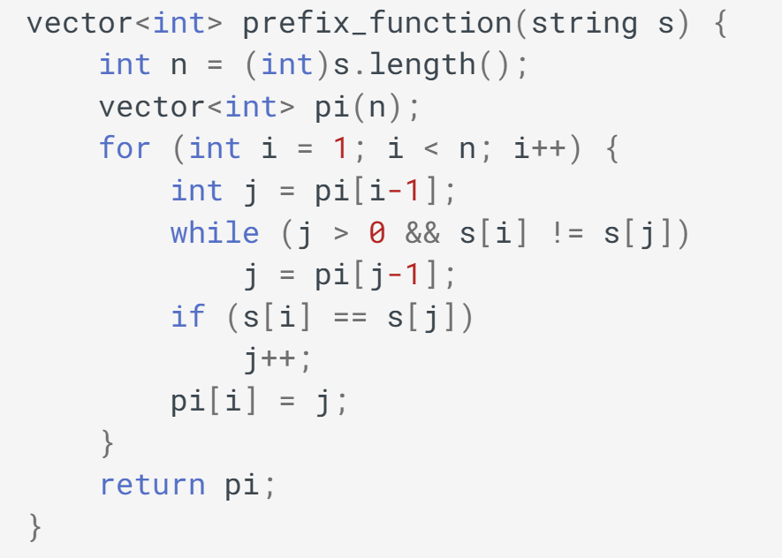



Prefix Function: Algorithm Walkthrough
Even with a nested while loop, it is still since total number of iterations of the while loop over the entire run is at most
Notes:
Credit: CP-Algorithms

Slide 12
Key Question: How can we use prefix matching to search for a substring in a text?
Insight: Where does this algorithm perform string matching? (In the naive implementation of the prefix function, at what points does it check for equal characters)
The prefix matching algorithm compares the strings at the start (the prefix) and the end (the suffix) at the current position.
Each occurrence of the substring will be a suffix at some position - so put the substring before the text!
Knuth-Morris-Pratt Algorithm

Slide 13
Place the substring before the text, separated by a separator that is present in neither string.
Example (substring is needle, separator is #):
π[18] = 6, so the first 6 letters (the full substring) matches the last 6 letters (the occurrence of the substring). Therefore, i=18-6+1=13 must be the starting index of an occurrence of the substring.
Knuth-Morris-Pratt Algorithm

Slide 14
From earlier:
If we know the prefix values never are higher than m, we don’t need to store the entire string/function but only beginning.
We store:
s (with separator character) - O(m)
Values of prefix function for last m+1 characters O(m)
Space complexity is O(m)
Still need to build prefix for equivalent of entire string m+n+1 length
Time complexity is O(m+n)
Knuth-Morris-Pratt Algorithm: Complexity

Slide 15
Rabin-Karp String Matching
Uses hash values of individual characters and strings
Requires being able to hash sequential elements
Might produce spurious hits (equal hashes but not equal substrings)
Aho-Corasick Algorithms
Builds a search trie to keep track of suffix/prefix patterns
Requires high initial overhead to build trie
Similar Algorithms

