Slide 1
BURROWS-WHEELER TRANSFORM
Advanced Algorithms Luke Del giudice, Siddharth Premjith, eddie li

Slide 2
motivation
Goal: Given a string, rearrange the elements of the string to cluster similar characters together.
Why: Compression algorithms work best with redundant information.
Twist: How do we recover information? We need to be able to reverse the transform.
Original Text | Transformed with BWT
banana | annb$aa
Process: original string → BWT → compression

Slide 3
Forward transform
0.5) Add $ to the end:
1) Full list of rotated strings:
2) Alphabetically sorted list:
banana$
banana$
$banana
a$banan
na$bana
ana$ban
nana$ba
anana$b
$banana
a$banan
ana$ban
anana$b
banana$
na$bana
nana$ba
3) Extract each string’s last character:
annb$aa
Rotation: Move the last character to the front of the string
Final string: BWT attempts to create runs of similar characters (not perfect!)

Slide 4
how does clustering work?
2) Alphabetically sorted list:
Intuition: When a character is followed by a similar substring, those substrings will be next to each other in the sorted list.
$banana
a$banan
ana$ban
anana$b
banana$
na$bana
nana$ba
na
3) Extract each string’s last character:
Both n’s are followed by an a, so they will be next to each other in the final string. The same is true for the two a’s being followed by na.
annb$aa
ana

Slide 5
Compression example
Run-Length Encoding (RLE)
Run-length encoding is a simple compression technique that replaces consecutive repeated characters with a single instance of the character followed by the number of times it repeats. This compression works best when the same characters appear many times in a row.
annnnb$aaa
an4b$a3
This reduction will be more significant for strings with MANY repeated substrings

Slide 6
Simulation Measuring $\frac{compressed string length}{original string length}∗100$
Simulation: Compression algorithms run on 5,000 randomized strings (5,000 characters in length).
Repeating substrings leads to repeating characters with BWT
 | Uniform Selection |  | Substrings Likely Repeated
Compression Algorithm | Without BWT | With BWT | Without BWT | With BWT
Run-Length Encoding (RLE) | 99.85 | 99.85 | 99.87 | 6.61
Huffman Coding | 11416.55 | 11482.77 | 34375.87 | 34369.04
Move-to-Front Encoding | 62.50 | 62.51 | 62.50 | 62.51
Arithmetic Coding | 58.72 | 58.74 | 26.81 | 26.84
Lempel-Ziv (LZ77 / LZ78) | 62.45 | 62.50 | 5.49 | 5.21
Not great!
Overhead from additional metadata

Slide 7
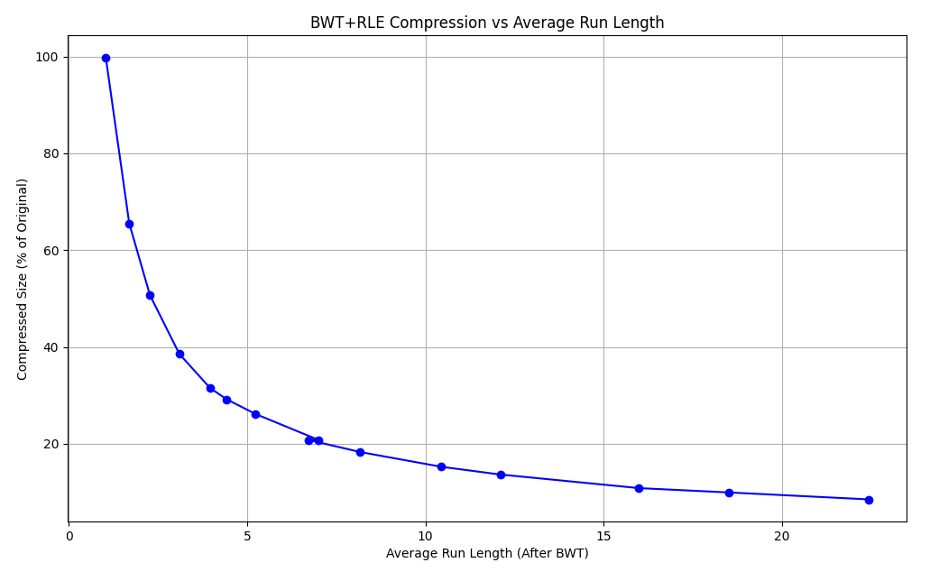

Redundancy visualized
$$\frac{compressed string length}{original string length}∗100$$
Basically, average number of redundant substrings

Slide 8
Reverse transform: Overview
F
L
“First”
“Last”
0
1
2
3
4
5
6
$banana
a$banan
ana$ban
anana$b
banana$
na$bana
nana$ba
T
BWT(T)
banana$
annb$aa
All rotations
Burrows-Wheeler Matrix
T-ranking: assign characters ranks by # times character occurred previously in T → $b_{0}a_{0}n_{0}a_{1}n_{1}a_{2}\$$

Slide 9
































































































Last-to-front mapping
F
L
F
L
$$\$$$
$$b_{0}$$
$$a_{2}$$
$$n_{1}$$
$$a_{2}$$
$$n_{1}$$
$$a_{2}$$
$$\$$$
$$b_{0}$$
$$a_{2}$$
$$n_{1}$$
$$a_{2}$$
$$n_{1}$$
$$a_{2}$$
$$a_{2}$$
$$\$$$
$$b_{0}$$
$$a_{2}$$
$$n_{1}$$
$$a_{2}$$
$$n_{1}$$
$$a_{2}$$
$$\$$$
$$b_{0}$$
$$a_{2}$$
$$n_{1}$$
$$a_{2}$$
$$n_{1}$$
Why are the a’s in this order relative to each other?
Why are the a’s in this order relative to each other?
$$a_{1}$$
$$n_{1}$$
$$a_{1}$$
$$\$$$
$$b_{0}$$
$$a_{1}$$
$$n_{0}$$
$$a_{1}$$
$$n_{1}$$
$$a_{2}$$
$$\$$$
$$b_{0}$$
$$a_{1}$$
$$n_{0}$$
$$a_{0}$$
$$n_{0}$$
$$a_{0}$$
$$n_{0}$$
$$a_{1}$$
$$\$$$
$$b_{0}$$
$$a_{0}$$
$$n_{0}$$
$$a_{1}$$
$$n_{0}$$
$$a_{1}$$
$$\$$$
$$b_{0}$$
$$b_{0}$$
$$a_{2}$$
$$n_{1}$$
$$a_{1}$$
$$n_{0}$$
$$a_{0}$$
$
$$b_{0}$$
$$a_{2}$$
$$n_{1}$$
$$a_{1}$$
$$n_{0}$$
$$a_{0}$$
$
$$n_{1}$$
$$a_{1}$$
$$\$$$
$$b_{0}$$
$$a_{0}$$
$$n_{0}$$
$$a_{1}$$
$$n_{1}$$
$$a_{1}$$
$$\$$$
$$b_{0}$$
$$a_{0}$$
$$n_{0}$$
$$a_{1}$$
$$n_{0}$$
$$a_{0}$$
$$n_{0}$$
$$a_{0}$$
$$\$$$
$$b_{0}$$
$$a_{0}$$
$$n_{0}$$
$$a_{0}$$
$$n_{0}$$
$$a_{0}$$
$$\$$$
$$b_{0}$$
$$a_{0}$$
They’re sorted by right context
They’re sorted by right context

Slide 10






















lf mapping definition/implication
F
LF Mapping: the i^{th} occurrence of a character c in L and the i^{th} occurrence of c in F correspond to the same occurrence of c in T.
L
F
L
$$\$$$
$$a_{2}$$
$$\$$$
$$a_{2}$$
$$a_{2}$$
$$n_{1}$$
$$a_{2}$$
$$n_{1}$$
We know L since it’s the result of BWT, and we can find F since it’s just L sorted with order preserved.
$$a_{1}$$
$$n_{0}$$
$$a_{1}$$
$$n_{0}$$
$$a_{0}$$
$$b_{0}$$
$$a_{0}$$
$$b_{0}$$
Start in first row. For F this will be $ (lowest rotated string by definition).
L will contain character just prior to $: $a_{2}$
By LF Mapping, this is the same $a$ as the first $a$ in F.
Next, we find $a_{2}$ in F to get the character that comes before $a_{2}$ in T. And repeat…
$$b_{0}$$
$
$$b_{0}$$
$
character before $ in T
$$n_{1}$$
$$a_{1}$$
$$n_{1}$$
$$a_{1}$$
$$n_{0}$$
$$a_{0}$$
$$n_{0}$$
$$a_{0}$$

Slide 11
Trace reverse path
F
F
L
F
F
L
F
F
L
L
F
L
L
L
$$\$$$
$$a_{2}$$
$$\$$$
$$a_{2}$$
$$\$$$
$$a_{2}$$
$$\$$$
$$a_{2}$$
$$\$$$
$$a_{2}$$
$$\$$$
$$a_{2}$$
$$\$$$
$$a_{2}$$
$$a_{2}$$
$$n_{1}$$
$$a_{2}$$
$$n_{1}$$
$$a_{2}$$
$$n_{1}$$
$$a_{2}$$
$$n_{1}$$
$$a_{2}$$
$$n_{1}$$
$$a_{2}$$
$$n_{1}$$
$$a_{2}$$
$$n_{1}$$
$$a_{1}$$
$$n_{0}$$
$$a_{1}$$
$$n_{0}$$
$$a_{1}$$
$$n_{0}$$
$$a_{1}$$
$$n_{0}$$
$$a_{1}$$
$$n_{0}$$
$$a_{1}$$
$$n_{0}$$
$$a_{1}$$
$$n_{0}$$
$$a_{0}$$
$$b_{0}$$
$$a_{0}$$
$$b_{0}$$
$$a_{0}$$
$$b_{0}$$
$$a_{0}$$
$$b_{0}$$
$$a_{0}$$
$$b_{0}$$
$$a_{0}$$
$$b_{0}$$
$$a_{0}$$
$$b_{0}$$
$$b_{0}$$
$
$$b_{0}$$
$
$$b_{0}$$
$
$$b_{0}$$
$
$$b_{0}$$
$
$$b_{0}$$
$
$$b_{0}$$
$
$$n_{1}$$
$$a_{1}$$
$$n_{1}$$
$$a_{1}$$
$$n_{1}$$
$$a_{1}$$
$$n_{1}$$
$$a_{1}$$
$$n_{1}$$
$$a_{1}$$
$$n_{1}$$
$$a_{1}$$
$$n_{1}$$
$$a_{1}$$
$$n_{0}$$
$$a_{0}$$
$$n_{0}$$
$$a_{0}$$
$$n_{0}$$
$$a_{0}$$
$$n_{0}$$
$$a_{0}$$
$$n_{0}$$
$$a_{0}$$
$$n_{0}$$
$$a_{0}$$
$$n_{0}$$
$$a_{0}$$
Trace path: $$a_{2}n_{1}a_{1}n_{0}a_{0}b_{0}$ → $b_{0}a_{0}n_{0}a_{1}n_{1}a_{2}$$ = T

Slide 12
can we improve runtime?
This gives the same result for BWT, so where’s the speedup?
Suffix Array: Data structure to store the rotation information through the starting indexes of all the suffixes after sorting.
(6, 5, 3, 1, 0, 4, 3)
0
1
2
3
4
5
6
banana$
anana$
nana$
ana$
na$
a$
$
6
5
3
1
0
4
1
$
a$
ana$
anana$
banana$
na$
nana$

Slide 13
Suffix array construction (dc3)
Still using the example S = banana$
Position | Triplet
1 | (a, n, a)
2 | (n, a, n)
4 | (n, a, $)
5 | (a, $, $)
Step 1: Split Suffixes by Modulo 3
Group 1+2 is mod 3 = 1 or 2 → [1, 2, 4, 5]
Group 0 is mod 3 = 0 → [0, 3, 6]
Step 2: Sort Group 1+2
Represent each suffix in Group 1+2 by triplets (S[i], S[i+1], S[i+2])
Radix sort these triplets to get the order of Group 1+2 suffixes
Sorted Group 1+2: [5, 1, 4, 2]
Step 3: Recurse on Reduced String
Map the sorted triplets to ranks and create a new string:
a$$ → 0, ana → 1, na$ → 2, nan → 3
New string becomes [0, 1, 2, 3]
Recursively compute the suffix array of this new string (solves ties)

Slide 14
Suffix array construction (dc3)
This works because Group 0 suffixes start with a character followed by a suffix in Group 1+2, which is already sorted so comparisons are O(1)
Step 4: Sort Group 0 using Group 1+2
The Group 0 positions are [0, 3, 6]. To compare two positions i, j in Group 0:
Compare S[i] vs S[j]
If equal, compare the suffixes starting at i+1 and j+1 (already sorted in Group 1+2)
i = 0 is b, i = 3 is a, i = 6 is $
a < b so 3 comes before 0, $ < a so 6 comes first → [6, 3, 0]
Step 5: Merge Group 0 [6, 3, 0] and Group 1+2 [5, 1, 4, 2] by comparing suffixes
Why DC3 runs in O(n) time?
Radix Sort: sorting triplets takes O(n) time (fixed-length keys)
Recursion: the reduced string has size 2n/3, so T(n) = T(2n/3) + O(n) → T(n) = O(n)
Induced Sorting: Group 0 is sorted in O(n) using precomputed Group 1+2 order
Merge Step: each comparison is O(1) due to precomputed ranks

Slide 15
conclusions
Burrows-Wheeler Transform is a reversible text transformation that rearranges characters in a string to group similar characters together, enabling more efficient compression.
Original Naive Compexity: time is O(n²logn), space is O(n²)
Suffix Array Optimization Compexity: time is O(n), space is O(n)
When to use: For data containing frequent redundant substrings; otherwise, BWT is useless
Combines best with: Run-length encoding based on the compression algorithms simulated

Slide 16
References
https://www.youtube.com/watch?v=4n7NPk5lwbI
https://nbviewer.org/github/BenLangmead/comp-genomics-class/blob/master/notebooks/CG_BWT_Reverse.ipynb
https://en.wikipedia.org/wiki/Burrows%E2%80%93Wheeler_transform
https://www.geeksforgeeks.org/burrows-wheeler-data-transform-algorithm/

