Slide 1
Mo’s Algorithm
Sebastian Condyles, Josh Huddleston, Keshav Tarafdar
Cole Frankenhoff
Material from:
https://cp-algorithms.com/data_structures/sqrt_decomposition.html#mos-algorithm

Slide 2
Motivation
Goal: Given an array of elements A and a list of queries for some function (ex. Sum, mode, mean, etc.), how can we answer them efficiently?
Support the following operations:
1. Calculate (for any l,r) the value of f(l,r)=f(a_l,…,a_r) for each query in a list of queries Q
2. Use no more than O(n) memory (so no more than list A itself)
**Note: This will work for any function f(), but sum(l, r) is a common first one to start with

Slide 3
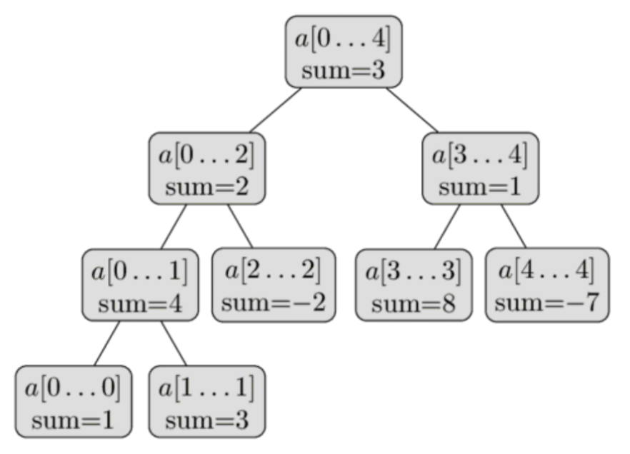
Range Queries
Segment Trees - stores function answers for whole ranges.
This prevents having to recurse down to leaf nodes if whole range of a node is contained in a query, which makes query runtime O(logn).

Slide 4
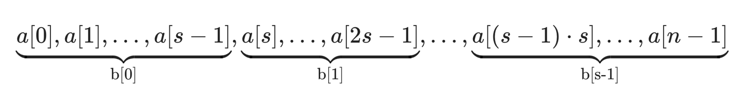
Sqrt Decomposition
Input: A function f(l, r) that operates on a range of elements, a merge operator and a list of elements with size n. Let s = sqrt(n)
Create a list L of size sqrt(n), where every element l[k] stores the range query in the sqrt(n)-sized block. Formally, L[k] = f(k*s, (k + 1) * s).
To compute f(L, r), manually compute the value of f(L, start of right block), f(start of right block, r), and the values of every block in between
Formally: f(l, l + s - l % s) + sum(l[(l + s) % s]...l[k) + f(r - r % s, r)

Slide 5
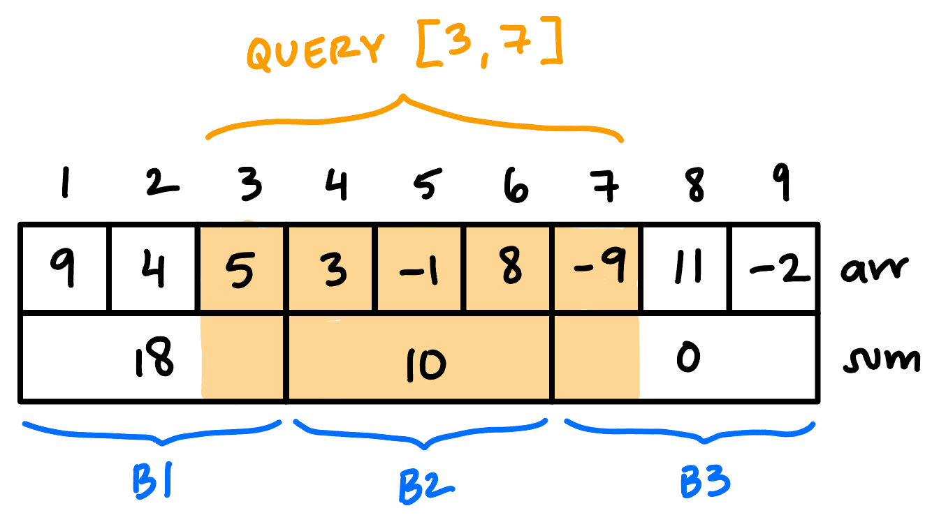
Sqrt Decomposition
O(n) to precompute values, O(q * sqrt(n)) to execute q queries
Update time is O(1) for most functions
Outperforms segment trees in cases when there are far more updates than queries, small input size, and cases where space is a large concern
Multiple queries end up with precomputed windows
What if there was a way to optimize these away?
Repeated queries?

Slide 6
Mo’s Algorithm Intuition
See example with n=9
And keys beside
Block size, sqrt(9) = 3
Query input (l,r) order :
0 4 → (0, 4)
1 3 → (0, 3)
6, 8 → (2, 8)
4 8 → (1, 8)
3 5 → (1, 5)
Sorted queries:
1, 3
0, 4
3, 5
4, 8
6, 8
Instead of precomputing query answers in a data structure (segment tree), we now answer many queries in a row, sorted to reduce redundant computations.
Keeps sqrt decomposition idea of blocks without storing answers for b[k] ahead of time.
Key idea: For each query (l, r), calculate key ( l // sqrt(n), r ) i.e. sort first by the block of the left index, then by the right index, both ascending.

Slide 7

Mo’s Data Structure
Uses a custom range data structure, which reflects the value of function f over the range [L, R].
3 main operations:
Remove(idx): remove value at idx, and update the value of the data structure appropriately. Decrease R or increase L.
Add(x): add a new element, and update the data structure. Either increases R or decreases L.
Query(L, R): get the value of f(L, R)
All in O(1)

Slide 8
Pseudocode 1:Setup
Input:
- L: list of n elements
- Q: list of queries (left, right, index)
//Intuition–Divide L into blocks of size sqrt(n), and sort Q based on the leftmost query blocks with right query as a tiebreaker. Being “in a block” means that both the left and right indices are in that block
Let block_size = sqrt(n)
Sort Q using the following comparator for queries q1, q2:
If q1 and q2 are in different blocks, the query with the lowest left index is greater
If q1 and q2 are in the same block, the query with the lowest right index is greater
f
Notes:
INSERT SOME GRAPHIC

Slide 9
Pseudocode 2: Algorithm
1. Sort Q by (left, then right)
2. Initialize:
- moe = Moe(L)
- cur_left = 0, cur_right = -1
- answers = [ ] of size len(Q)
3. For each query q in Q:
- Shrink right: while cur_right > q.right → remove & cur_right--
- Expand right: while cur_right < q.right → cur_right++ & add
- Shrink left: while cur_left < q.left → remove & cur_left++
- Expand left: while cur_left > q.left → cur_left-- & add
- Store answer at q.index
4. Return answers

Slide 10
Ex. Count Distinct Elements
3 | 1 | 1 | 2 | 3 | 4 | 2 | 1
0 1 2 3 4 5 6 7
Block size = ⌈√8⌉ = 3
Queries: (0,3) (2,7) (1,5)
Block of left index: 0 0 0
Sorted queries → (0,3) (1,5) (2,7)
First step:
curL | curR | Subarray | Freq. | Distinct Count
0 | -1 | [ ] | { } | 0

Slide 11
Ex. Count Distinct Elements
3 | 1 | 1 | 2 | 3 | 4 | 2 | 1
0 1 2 3 4 5 6 7
Queries: (0,3) (2,7) (1,5) → (0,3) (1,5) (2,7)
Answer: 3
curL | curR | Subarray | Freq. | Distinct Count
0 | 0 | [3] | {3: 1} | 1
0 | 1 | [3, 1] | {3: 1, 1: 1} | 2
0 | 2 | [3, 1, 1] | {3: 1, 1: 2} | 2
0 | 3 | [3, 1, 1, 2] | {3: 1, 1: 2, 2: 1} | 3

Slide 12
Ex. Count Distinct Elements
3 | 1 | 1 | 2 | 3 | 4 | 2 | 1
0 1 2 3 4 5 6 7
Queries: (0,3) (2,7) (1,5) → (0,3) (1,5) (2,7)
Answer: 4
curL | curR | Subarray | Freq. | Distinct Count
0 | 3 | [3, 1, 1, 2] | {3: 1, 1: 2, 2: 1} | 3
1 | 3 | [1, 1, 2] | {1: 2, 2: 1} | 2
1 | 4 | [1, 1, 2, 3] | {1: 2, 2: 1, 3: 1} | 3
1 | 5 | [1, 1, 2, 3, 4] | {1: 2, 2: 1, 3: 1, 4: 1} | 4
(Q1)

Slide 13
Ex. Count Distinct Elements
3 | 1 | 1 | 2 | 3 | 4 | 2 | 1
0 1 2 3 4 5 6 7
Queries: (0,3) (2,7) (1,5) → (0,3) (1,5) (2,7)
Answer: 4
curL | curR | Subarray | Freq. | Distinct Count
1 | 5 | [1, 1, 2, 3, 4] | {1: 2, 2: 1, 3: 1, 4: 1} | 4
2 | 5 | [1, 2, 3, 4] | {1: 1, 2: 1, 3: 1, 4: 1} | 4
2 | 6 | [1, 2, 3, 4, 2] | {1: 1, 2: 2, 3: 1, 4: 1} | 4
2 | 7 | [1, 2, 3, 4, 2, 1] | {1: 2, 2: 2, 3: 1, 4: 1} | 4
(Q2)

Slide 14
Thought Bubble
We never recomputed anything from scratch, 11 total pointer moves handled all 3 queries
(8 + 3) * √8 ≈ 16 operations, vs. 3 * 8 = 24 with naive method
For a large number of queries, this √n factor can make a huge difference!
First query will always be O(n)
No recursion - divides by √n once and adjusts L/R to each query

Slide 15
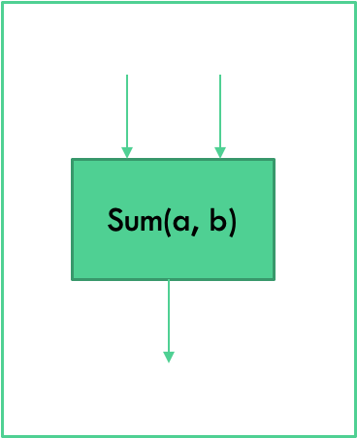
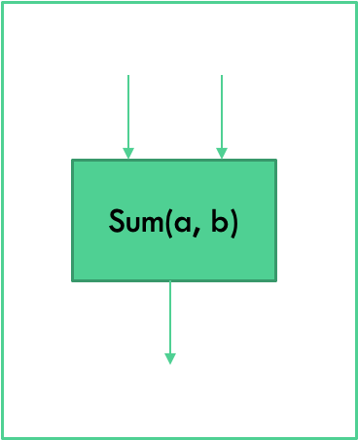
What Functions are Supported?
Similar to Fenwick Trees
Most efficient functions for Mo’s are invertible
Non-Invertible like min/max are not supported
Requires storing data about every possible query and/or previous queries, which defeats the purpose of Mo’s (this is where segment trees would apply)
SOME non-invertible functions can be implemented with helper data structures, ex. mode w/ hashmap to store element frequencies.

Slide 16
Time Complexity
Let Q be the number of queries, N be the size of the data array, and S be the block size.
We need to sort the queries to utilize Mo’s effectively. O(Q log(⁡Q))
For each of the N / S blocks, we increment to the right index of the query range at most N times, because the queries within a block are sorted by right index. O(N²/S)
Between queries within blocks, the left index of the query range changes by at most the block size S. This occurs at most Q times. O(QS)
Between queries in different blocks, the left index of the query range changes by at most 2N throughout the entire execution. O(2N)
When using S ≈ √(N), the total runtime is O(Q log(⁡Q) + N√(N) + Q√(N) + 2N), which is equivalent to O(Q log(⁡Q) + (N + Q)√(N)). In most cases Qlog(Q) << N√(N), so the runtime is dominated by the (N + Q)√(N) term.

Slide 17
Practical Applications
Large amount of offline range queries and only O(n) extra memory
Competitive programming problems, such as Spoj’s DQUERY or Codeforces’ Powerful Array

