Slide 1

Gale-Shapley Algorithm
Arthur Wu, Ayaan Rahman, Ridge Redding, Artie Humphreys

Slide 2
Motivation
Algorithm for finding solution to the Stable Matching Problem
Stable Matching Problem seeks to find a stable matching to two same-sized sets given an ordering of preferences for each element of all elements in the other set
The stable matching must mean that there exists no pair (X, Y) where X prefers Y and Y prefers X more than their current partner in the matching
The classic application is found in the marriage problem, which matches proposers and acceptors based on their ordered preferences of each other. Applications include dating apps (Hinge) and medical school matching (National Resident Matching Program)

Slide 3
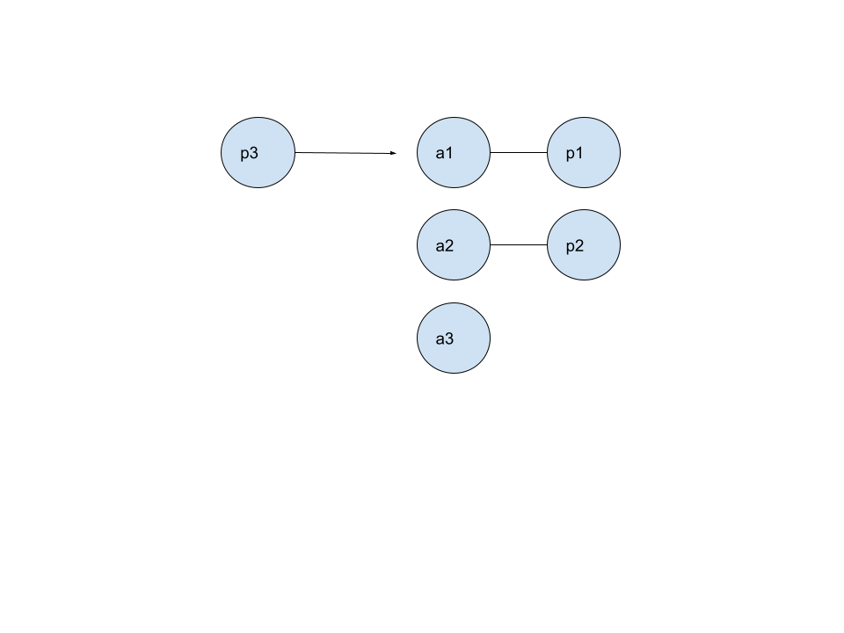
Algorithm Description
Split the two sets into "proposers" and "acceptors"
Each free proposer selects their most-preferred acceptor on their list whom they have not yet approached and sends a proposal immediately—regardless of whether that acceptor already has a tentative match.

Slide 4

Algorithm Description (Cont.)
If that acceptor is free, tentatively match them with the proposer and indicate that this proposer and acceptor pair are matched.
If that acceptor already has a tentative match, compare the new proposer against the current partner using the acceptor’s rankings.
If the acceptor prefers the newcomer, break the existing match, pair with the new proposer, and mark the old partner as free
Else, the new proposal is rejected, and the proposer remains free to propose to the next acceptor on its list
Repeat the above process until there are no elements in the proposer set who are left unmatched.

Slide 5


Pseudocode
Initialize the 2 input sets to a "proposer" set and an "acceptor" set
While there exists an unmatched proposer p
For each acceptor a in the order of p's remaining preferences:
Remove a from p's preference list so that p cannot repropose to a.
If a is free:
Match a and p, mark a and p as matched
Exit the for-loop
Else:
If a prefers p to her old partner o:
Un match a and o, and mark o as unmatched.
Match a and p, and mark p as matched.
Exit the for-loop
Result is optimal for proposers
and least optimal for receivers
Used in:

Slide 6
Time Complexity
The time complexity for the Gale-Shapley algorithm is O(n²) as each of the n proposers can only propose to as much as n acceptors, creating an asymptotic upper-bound of O(n²)
The space complexity for the Gale-Shapley algorithm is O(n²) as we need a way to check for acceptor preferences in constant time.
Solution: store a n x n matrix where the cell in the i^{th} column and j^{th} row represents the position of proposer j in acceptor i’s preference list.

Slide 7
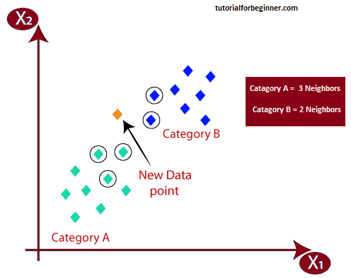
Similar Algorithms
The Elo rating system is another common algorithm used in dating apps such as Tinder to match people into potentially stable matchings
Another similar algorithm is the K-Nearest-Neighbors algorithm, which can be used to classify elements into a category with which they fit closest

Slide 8
Sources
https://en.wikipedia.org/wiki/Gale%E2%80%93Shapley_algorithm
https://www.geeksforgeeks.org/stable-marriage-problem/
https://mr-easy.github.io/2018-08-19-programming-gale-shapley-algorithm-in-cpp/
https://wayback.archive-it.org/5456/20240920170021/http://www.eecs.harvard.edu/cs286r/courses/fall09/papers/galeshapley.pdf
https://medium.com/aiskunks/understanding-gale-shapley-stable-matching-algorithm-and-its-time-complexity-4b814ee2642

