Slide 1
MICRO SERVICE EVENT – DRIVEN ARCHITECTURE

Slide 2
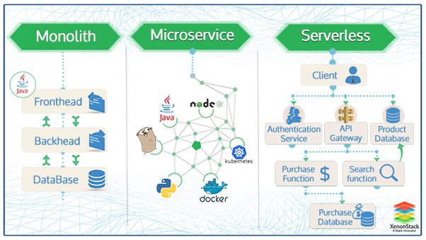

Slide 3
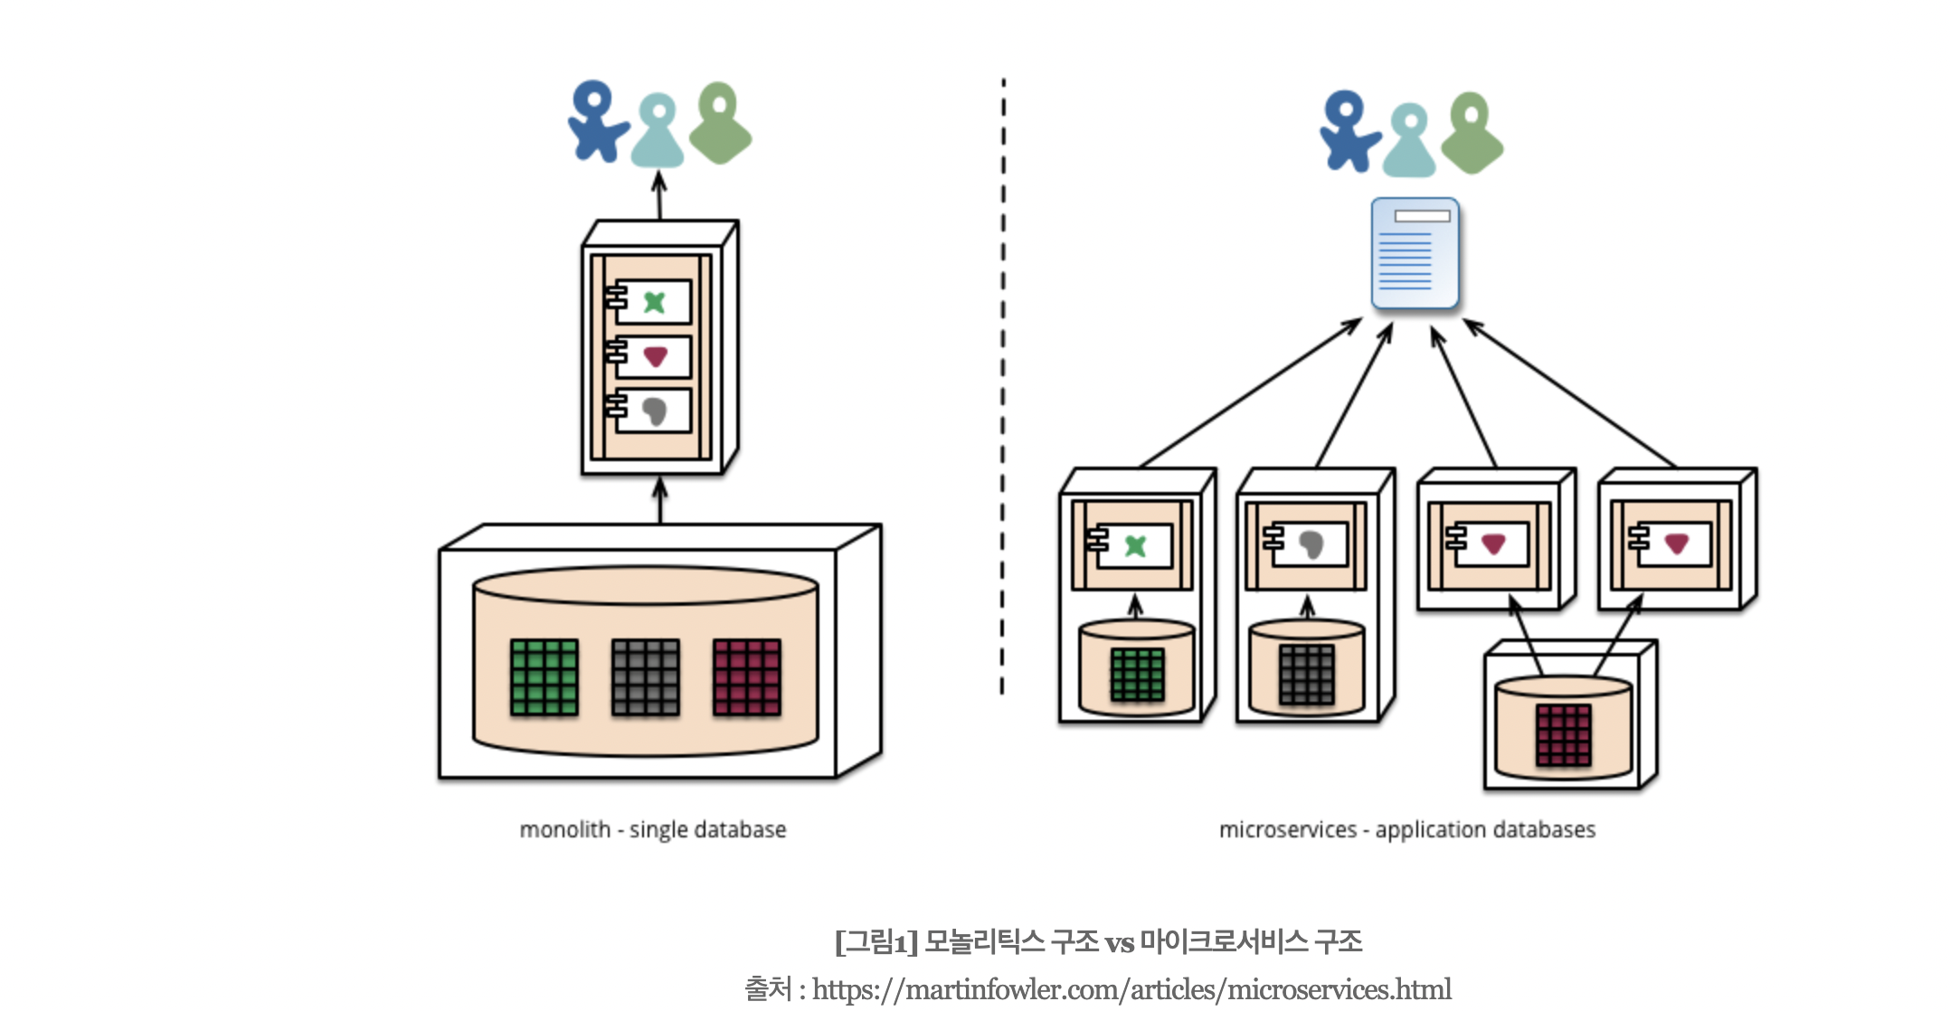
MICRO SERVICE란?

Slide 4
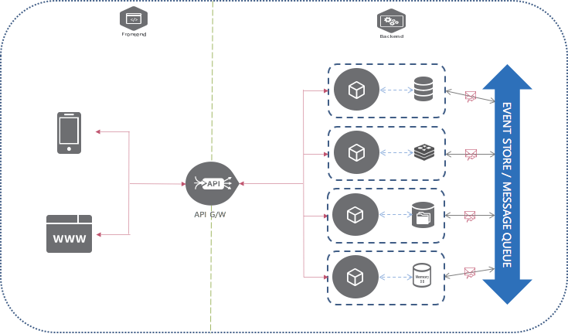
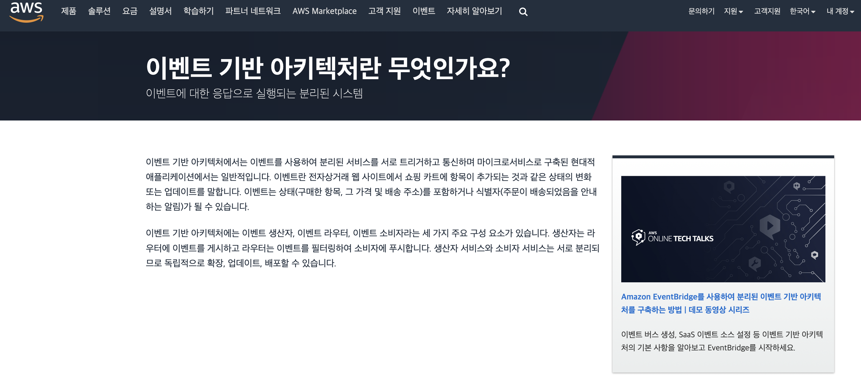
EVENT – DRIVEN ARCHITECTURE 란

Slide 5
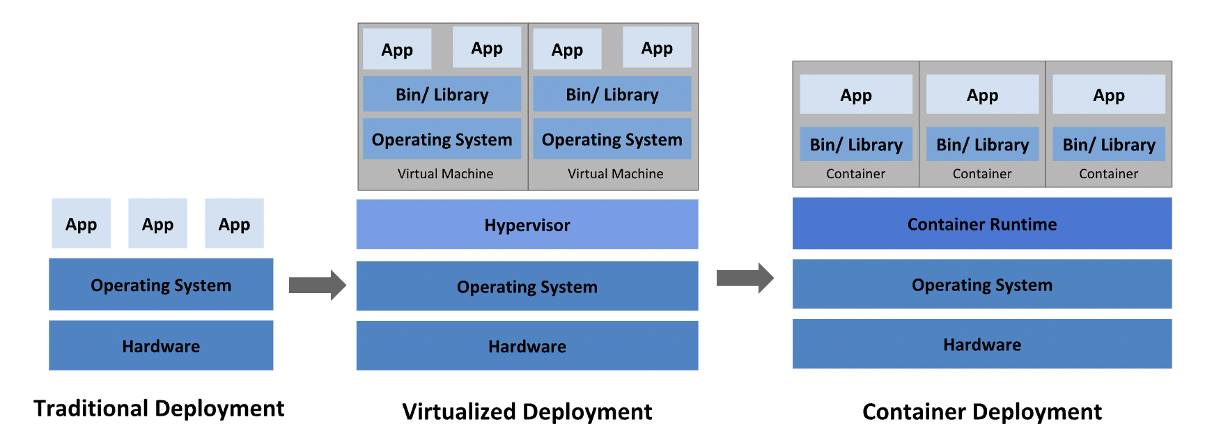
KUBERNATICS DOCKER CI/CD

Slide 6
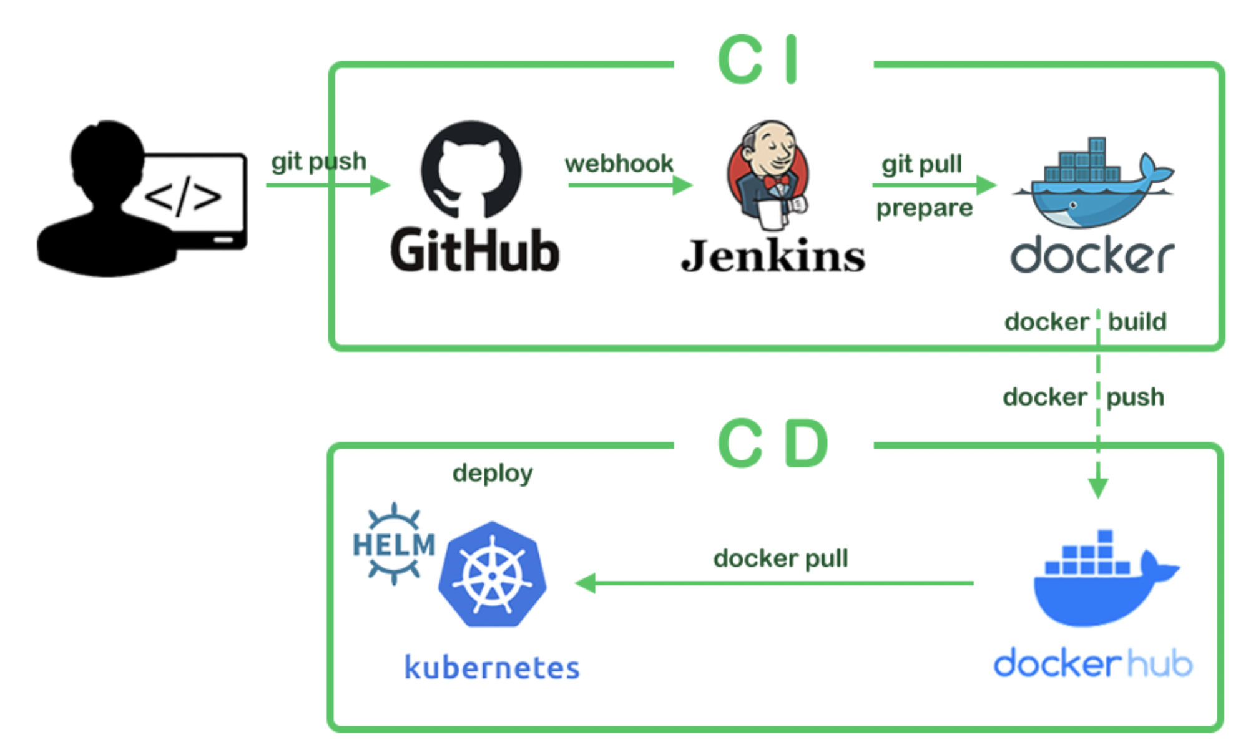
KUBERNATICS DOCKER CI/CD

Slide 7
참고 하면 좋을 youtube list
https://www.youtube.com/watch?v=y8OnoxKotPQ
https://www.youtube.com/watch?v=CZ3wIuvmHeM
https://www.youtube.com/watch?v=A_mstzRGfIE
https://www.youtube.com/watch?v=1xo-0gCVhTU

