Slide 1

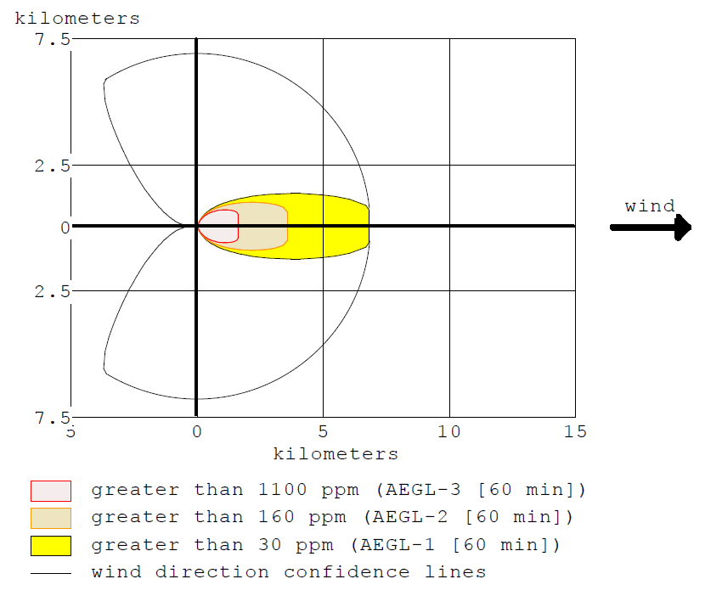
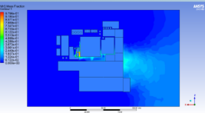
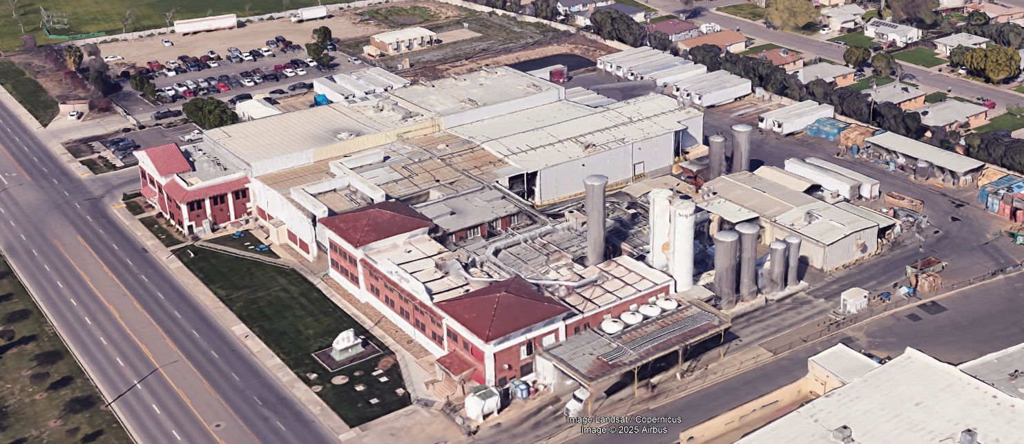
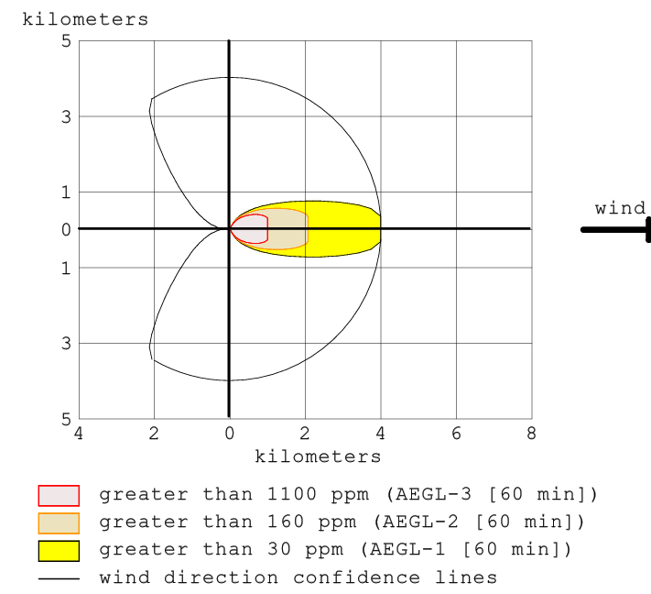
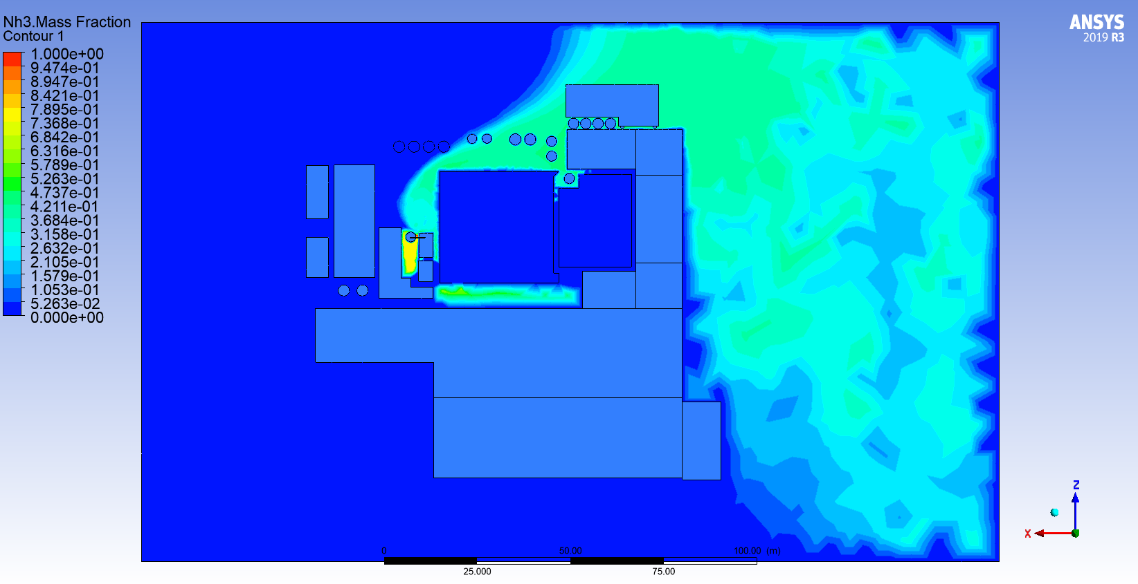
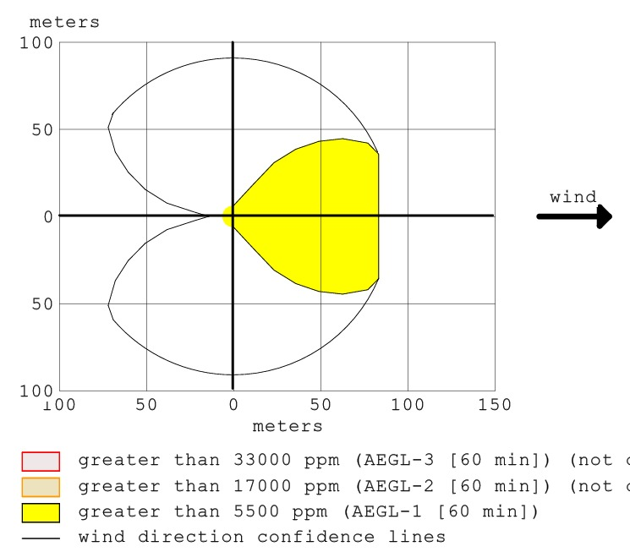
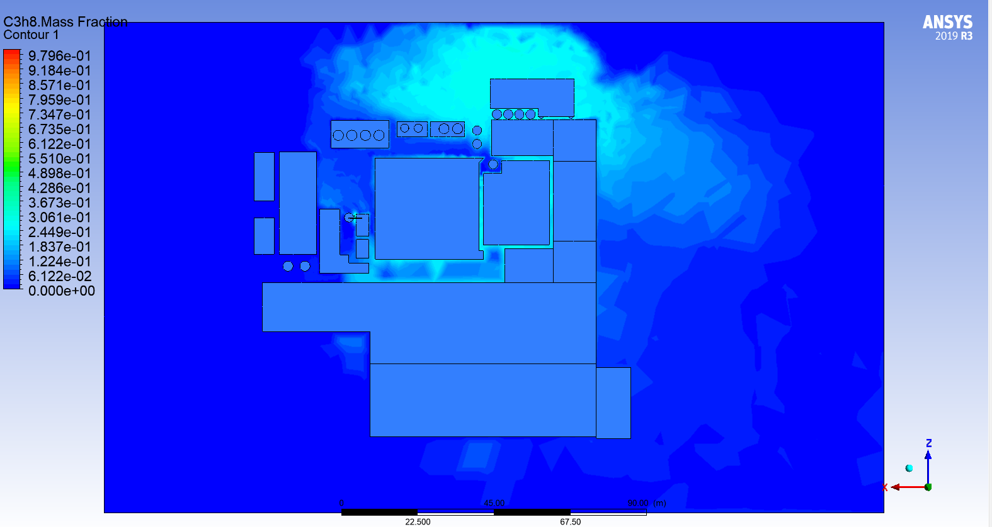
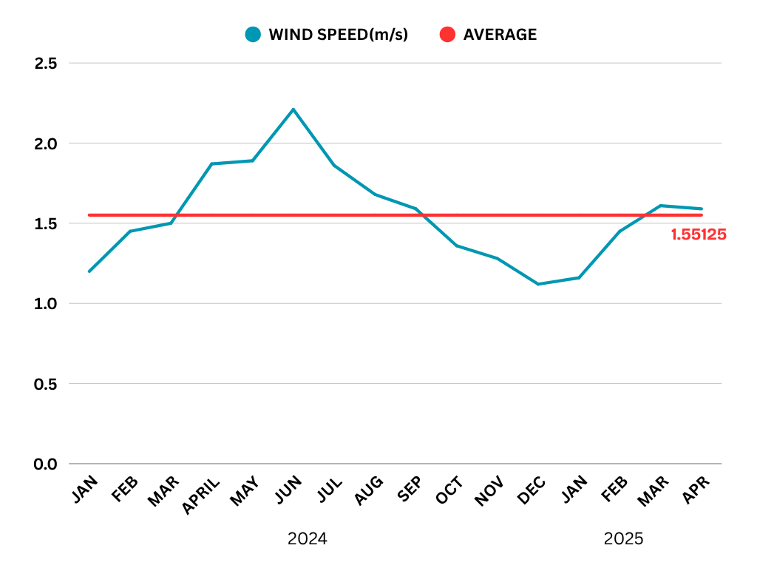
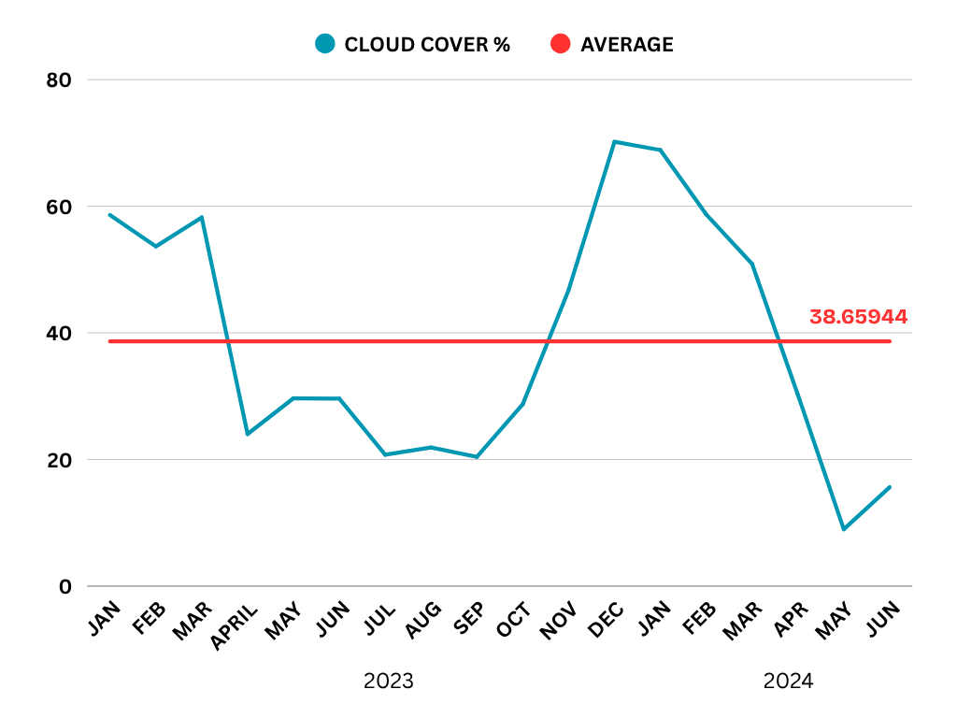
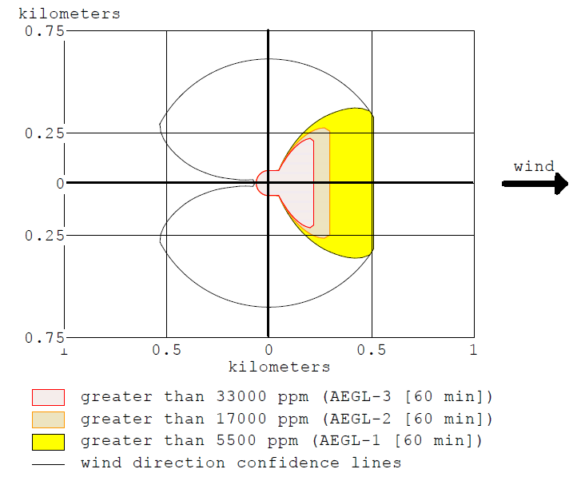
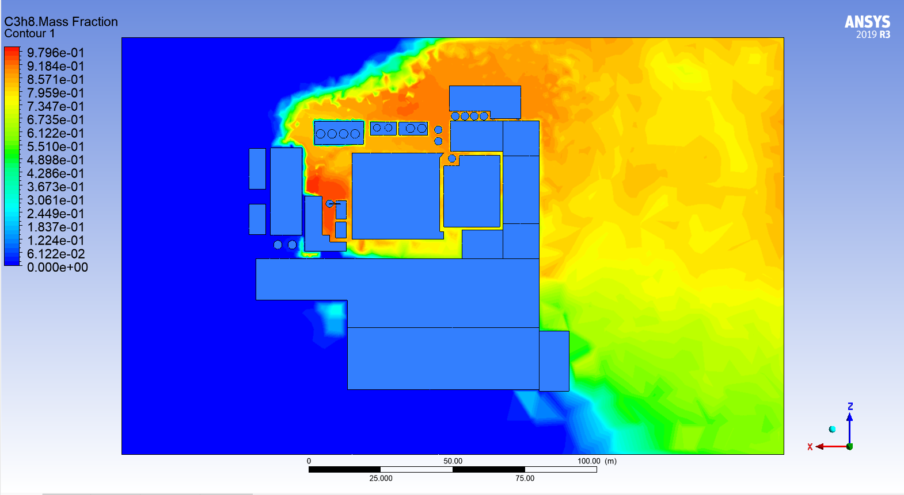

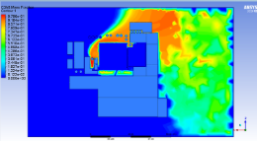
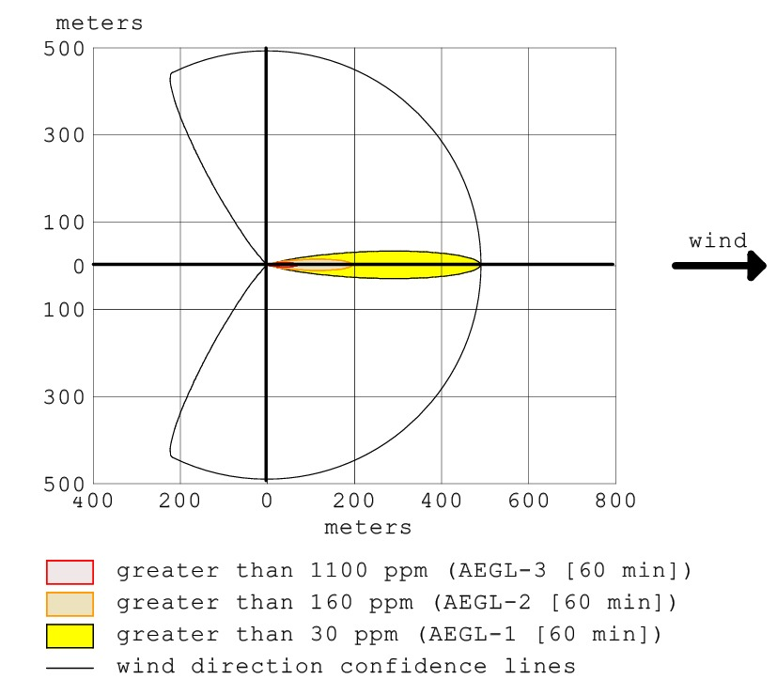
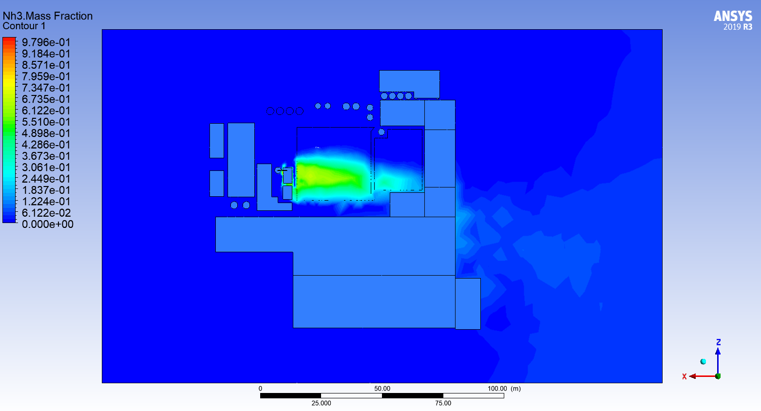
ANALYSIS OF FLAMMABLE REFRIGERANT LEAKS THROUGH CFD SIMULATION AND RISK ASSESSMENT TO ENHANCE INDUSTRIAL SAFETY
E/20/045 Chamika M.A.K ǀ E/20/048 Chandralal U.H.S | E/20/175 Jayawardana S.D.U.B | E/20/302 Premarathne K.M.M.D
Supervised By : Prof. Primal Fernando
Department of Mechanical Engineering, Faculty of Engineering, University of Peradeniya
OBJECTIVES
Dispersion for 5 cm hole diameter and 256kg ammonia
Ammonia ( Mass flow rate – 32.83 kg/s)
Simulate refrigerant leak scenarios for ammonia and propane under different scales and situations.
Analyze dispersion patterns based on leak location and external factors (like wind, temperature).
Identify potential danger zones.
Compare current industry safety protocols against simulation results.
Propose improvements for industrial facility designs and emergency response plans
PLANT LAYOUT
Figure 04: Dispersion area & mass fraction of ammonia at 2 m height
Dispersion for 5 cm hole diameter and 1571kg ammonia
Mass flow rate – 15.61 kg/s
Company Name : Saputo Dairy Foods
Location: Tulare, California, USA
Latitude : 36°12'53.91"N
Longitude : 119°20'54.42"W
Figure 01: Layout of the plant
METHODOLOGY
Design phase
Identified safety issues related to ammonia and propane.
Atmospheric data (Cloud, wind speed/direction, humidity, temperature) is collected and get the average values of it.
Built up basic simulations and selection of the plant
Figure 06: Dispersion area & mass fraction of ammonia at 2 m height
Dispersion for 1 cm hole diameter and 4213kg Propane
(Mass Flow rate – 1.178 kg/s)
Figure 02: Atmospheric data and their average values
Figure 07: Dispersion area & mass fraction of Propane at 2 m height
Dispersion for 5 cm hole diameter and 4213kg Propane
Implementing phase
Run aloha simulations and estimate the area of dispersion.
Perform CFD modeling and simulation for the plant
Testing phase
Compare simulation results by simulating for different hole sizes and different tank sizes of the gas tank.
Identify the communities exposed and hazardous zones.
Evaluation phase
Build up HAZOP for both ammonia and propane
Suggest safety improvements for selecting tank sizes for a plant to store ammonia and propane
Propane ( Mass flow rate – 31.83 kg/s)
Figure 08: Dispersion area & mass fraction of Propane at 2 m height
Dispersion for 5 cm hole diameter and 3716kg Propane
Propane ( Mass flow rate – 0.07 kg/s)
RESULTS AND OUTCOMES
Dispersion for 1 cm hole diameter and 256kg ammonia
Mass flow rate – 0.0707 kg/s
Figure 09: Dispersion area & mass fraction of Propane at 2 m height
HAZOP
HAZOP is applied to both propane and ammonia systems to identify potential risks such as leaks and operational failures. It helps implement corrective measures, effectively reducing the overall risk and enhancing system safety.
Figure 03: Dispersion area & mass fraction of ammonia at 2 m height

