Slide 1
Summarizing & Identifying PII Data from Downloaded Social Media Data
Notes:
Final presentation

Slide 2
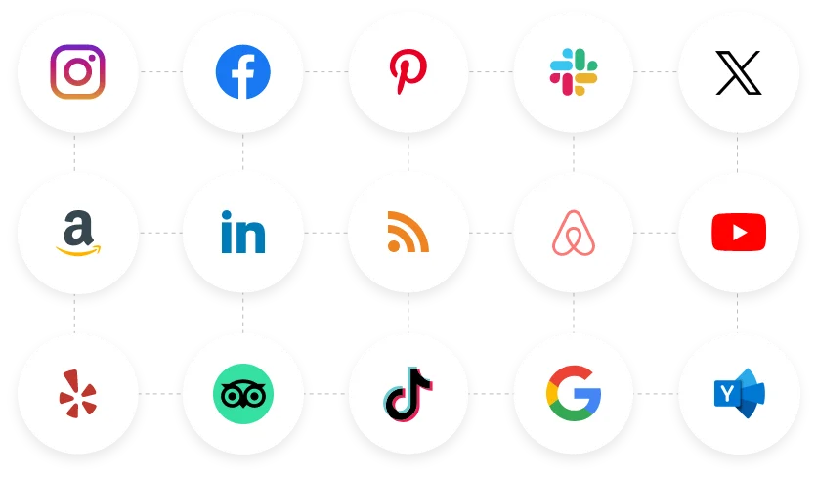
BLUF
As we expand our use of social media apps; the risk of our personally identifiable information (PII) becoming exposed increases with each new app that we feed our data into with or without our knowledge. While we may view these social media apps as harmless and fun entertainment to connect with others, there are dangers to putting all of our information online.
“Tagembed: Free Social Media Aggregator For Website,” Best Social Media Aggregator Tool For Websites | Tagembed, May 30, 2024. https://tagembed.com/

Slide 3
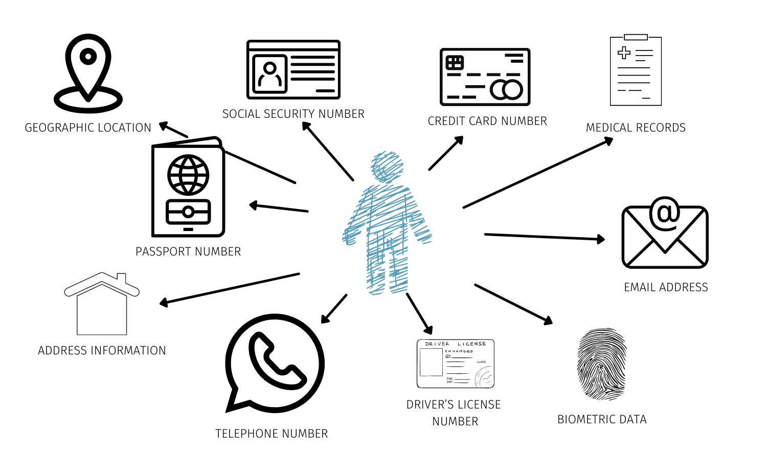
What is PII?
Data that can identify specific individuals such as full names, phone number, email address, social security number, home address, etc. and if this information was put online or collected by attackers, then this data could be used to steal a person’s identity or commit fraud [1].
DPM, “What is Personally Identifiable Information (PII)?,” Data Privacy Manager, Feb. 23, 2021. https://dataprivacymanager.net/what-is-personally-identifiable-information-pii/
Notes:
Image citation: DPM, “What is Personally Identifiable Information (PII)?,” Data Privacy Manager, Feb. 23, 2021. https://dataprivacymanager.net/what-is-personally-identifiable-information-pii/

Slide 4
Importance
Every day we hear about new data breaches occurring and exposing millions of people’s data records online and with no stop in sight, it is critical that users understand exactly how much PII data they are willingly sharing to social media apps and perhaps take a more firm security posture on sharing sensitive information online in order to take back their privacy rights.
Unless there are regulations, consumer pressure, and hefty fines in place; social media companies will not protect their user’s data so it’s up to us to protect ourselves and our information [2]. We as consumers can take action by controlling the sharing and release of our personal data, however social media apps need to rise to the occasion with us and improve their transparency methods and build back trust with users [3].

Slide 5
My Project
The focus of my capstone project has been to utilize an AI model to summarize data from users downloaded information from social media platforms to help users be more informed of what information they are inputting into their online profiles and for future works offer security recommendations to users in making better decisions about their data sharing.

Slide 6
Methodology
My steps for this project were:
Find a text summarization model from the Hugging Face website
Download the necessary code and set it up in Visual Studio Code
Submit download requests of my account data from various social media apps
Acquire downloaded data and select account/profile information
Begin testing data in the model

Slide 7
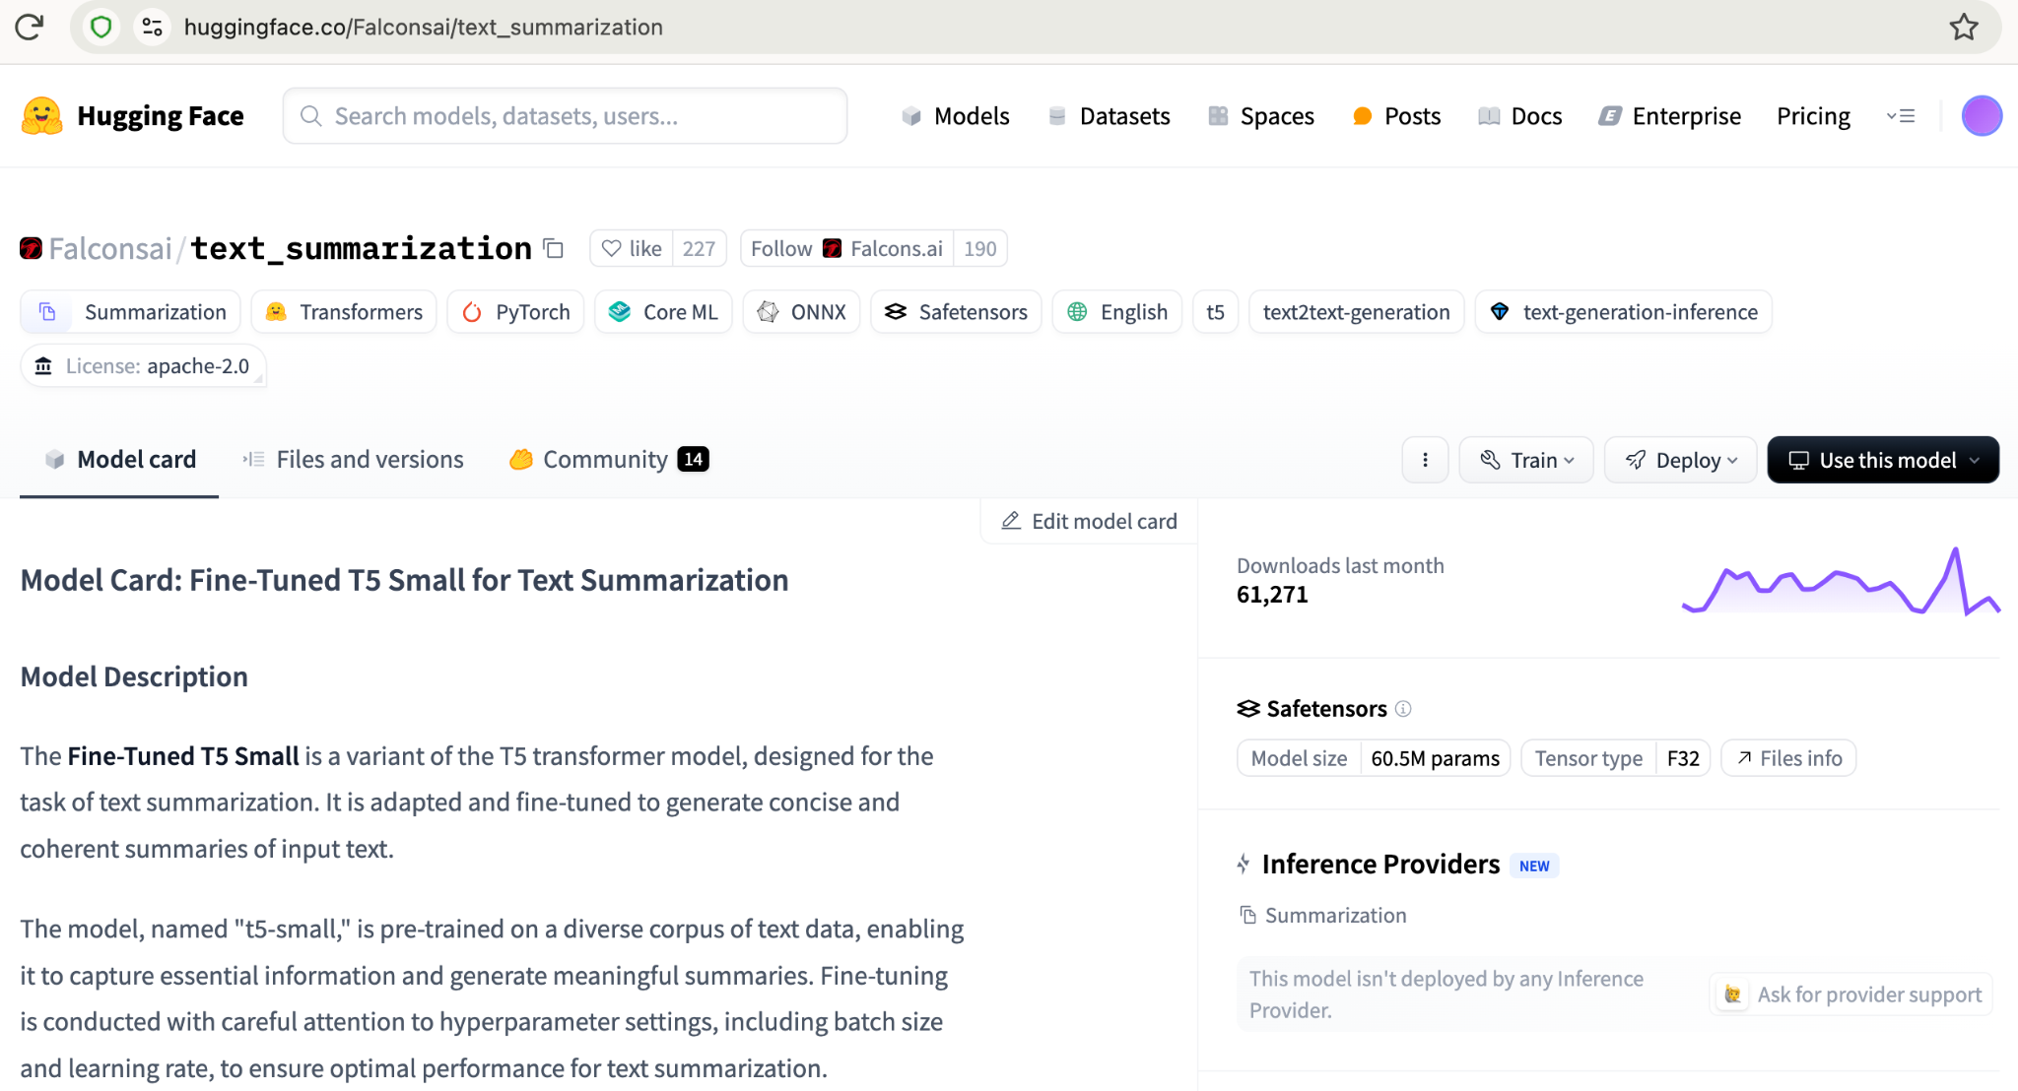
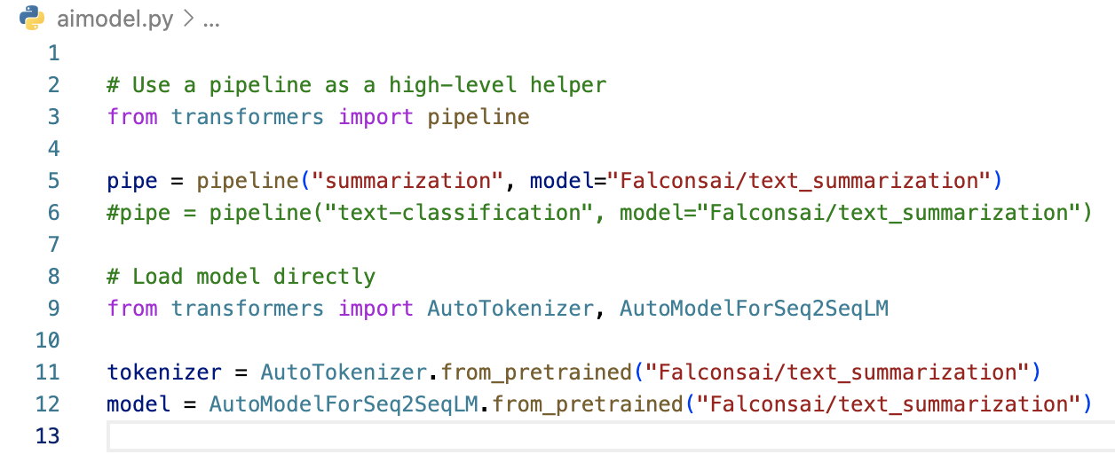
Methodology Figures

Slide 8
Code 1 Key Findings
Data input in the article section should be full sentences in paragraph form not in bullet point format
Metrics for best summarization in the print command are max_length = 425 and min_length = 30
Despite getting the error (token indices sequence length is longer than the specified maximum sequence length for this model (919 > 512). Running this sequence through the model will result in indexing errors), my output is successful
Notes:
When I was first trying this model out, my preliminary results of the model were just giving me the first three pieces of information which was the data title, the first two sentences of the input paragraph, and then a random sentence that was pulled from the input; which was not an ideal summarization representation of the downloaded data that I used. So I went through a lot of trial and error with tweaking the data inputs or changing the model metrics, where I could eventually get better results and see that good progress was made.

Slide 9
Code 1 Challenges
As I was reaching the end of my project, one insight I realized was that my model had met its goal of summarizing the downloaded data into a well-balanced summary, but now I also wanted to achieve a new goal: identifying and extracting PII data from the data input. I realized that I had hit a wall with this new goal as this could not be achieved by the standard code that the Hugging Face website gave me because the goal of my original Fine-Tuned T5 Small model is focused on “generating concise and coherent summaries of input text” [4].
Notes:
When I was first trying this model out, my preliminary results of the model were just giving me the first three pieces of information which was the data title, the first two sentences of the input paragraph, and then a random sentence that was pulled from the input; which was not an ideal summarization representation of the downloaded data that I used. So I went through a lot of trial and error with tweaking the data inputs or changing the model metrics, where I could eventually get better results and see that good progress was made.

Slide 10
Pivot
After hitting the wall with my first code, I moved onto meeting my second goal so I went to DeepSeek and specifically asked it to “write a python code to add into a Falconsai/text_summarization model to identify and extract PII data”. The chatbot gave me a code to try and it worked with some minor output errors. The new Python code takes the same data text input and now provides:
An output with a generated summary of the input
A summary of the PII redacted
A summary of the anonymized text information
A list of detected PII entities such as email, phone number, birthdate, social security number, and person
Notes:
When I was first trying this model out, my preliminary results of the model were just giving me the first three pieces of information which was the data title, the first two sentences of the input paragraph, and then a random sentence that was pulled from the input; which was not an ideal summarization representation of the downloaded data that I used. So I went through a lot of trial and error with tweaking the data inputs or changing the model metrics, where I could eventually get better results and see that good progress was made.

Slide 11
Code 2 Key Findings
Model summarizes 2 out of 4 sentences in the original summary with the first 2 sentences being a direct copy and paste and the last 2 sentences are summarized
Detection of the first PII Entities are correct: EMAIL, PHONE, and BIRTHDATE

Slide 12
Code 2 Challenges
This new code does still have some drawbacks as the code does categorize some of the data inputs into the wrong PII entity like identifying random text as a person or an ID number being categorized as a phone number. I did remove the social security number and person PII entities as well as the summary of the PII redacted and the summary of the anonymized text information since those results in the output came back clearly wrong for the entities and unnecessary for the summaries.

Slide 13
Conclusion
My capstone project has taken me through a new and challenging experience that has rewarded me with two high-level outcomes and possible model feasibility as my first model met my goal of getting a balanced summary of the data input and the new DeepSeek code helping me get closer to my second goal of identifying and extracting specific PII data from the data input. While this project did have to change course, I was able to pivot and get two different results that still helped me achieve my project goals.

Slide 14
Future Works
For future works, I could possibly work on integrating both models into one so that the summarization and PII identification results are both provided to users in a cohesive report with the sensitive data that they provide to social media apps and possibly even suggest recommendations on how to make better data privacy and security decisions going forward on social media platforms to improve their security posture over their own data.

Slide 15
Any questions?

Slide 16
Thank you!

Slide 17
References
[1] IBM, “PII,” Ibm.com, Dec. 06, 2022. https://www.ibm.com/think/topics/pii
[2] “These Social Media Platforms Harvest the Most Personal Data,” Kiteworks | Your Private Content Network, Sep. 27, 2024. https://www.kiteworks.com/company/press-releases/these-social-media-platforms-harvest-the-most-personal-data/
[3] K. L. Walker, “Surrendering Information through the Looking Glass: Transparency, Trust, and Protection,” Journal of Public Policy & Marketing, vol. 35, no. 1, pp. 144–158, Apr. 2016, doi: https://doi.org/10.1509/jppm.15.020.
[4] “Falconsai/text_summarization · Hugging Face,” huggingface.co. https://huggingface.co/Falconsai/text_summarization
Images:
“Tagembed: Free Social Media Aggregator For Website,” Best Social Media Aggregator Tool For Websites | Tagembed, May 30, 2024. https://tagembed.com/
DPM, “What is Personally Identifiable Information (PII)?,” Data Privacy Manager, Feb. 23, 2021. https://dataprivacymanager.net/what-is-personally-identifiable-information-pii/

