Slide 1

Word embeddings

Slide 2

Encoding problem
Neural networks can only work with numbers and/or sequences of numbers. So, what can we do to work with words, sentences or entire texts?

Slide 3
Vectors is all you need
In this case, we need the representation of words and sentences, so we can fed it to our model. In every method we will need to create a dictionary in which for every vocabulary word there is numerical/vector representation of it(i. e. tokenization).
So, we can do it in following ways:
Represent as discrete symbols(one-hot vectors)
Bag of Words(unlike previous, pays attention to frequency)
TF-IDF(like BoW, but also with inverse document frequency)
Word2Vec(NN that produces sets of vectors, representing words. Unlike all previous it is based on context in corpus)
Bert(NN based on transformers, can take into account semantic meaning of words, e. g. “can” as verb and “can” as noun will had different representation)
Some other methods (To exemplify, LSA and ELMO)

Slide 4
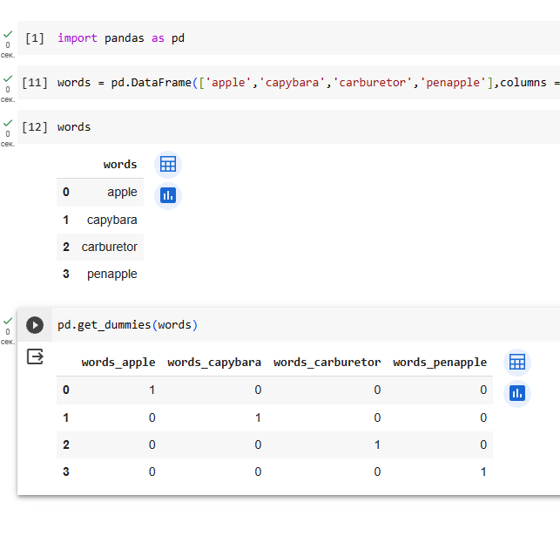
One-Hot encoding
That is the simple method in which we representing i-th word in vocabulary as vector that has 1 on the i-th position and 0 on any other.
Pros:
Easy to implement
Cons:
O(n²) memory
Do not capture any meaning(e.g. on the picture apple is clouser to capybara then ot penapple)

Slide 5
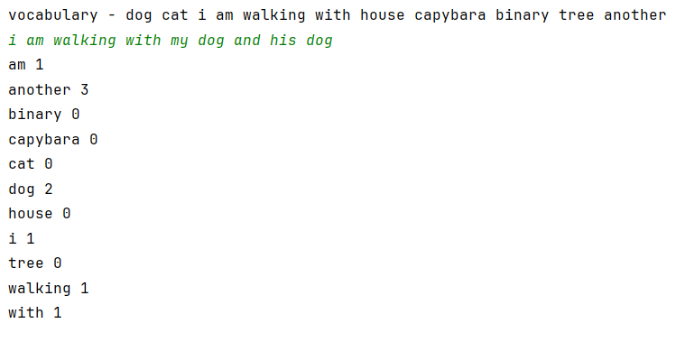
Bag of Words(BoW)
In that case we simply count the frequency of every word which is in vocabulary(if word absent in the text, we count it as a rare word)
Pros:
We taking into account number of the words in the text
Cons:
If we use only frequency of the word in the text, we do not handle the importance of each word in the text(for example, articles(like ‘a’ and ‘the’) and pronouns will have average bigger frequency then other words).
Сan not handle the semantic of words and position of words in the text

Slide 6



TF-IDF
This method count term frequency and inverse document frequency of gained text
Pros:
Reduces the weight of the words which appear frequently in the texts in the collection
Cons:
Still can not handle the semantic of words and position of words in the text

Slide 7
Neural Network methods: Word2Vec
It takes a large text corpus and matches each word to a vector. It first constructs a dictionary and then calculates the vector representation of the words. The representation of words is based on contextual proximity.
Main idea: we try to to predict words from contexts(or contexts from words). So, similar words should have the similar context

Slide 8
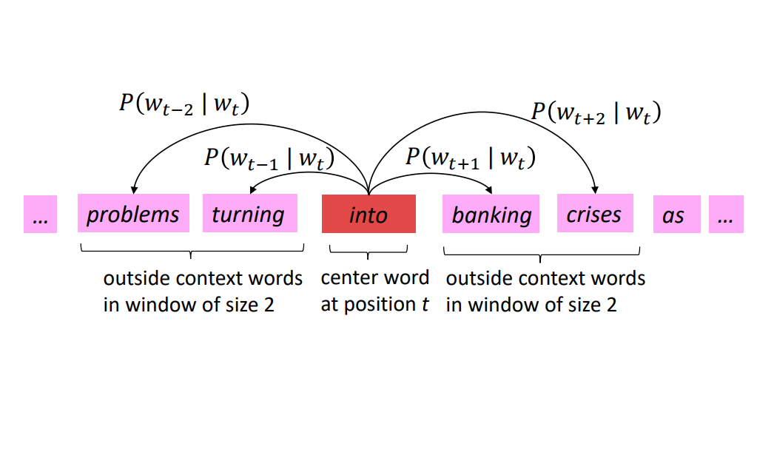
Main ideas of this method:
We should have a large corpus of text;
We should have fixed vocabulary of words;
Every word is represented by a vector;
We go through every position t in text, which has a center word c and context o(‘outside’);
We calculate the probability of c given o (or o given c) using similarity between vectors
We correct each vector to get a high probability
Visualization of the idea from the Stanford CS224n course.

Slide 9
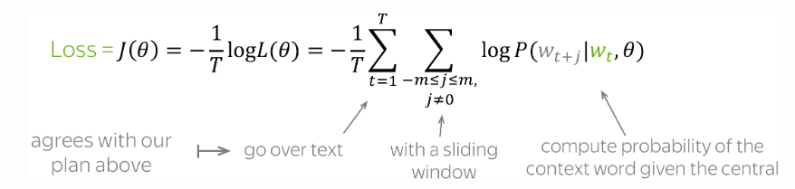
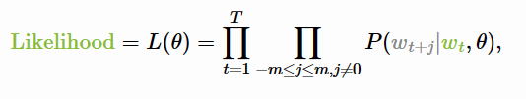
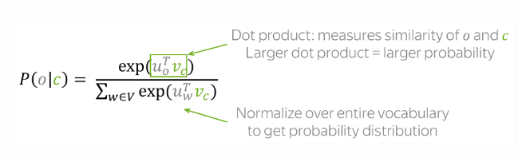
There is two variants of Word2Vec:
CBOW – predicts the central word based on context words
Skip-Gram – predicts context words based on central word
In the Skip-Gram model we train two embeddings v_{w}(when the word w is central) and u_{w} (when the w is the part of a context). On each step, we trying to predict context words within window for given central word w_{t}. To calculate probabilities, we calculate softmax of dot product of (v_{c} u_{o}). To calculate the loss function we calculate the sum of cross-entropy over all words in context:
Formulas from Lena’s Voita course

Slide 10
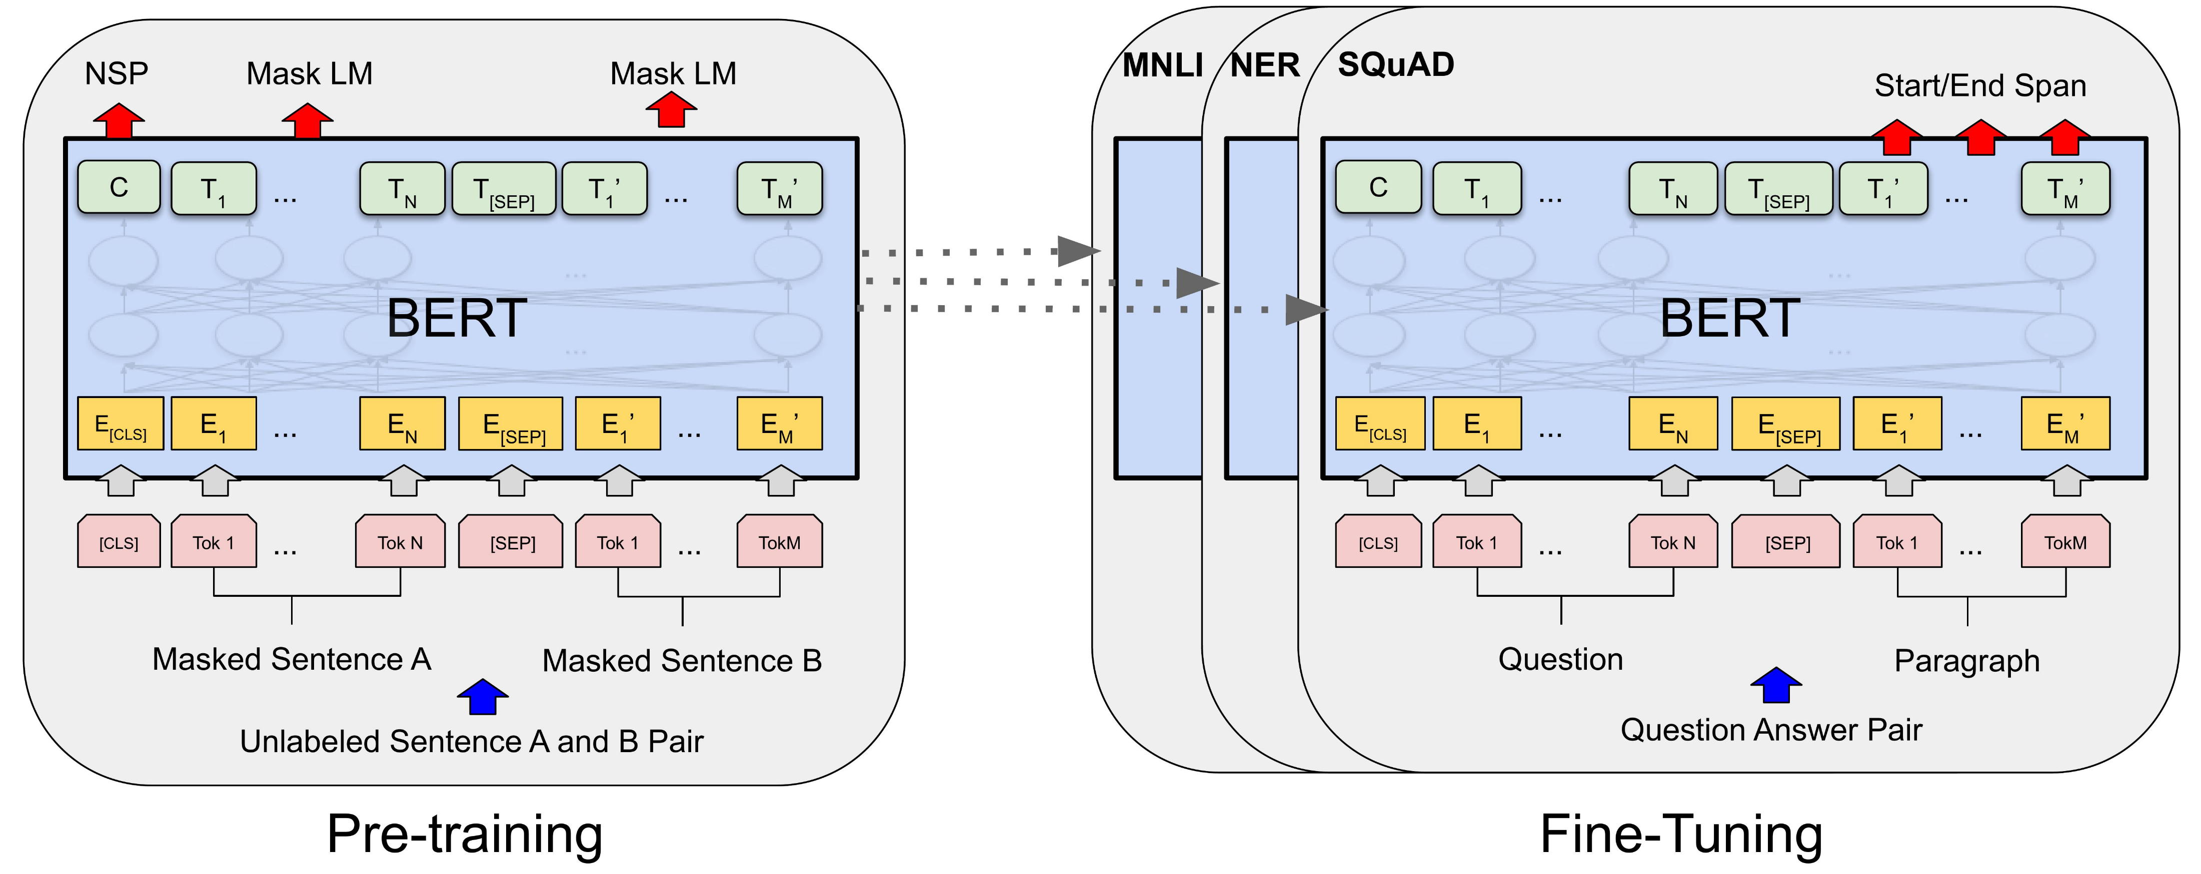

BERT
BERT(Biderectional Encoder Representations from Transformers) is a bidirectional transformer model that generate context aware embeddings, which allow multiple representations of each word based on its context. Biderectional strategy allows to take position into consideration.
Differences from Word2Vec:
Takes sequence as input rather that word
Is able to generate embeddings of words outside vocabulary

Slide 11
Important notes:
Before training neural network or using TF-IDF and BoW, text should be tokenized. It can be done using stemming(when we throw away endings of words) or lemmatization(when determining the lemma of the word). Also, frequently encountered words (stop-words)should be throwed away;
Words can be subdivided to subunits, so Word2Vec will be trained on vocabulary of this subunits;
Words that is absent in dictionary, should be handled as ‘Unknown’;
This methods may help to deal with limited size of vocabulary

Slide 12
Sources:
RusVectōrēs: семантические модели для русского языка (rusvectores.org)
Векторное представление слов — Викиконспекты (ifmo.ru)
Word Embeddings (lena-voita.github.io)
Нейросети для работы с последовательностями (yandex.ru)
Stanford CS 224N | Natural Language Processing with Deep Learning

