Slide 1


Generative Modeling
Wasserstein generative adversarial networks and friends
Tigran Ramazyan, Anwar Ibrahim, Fedor Pakhurov
Laboratory for methods of big data analysis
Fall 2025

Slide 2

Quiz
https://forms.gle/daD3k8ffQDraz9o7A

Slide 3
In this Lecture
f-GANs
Wasserstein Distance
  Kantorovich-Rubenstein Duality.
WGAN
  Algorithm.
  Gradient Penalty.
  Biased Gradients.

Slide 4
Reminder

Slide 5








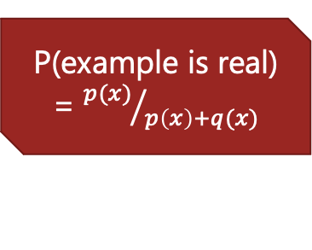

JS GAN scheme
$$L_{G}=−\log{D(G\left(z\right))}$$
Noise
Generator (a neural network)
$$L_{D}=−\log\left[1−D\left(G\left(z\right)\right)\right]−\log{D(x)}$$
Discriminator
P(example is real) = ${p(x)}/{p\left(x\right)+q(x)}$
Real Data

Slide 6
JS GAN Summary
Pros:
  Can utilize power of back-prop.
  No explicit intractable integral.
  No MCMC needed.
Cons:
  Unclear stopping criteria
  No explicit representation of PDF
  Hard to train
  No evaluation metric so hard to compare with other models
  Easy to get trapped in local optima that memorize training data
  Hard to invert generative model to get back latent z from generated x

Slide 7

$f$-GANs

Slide 8
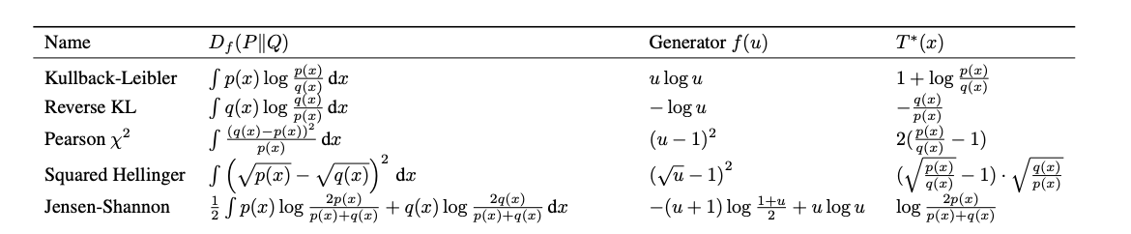
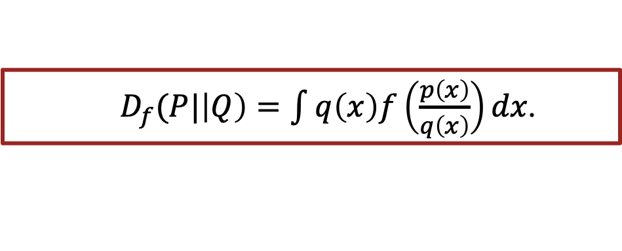
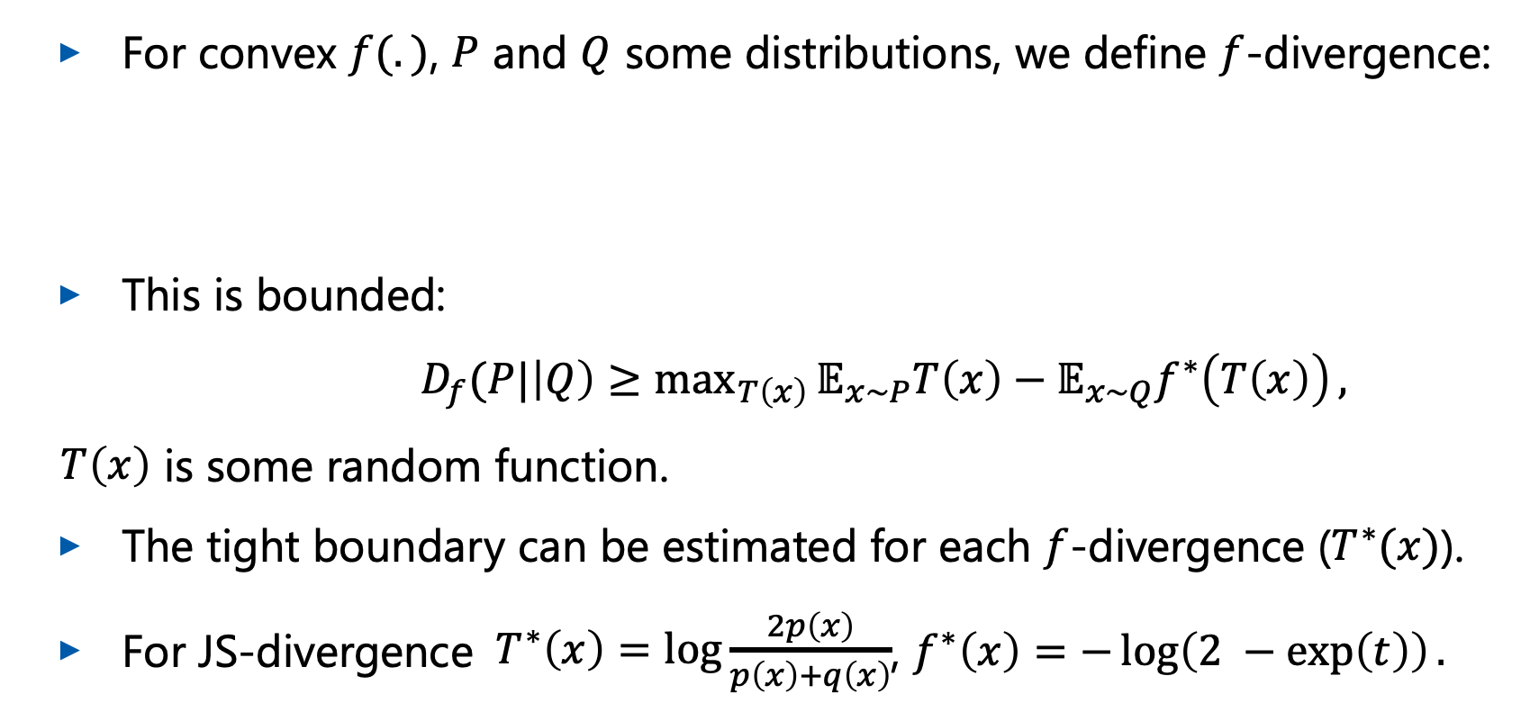
Reminder: Variational Lower Bound
For convex $f(.)$, $P$ and $Q$ some distributions, we define $f$-divergence:
This is bounded:
$D_{f}(P|\left|Q\right)≥\max_{T\left(x\right)}{𝔼_{x\sim P}T\left(x\right)−𝔼_{x\sim Q}f^{∗}\left(T\left(x\right)\right)},$
$T\left(x\right)$ is some random function.
The tight boundary can be estimated for each $f$-divergence ($T^{∗}(x)$).
For JS-divergence $T^{∗}\left(x\right)=\log{\frac{2p\left(x\right)}{p\left(x\right)+q\left(x\right)}}$, $f^{∗}\left(x\right)=−\log\left(2 −\exp\left(t\right)\right).$
$D_{f}(P|\left|Q\right)=\int{q\left(x\right)f\left(\frac{p\left(x\right)}{q\left(x\right)}\right)dx}$.

Slide 9
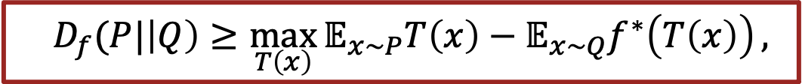
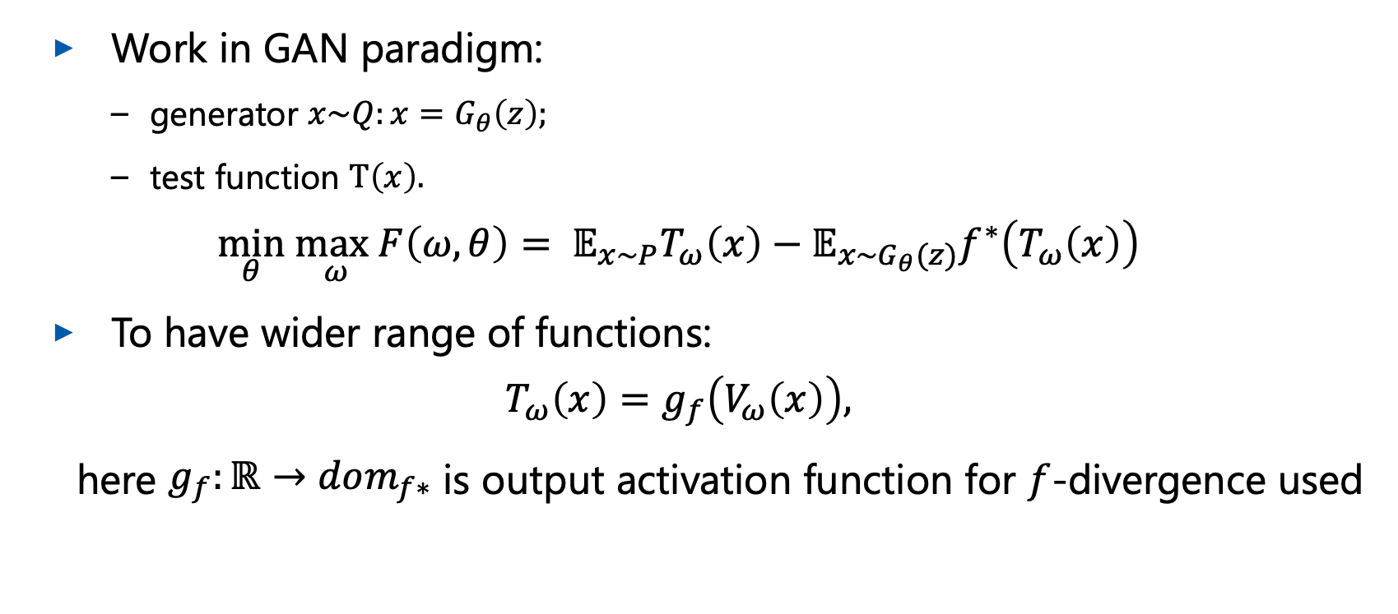
Variational Divergence Minimization
$$D_{f}(P|\left|Q\right)≥\max_{T\left(x\right)}{𝔼_{x\sim P}T\left(x\right)−𝔼_{x\sim Q}f^{∗}\left(T\left(x\right)\right)},$$
Work in GAN paradigm:
  generator ${x\sim Q:x=G}_{θ}\left(z\right);$
  test function $T\left(x\right).$
$$\min_{θ} \max_{ω}F\left(ω,θ\right)= 𝔼_{x\sim P}T_{ω}\left(x\right)−𝔼_{x\sim G_{θ}(z)}f^{∗}\left(T_{ω}\left(x\right)\right)$$
To have wider range of functions:
$$T_{ω}\left(x\right)=g_{f}\left(V_{ω}\left(x\right)\right),$$
here $g_{f}:ℝ→dom_{f∗}$ is output activation function for $f$-divergence used
S. Nowozin et al. f-GAN: Training Generative Neural Samplers using Variational Divergence Minimization

Slide 10
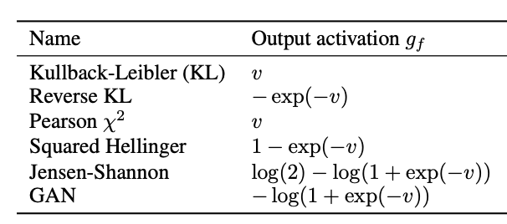
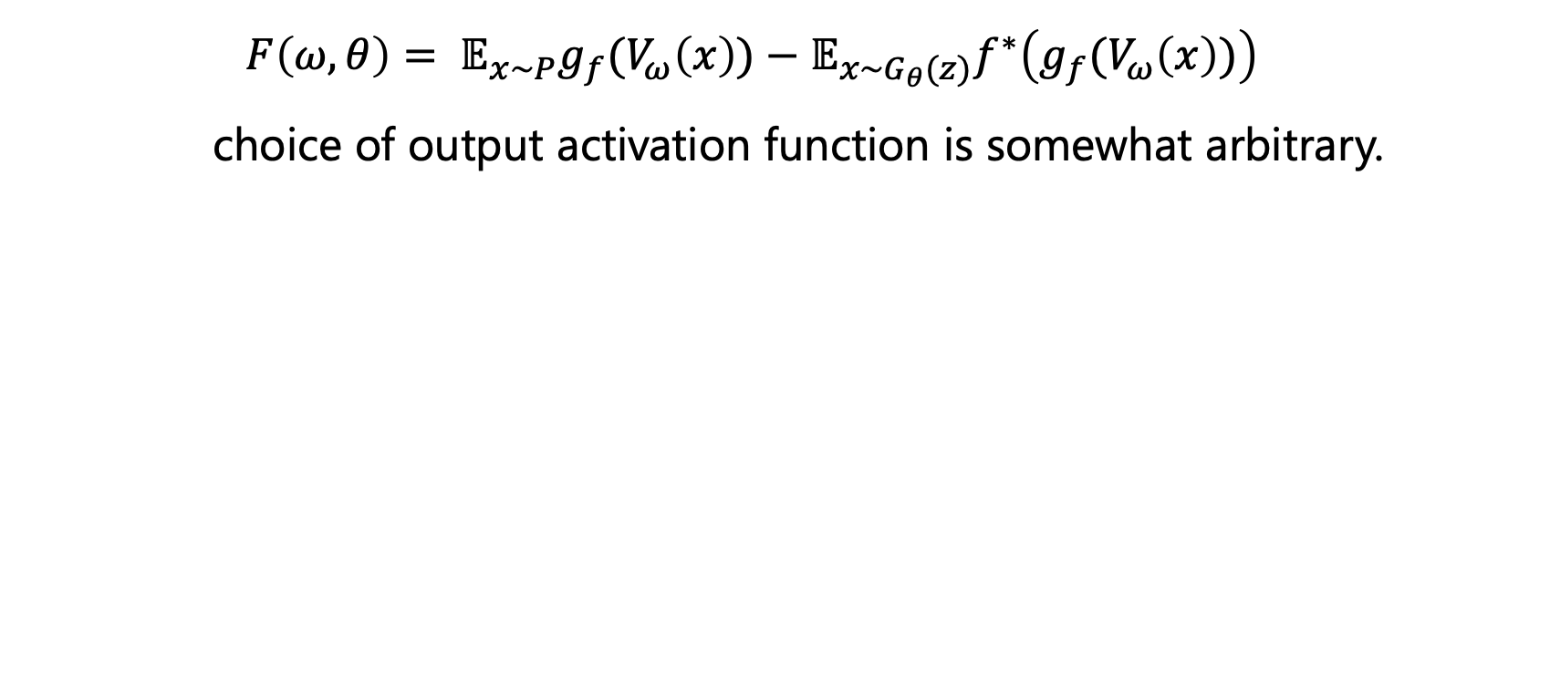
Output activation function
$$F\left(ω,θ\right)= 𝔼_{x\sim P}{g_{f}(V}_{ω}\left(x\right))−𝔼_{x\sim G_{θ}(z)}f^{∗}\left(g_{f}(V_{ω}\left(x\right))\right)$$
choice of output activation function is somewhat arbitrary.

Slide 11
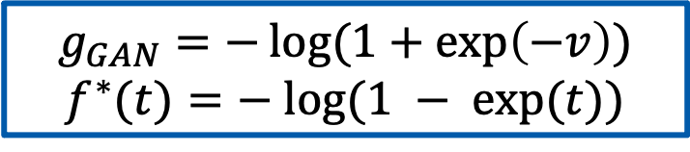

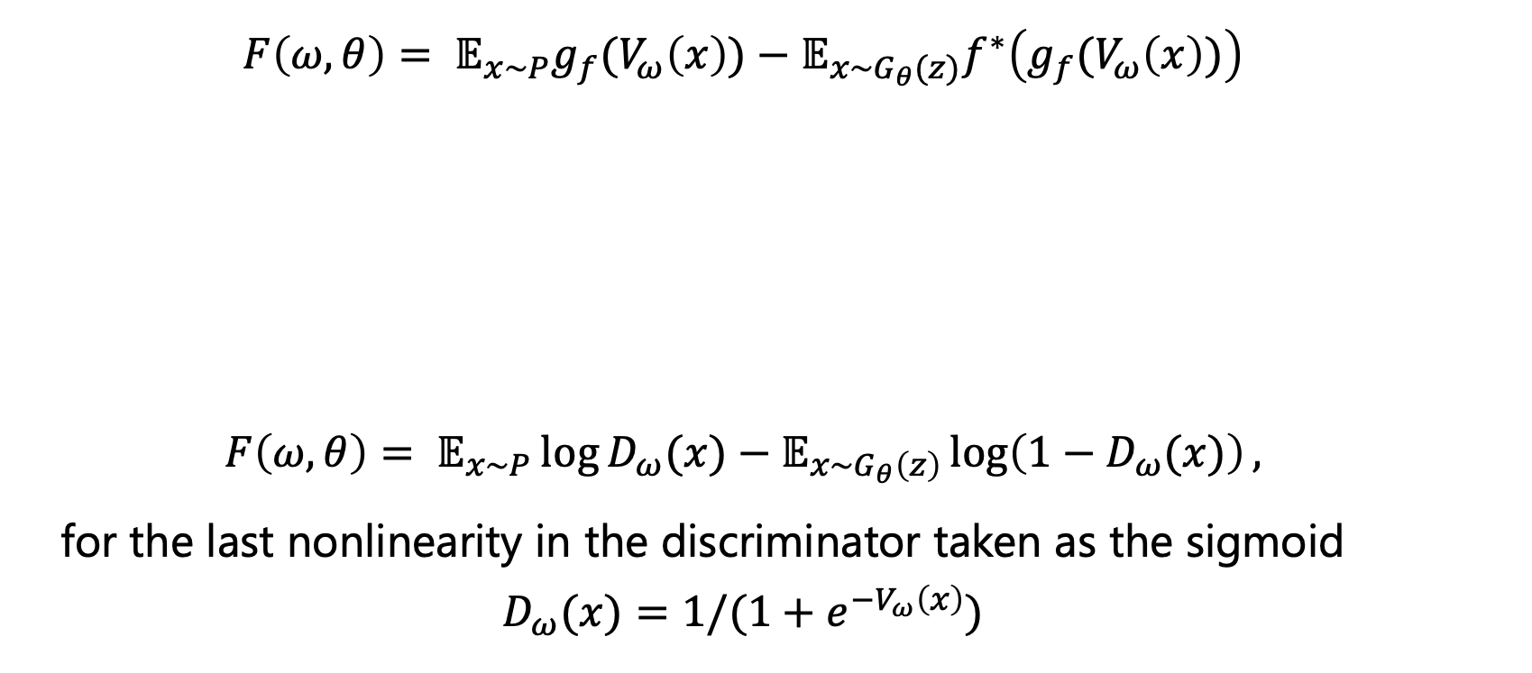
Example: GAN objective
$$F\left(ω,θ\right)= 𝔼_{x\sim P}{g_{f}(V}_{ω}\left(x\right))−𝔼_{x\sim G_{θ}(z)}f^{∗}\left(g_{f}(V_{ω}\left(x\right))\right)$$
$$F\left(ω,θ\right)= 𝔼_{x\sim P}\log{D_{ω}(x)}−𝔼_{x\sim G_{θ}\left(z\right)}\log\left(1−D_{ω}(x)\right),$$
for the last nonlinearity in the discriminator taken as the sigmoid
$$D_{ω}(x)=1/(1+e^{−V_{ω}\left(x\right)})$$
$$g_{GAN}=−\log{(1+\exp\left(−v\right))}$$
$$f^{∗}(t)=− log⁡(1 − exp⁡(t))$$

Slide 12
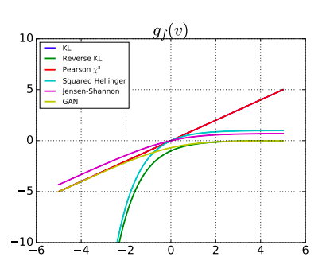
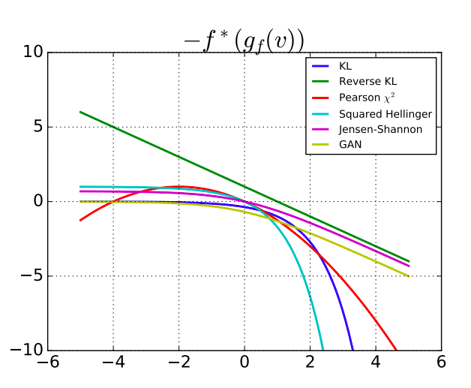
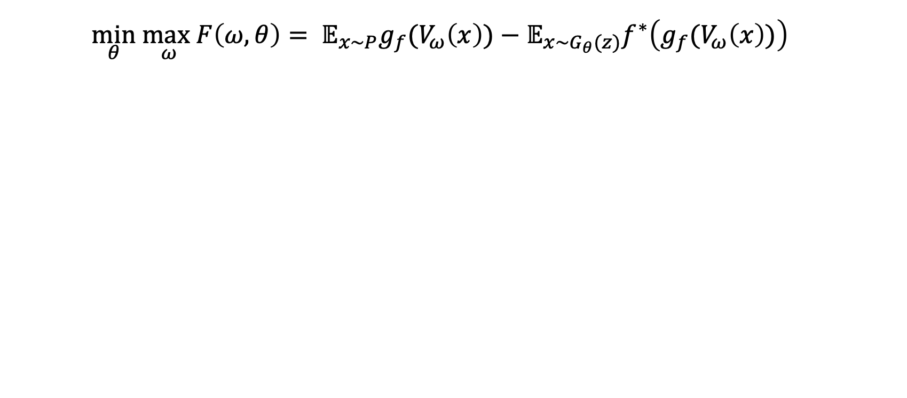
Variational Divergence Minimization
$$\min_{θ} \max_{ω}F\left(ω,θ\right)= 𝔼_{x\sim P}{g_{f}(V}_{ω}\left(x\right))−𝔼_{x\sim G_{θ}(z)}f^{∗}\left(g_{f}(V_{ω}\left(x\right))\right)$$

Slide 13
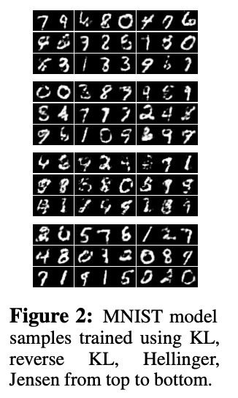
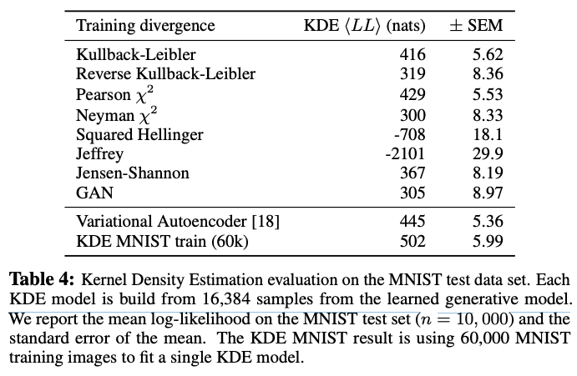
$f$-GAN results

Slide 14
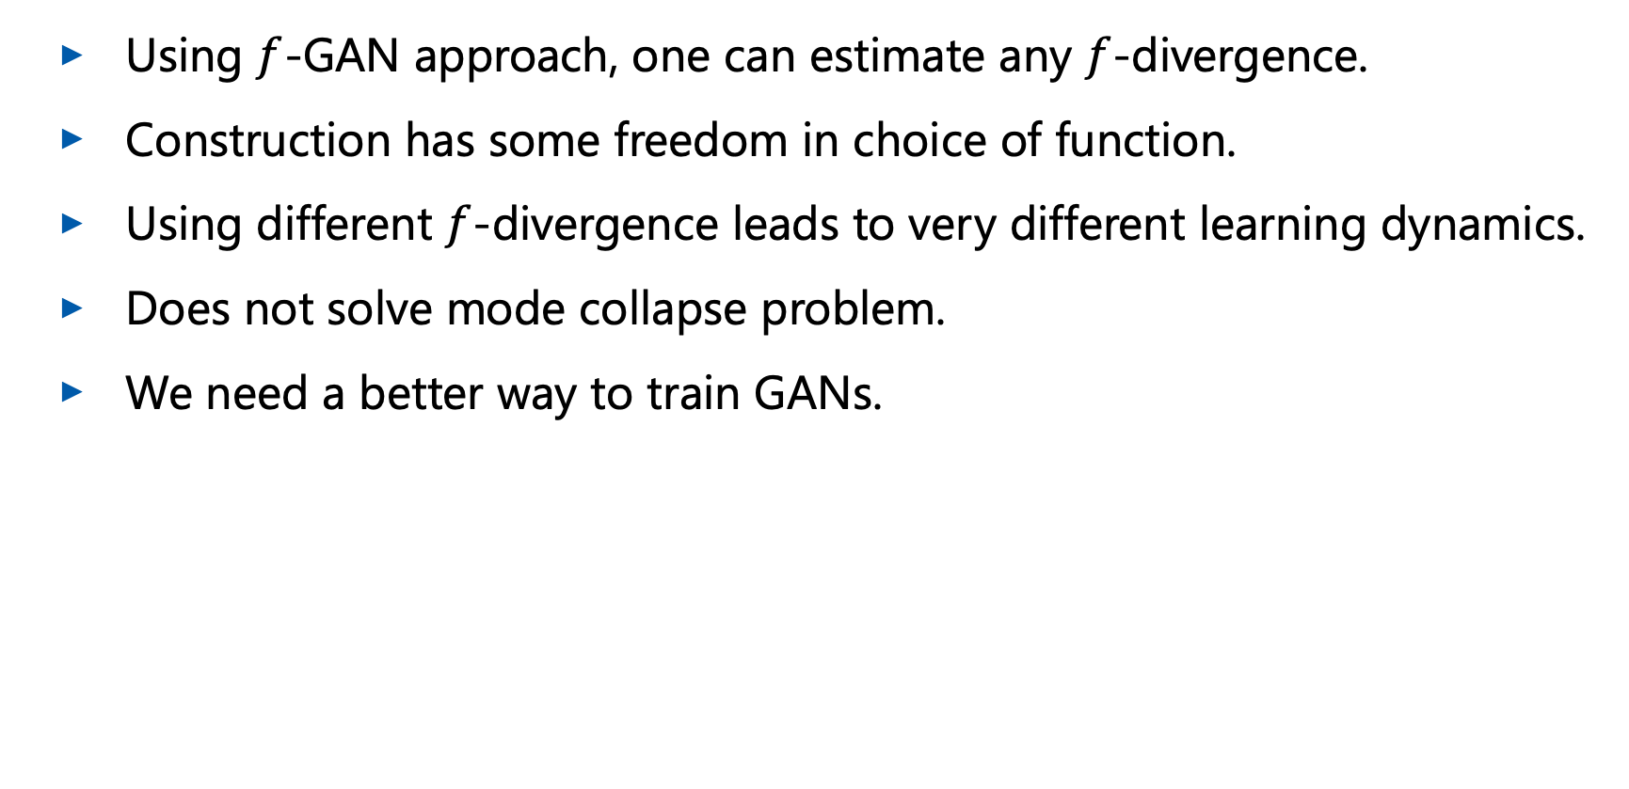
$f$-GAN Discussion
Using $f$-GAN approach, one can estimate any $f$-divergence.
Construction has some freedom in choice of function.
Using different $f$-divergence leads to very different learning dynamics.
Does not solve mode collapse problem.
We need a better way to train GANs.

Slide 15
Parisian Bakeries

Slide 16
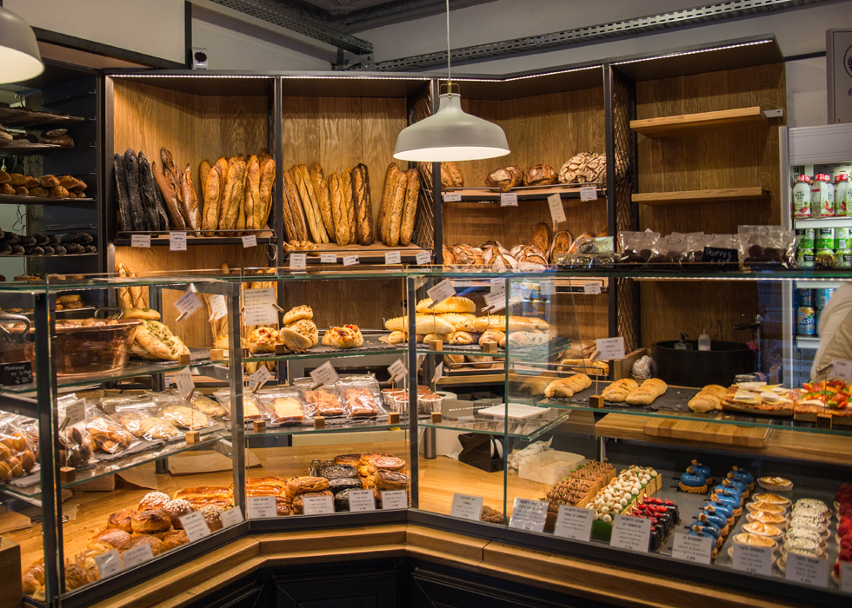

Problem Statement

Slide 17
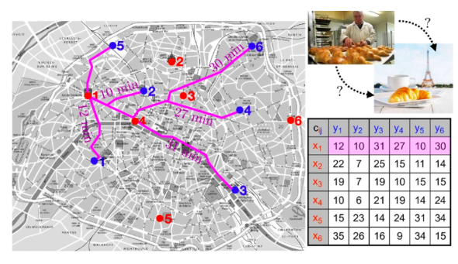



Delivery Optimization
given a set of $N$ bakeries and $M$ cafes, what is the optimal way to transport loaves of bread between them?
G. Peyre web-site

Slide 18
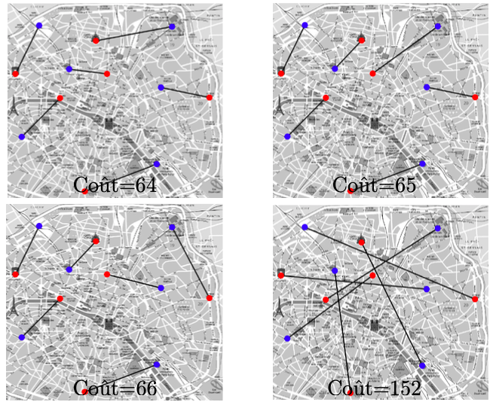
Delivery Solutions
We can estimate different possibilities, using the same matrix of costs.

Slide 19
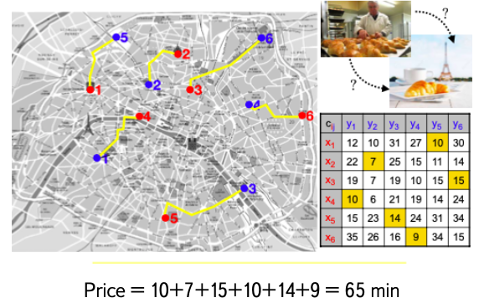
Optimal Delivery

Slide 20
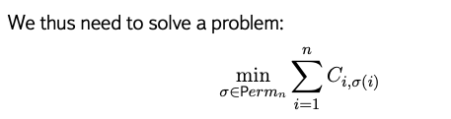
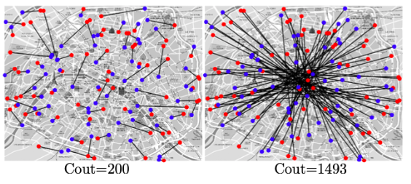


Problem Statement: Monge
The number of calculations rises as factorial.

Slide 21
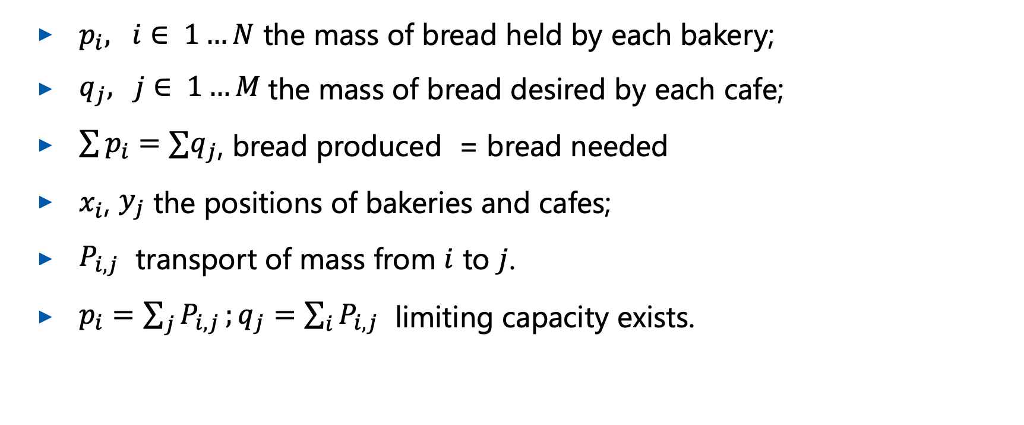
Kantorovich: Add Bread Masses
$p_{i}, i∈ 1…N$ the mass of bread held by each bakery;
$q_{j}, j∈ 1…M$the mass of bread desired by each cafe;
$\sum{p_{i}=∑q_{j}}$, bread produced = bread needed
$x_{i}$, $y_{j}$ the positions of bakeries and cafes;
$P_{i,j}$ transport of mass from $i$ to $j$.
$p_{i}=\sum_{j}{P_{i,j}};q_{j}=\sum_{i}{P_{i,j}}$ limiting capacity exists.

Slide 22

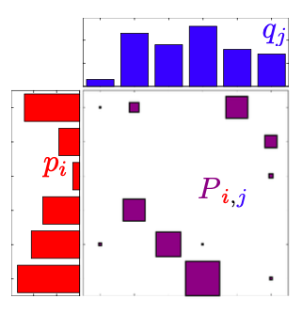
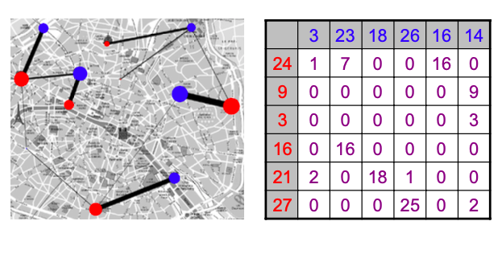
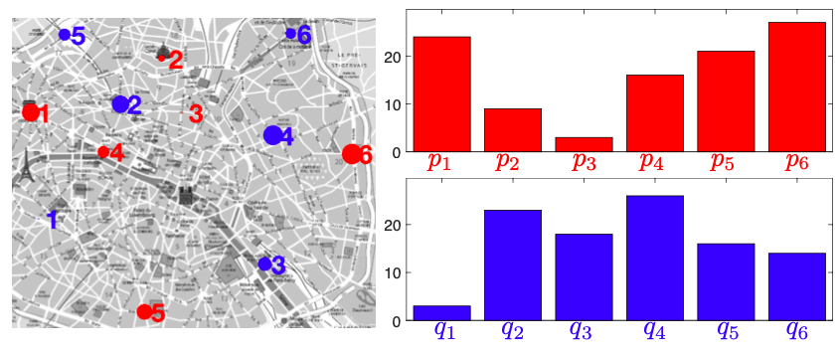



Paris deliveries
Deliver the bread to the café, which needs it
Optimal plan for minimal efforts needed.

Slide 23
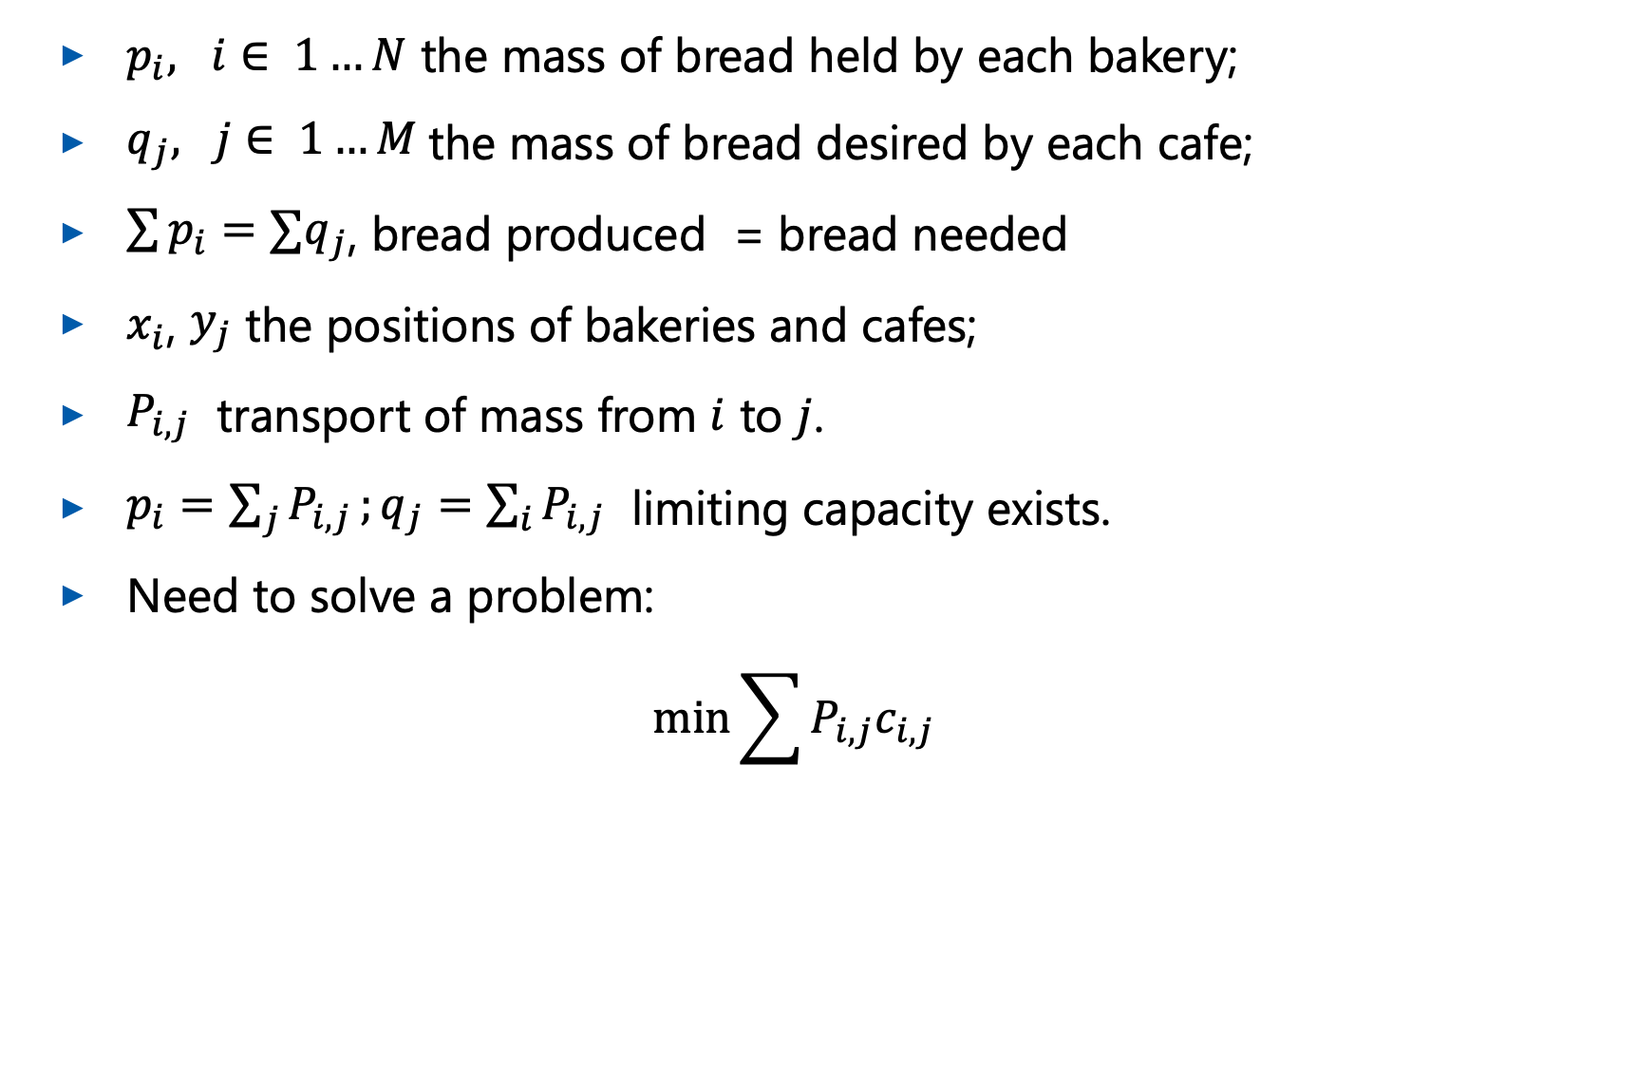

Kantorovich: Add Bread Masses
$p_{i}, i∈ 1…N$ the mass of bread held by each bakery;
$q_{j}, j∈ 1…M$the mass of bread desired by each cafe;
$\sum{p_{i}=∑q_{j}}$, bread produced = bread needed
$x_{i}$, $y_{j}$ the positions of bakeries and cafes;
$P_{i,j}$ transport of mass from $i$ to $j$.
$p_{i}=\sum_{j}{P_{i,j}};q_{j}=\sum_{i}{P_{i,j}}$ limiting capacity exists.
Need to solve a problem:
$$\min{\sum{P_{i,j}c_{i,j}}}$$

Slide 24
Wasserstein Distance

Slide 25
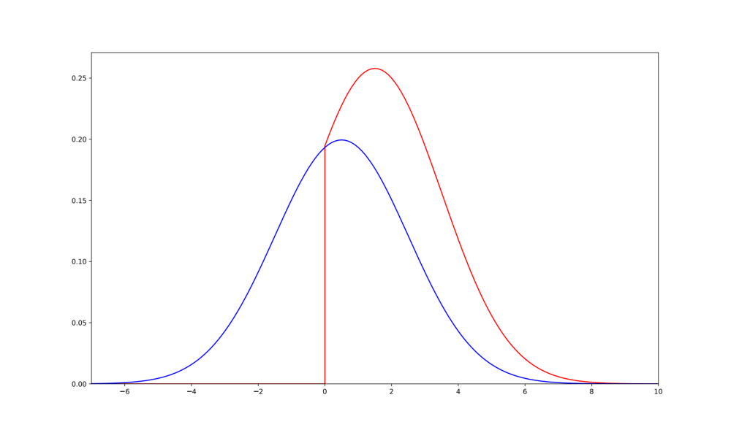
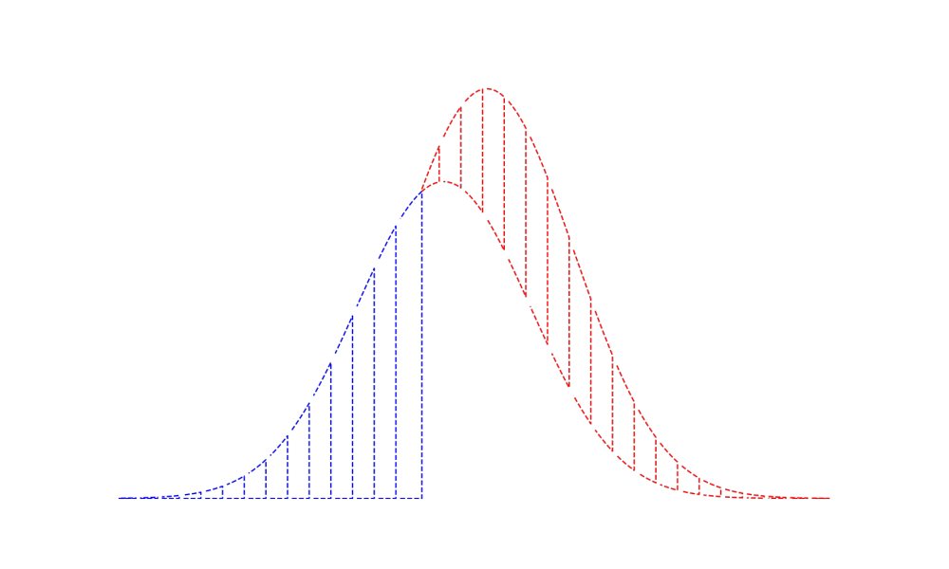


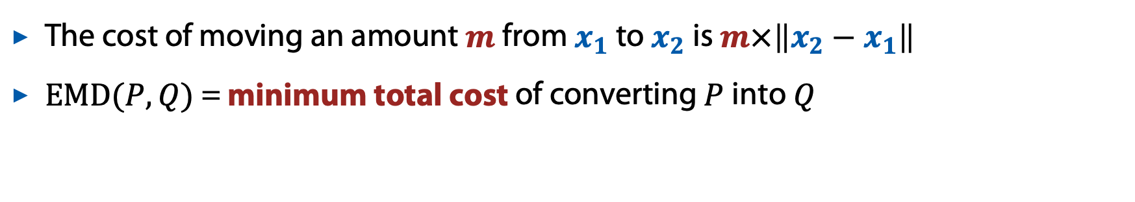
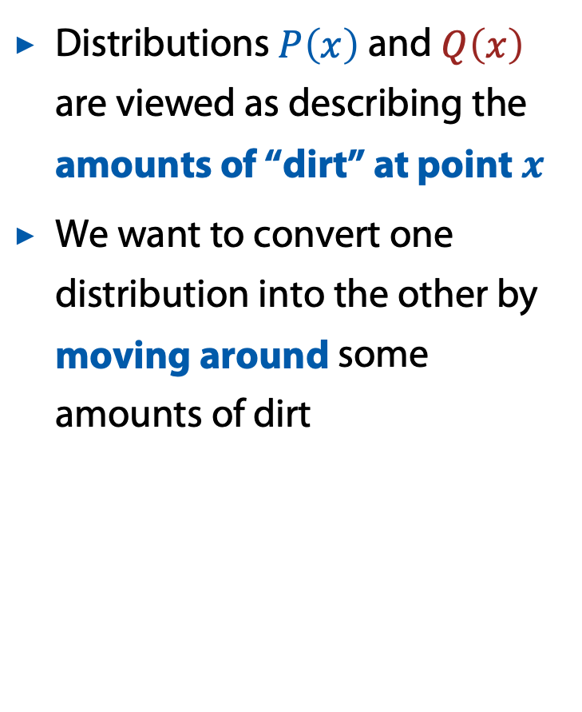

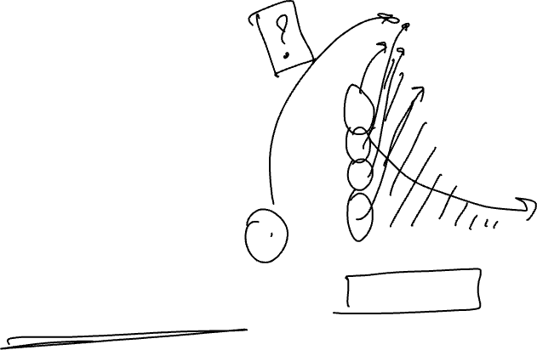
Wasserstein distance
Also called “Earth mover’s distance” (EMD)
Distributions $P\left(x\right)$ and $Q\left(x\right)$ are viewed as describing the amounts of “dirt” at point $x$
We want to convert one distribution into the other by moving around some amounts of dirt
The cost of moving an amount $m$ from $x_{1}$ to $x_{2}$ is $m×\left\|x_{2}−x_{1}\right\|$
$EMD(P,Q)$ = minimum total cost of converting $P$ into $Q$

Slide 26
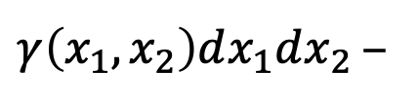
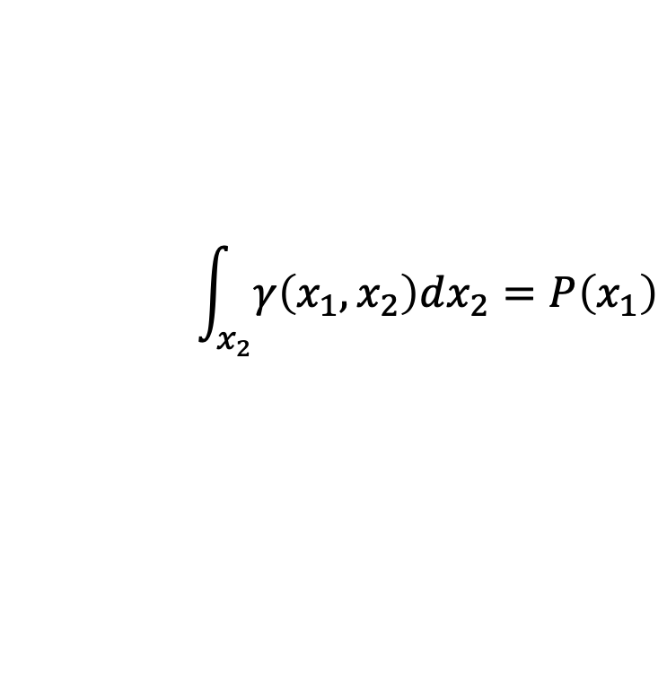
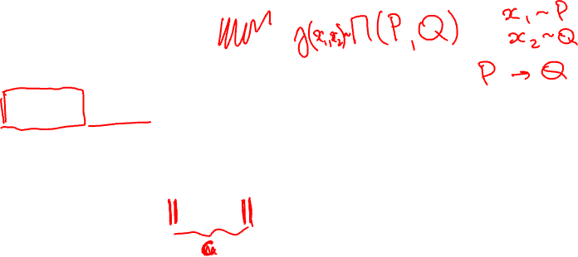
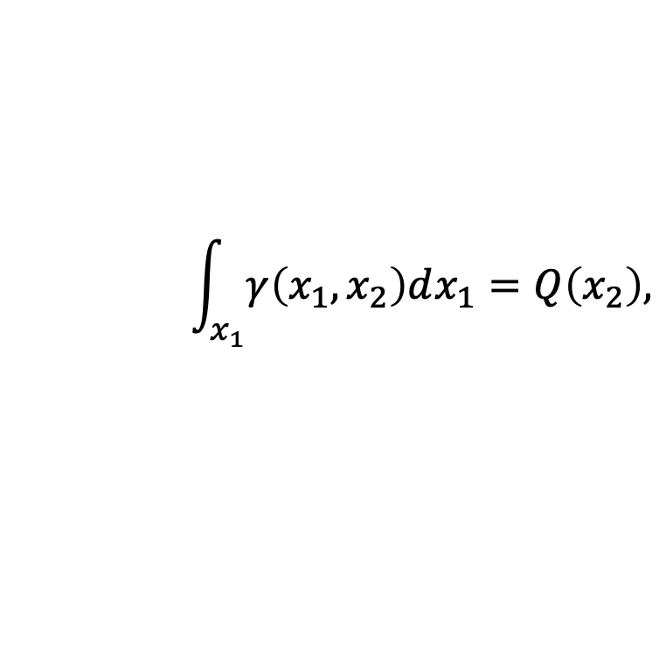
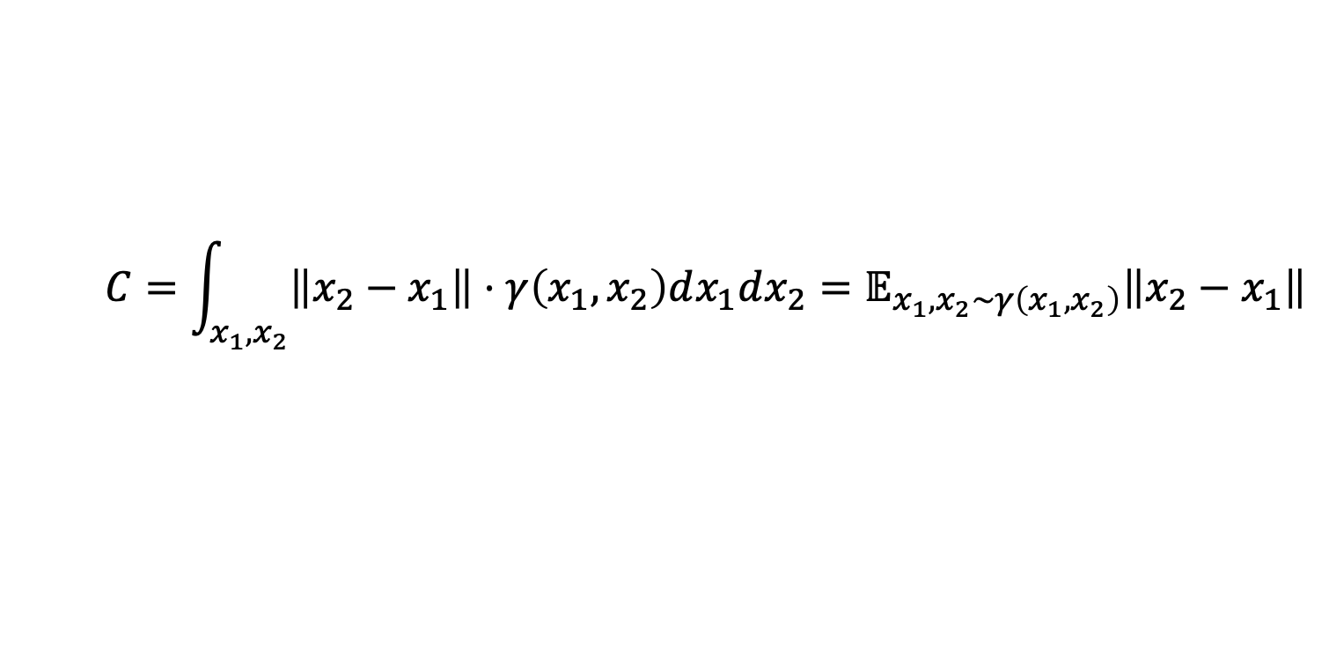
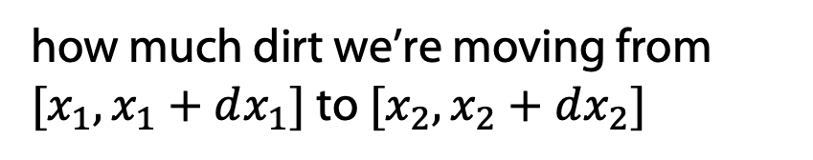

Idea of definition
Say, we have a moving plan $γ\left(x_{1},x_{2}\right)≥0$:
$γ\left(x_{1},x_{2}\right)dx_{1}dx_{2}$ –
how much dirt we’re moving from $[x_{1},x_{1}+dx_{1}]$ to $[x_{2},x_{2}+dx_{2}]$
Then, the cost of moving from $[x_{1},x_{1}+dx_{1}]$ to $[x_{2},x_{2}+dx_{2}]$is:
$$\left\|x_{2}−x_{1}\right\|⋅γ\left(x_{1},x_{2}\right)dx_{1}dx_{2}$$
and the total cost is:
$$C=\int_{x_{1},x_{2}}{\left\|x_{2}−x_{1}\right\|⋅γ\left(x_{1},x_{2}\right)dx_{1}dx_{2}}=𝔼_{x_{1},x_{2}∼γ\left(x_{1},x_{2}\right)}\left\|x_{2}−x_{1}\right\|$$
Since we want to convert $P$ to $Q$, the plan has to satisfy:
$$\int_{x_{1}}{γ\left(x_{1},x_{2}\right)dx_{1}}=Q\left(x_{2}\right),$$
$$\int_{x_{2}}{γ\left(x_{1},x_{2}\right)dx_{2}}=P\left(x_{1}\right)$$

Slide 27
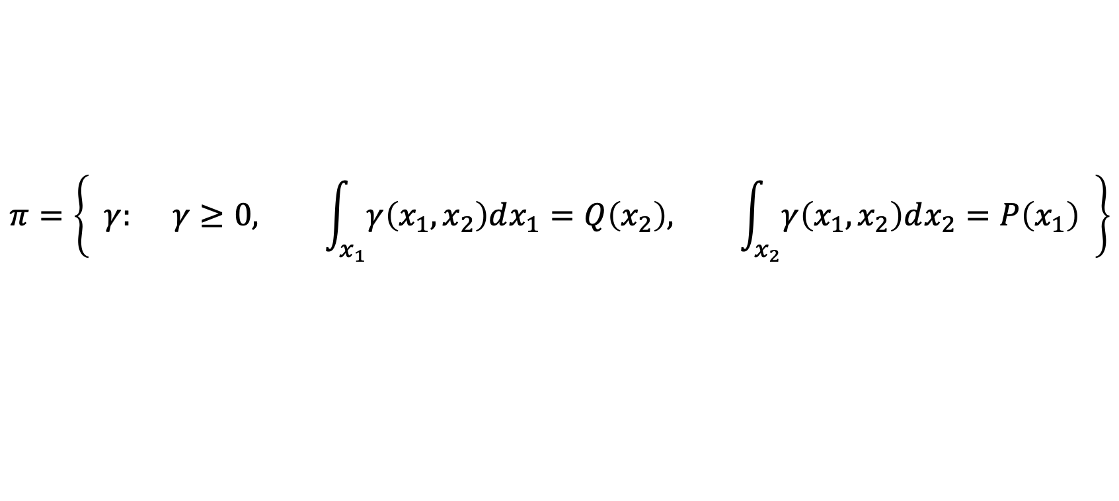

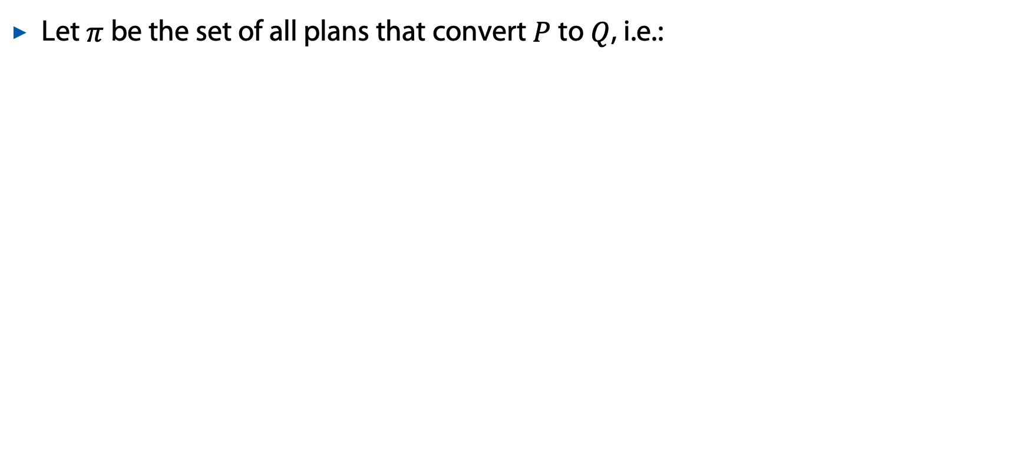
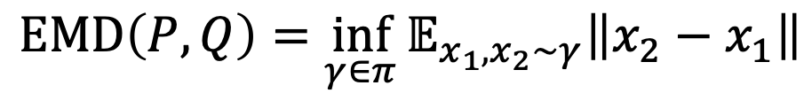

Idea of Definition
Let $π$ be the set of all plans that convert $P$ to $Q$, i.e.:
$$π=\left\{ γ: γ≥0, \int_{x_{1}}{γ\left(x_{1},x_{2}\right)dx_{1}}=Q\left(x_{2}\right), \int_{x_{2}}{γ\left(x_{1},x_{2}\right)dx_{2}}=P\left(x_{1}\right) \right\}$$
Then, the Wasserstein distance between $P$ and $Q$ is:
$$EMD\left(P,Q\right)=\inf_{γ∈π}{𝔼_{x_{1},x_{2}∼γ}\left\|x_{2}−x_{1}\right\|}$$
Optimization over all transport plans – not too friendly

Slide 28
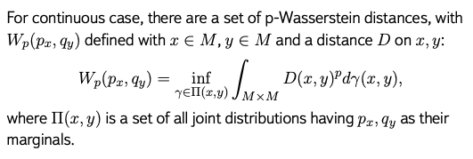
Wasserstein Distance

Slide 29
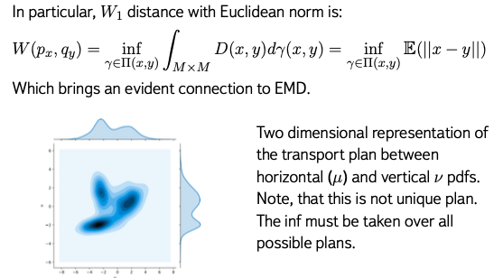
$W_{1}$distance
Wikimedia

Slide 30
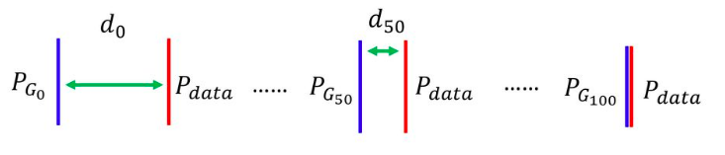
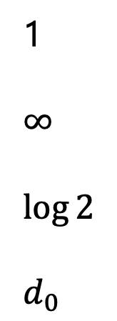
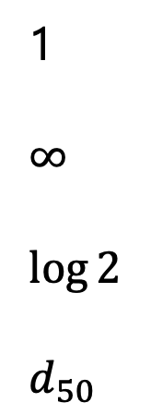
Convergence Example
TV:
KL:
JS:
W:
1
$$∞$$
$$\log{2}$$
$$d_{0}$$
1
$$∞$$
$$\log{2}$$
$$d_{50}$$
0
0
0
0

Slide 31
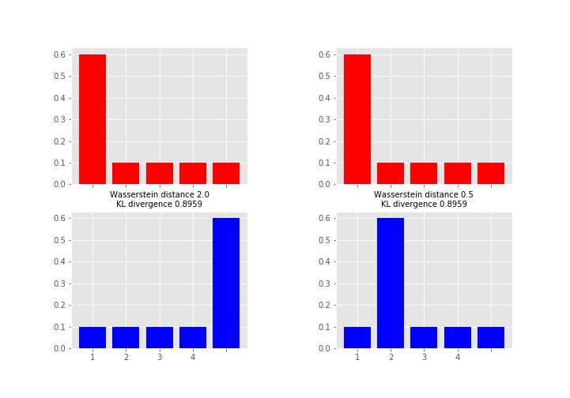
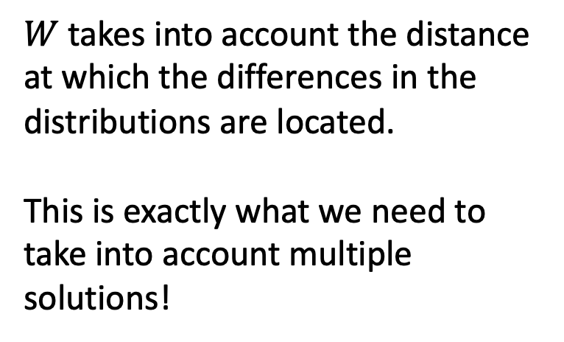
Mass Attention
$W$ takes into account the distance at which the differences in the distributions are located.
This is exactly what we need to take into account multiple solutions!
Wikimedia

Slide 32
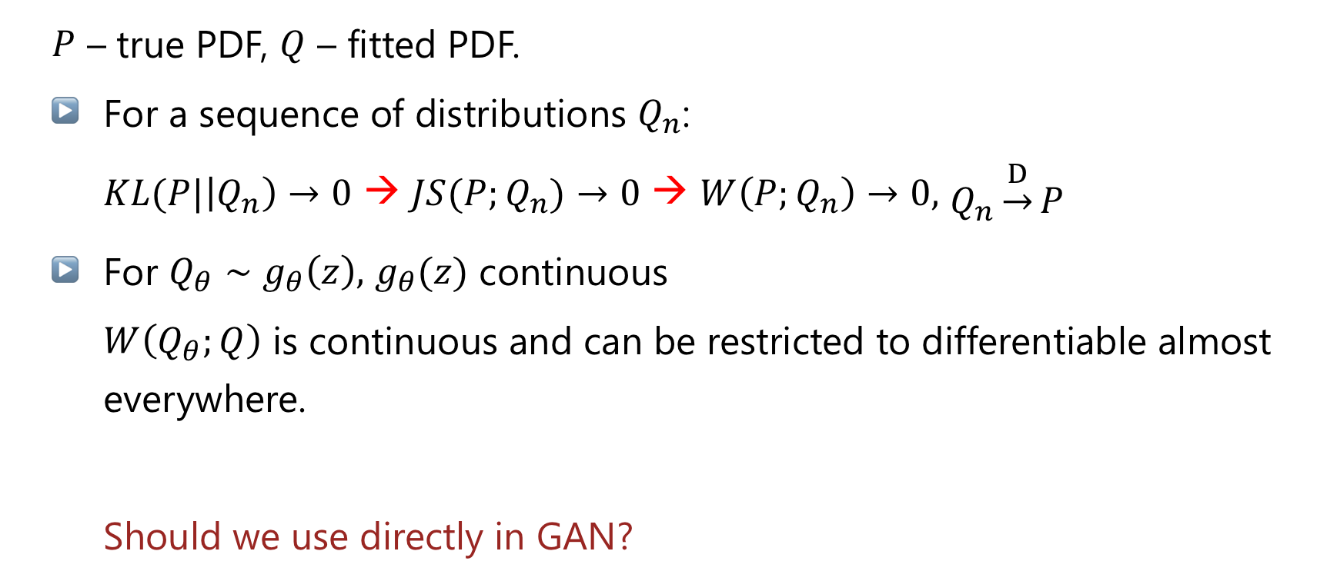
$W$ properties hints
$P$ – true PDF, $Q$ – fitted PDF.
For a sequence of distributions $Q_{n}$:
  $KL(P|\left|Q_{n}\right)→0$ → $JS(P;Q_{n})→0$ → $W\left(P;Q_{n}\right)→0,$ $Q_{n}\underset{→}{D}P$
For $Q_{θ}∼g_{θ}\left(z\right),$ $g_{θ}(z)$ continuous
  $W\left(Q_{θ};Q\right)$ is continuous and can be restricted to differentiable almost everywhere.
  Should we use directly in GAN?

Slide 33
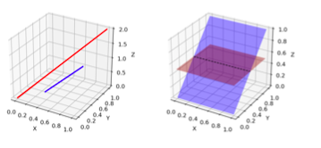




Reminder: Noisy Supports
Let’s make the problem harder: introduce random noise $ε∼N(0;σ^{2}I)$:
$$ℙ_{x+ε(x)} = 𝔼_{y∼P(x)}ℙ_{ε}(x − y).$$
This will make noisy supports, that makes it difficult for discriminator.
For $V=𝔼{|\left|ε\right||}^{2}$
$$W\left(P,Q\right)≤2\sqrt{V}+\sqrt{JS(P,Q)}.$$
We thus approximated $W$ with $JS$

Slide 34



Lipschitz continuity
$f$ is Lipschitz-k continuous if
there exists a constant $k≥0$, such that for all $x_{1}$ and $x_{2}$:
$$\left|f\left(x_{1}\right)−f\left(x_{2}\right)\right|≤k⋅\left\|x_{1}−x_{2}\right\|$$
img from https://en.wikipedia.org/wiki/Lipschitz_continuity

Slide 35

Kantorovich-Rubinstein Duality
$P$ – true PDF, $Q$ – fitted PDF.
$$W(P;Q)=\sup_{f∈Lip_{1}}\left(𝔼_{x∼P }f\left(x\right)−𝔼_{x∼Q}f(x)\right),$$
where $Lip_{1}$ is 1-Lipshitz condition.

Slide 36

Back to Bakeries

Slide 37

Integral Probability Metrics
$p\left(x\right), q(x)$ – PDF.
$$γ_{ℱ}\left(P,Q\right)=\sup\left\{\left|\int{f}dp\left(x\right)−\int{f}dq\left(x\right)\right|:f∈ℱ\right\}$$
$ℱ$ is a class of real-valued bounded measurable functions on $S$.
For $ℱ=\left\{f:\right| \left|f\right|{\left.​\right|}_{L}≤1 \},$ with 1-Lipschitz condition:
$W_{1}$is IPM but not $f$-divergence
B. Sriperumbudur et al. On the empirical estimation of integral probability metrics
S. Nowozin, NIPS2016 workshop talk

Slide 38

Conclusions
Wasserstein-1 is a distance with desired properties.
Kantorovich-Rubinstein duality connects Wasserstein-1 distance to IPM.
Lipschitzeness is needed for above to work.
Wasserstein-1 distance cannot directly be inserted into $f$-GAN style*.
*J. Song et al., Bridging the Gap Between f-GANs and Wasserstein GANs, ICML 2020

Slide 39
Wasserstein GAN

Slide 40






Lipschitz-1 Condition and Neural Networks
$$W(P;Q)=\sup_{f∈Lip_{1}}\left(𝔼_{x∼P }f\left(x\right)−𝔼_{x∼Q}f(x)\right),$$

Slide 41


Lipschitz-1 Condition and Neural Networks
$$W(P;Q)=\sup_{f∈Lip_{1}}\left(𝔼_{x∼P }f\left(x\right)−𝔼_{x∼Q}f(x)\right),$$
$f$ is a neural net – discriminator (‘critic’ in the original paper).
The expectations is estimated from samples.
Lipschitz-1 continuity can be replaced with Lipschitz-k continuity
  estimate $k×W(P,Q)$
  achieved by clipping the weights of the critic: $w→clip(w, −c, c)$ with some constant $c$.
M. Arjovsky et al. Wasserstein GAN

Slide 42

WGAN

Slide 43

WGAN: problems solved
the vanishing gradient problem is solved;
mode collapse problem is addressed;
From authors: Weight clipping is a clearly terrible way to enforce a Lipschitz constraint. :
https://arxiv.org/abs/1701.07875

Slide 44

WGAN: results

Slide 45





WGAN-GP
Weight clipping makes the critic less expressive and the training harder to converge
Optimal $f$ should satisfy $\left\|∇f\right\|=1$ almost everywhere under $P$ and $Q$
Also: ${\left\|f\right\|}_{L}≤1 ⟺ \left\|∇f\right\|≤1$
Can replace weight clipping with a gradient penalty term:
Largest gradient constrained here
$$ℙ_{\tilde{x}} : \left[\begin{matrix}\tilde{x}=αx_{1}+\left(1−α\right)x_{2} \\ α∼Uniform\left(0, 1\right) \\ x_{1}∼P \\ x_{2}∼Q\end{matrix}\right]$$
$$GP=λ\int{\max\left[{\left(\left\|∇_{\tilde{x}}f\left(\tilde{x}\right)\right\|−1\right)}^{2}\right]}dx$$
$$GP=λ𝔼_{\tilde{x}∼ℙ_{\tilde{x}}}\left[{\left(\left\|∇_{\tilde{x}}f\left(\tilde{x}\right)\right\|−1\right)}^{2}\right]$$
Ishaan GulrajaniImproved Training of Wasserstein GANs

Slide 46


WGAN-GP
Weight clipping makes the critic less expressive and the training harder to converge
Optimal $f$ should satisfy $\left\|∇f\right\|=1$ almost everywhere under $P$ and $Q$
Also: ${\left\|f\right\|}_{L}≤1 ⟺ \left\|∇f\right\|≤1$
Can replace weight clipping with a gradient penalty term:
$$ℙ_{\tilde{x}} : \left[\begin{matrix}\tilde{x}=αx_{1}+\left(1−α\right)x_{2} \\ α∼Uniform\left(0, 1\right) \\ x_{1}∼P \\ x_{2}∼Q\end{matrix}\right]$$
$$GP=λ𝔼_{\tilde{x}∼ℙ_{\tilde{x}}}\left[{\left(\left\|∇_{\tilde{x}}f\left(\tilde{x}\right)\right\|−1\right)}^{2}\right]$$
or alternatively (‘one-sided’ penalty):
$$GP=λ𝔼_{\tilde{x}∼ℙ_{\tilde{x}}}\left[{\max\left(0, \left\|∇_{\tilde{x}}f\left(\tilde{x}\right)\right\|−1\right)}^{2}\right]$$
Ishaan GulrajaniImproved Training of Wasserstein GANs

Slide 47


WGAN: spectral normalization
Miyato et al. Spectral Normalization for Generative Adversarial Networks, ICLR 2018

Slide 48

WGAN: problems
M. Bellemare et al. The Cramer Distance as a Solution to Biased Wasserstein Gradients

Slide 49
Conclusions
WGAN is a power generative model.
Simpler training procedure but need to control Lipschitz continuity
Several ideas how do this.
Still problems:
  Kantorovich-Rubinstein duality only mimicked;
  gradient is stuck near solutions.

