Slide 1


Generative Modeling
Variational Autoencoders
Denis Derkach, Tigran Ramazyan, Anwar Ibrahim, Fedor Pakhurov
Laboratory for methods of big data analysis
Fall 2025

Slide 2
Today’s quiz

Slide 3
In this Lecture
Autoencoders.
Gaussian Mixture Models.
Variational Autoencoders:
  Construction.
  ELBO.
  Problems.

Slide 4
Idea

Slide 5
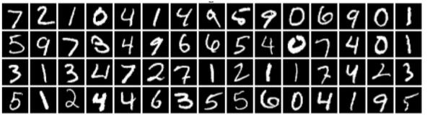
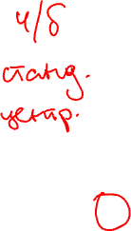
Latent variables - MNIST
What is common in these images? How can they be characterized?

Slide 6
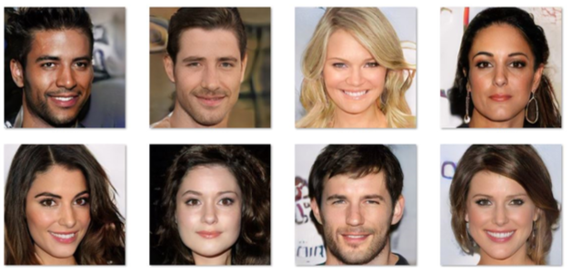
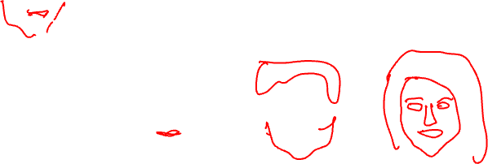
Latent Variables - Celeb
Variability due to eye and hair color, gender, race. However, unless
images are annotated, these factors of variation are not explicitly
available (latent).

Slide 7
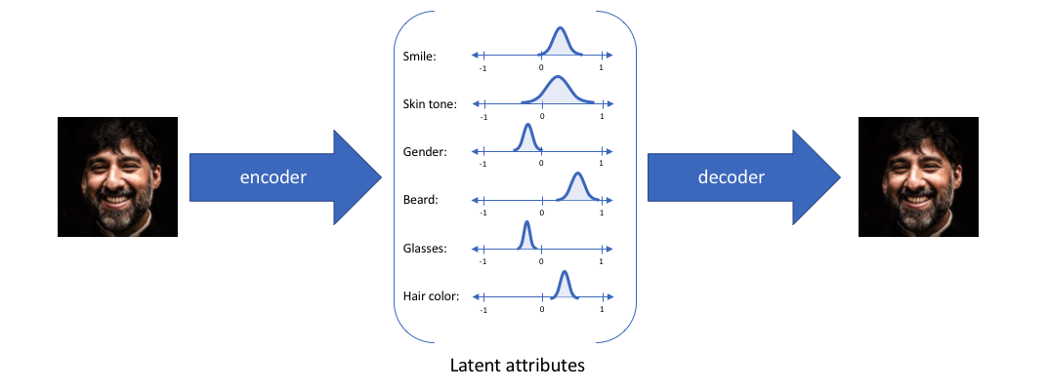
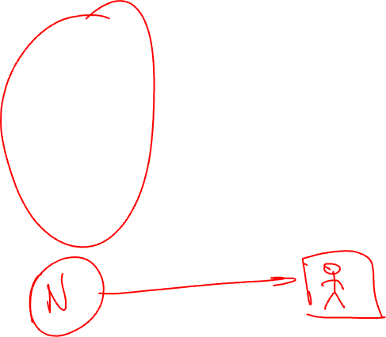
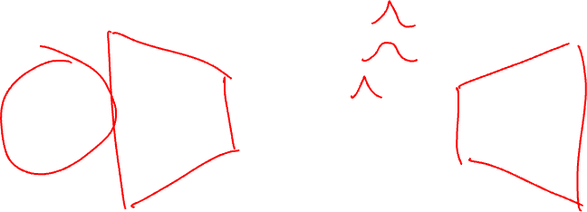
Latent Variables - Celeb
Variability due to eye and hair color, gender, race. However, unless
images are annotated, these factors of variation are not explicitly
available (latent).

Slide 8
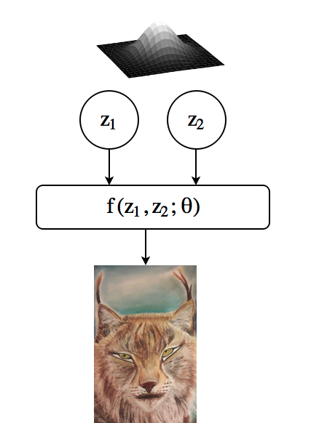
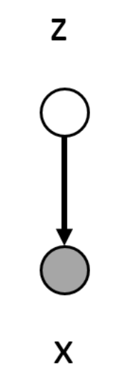

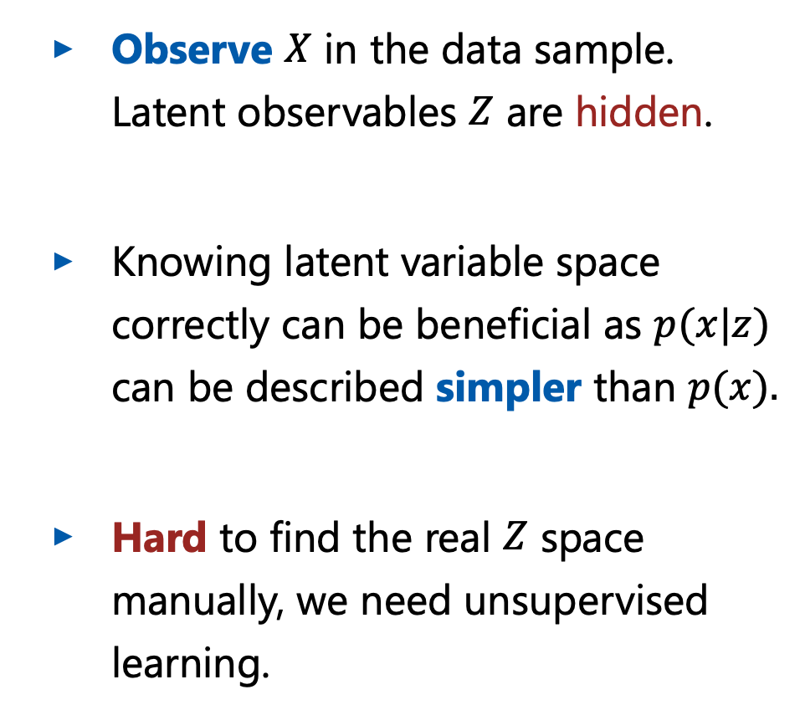
Latent Variable Models: Motivation
Observe $X$ in the data sample. Latent observables $Z$ are hidden.
Knowing latent variable space correctly can be beneficial as $p(x|z)$ can be described simpler than $p(x).$
Hard to find the real $Z$ space manually, we need unsupervised learning.

Slide 9
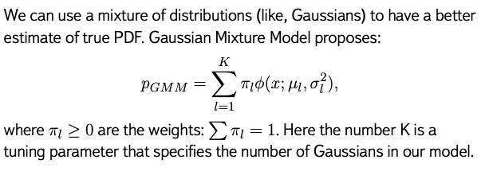

Gaussian Mixture Model

Slide 10
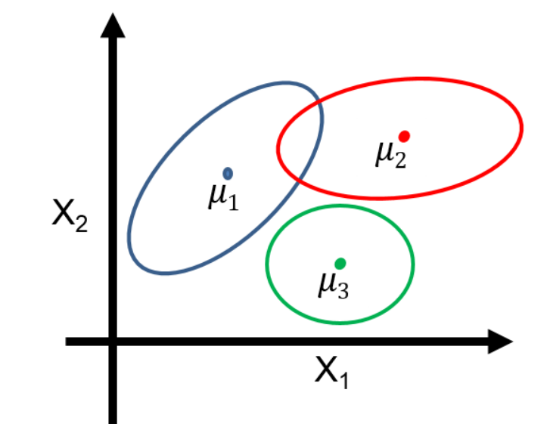
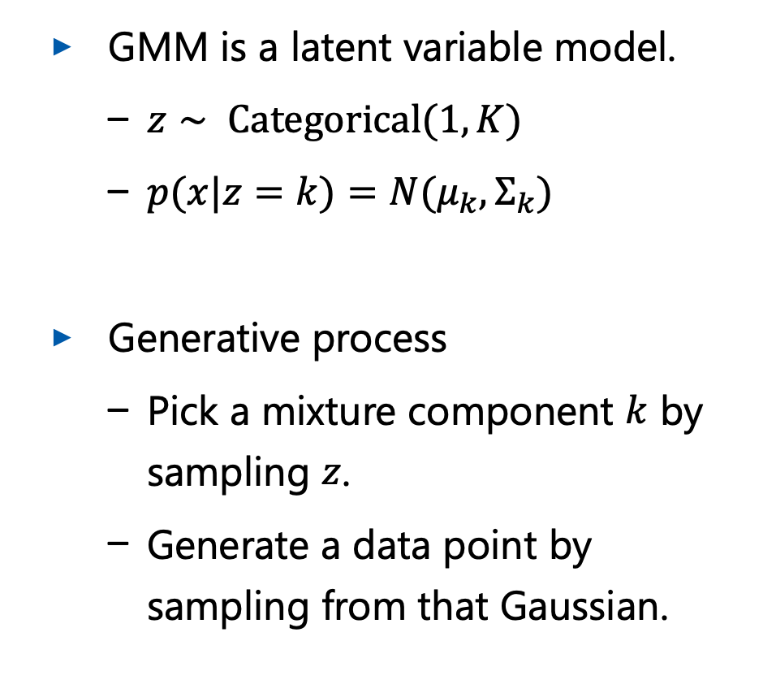
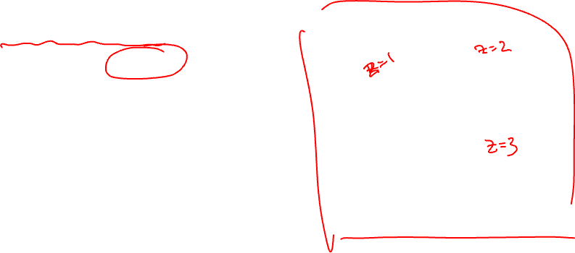
Mixture of Gaussians as Latent Variable Model
GMM is a latent variable model.
  $z∼ Categorical(1, K)$
  $p(x|z=k)=N(μ_{k},Σ_{k})$
Generative process
  Pick a mixture component $k$ by sampling $z$.
  Generate a data point by sampling from that Gaussian.

Slide 11
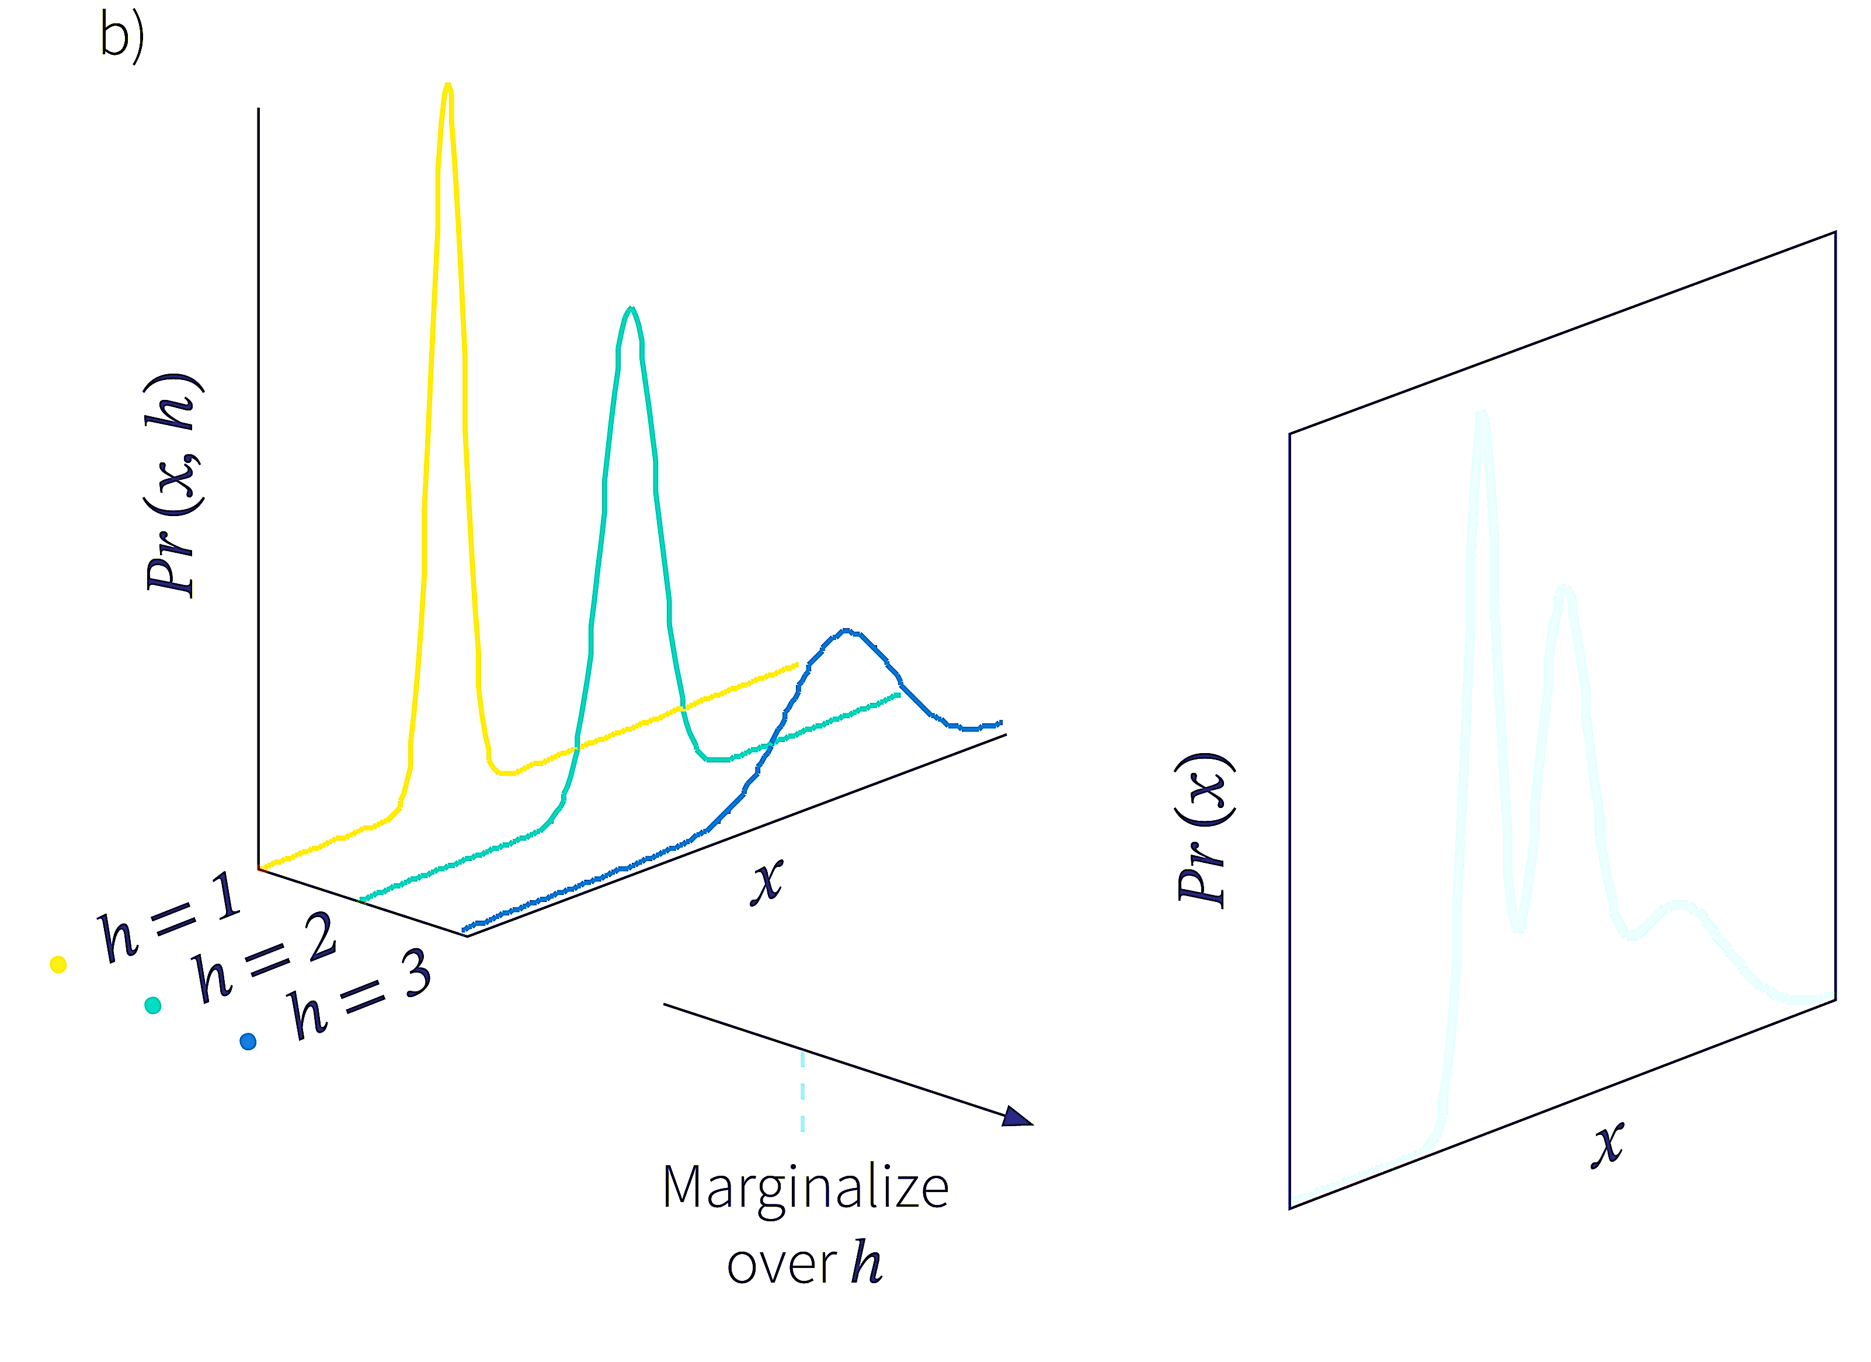
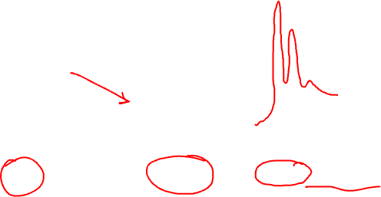
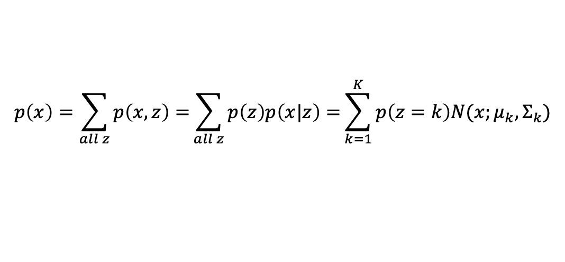
Combination of $p(x)$
Combine simple models into a more complex and expressive one.
Obtain PDF using simple formula.
$$p\left(x\right)=\sum_{all z}{p\left(x,z\right)=}\sum_{all z}{p\left(z\right)p\left(x|z\right)=}\sum_{k=1}^{K}{p\left(z=k\right)N(x;μ_{k},Σ_{k})}$$

Slide 12
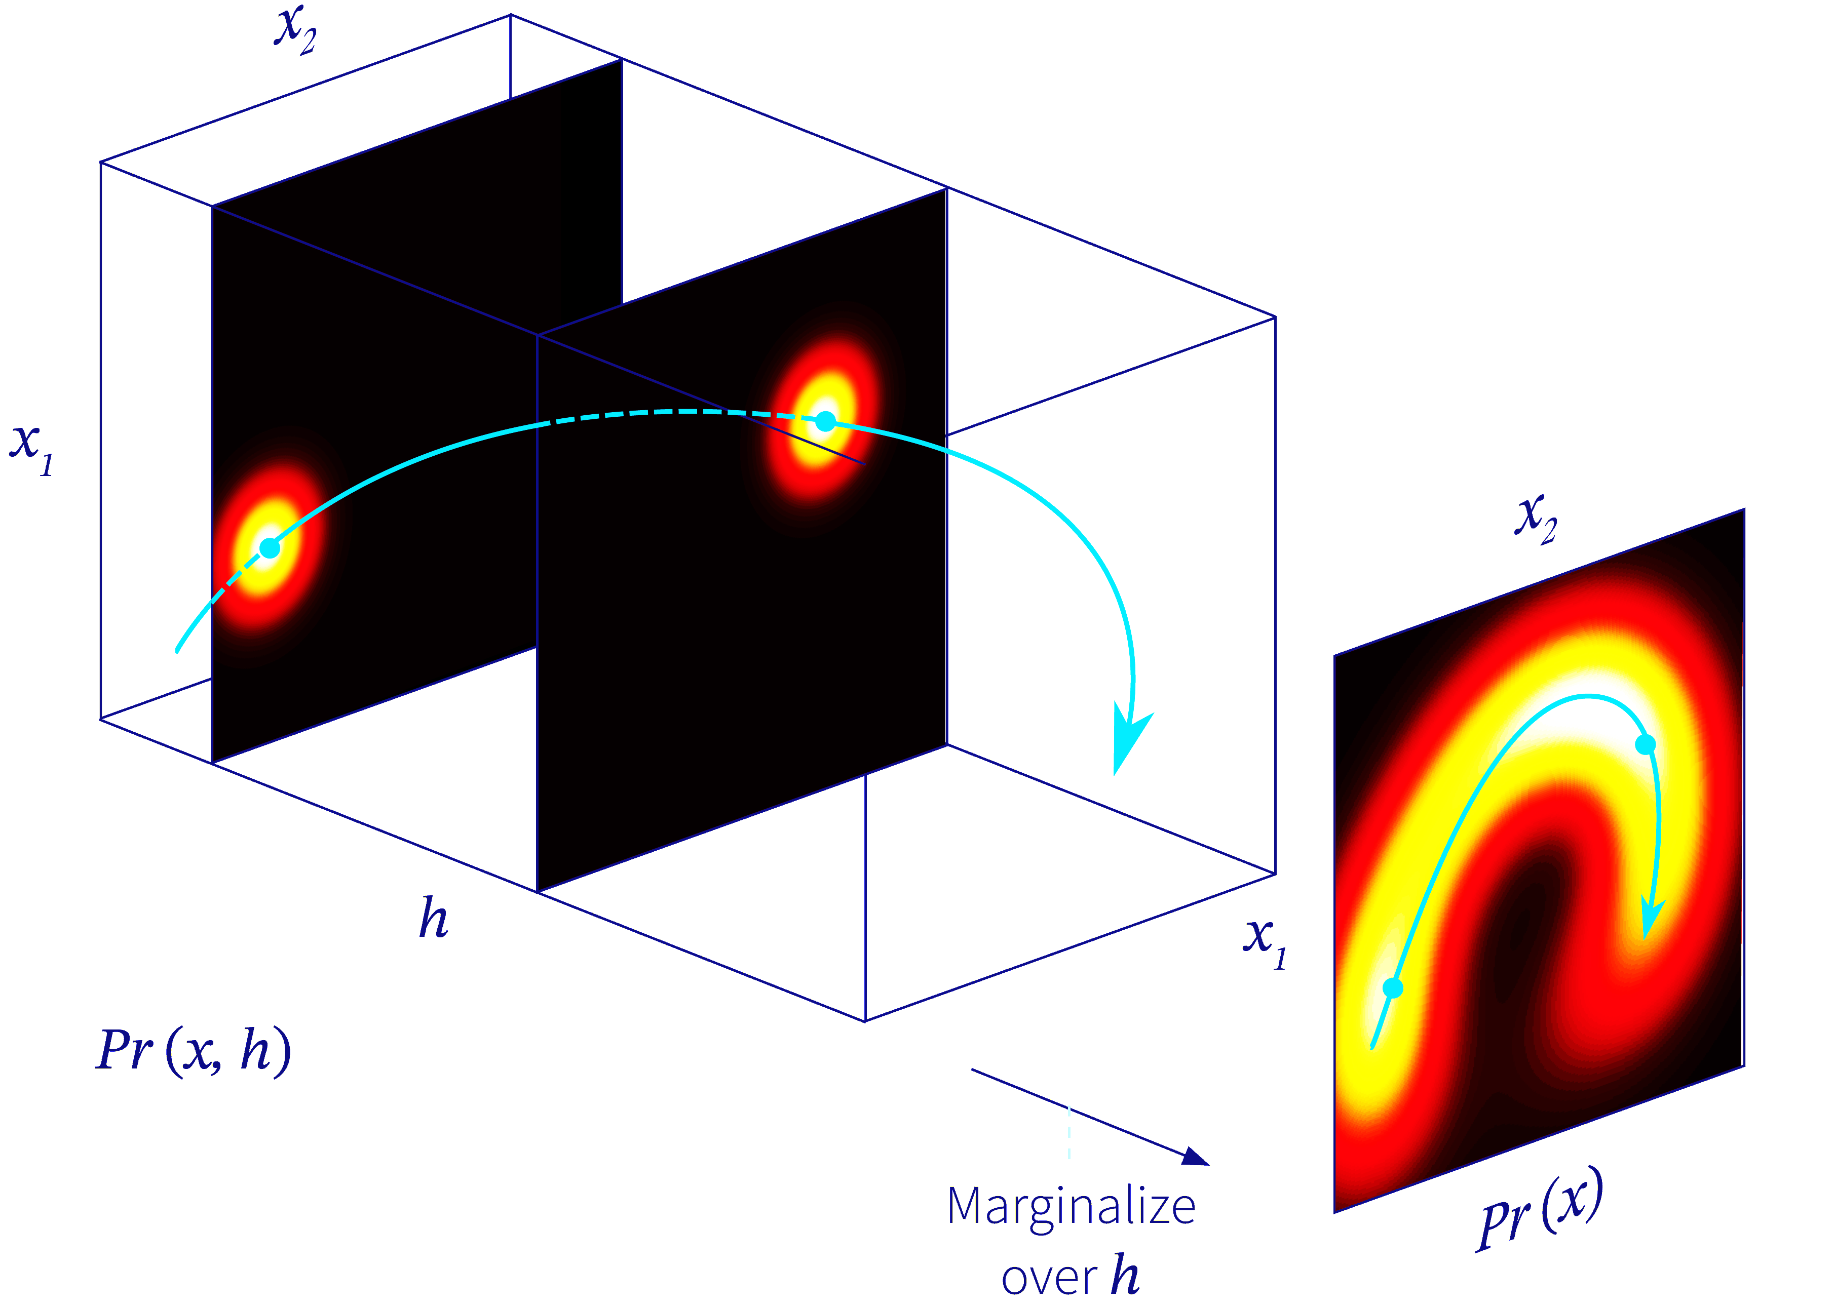
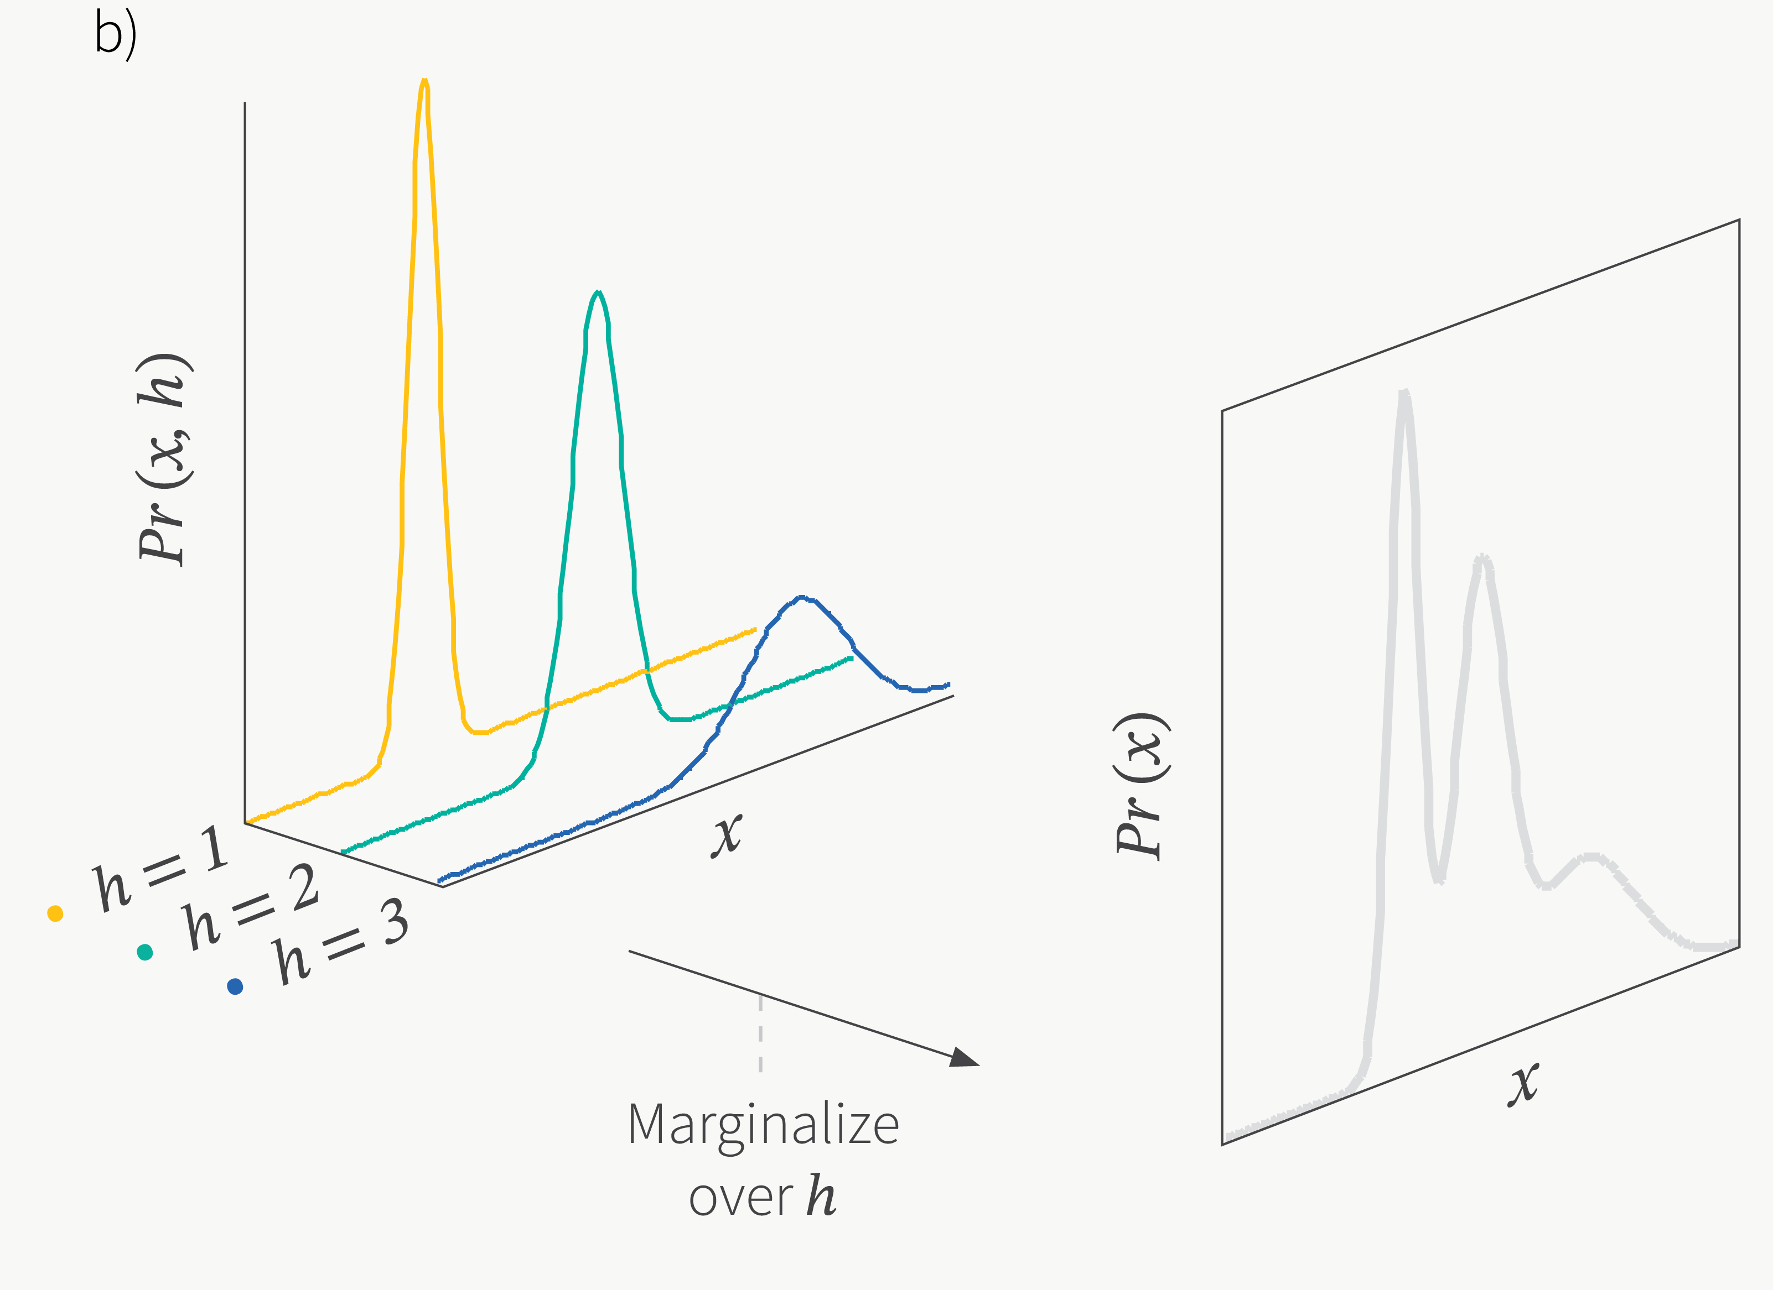

















Combination of $p(x)$
Combine simple models into a more complex and expressive one.
Obtain PDF using simple formula.
What if we have a continuous observable?
$$p\left(x\right)=\sum_{all z}{p\left(x,z\right)=}\sum_{all z}{p\left(z\right)p\left(x|z\right)=}\sum_{k=1}^{K}{p\left(z=k\right)N(x;μ_{k},Σ_{k})}$$

Slide 13
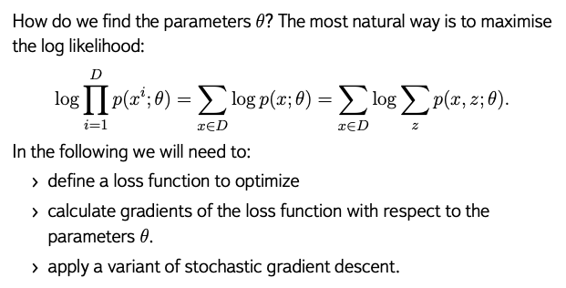


Finding parameters $θ$

Slide 14
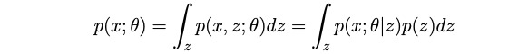

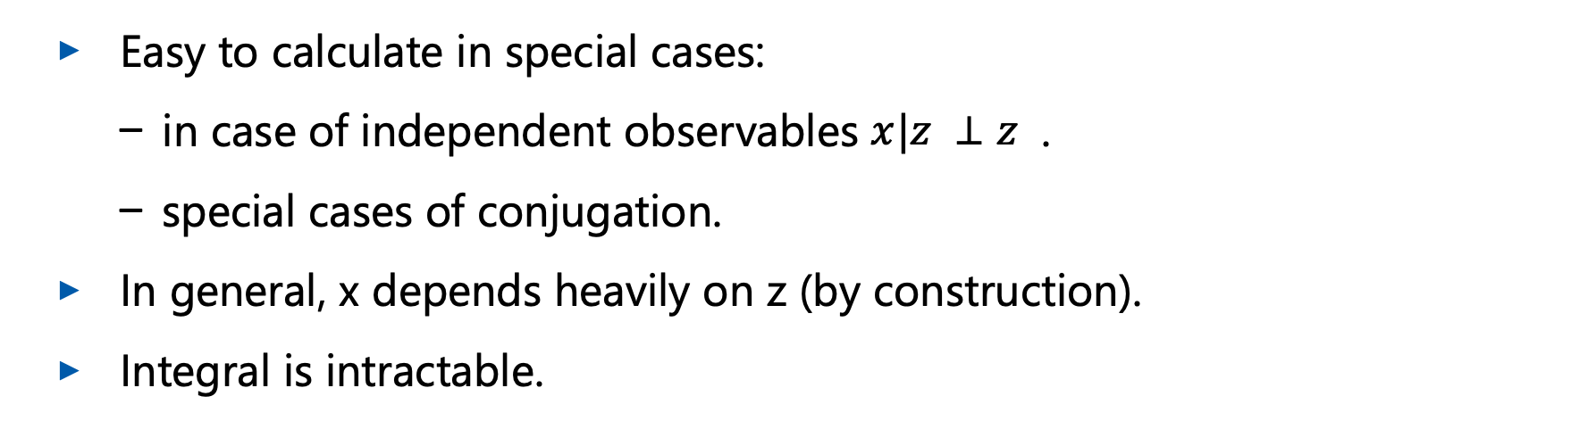
Maximizing the likelihood
Consider one sample, $x$. Then to maximize the likelihood, we need to calculate:
Easy to calculate in special cases:
  in case of independent observables $x|z ⊥z$ .
  special cases of conjugation.
In general, x depends heavily on z (by construction).
Integral is intractable.

Slide 15
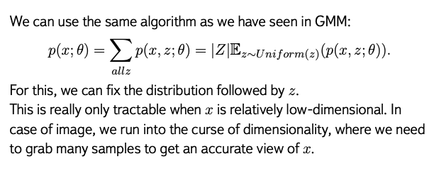





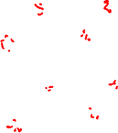
Estimating likelihood: Naive Monte-Carlo

Slide 16
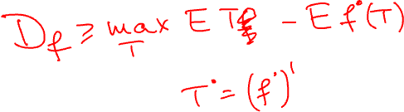
Wrap-up
Problems:
  We can’t calculate p(x).
  We can’t write the maximum-likelihood objective.
We need a different approach or objective function. Idea:
  if we can’t write likelihood, let’s instead derive a lower bound on it.
  If the lower bound is tractable, then we can optimize the parameters with respect to the lower bound.
  If we are making the lower bound larger, we are making the likelihood larger.

Slide 17

Evidence Lower Bound

Slide 18
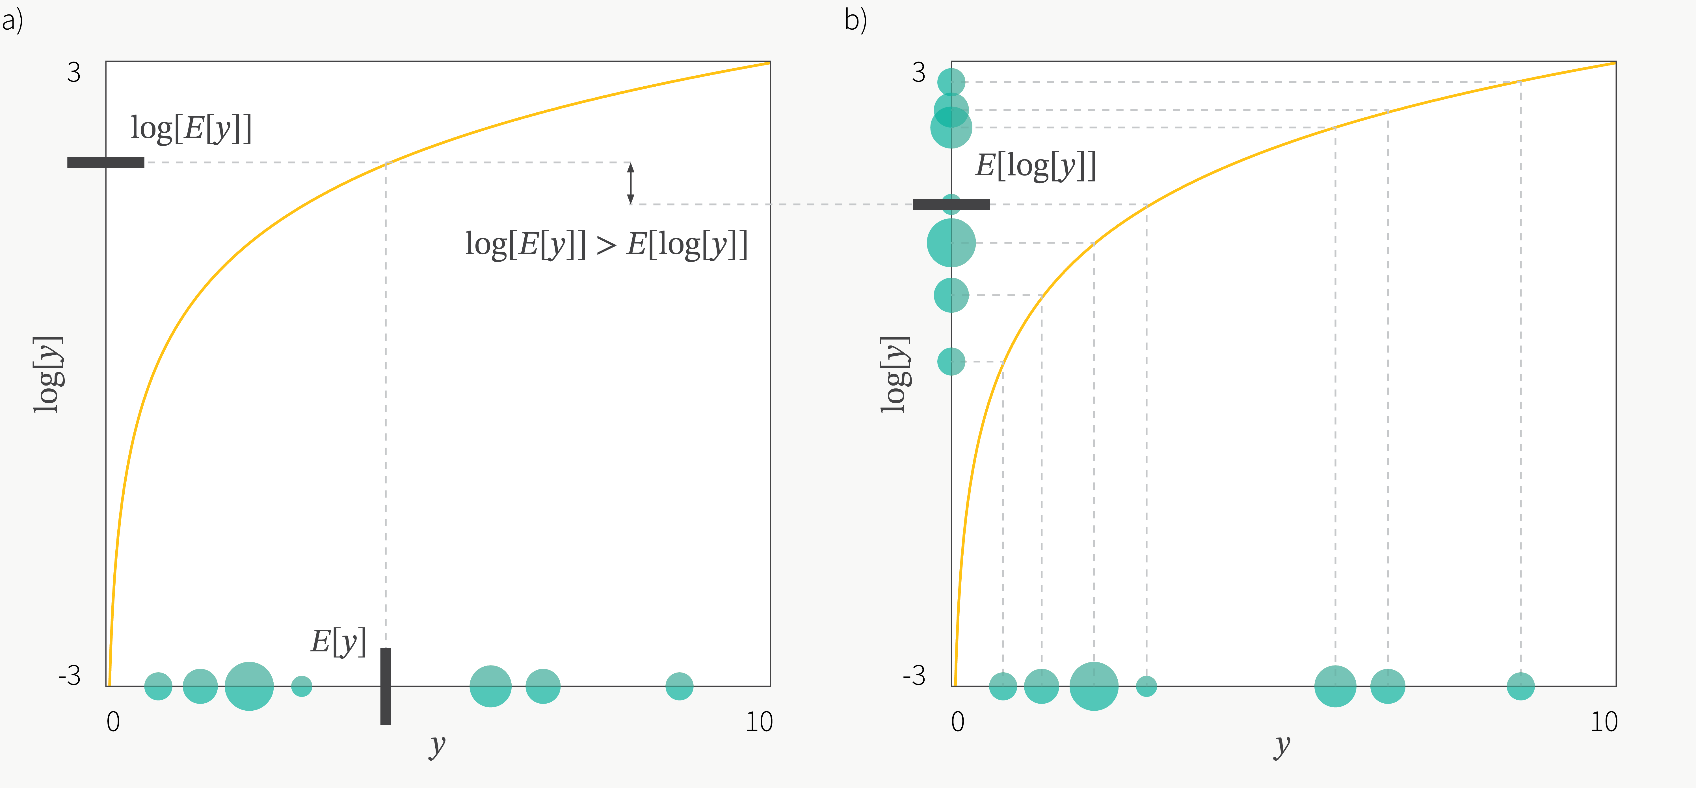
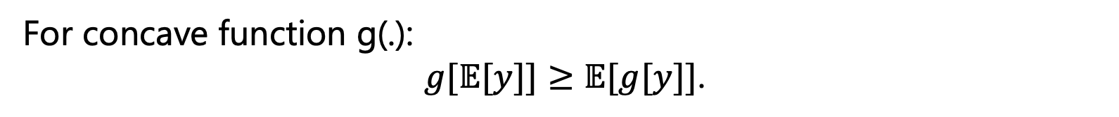

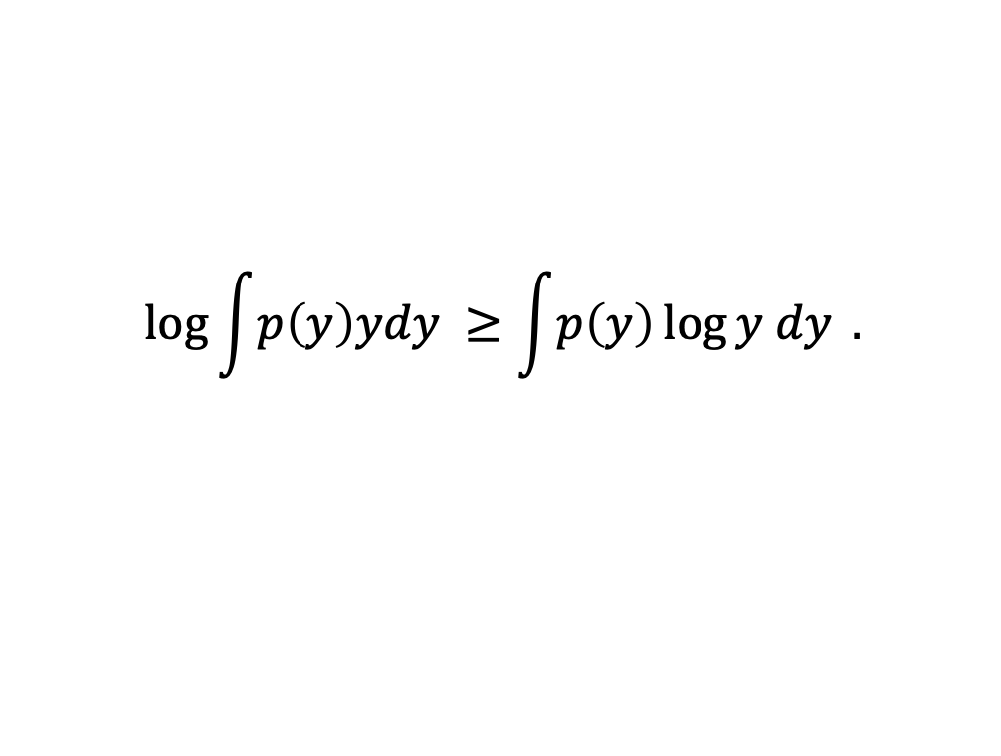
Jensen’s inequality
For concave function g(.):
$g[𝔼[y]]≥𝔼[g[y]]$.
$$\log{\int{p\left(y\right)ydy }}≥\int{p\left(y\right)\log{y dy }}.$$
Figure: BorelisAI

Slide 19
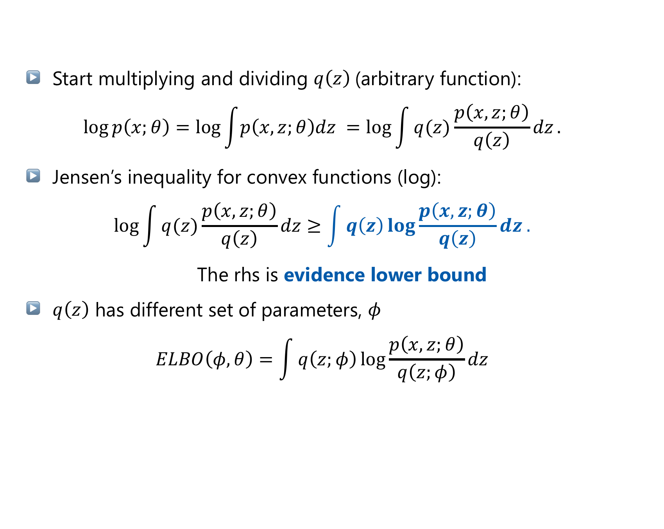
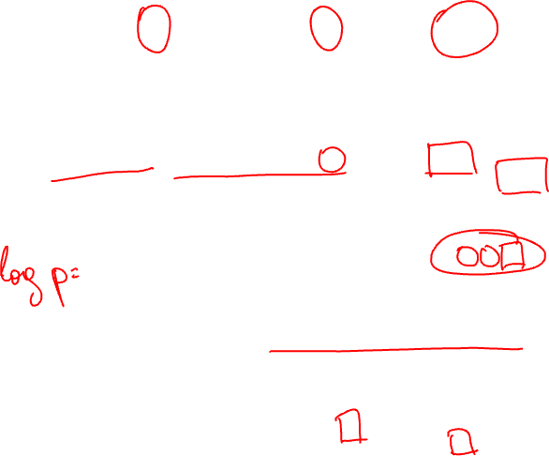
Deriving the Evidence Lower BOund
Start multiplying and dividing $q\left(z\right)$(arbitrary function):
$$\log{p\left(x;θ\right)=\log{\int{p\left(x,z;θ\right)dz }}=\log{\int{q(z)\frac{p\left(x,z;θ\right)}{q\left(z\right)}dz}}.}$$
Jensen’s inequality for convex functions (log):
$$\log{\int{q(z)\frac{p\left(x,z;θ\right)}{q\left(z\right)}dz}}≥\int{q\left(z\right)\log{\frac{p\left(x,z;θ\right)}{q\left(z\right)}}dz .}$$
The rhs is evidence lower bound
$q\left(z\right)$ has different set of parameters, $φ$
$$ELBO\left(φ, θ\right)=\int{q\left(z;φ\right)\log{\frac{p\left(x,z;θ\right)}{q\left(z;φ\right)}}dz}$$

Slide 20



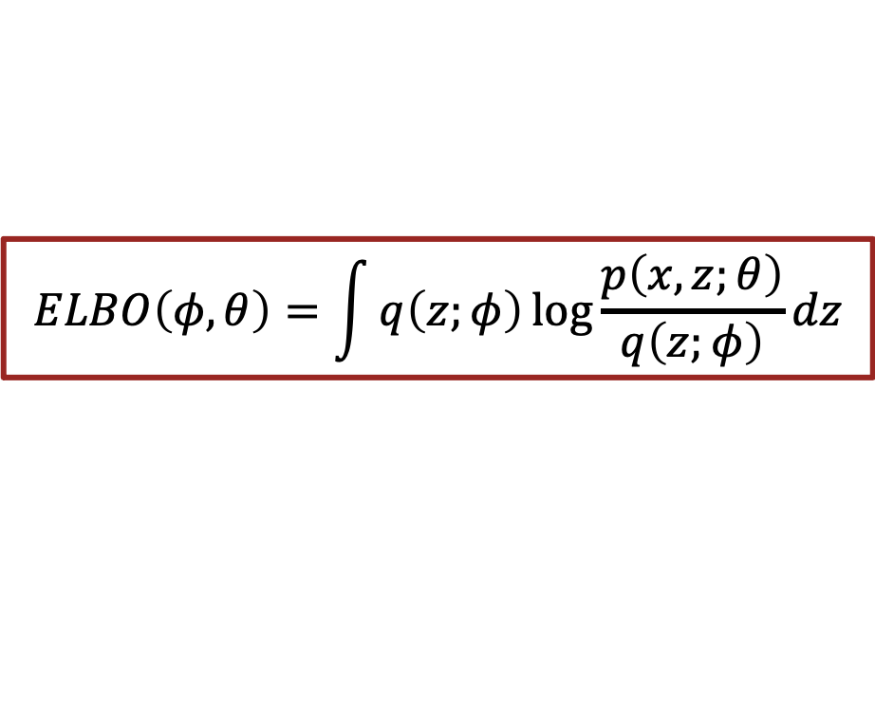







ELBO so far
$$ELBO\left(φ, θ\right)=\int{q\left(z;φ\right)\log{\frac{p\left(x,z;θ\right)}{q\left(z;φ\right)}}dz}$$
$$θ=θ_{1}$$
$$θ=θ_{1}$$
$$θ=θ_{2}$$
$$\log{p(x;θ)}$$
$$\log{p(x;θ)}$$
Likelihood value
Likelihood value
$$ELBO(φ_{2},θ)$$
$$ELBO(φ,θ)$$
$$ELBO(φ_{1},θ)$$
$$θ$$
$$θ$$

Slide 21

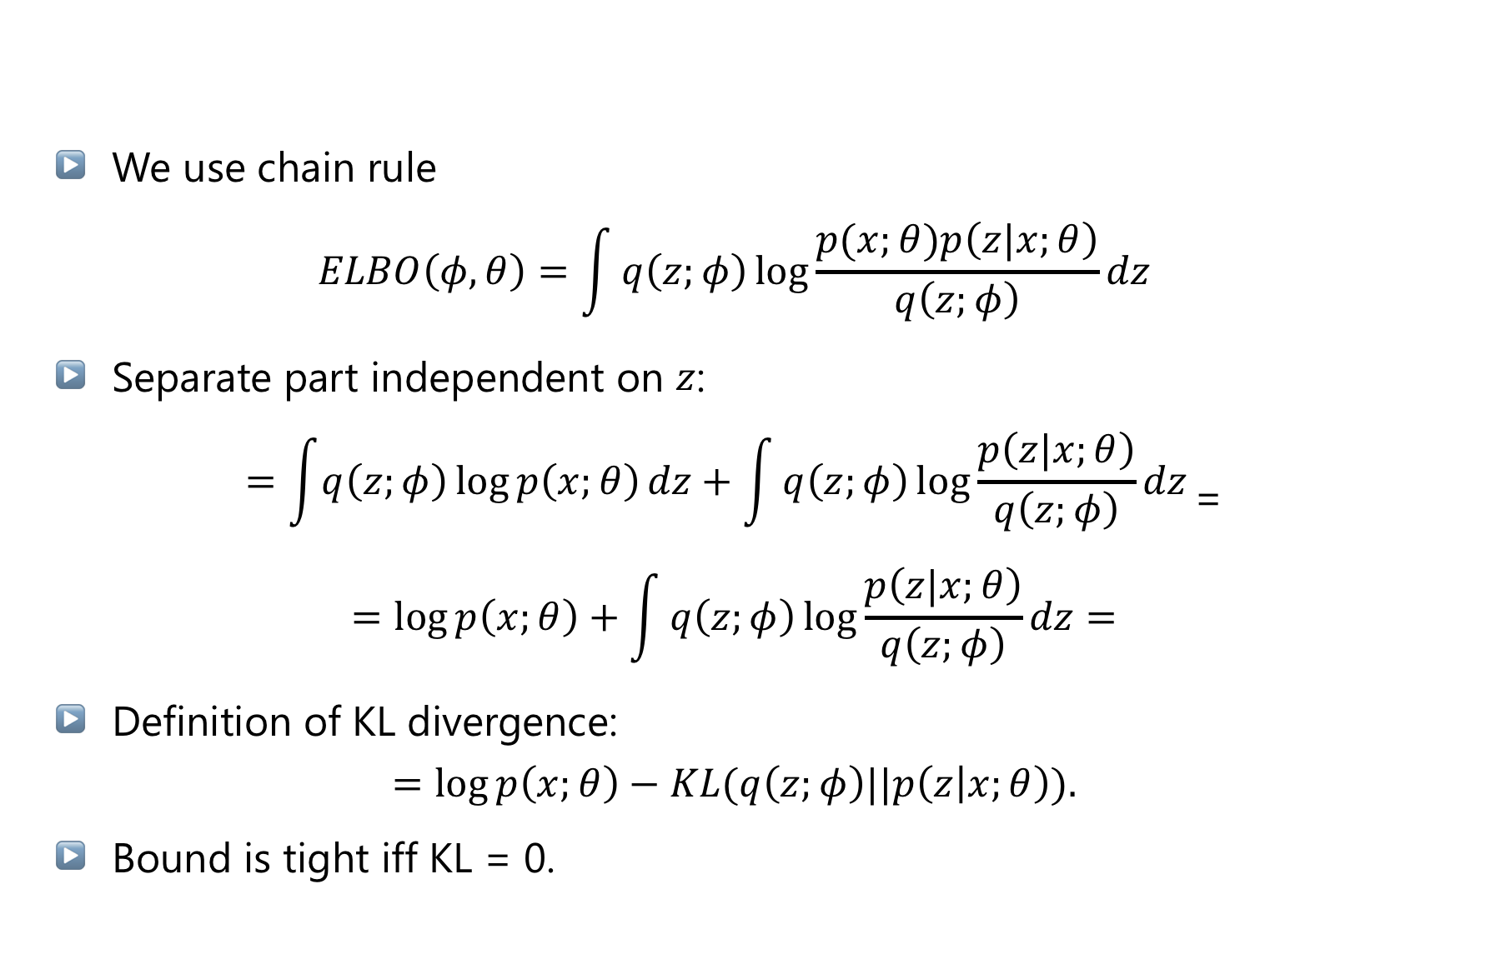
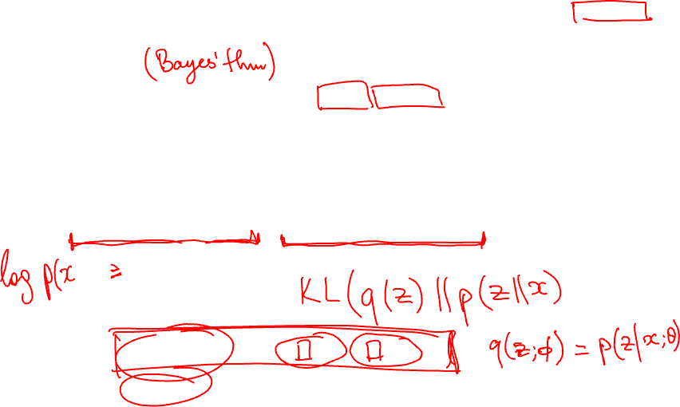


Tightness of bound
$$ELBO\left(φ, θ\right)=\int{q\left(z;φ\right)\log{\frac{p\left(x,z;θ\right)}{q\left(z;φ\right)}}dz}$$
We use chain rule
$$ELBO\left(φ, θ\right)=\int{q\left(z;φ\right)\log{\frac{p(x;θ)p\left(z|x;θ\right)}{q\left(z;φ\right)}}dz}$$
Separate part independent on $z$:
$$=\int{q\left(z;φ\right)\log{p\left(x;θ\right)}dz}+\int{q\left(z;φ\right)\log{\frac{p\left(z|x;θ\right)}{q\left(z;φ\right)}}dz}\text{=}$$
$$=log{p\left(x;θ\right)}+\int{q\left(z;φ\right)\log{\frac{p\left(z|x;θ\right)}{q\left(z;φ\right)}}dz}=$$
Definition of KL divergence:
$$=log{p\left(x;θ\right)}−KL(q\left(z;φ\right)||p\left(z | x;θ\right)).$$
Bound is tight iff KL = 0.
M. Hoffman, M. Johnson, ELBO surgery, NIPS2016

Slide 22
Variational Autoencoder

Slide 23



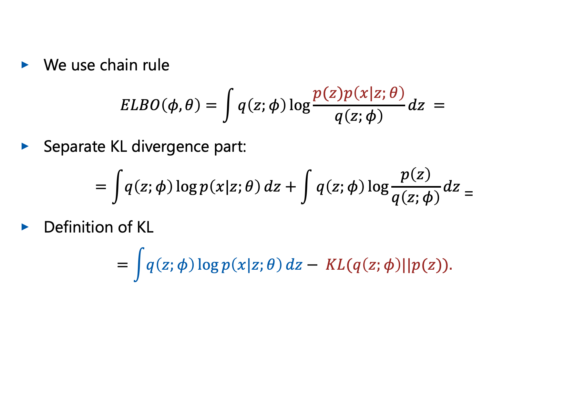
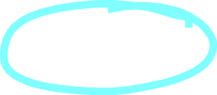


Dependence on prior on $z$
We use chain rule
$$ELBO\left(φ, θ\right)=\int{q\left(z;φ\right)\log{\frac{p(z)p\left(x|z;θ\right)}{q\left(z;φ\right)}}dz }=$$
Separate KL divergence part:
$$=\int{q\left(z;φ\right)\log{p\left(x|z;θ\right)}dz}+\int{q\left(z;φ\right)\log{\frac{p\left(z\right)}{q\left(z;φ\right)}}dz}\text{=}$$
Definition of KL
$$=\int{q\left(z;φ\right)\log{p\left(x|z;θ\right)}dz}− KL(q\left(z;φ\right)||p(z)).$$
Reconstruction loss
Latent Parametrization agreement

Slide 24



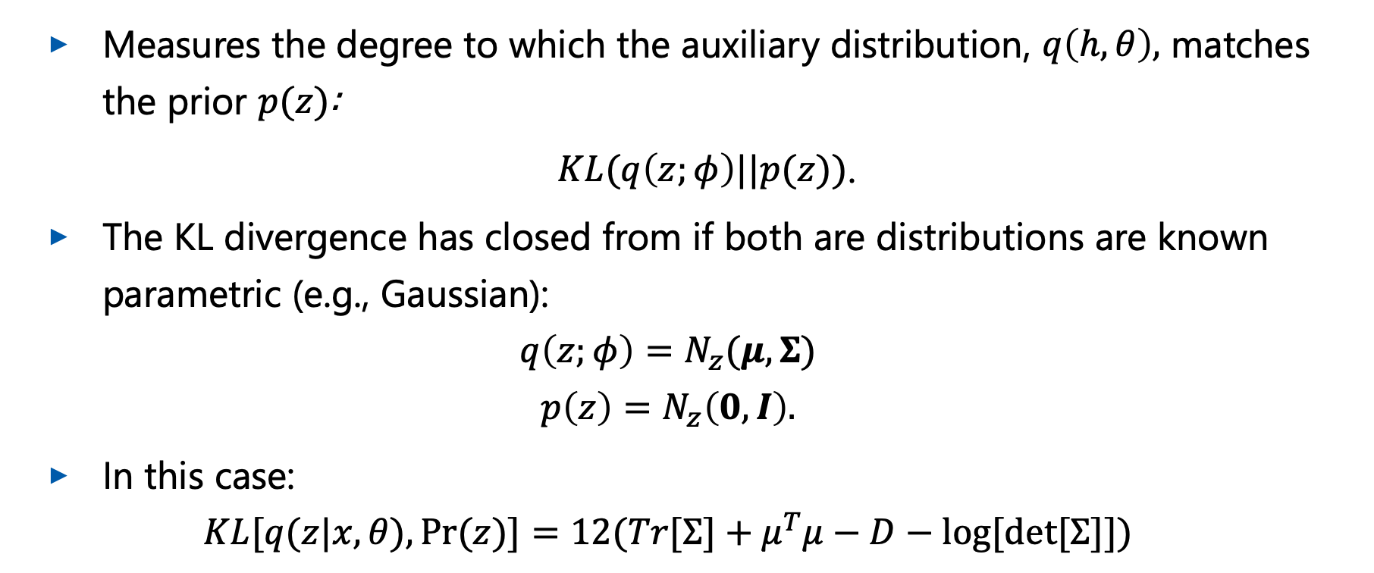






Latent Parametrization Agreement
Measures the degree to which the auxiliary distribution, $q\left(h,θ\right),$ matches the prior $p(z)$:
$KL(q\left(z;φ\right)||p(z))$.
The KL divergence has closed from if both are distributions are known parametric (e.g., Gaussian):
$$q\left(z;φ\right)=N_{z}(μ,Σ)$$
$$p\left(z\right)=N_{z}\left(0,I\right).$$
In this case:
$$KL[q(z|x,θ),Pr⁡(z)]=12(Tr[Σ]+μ^{T}μ−D−log⁡[det⁡[Σ]])$$
D. Kingma et al. Auto-Encoding Variational Bayes, ICLR 2014

Slide 25

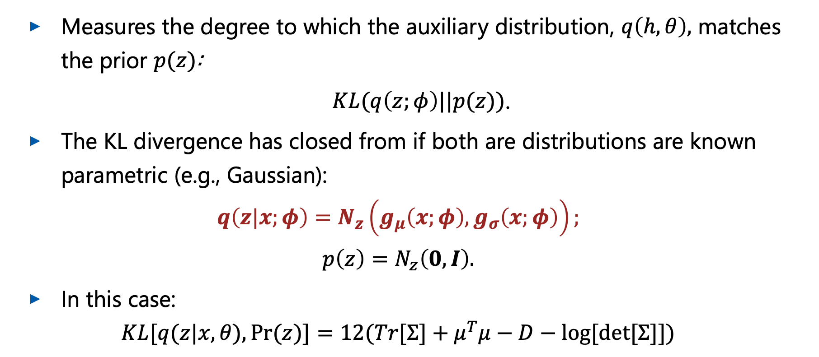




Latent Parametrization Agreement: training
Measures the degree to which the auxiliary distribution, $q\left(h,θ\right),$ matches the prior $p(z)$:
$KL(q\left(z;φ\right)||p(z))$.
The KL divergence has closed from if both are distributions are known parametric (e.g., Gaussian):
$$q\left(z|x;φ\right)=N_{z}\left(g_{μ}\left(x;φ\right),g_{σ}\left(x;φ\right)\right);$$
$$p\left(z\right)=N_{z}\left(0,I\right).$$
In this case:
$$KL[q(z|x,θ),Pr⁡(z)]=12(Tr[Σ]+μ^{T}μ−D−log⁡[det⁡[Σ]])$$

Slide 26
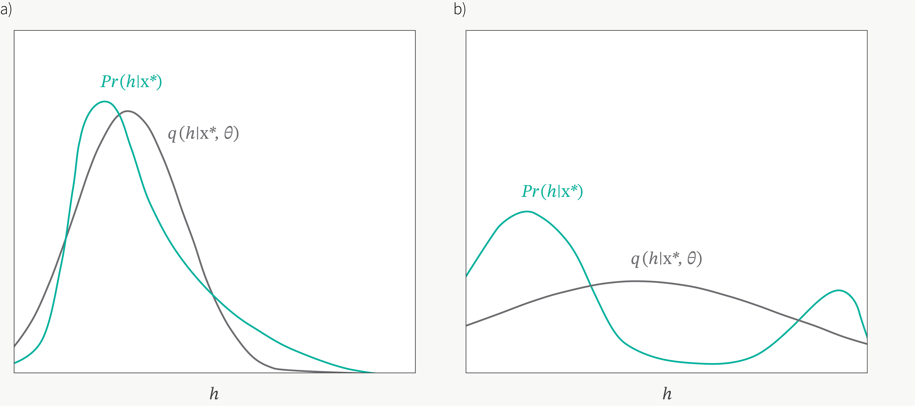

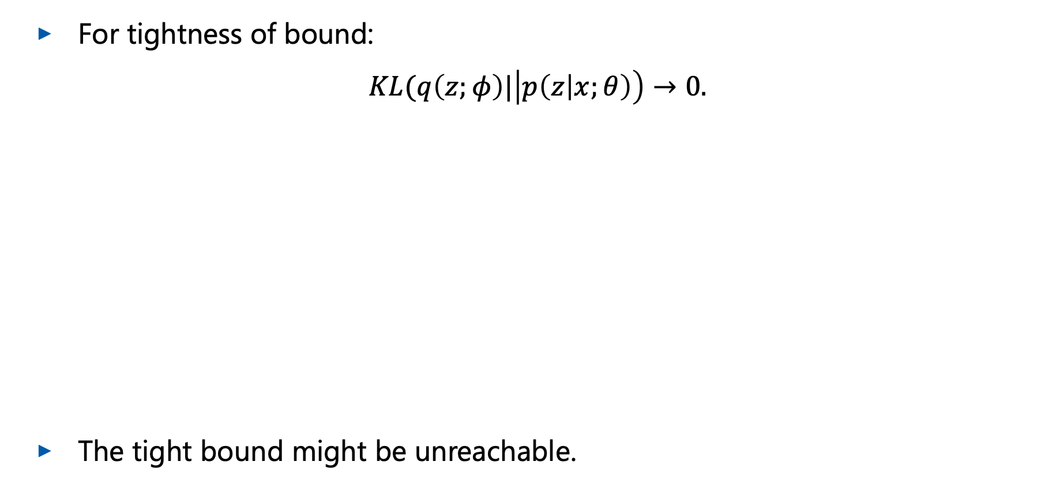



Problems of parametrization choice
For tightness of bound:
$KL(q\left(z;φ\right)|\left|p\left(z | x;θ\right)\right)→0.$
The tight bound might be unreachable.
$$p(z|x;θ)$$
$$q(z;φ)$$
$$p(z|x;θ)$$
$$q(z;φ)$$
Figure: BorelisAI

Slide 27
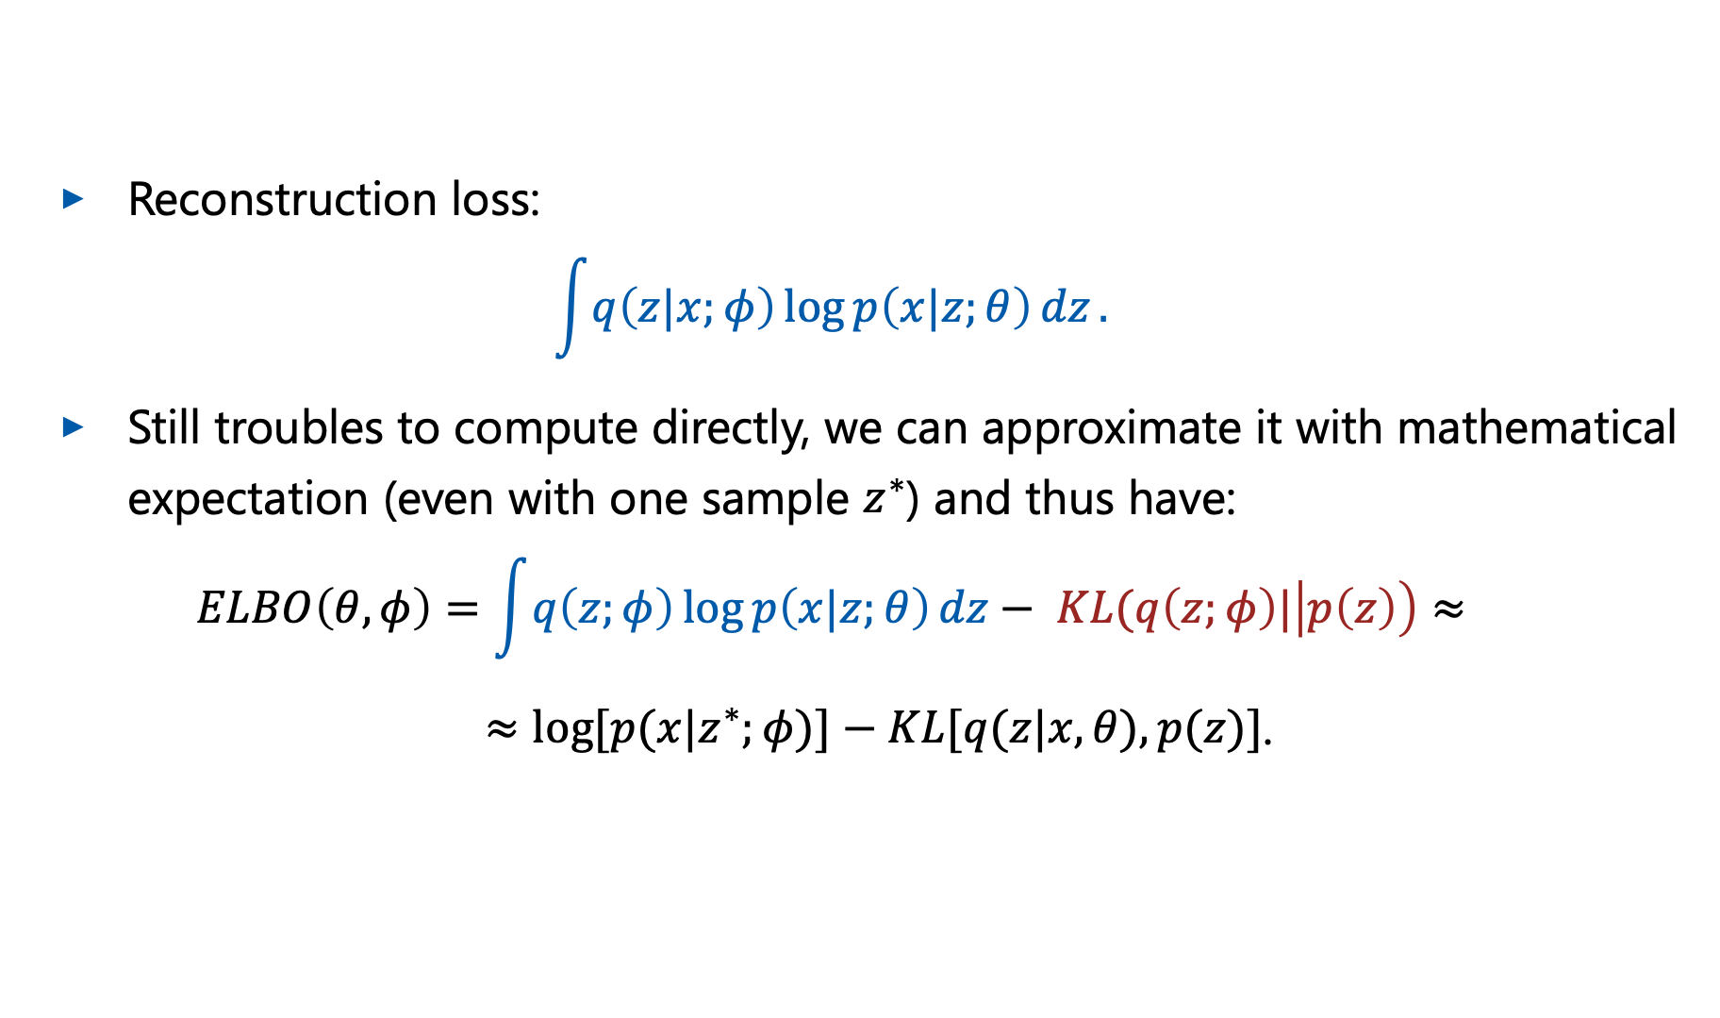
Reconstruction Loss
Reconstruction loss:
$$\int{q\left(z|x;φ\right)\log{p\left(x|z;θ\right)}dz}.$$
Still troubles to compute directly, we can approximate it with mathematical expectation (even with one sample $z^{∗}$) and thus have:
$$ELBO\left(θ,φ\right)=\int{q\left(z;φ\right)\log{p\left(x|z;θ\right)}dz}− KL(q\left(z;φ\right)|\left|p\left(z\right)\right)≈$$
$≈log⁡[p⁡(x|z^{∗};φ)]−KL[q(z|x,θ),p⁡(z)]$.

Slide 28
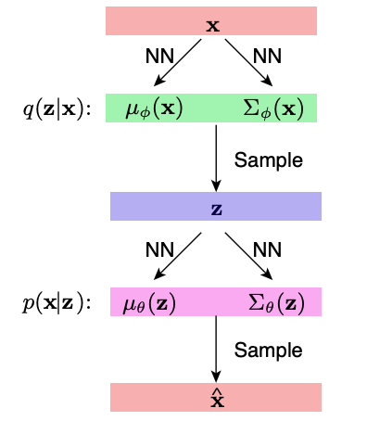
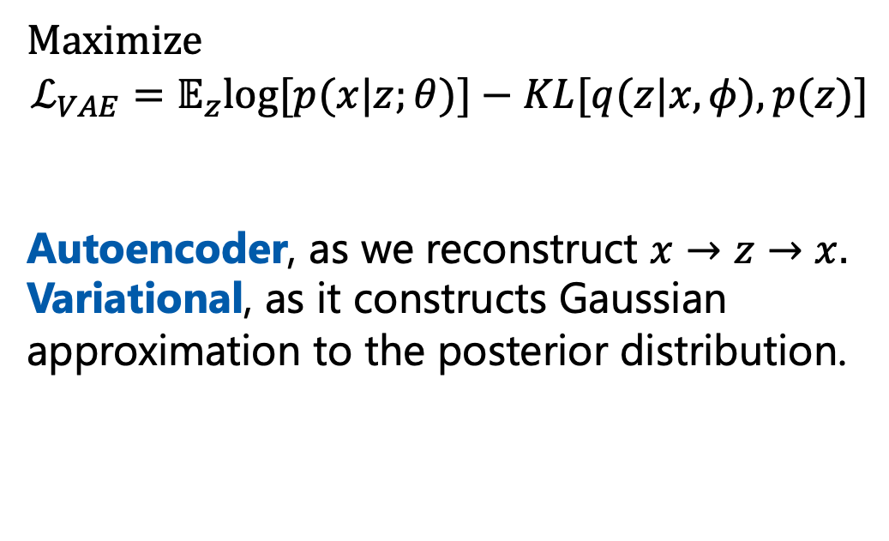
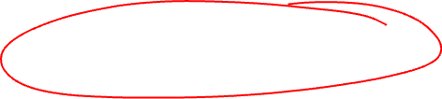
Variational Autoencoder
Maximize
$$ℒ_{VAE}=𝔼_{z}log⁡[p⁡(x|z;θ)]−KL[q(z|x,φ),p⁡(z)]$$
Autoencoder, as we reconstruct $x→z→x.$
Variational, as it constructs Gaussian approximation to the posterior distribution.
Fig: Kao UCLA DL lectures

Slide 29
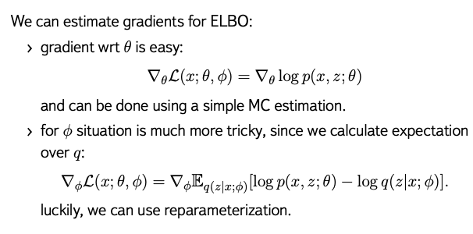
Training VAE

Slide 30
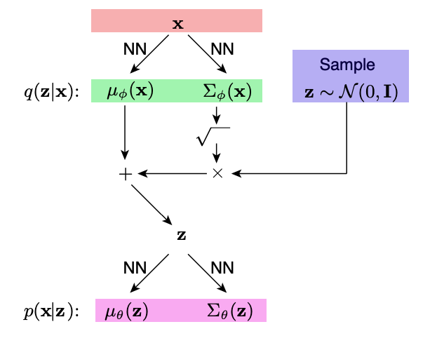
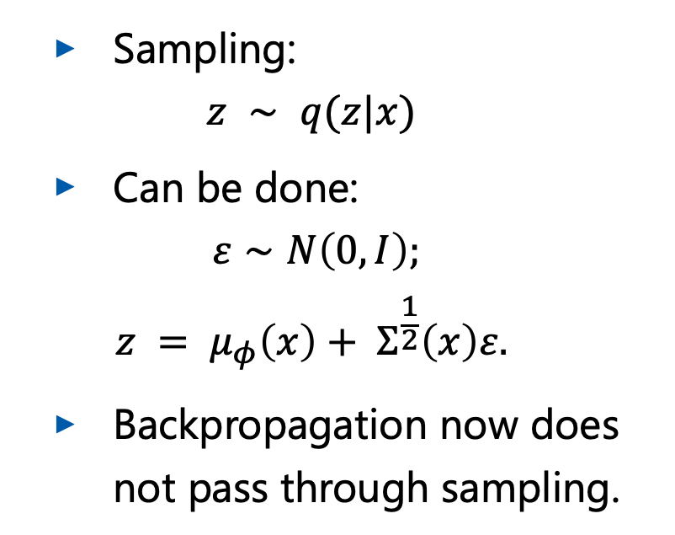
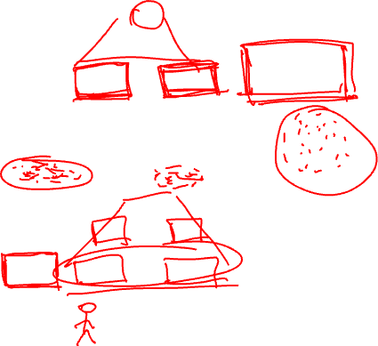
Reparameterization trick
Sampling:
$$z ∼ q(z|x)$$
Can be done:
$$ε∼N\left(0,I\right);$$
$$z = μ_{φ}\left(x\right)+ Σ^{\frac{1}{2}}\left(x\right)ε.$$
Backpropagation now does not pass through sampling.

Slide 31
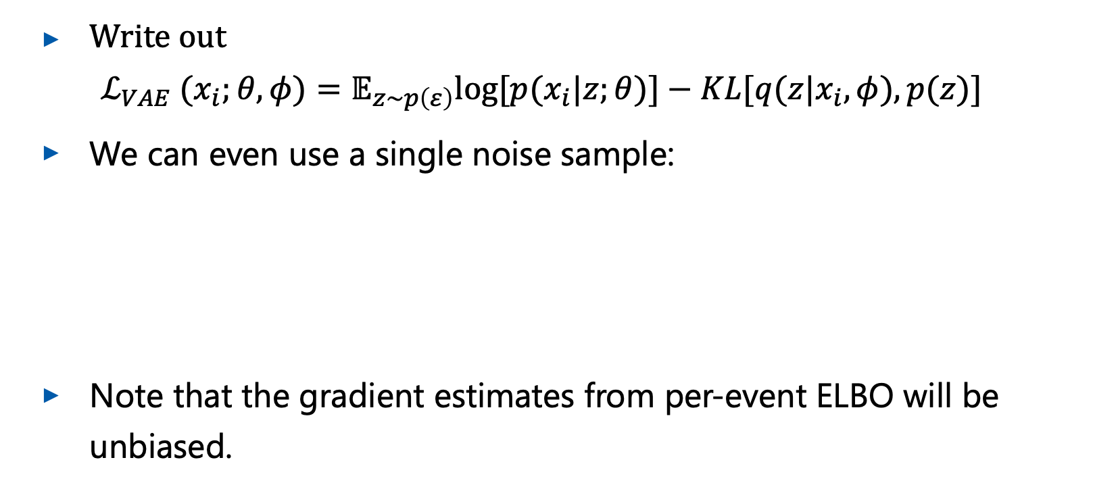
Final Per-event Objective and Results
Write out
$$ℒ_{VAE} (x_{i};θ,φ)=𝔼_{z∼p\left(ε\right)}log⁡[p⁡(x_{i}|z;θ)]−KL[q(z|x_{i},φ),p⁡(z)]$$
We can even use a single noise sample:
Note that the gradient estimates from per-event ELBO will be unbiased.
$$ℒ_{VAE} (x_{i};θ,φ)=log⁡[p⁡(x_{i}|z;θ)]−KL[q(z|x_{i},φ),p⁡(z)]$$

Slide 32
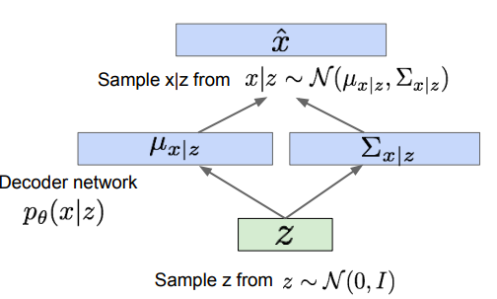
Sampling
We now can use the same idea like in GMM.
Sampling from prior.

Slide 33
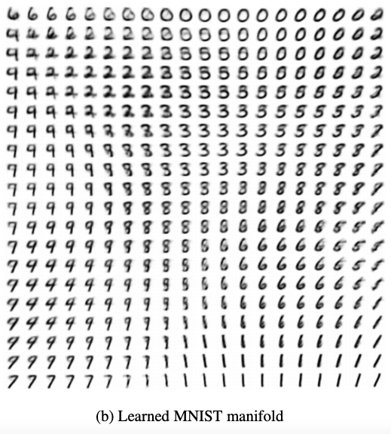



Results
The latent space is well organized.
The results are good.
$$z_{2}$$
$$z_{1}$$

Slide 34


Results

Slide 35


Results Discussed
Shafkat’s blog

Slide 36



Amortized Inference
variational parameters $φ_{i}$ should be calculated for every data point $x_{i}$;
for big datasets this is unsustainable;
forget about it and make a single model.
Cremer et al Inference Suboptimality in Variational Autoencoders, ICML 2018

Slide 37

Images for Amortization Gap

Slide 38

VAE: starting optimization problem
Stochastic optimization can get stuck:
  in the beginning, likelihood term log $p(x|z)$ is relatively weak, such that an initially attractive state is where $q(z|x) ≈ p(z)$.
Several ideas possible:
  optimization schedule - gradually increase weight of KL.
  free bits - ensure that on average, a certain minimum number of bits of information are encoded per latent variable.
D. Kingma et al., An Introduction to Variational Autoencoders

Slide 39


VAE: posterior collapse
Can happen to weak encoders or noisy data.
The sampling does not depend on the latent model.
An averaged figures are produced.
KL-divergence term annealing is proposed.
Fig: J. Chou Generated Loss and Augmented Training of MNIST VAE

Slide 40



VAE: blurred problem
Due to minimization of KL
$$KL(q\left(z;φ\right)|\left|p\left(z | x;θ\right)\right)→0.$$
Can be countered by choosing a sufficiently flexible inference model, and/or a sufficiently flexible generative model.

Slide 41
VQ-VAE

Slide 42


Latent Spaces
VAE gives a good representations
Can we study it?

Slide 43



Latent Space Quantization
Aaron van den Oord et al., Neural Discrete Representation Learning
Reconstruction loss:
$$z_{q}\left(x\right)=argmin_{i}\left|\left|z_{e}\left(x\right)−e_{i}\right|\right|$$
$z_{e}\left(x\right)$ - encoder vector for some raw input x
$e_{i}$ - i-th codebook vector
$z_{q}\left(x\right)$ - resulting quantized vector that is passed as input to the decoder

Slide 44

VQ-VAE results

Slide 45
VAE+GAN

Slide 46

Improving GANs
Main problems with GAN:
  mode collapse;
  intractable likelihood.
Idea:
  use likelihood-based mode;.
  have easier inference;
  diversify sampling.

Slide 47





Reminder: VAE structure
$$ℒ_{prior}=KL(q_{n}(z|x)||p\left(z\right))$$
$$+$$
$${−ℒ}_{pixel}= 𝔼_{q_{n}\left(z | x\right)}(\log{p_{θ}(x|z)}$$
$$= ℒ_{VAE}$$

Slide 48


VAE+GAN
problem of VAE is blurry output
GAN overcomes due to the use of discriminator
add GAN loss to VAE
https://arxiv.org/pdf/1512.09300.pdf

Slide 49


VAE+GAN expanded
Consider image as a whole:
$${−ℒ}_{DIS}=𝔼_{q_{n}\left(z | x\right)}p(Dis_{l}(x)|z) =𝔼_{q_{n}\left(z | x\right)}N \left(Dis_{l}\left(x\right)\right|Dis_{l}(\tilde{x}), I), \tilde{x}∼Dec(z)$$
where $Dis_{l}(x)$ denote the hidden representation of the $l$-th layer of the discriminator.

Slide 50

VAE+GAN final loss
$$ℒ_{GAN+VAE}=ℒ_{prior}+ℒ_{DIS}+ℒ_{GAN}$$
Image
Style

Slide 51

VAE+GAN results

Slide 52
Wrap-up
Benefits from combined loss and combined architecture.
Better images than VAE or GAN standalone.
Can be viewed as extension of VAE with adversarial selection.
Can be viewed as extension of GAN with better latent space construction.

Slide 53
More VAEGANs

Slide 54
VAE structure
KL divergence is considered as one of blurriness causes.
We can switch this objective to GAN-like.
https://arxiv.org/pdf/1511.05644.pdf

Slide 55

AAE structure
KL divergence is considered as one of blurriness causes.
We can switch this objective to GAN-like.
Price to pay: ELBO becomes less constrained.
https://arxiv.org/pdf/1511.05644.pdf

Slide 56

AAE results
https://arxiv.org/pdf/1802.06847.pdf

Slide 57


VEEGAN and VGH
VGH: Marginal matching and implicit distributions using GANs both in latent and visible space;
VEEGAN: Directly match in joint space.

Slide 58

VAE+GAN merged
Our aim was to improve GAN mode collapse and VAE blurriness.
The results are yet to be improved.

Slide 59
Conclusions
VAE is one of the strong generative models that is used in current days.
Several attempts were made to merge strong points of GANs and VAE.
Work is ongoing.

