Slide 1

autoencoders

Slide 2
autoencoder
artificial neural network designed to learn an efficient, compressed representation of data. It achieves this by training the network to reconstruct the input data from a compressed, lower-dimensional encoding. Autoencoders are primarily used for dimensionality reduction, denoising, or unsupervised feature learning.

Slide 3
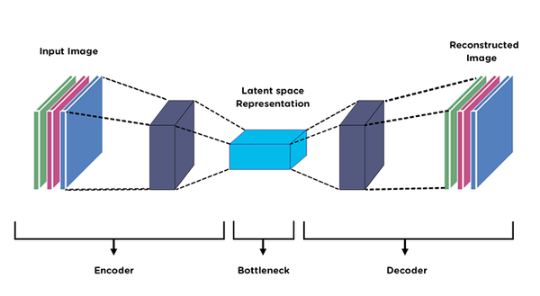
Components of autoencoder
Encoder:
Maps the input data into a lower-dimensional latent space.
Consists of one or more layers that progressively reduce the input dimensions.
The latent space representation is often called the bottleneck or embedding.
Latent Space:
A compact, encoded representation of the input data.
Ideally, it captures the most important features or patterns of the data.
Decoder:
Reconstructs the original input from the latent space representation.
The output dimension matches the input dimension.
Architecture
Autoencoders typically have two symmetrical parts:
Input → Encoder → Latent Space → Decoder → Output

Slide 4
Variants of Autoencoders
Denoising Autoencoder: Trained to reconstruct original data from noisy inputs, making them useful for noise reduction.
Sparse Autoencoder: Adds sparsity constraints to the latent space to encourage feature selection.
Variational Autoencoder (VAE): A probabilistic model that learns a distribution over the latent space for generative tasks.
Convolutional Autoencoder: Uses convolutional layers for image data, preserving spatial features.
Sequence-to-Sequence Autoencoder: Designed for sequential data, such as text or time series.

Slide 5
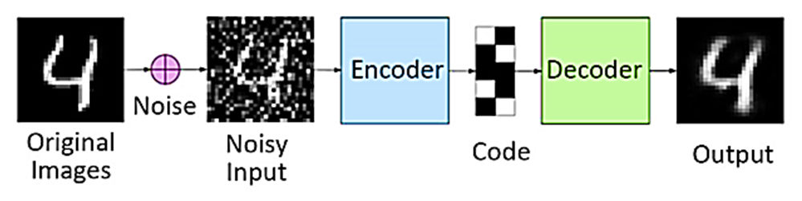
Denoising Autoencoder (DAE)
type of autoencoder specifically designed to learn how to remove noise from data. Instead of training the autoencoder to reconstruct the exact input, the model is trained to reconstruct the original, clean version of the data from a corrupted or noisy version.

Slide 6
How It Works
Input Corruption (Adding Noise):
A noisy version of the input data (X_{noisy}​) is created by applying random noise to the original data (X_{clean}​). Common methods include:
Gaussian Noise: Adding random values drawn from a Gaussian distribution.
Salt-and-Pepper Noise: Randomly setting pixels in an image to the maximum or minimum value.
Dropout Noise: Setting some values to zero.
Training Objective:
The network is trained to minimize the difference between the clean input (X_{clean}​) and the reconstructed output (X’_{clean}​), even though it only sees the noisy input during training.
Architecture:
Similar to a regular autoencoder:
Encoder: Encodes the noisy input into a latent representation.
Decoder: Reconstructs the clean data from the latent representation.
Loss Function:
Typically, Mean Squared Error (MSE) is used to compare the clean data and the reconstructed data: Loss=∥X_{clean}​− X’_{clean} ∥²

Slide 7
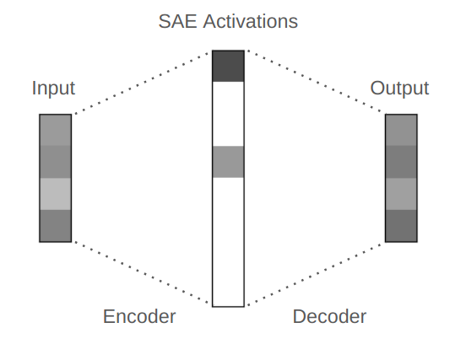
Sparse Autoencoder
type of autoencoder that incorporates a sparsity constraint on the latent space representation. This sparsity encourages the network to learn more distinct and meaningful features from the data, which is particularly useful for tasks like feature selection and representation learning.
Diagram of a sparse autoencoder. Note that the intermediate activations are sparse, with only 2 nonzero values.

Slide 8
How does it work:
Encoder:
Encodes the input into a latent representation.
Adds sparsity by penalizing activations, encouraging only a few neurons to be active.
Sparsity Constraint:
A penalty term is added to the loss function, ensuring that the average activation of each neuron in the latent space is close to a small value (e.g., 0.05).
Common methods:
KL Divergence: Measures the divergence between the average activation and a target sparsity value.
L1 Regularization: Penalizes large values in the latent space.
Decoder:
Reconstructs the input from the sparse latent representation.

Slide 9
When to Use Each?
Use KL Divergence When:
You have a clear target sparsity in mind (e.g., a specific percentage of active neurons).
You want to enforce sparsity at a probabilistic level rather than directly on activation values.
You're working with activations normalized to a probability space (e.g., outputs of a sigmoid layer).
Use L1 Regularization When:
You want to enforce general sparsity without requiring a target sparsity.
The problem benefits from simplicity and computational efficiency.
You don’t need a probabilistic interpretation of the activations.

