Slide 2
Text & references:
0. Fundamentals of thermal-fluid sciences, 5th Ed., Yunus A. Cengel, et al. McGraw-Hill, 2017.
1. Understanding Thermodynamics, H. C. Van Ness, Dover, 1983.
2. Understanding Energy, R. S. Berry, World Scientific, 1991.
3. Thermodynamics, E. Fermi, Dover, 1956.
4. From Watt to Clausius, D. S. L. Cardwell, Iowa State University Press, 1989.
절대평가와 상대평가의 혼합형
수시시험(30%), 기말시험(30%), 과제물(40%, 8회 각 5%)

Slide 3
W01. 열역학 입문; 온도, 에너지, 효율
W02. 미시적 및 거시적 기술, 차원과 단위(과제 1)
W03. 기본적인 개념들, 상태, 성질
W04. 상태의 기술에 대한 가정, 열역학 제0 법칙(과제 2)
W05. 열역학 제1 법칙; 에너지 보존 법칙(과제3)
W06. 순수 물질의 성질
W07. 상태 평면과 포화 상태(과제 4)
W08. 닫힌 계의 에너지 해석(과제 5)
W09. 유동이 있는 계의 에너지 해석(과제 6)
W10. 열역학 제2 법칙
W11. 엔트로피, Carnot 사이클
W12. 이상기체의 엔트로피 변화(과제 7)
W13. Otto 사이클, 디젤 사이클
W14. Rankine 사이클(과제 8)
W15. 냉동 사이클과 열 펌프

Slide 4
Ch. 0 Introduction-1
What is temperature?
Celsius(攝氏), Fahrenheit(華氏)
Celsius (also known historically as centigrade) is a temperature scale that is named after the Swedish astronomer Anders Celsius(1701–1744), who developed a similar temperature scale two years before his death, in 1742.
Fahrenheit is the temperature scale proposed in 1724 by, and named after, the German physicist Daniel Gabriel Fahrenheit(1686–1736).
Notes:
Celsius (also known historically as centigrade) is a temperature scale that is named after the Swedish astronomer Anders Celsius (1701–1744), who developed a similar temperature scale two years before his death.
Fahrenheit is the temperature scale proposed in 1724 by, and named after, the German physicist Daniel Gabriel Fahrenheit (1686–1736).

Slide 5
Ch. 0 Introduction-2
Kelvin(1848), Rankine(1859);
absolute temperature
William Thomson, 1st Baron Kelvin (or Lord Kelvin)(26 June 1824 – 17 December 1907) was a Belfast(Northern Ireland)-born mathematical physicist and engineer. At the University of Glasgow he did important work in the mathematical analysis of electricity and formulation of the first and second Laws of Thermodynamics, and did much to unify the emerging discipline of physics in its modern form. Lord Kelvin is widely known for developing the basis of Absolute Zero, and for this reason a unit of temperature measure is named after him.
William John Macquorn Rankine(5 July 1820 – 24 December 1872) was a Scottish engineer and physicist. He was a founding contributor, with Rudolf Clausius and William Thomson(1st Baron Kelvin), to the science of thermodynamics. Rankine developed a complete theory of the steam engine and indeed of all heat engines. His manuals of engineering science and practice were used for many decades after their publication in the 1850s and 1860s. He was born in Edinburgh and died in Glasgow, a bachelor.

Slide 6
Ch. 0 Introduction-3
Notes:
Robert Boyle (25 January 1627 – 31 December 1691) was an Irish natural philosopher, chemist, physicist, and inventor, also noted for his writings in theology. He is best known for Boyle's law. Although his research and personal philosophy clearly has its roots in the alchemical tradition, he is largely regarded today as the first modern chemist, and therefore one of the founders of modern chemistry. Among his works, The Sceptical Chymist is seen as a cornerstone book in the field of chemistry.
Jacques Alexandre César Charles (November 12, 1746, Beaugency, Loiret – April 7, 1823) was a French inventor, scientist, mathematician, and balloonist. Charles and the Robert brothers launched the world's first (unmanned) hydrogen-filled balloon in August 1783, then in December 1783, Charles and his co-pilot Nicolas-Louis Robert ascended to a height of about 1,800 feet (550 m) in a manned balloon. Their pioneering use of hydrogen for lift led to this type of balloon being named a Charlière (as opposed to a Montgolfière which used hot air).
Charles's law, describing how gases tend to expand when heated, was formulated by Joseph Louis Gay-Lussac in 1802, but he credited it to unpublished work by Jacques Charles. Charles was elected to the Académie des Sciences, in 1793, and subsequently became professor of physics at the Conservatoire des Arts et Métiers.

Slide 7
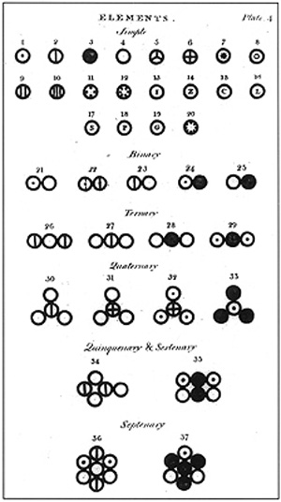
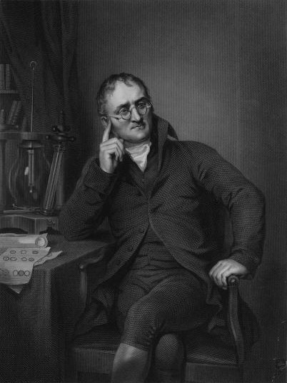
Ch. 0 Introduction-3a
Dalton (1766-1844, UK)
John Dalton was an English chemist, meteorologist and physicist, and is best known for his pioneering work in the development of modern atomic theory, and his research into color blindness.
Various atoms and molecules as depicted in John Dalton‘s(1808)
A New System of Chemical Philosophy.

Slide 8
Ch. 0 Introduction-4
Notes:
Ludwig Eduard Boltzmann (February 20, 1844 – September 5, 1906) was an Austrian physicist famous for his founding contributions in the fields of statistical mechanics and statistical thermodynamics. He was one of the most important advocates for atomic theory when that scientific model was still highly controversial.
Lorenzo Romano Amedeo Carlo Avogadro di Quaregna e di Cerreto, Count of Quaregna and Cerreto (9 August 1776 – 9 July 1856) was an Italian savant. He is most noted for his contributions to molecular theory, including what is known as Avogadro’s law. In tribute to him, the number of elementary entities (atoms, molecules, ions or other particles) in 1 mole of a substance, 6.02214179(30)×10²³, is known as the Avogadro constant.

Slide 9
Ch. 0 Introduction-5
Notes:
Benoît Paul Émile Clapeyron (26 February 1799 – 28 January 1864) was a French engineer and physicist, one of the founders of thermodynamics. In 1834, he made his first contribution to the creation of modern thermodynamics by publishing a report entitled the Driving force of the heat (Puissance motrice de la chaleur), in which it developed the work of the physicist Nicolas Léonard Sadi Carnot, deceased two years before. Though Carnot had developed a compelling analysis of a generalised heat engine, he had employed the clumsy and already unfashionable caloric theory. Clapeyron, in his memoire, presented Carnot's work in a more accessible and analytic graphical form, showing the Carnot cycle as a closed curve on an indicator diagram, a chart of pressure against volume (named in his honor Clapeyron's graph). In 1843, Clapeyron further developed the idea of a reversible process, already suggested by Carnot and made a definitive statement of Carnot's principle, what is now known as the second law of thermodynamics.

Slide 10
Ch. 0 Introduction-6
Important findings:
Boyle; 1627-1691, Ireland, 1662, Gas law I, ‘temperature’
Fahrenheit(華氏); 1686-1736, Germany, 1724
Celsius(攝氏); 1701-1744, Sweden, 1742
Charles; 1746-1823, France, 1787, Gas law II
Watt; 1736-1819, UK, 1787, Steam engine
Dalton; 1766-1844, UK, 1808, Atomic theory
Avogadro; 1776-1856, Italy, 1811, # of molecules per mol
Clapeyron; 1799-1864, France, 1834, Ideal gas law
Joule; 1818-1889, UK, 1845, heat-work equivalence
Lord Kelvin; 1824-1907, UK, 1848 absolute temperature
Rankine; 1820-1872, UK, 1859, 1st textbook on thermodynamics
Clausius; 1822-1888, Germany, 1865, entropy
Boltzmann; 1844-1906, Austria, 1870, kinetic theory
see next
Notes:
Atom & molecule, Ideal gas, absolute temperature, heat and work, entropy are the essential concepts.

Slide 11
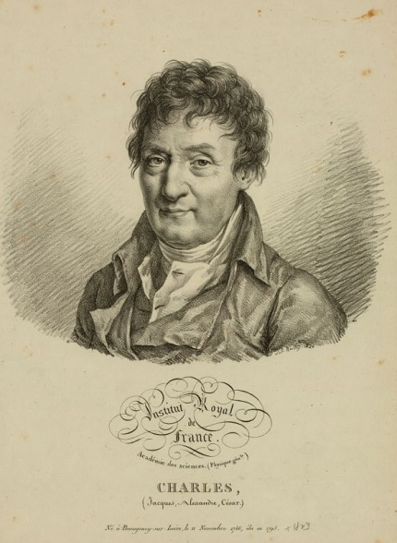
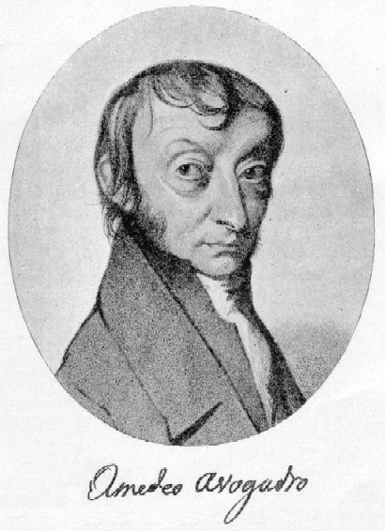
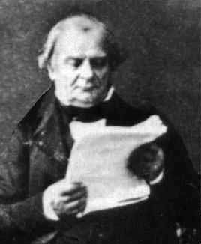
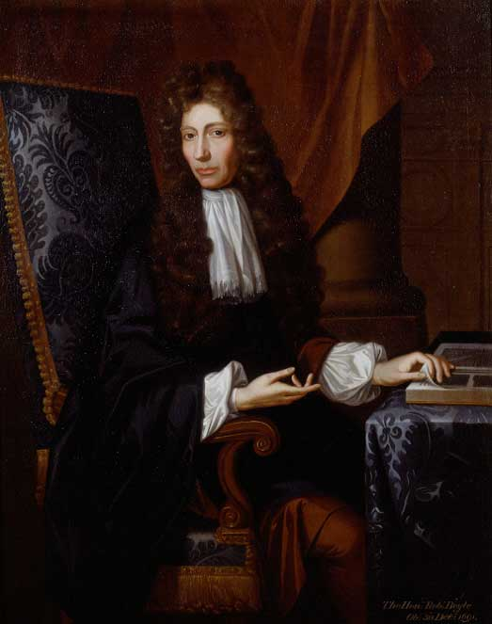
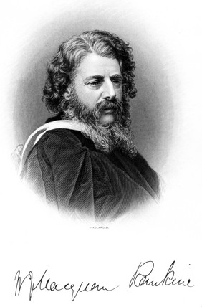
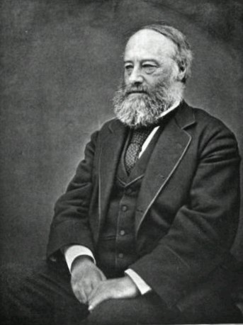
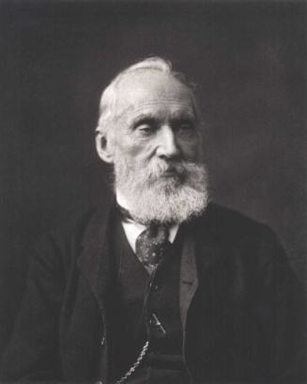
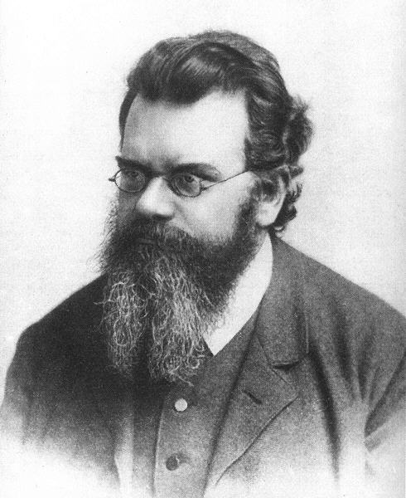
Ch. 0 Introduction-6a

Slide 12
Ch. 0 Introduction-7

Slide 13
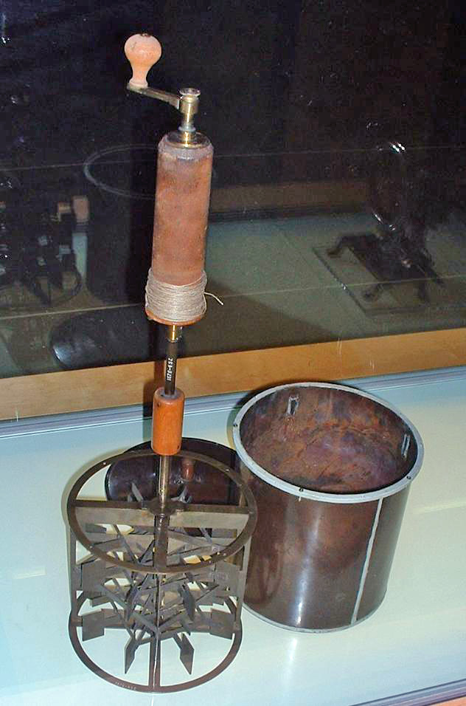
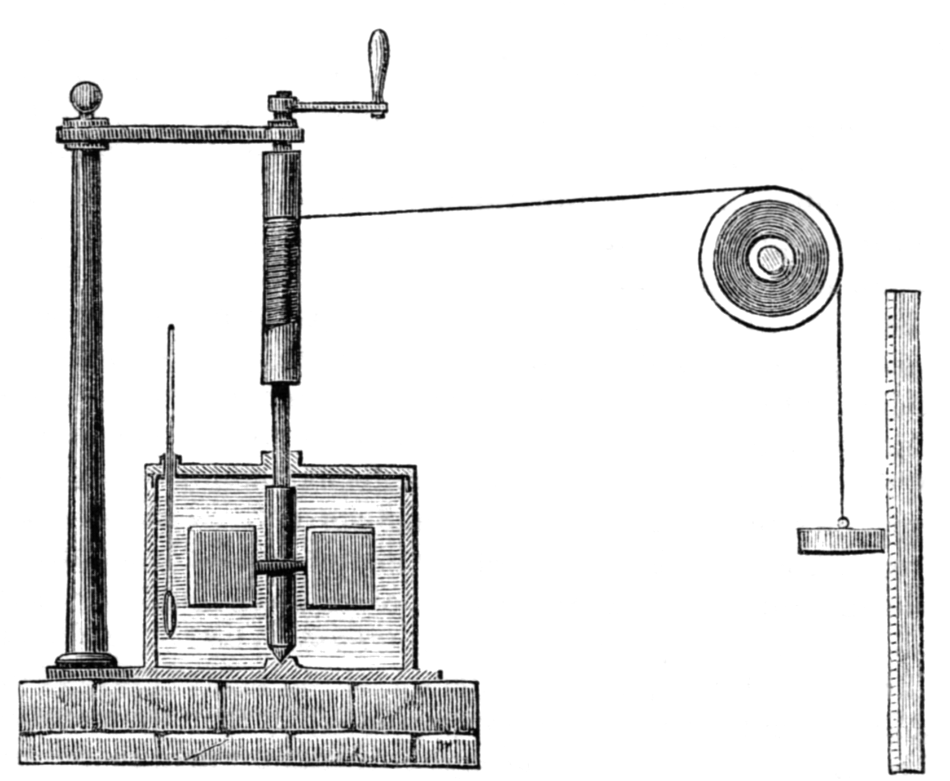
Ch. 0 Introduction-7a
Joule's apparatus for measuring the mechanical equivalent of heat(1845)
James Prescott Joule (1818 -1889) was an English physicist & brewer, born in Salford, Lancashire. Joule studied the nature of heat, and discovered its relationship to mechanical work(=energy). This led to the theory of energy conservation, and eventually led to the development of the 1st law of thermodynamics.
Notes:
James Prescott Joule FRS (pronounced /ˈdʒuːl/; 24 December 1818 – 11 October 1889) was an English physicist and brewer, born in Salford, Lancashire. Joule studied the nature of heat, and discovered its relationship to mechanical work (see energy). This led to the theory of conservation of energy, which led to the development of the first law of thermodynamics. The SI derived unit of energy, the joule, is named after him. He worked with Lord Kelvin to develop the absolute scale of temperature, made observations on magnetostriction, and found the relationship between the current through a resistance and the heat dissipated, now called Joule's law.
In 1845, Joule read his paper On the mechanical equivalent of heat to the British Association meeting in Cambridge. In this work, he reported his best-known experiment, involving the use of a falling weight to spin a paddle-wheel in an insulated barrel of water, whose increased temperature he measured. He now estimated a mechanical equivalent of 819 ft·lbf/Btu (4.41 J/cal).
The son of Benjamin Joule (1784–1858), a wealthy brewer, Joule was tutored at home in Salford until 1834 when he was sent, with his elder brother Benjamin, to study with John Dalton at the Manchester Literary and Philosophical Society. The pair only received two years' education in arithmetic and geometry before Dalton was forced to retire owing to a stroke. However, Dalton's influence made a lasting impression as did that of his associates, chemist William Henry and Manchester engineers Peter Ewart and Eaton Hodgkinson. Joule was subsequently tutored by John Davies. Fascinated by electricity, he and his brother experimented by giving electric shocks to each other and to the family's servants.

Slide 14
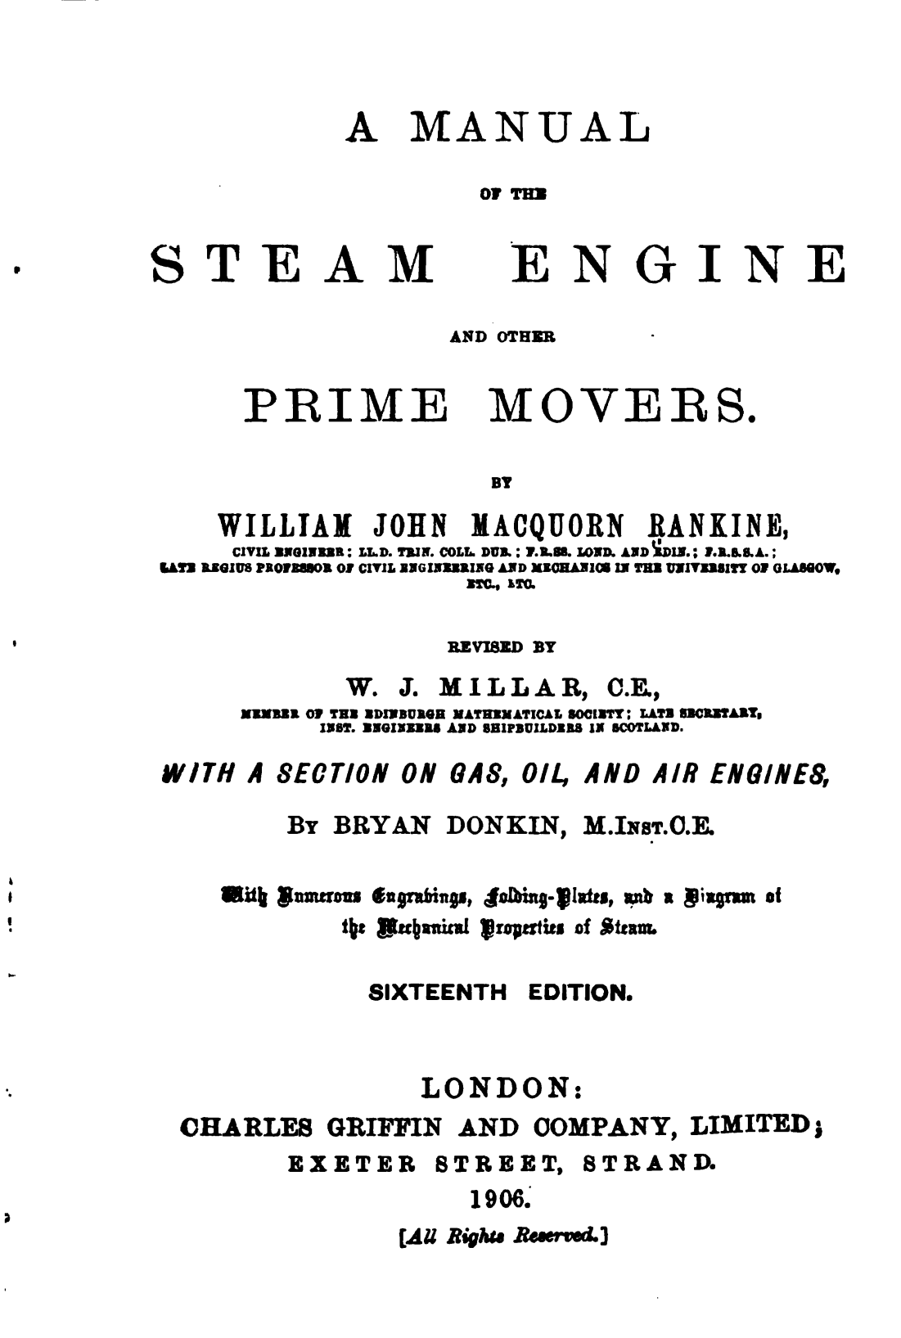
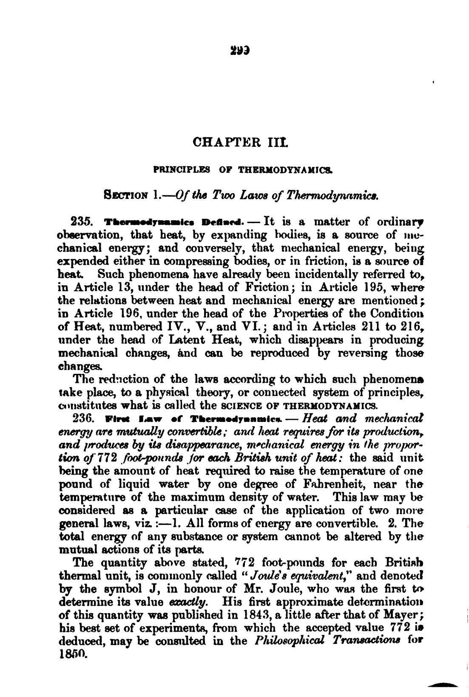

Slide 15
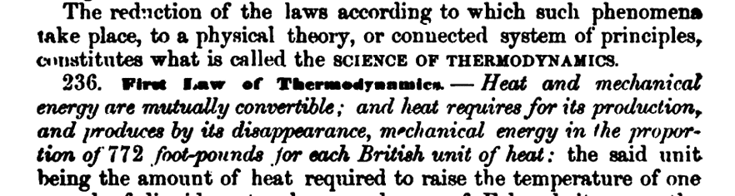

Slide 16
Ch. 0 Introduction-8

Slide 17
Ch. 0 Introduction-9

