Slide 2
Text & references:
0. Fundamentals of thermal-fluid sciences, 5th Ed., Yunus A. Cengel, et al. McGraw-Hill, 2017.
1. Understanding Thermodynamics, H. C. Van Ness, Dover, 1983.
2. Understanding Energy, R. S. Berry, World Scientific, 1991.
3. Thermodynamics, E. Fermi, Dover, 1956.
4. From Watt to Clausius, D. S. L. Cardwell, Iowa State University Press, 1989.
절대평가와 상대평가의 혼합형
수시시험(30%), 기말시험(30%), 과제물(40%, 8회 각 5%)

Slide 3
W01. 열역학 입문; 온도, 에너지, 효율
W02. 미시적 및 거시적 기술, 차원과 단위(과제 1)
W03. 기본적인 개념들, 상태, 성질
W04. 상태의 기술에 대한 가정, 열역학 제0 법칙(과제 2)
W05. 열역학 제1 법칙; 에너지 보존 법칙(과제3)
W06. 순수 물질의 성질
W07. 상태 평면과 포화 상태(과제 4)
W08. 닫힌 계의 에너지 해석(과제 5)
W09. 유동이 있는 계의 에너지 해석(과제 6)
W10. 열역학 제2 법칙
W11. 엔트로피, Carnot 사이클
W12. 이상기체의 엔트로피 변화(과제 7)
W13. Otto 사이클, 디젤 사이클
W14. Rankine 사이클(과제 8)
W15. 냉동 사이클과 열 펌프

Slide 4
Ch.2 Basic concepts of thermodynamics(THD)-0A
Every science has a unique vocabulary associated with it, and thermodynamics
is no exception. Precise definition of basic concepts forms a sound foundation
for the development of a science and prevents possible misunderstandings. We
start this chapter with a discussion of some basic concepts such as system,
state, state postulate, equilibrium, and process. We discuss intensive and extensive
properties of a system and define density, specific gravity, and specific weight. We
also discuss temperature and temperature scales with particular emphasis on the
International Temperature Scale of 1990. We then present pressure, which is the
normal force exerted by a fluid per unit area and discuss absolute and gage
pressures, the variation of pressure with depth, and pressure measurement devices,

Slide 5
Ch.2 Basic concepts of thermodynamics(THD)-0B
such as manometers and barometers. Careful study of these concepts is essential
for a good understanding of the topics in the following chapters.

Slide 6
Ch.2 Basic concepts of thermodynamics(THD)-0C
Every science has a unique vocabulary associated with it, and thermodynamics
모든 과학은 가진다 고유한 어휘를 그와 관련된, 그리고 열역학도
is no exception. Precise definition of basic concepts forms a sound foundation
아니다 예외가. 정확한 정의는 근본적인 개념들의 형성한다 건실한 기초를
for the development of a science and prevents possible misunderstandings. We
위한 전개를 한 과학의 또 방지한다 가능한 오해들을.
start this chapter with a discussion of some basic concepts such as system,
시작한다 이 장을 토론으로 기본적인 개념 와 같은 계
state, state postulate, equilibrium, and process. We discuss intensive and
상태, 상태 가설, 평형, 과정. 논의한다 내적 그리고
extensive properties of a system and define density, specific gravity, and specific
외적 성질들 계의 정의한다 밀도, 비중, 비중량을
weight. We also discuss temperature and temperature scales with particular
또한 논의한다 온도 온도 스케일 특히
emphasis on the International Temperature Scale of 1990. We then present
강조하면서 국제온도 스케일 1990년의. 다음으로 제시한다
pressure, which is the normal force exerted by a fluid per unit area and discuss
압력 법선 방향 힘 유체에 의해서 작용하는 단위 면적 당 또 논의한다
absolute and gage pressures, the variation of pressure with depth, and pressure 절대 및 게이지 압력 변화 압력의 깊이에 따른 압력

Slide 7
Ch.2 Basic concepts of thermodynamics(THD)-0D
measurement devices, such as manometers and barometers. Careful study of
계측 도구 와 같은 수주계 기압계 조심스러운 공부는
these concepts is essential for a good understanding of the topics in the
이들 개념들의 필수적이다 잘 이해하기 위해 주제들을
following chapters.
다음 장들의.

Slide 8
Ch.2 Basic concepts of thermodynamics(THD)-0E
Every science has a unique vocabulary associated with it, and thermodynamics
모든 과학은 그와 관련된 고유한 어휘를 가진다, 그리고 열역학도
is no exception. Precise definition of basic concepts forms a sound foundation
예외가 아니다. 기본적인 개념의 정확한 정의는 한 과학의 전개를 위한 건실한
for the development of a science and prevents possible misunderstandings. We
기초를 형성하며, 또 가능한 오해들을 방지한다.
start this chapter with a discussion of some basic concepts such as system,
이 장을 계, 상태, 상태 가설, 평형, 과정과 같은 기본적인 개념에 대한 토론으로
state, state postulate, equilibrium, and process. We discuss intensive and
시작한다. 내적인 그리고 외적인
extensive properties of a system and define density, specific gravity, and specific
계의 성질들에 대해 논의하고, 또 밀도, 비중, 비중량을 정의한다.
weight. We also discuss temperature and temperature scales with particular
또한 온도, 온도 스케일에 대해, 특히 1990년의 국제 온도 스케일을
emphasis on the International Temperature Scale of 1990. We then present
강조하면서 논의한다. 다음으로 유체에 의해서 단위 면적 당 작용하는
pressure, which is the normal force exerted by a fluid per unit area and discuss
법선 방향 힘인 압력을 제시하며,
absolute and gage pressures, the variation of pressure with depth, and pressure
또 절대 및 게이지 압력, 깊이에 따른 압력 변화,

Slide 9
Ch.2 Basic concepts of thermodynamics(THD)-0F
measurement devices, such as manometers and barometers. Careful study of
수주계, 기압계 와 같은 압력 계측 도구에 대해 토의한다.
these concepts is essential for a good understanding of the topics in the
이들 개념들의 조심스러운 공부는 다음 장들의 주제들을 잘 이해하기 위해
following chapters.
필수적이다.

Slide 10
Ch.2 Basic concepts of thermodynamics(THD)-1
2-1 Systems
System vs. surroundings; separated by boundary, Fig. 2-1
quantity of matter or region of space for study,
Closed vs. open; mass vs. volume
Fig. 2-2, 2-3, 2-4, 2-5

Slide 11
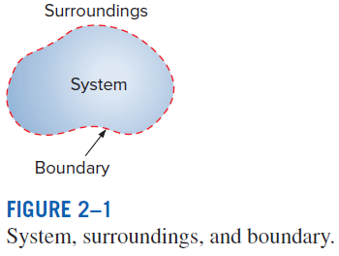
Ch.2 Basic concepts of thermodynamics(THD)-1a

Slide 12
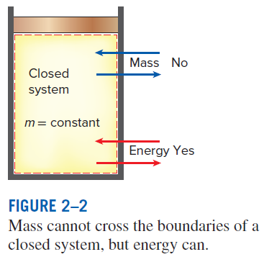
Ch.2 Basic concepts of thermodynamics(THD)-1b

Slide 13
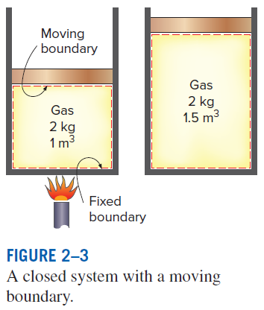
Ch.2 Basic concepts of thermodynamics(THD)-1c

Slide 14
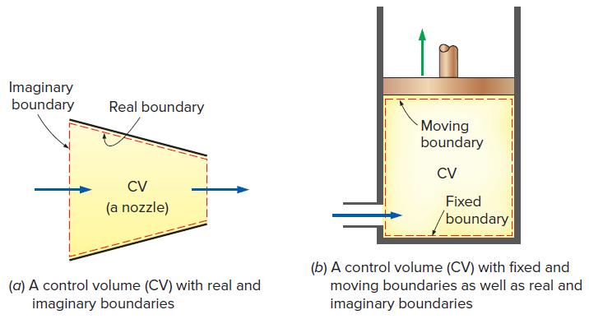
Ch.2 Basic concepts of thermodynamics(THD)-1c

Slide 15
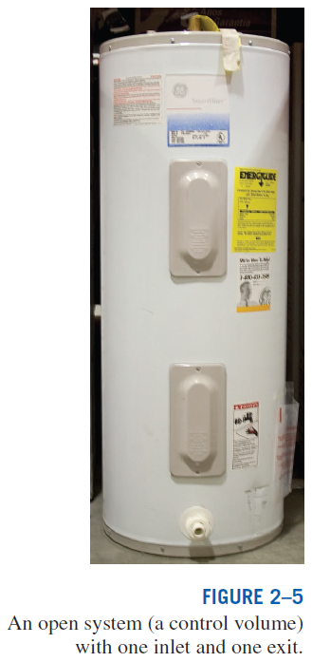
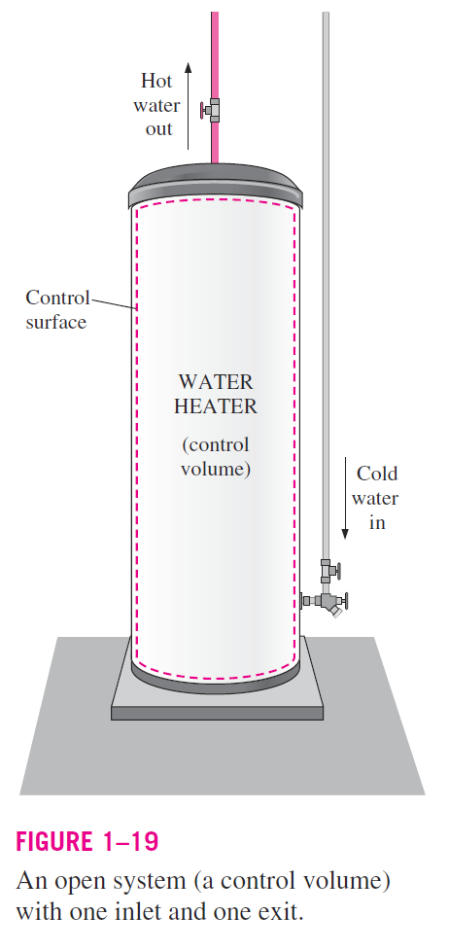
Ch.2 Basic concepts of thermodynamics(THD)-1e

Slide 16
Ch.2 Basic concepts of thermodynamics(THD)-2
2-2 Properties of a system
Property; characteristic of a system
ex. pressure, volume, temperature, mass, viscosity,
density, specific gravity, specific volume, etc
Intensive vs. extensive properties, Fig. 2-6+
intensive; independent of the size of the system,
extensive;
specific; properties per unit mass; Table2-1

Slide 17
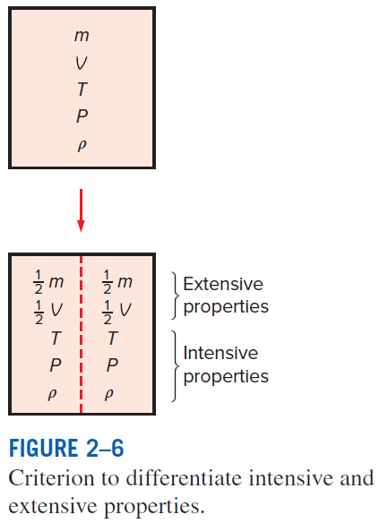
Ch.2 Basic concepts of thermodynamics(THD)-2a

Slide 18
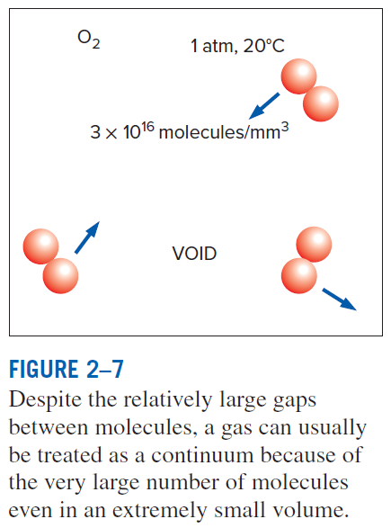
Ch.2 Basic concepts of thermodynamics(THD)-2b

Slide 19
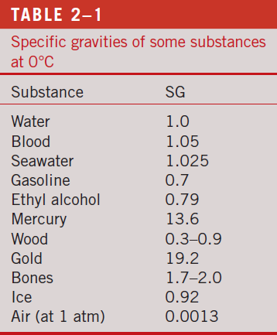
Ch.2 Basic concepts of thermodynamics(THD)-2c

Slide 20
Ch.2 Basic concepts of thermodynamics(THD)-3
2-4 State & equilibrium
Complete description of a system; state
all the properties have fixed values Fig. 2-9
Equilibrium state; Fig. 2-10
thermodynamic( ), mechanical( ), phase, and chemical equilibrium

Slide 21
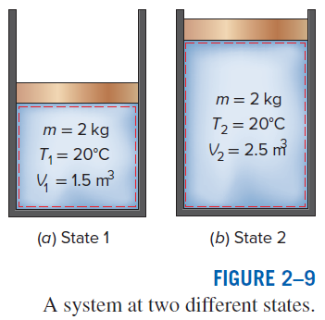
Ch.2 Basic concepts of thermodynamics(THD)-3a

Slide 22
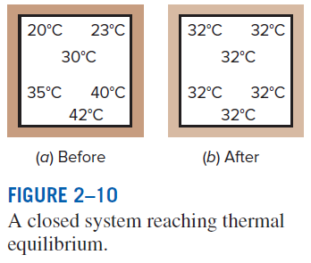
Ch.2 Basic concepts of thermodynamics(THD)-3b

Slide 23
Ch.2 Basic concepts of thermodynamics(THD)-4
2-4a The state postulate
Number of properties to fix the state of a system; Fig. 2-11
The state of a simple compressible system is completely
specified by two independent, intensive, properties
---suggested by the equation of state for ideal gas
Electric, magnetic, gravitational, motion, surface tension,
and multi-phase effects should be considered separately.

Slide 24
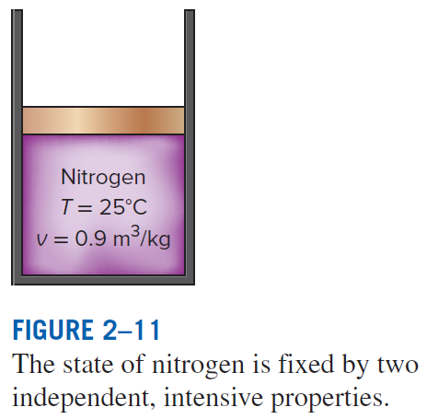
Ch.2 Basic concepts of thermodynamics(THD)-4a

Slide 25
Ch.2 Basic concepts of thermodynamics(THD)-5
2-5 Processes & cycles
Process and path; Fig. 2-12
change that a system undergoes from a state to another,
series of states for a process
- Quasi-equilibrium process; ideal like w/o ‘friction’, Fig. 2-13
Process diagrams; etc Fig. 2-14
Isothermal( ), isobaric( ), isometric( ) process
Cycle;
process for which the initial and the final states are the same
Fig. 2-15

Slide 26
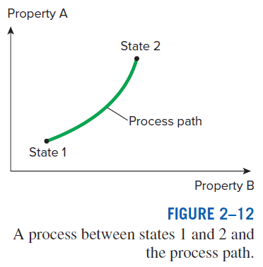
Ch.2 Basic concepts of thermodynamics(THD)-5a

Slide 27
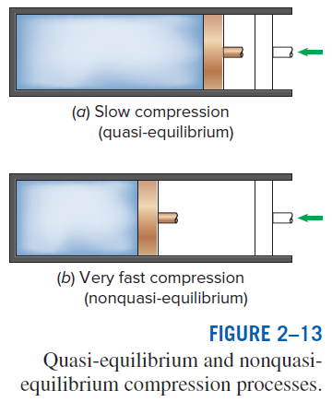
Ch.2 Basic concepts of thermodynamics(THD)-5b

Slide 28
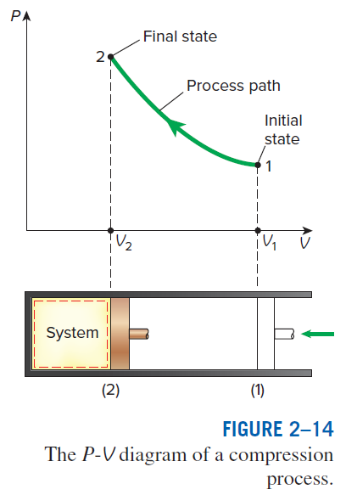
Ch.2 Basic concepts of thermodynamics(THD)-5c

Slide 29
Ch.2 Basic concepts of thermodynamics(THD)-5d

Slide 30
Ch.2 Basic concepts of thermodynamics(THD)-6
2-6 Temperature and the zeroth law of thermodynamics
- Temperature; zeroth law of THD; Fig. 2-17
Two bodies are in thermal equilibrium if both have the same reading
even if they are not in contact
- Temperature scales
Celsius, Fahrenheit, Kelvin(thermodynamic), Rankine, and
ideal gas temperature;
at low pressures, the temperature of a gas is proportional to
its pressure at constant volume
Fig. 2-18
Making the scale so that , → absolute gas temperature scale
- Absolute gas temperature scale = thermodynamic temperature scale
Ex. 2-1

Slide 31
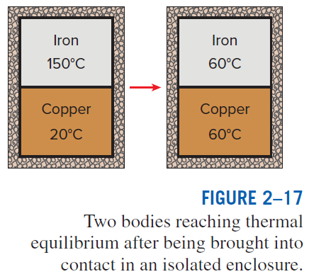
Ch.2 Basic concepts of thermodynamics(THD)-6a

Slide 32
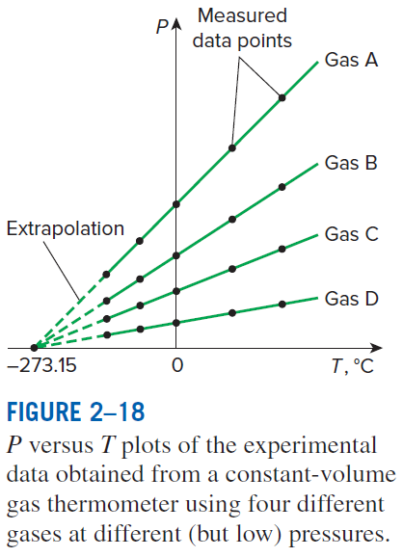
Ch.2 Basic concepts of thermodynamics(THD)-6b

Slide 33
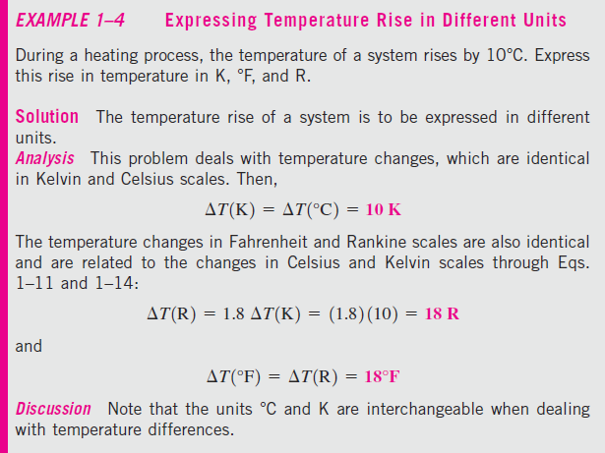
Ch.2 Basic concepts of thermodynamics(THD)-6c

Slide 34
The International Temperature Scale of 1990 (ITS-90)
The International Temperature Scale of 1990 supersedes the International Practical Temperature Scale of 1968 (IPTS-68), 1948 (ITPS-48), and 1927 (ITS-27).
The ITS-90 is similar to its predecessors except that it is more refined with updated values of fixed temperatures, has an extended range, and conforms more closely to the thermodynamic temperature scale.
On this scale, the unit of thermodynamic temperature T is again the kelvin (K), defined as the fraction 1/273.16 of the thermodynamic temperature of the triple point of water, which is sole defining fixed point of both the ITS-90 and the Kelvin scale and is the most important thermometric fixed point used in the calibration of thermometers to ITS-90. The unit of Celsius temperature is the degree Celsius (°C).
The ice point remains the same at 0°C (273.15 K) in both ITS-90 and ITPS-68, but the steam point is 99.975°C in ITS-90 whereas it was 100.000°C in IPTS-68.
The change is due to precise measurements made by gas thermometry by paying particular attention to the effect of sorption (the impurities in a gas absorbed by the walls of the bulb at the reference temperature being desorbed at higher temperatures, causing the measured gas pressure to increase).

Slide 35
Ch.2 Basic concepts of thermodynamics(THD)-7
2-7 Pressure
- pressure; force per unit area
- Absolute pressure and gage pressure
gage; relative to atmospheric pressure(standard, )
vacuum; below atmospheric pressure
- Pascal’s law; Fig. 2-30
- Barometer; Fig. 2-31
- Manometer; Fig. 2-37, 38, Ex. 2-6
HW: Ch. 2; 30, 38, 48, 50, 68, 69, 72, 74, 76, 78

Slide 36
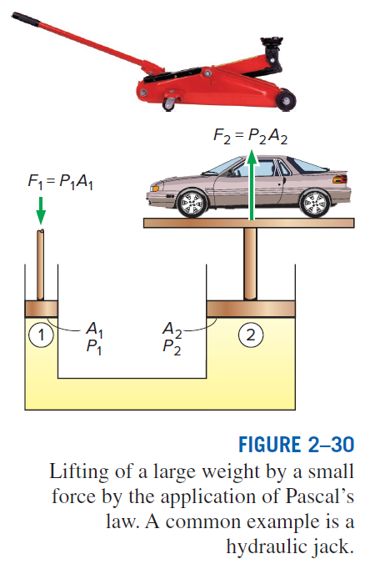
Ch.2 Basic concepts of thermodynamics(THD)-7a

Slide 37
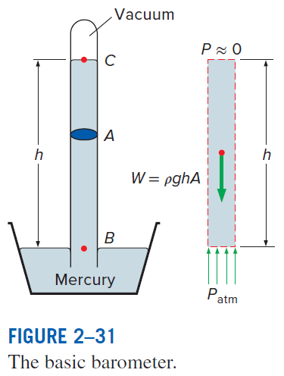
Ch.2 Basic concepts of thermodynamics(THD)-7b

Slide 38
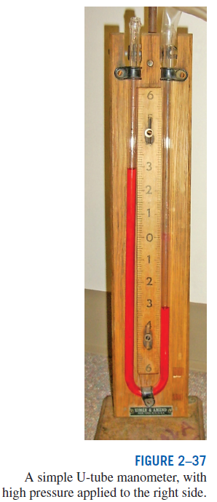
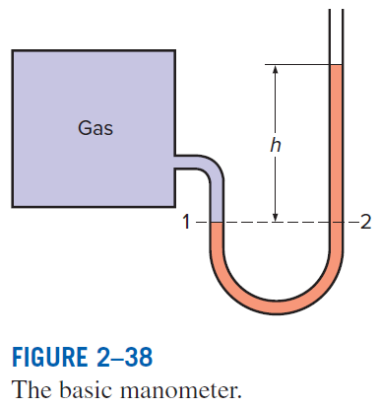
Ch.2 Basic concepts of thermodynamics(THD)-7c

Slide 39
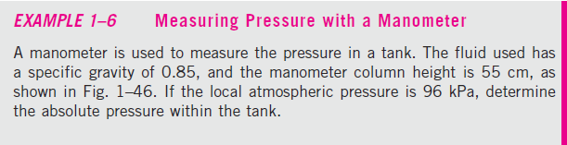
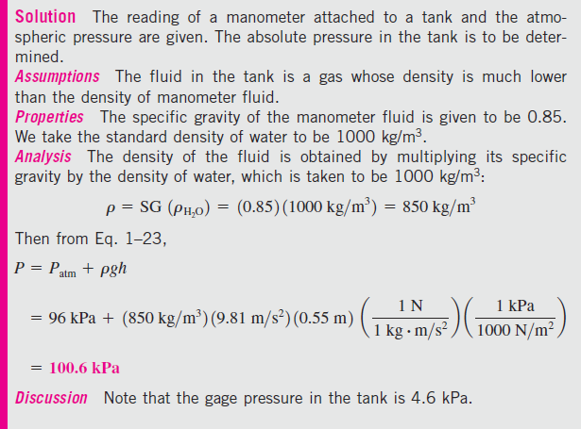
Ch.2 Basic concepts of thermodynamics(THD)-7d

Slide 40
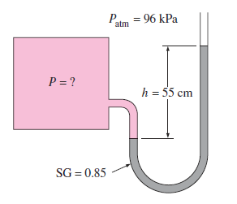
Ch.2 Basic concepts of thermodynamics(THD)-7e

