Slide 2
Text & references:
0. Fundamentals of thermal-fluid sciences, 5th Ed., Yunus A. Cengel, et al. McGraw-Hill, 2017.
1. Understanding Thermodynamics, H. C. Van Ness, Dover, 1983.
2. Understanding Energy, R. S. Berry, World Scientific, 1991.
3. Thermodynamics, E. Fermi, Dover, 1956.
4. From Watt to Clausius, D. S. L. Cardwell, Iowa State University Press, 1989.
절대평가와 상대평가의 혼합형
수시시험(30%), 기말시험(30%), 과제물(40%, 8회 각 5%)

Slide 3
W01. 열역학 입문; 온도, 에너지, 효율
W02. 미시적 및 거시적 기술, 차원과 단위(과제 1)
W03. 기본적인 개념들, 상태, 성질
W04. 상태의 기술에 대한 가정, 열역학 제0 법칙(과제 2)
W05. 열역학 제1 법칙; 에너지 보존 법칙(과제3)
W06. 순수 물질의 성질
W07. 상태 평면과 포화 상태(과제 4)
W08. 닫힌 계의 에너지 해석(과제 5)
W09. 유동이 있는 계의 에너지 해석(과제 6)
W10. 열역학 제2 법칙
W11. 엔트로피, Carnot 사이클
W12. 이상기체의 엔트로피 변화(과제 7)
W13. Otto 사이클, 디젤 사이클
W14. Rankine 사이클(과제 8)
W15. 냉동 사이클과 열 펌프

Slide 4
Ch.3 Energy-0A
Whether we realize it or not, energy is an important part of most aspects of daily life. The quality of life, and even its sustenance, depends on the availability of energy. Therefore, it is important to have a good understanding of the sources of energy, the conversion of energy from one form to another, and the ramifications of theses conversions.
Energy exists in numerous forms such as thermal, mechanical, electric, chemical, and nuclear. Even mass can be considered a form of energy. Energy can be transferred to or from a closed system (a fixed mass) in two distinct forms: heat and work. For control volumes, energy can also be transferred by mass flow. An energy transfer to or from a closed system is heat if it is caused by temperature difference. Otherwise it is work, and it is caused by a force acting through a distance.
We start this chapter with a discussion of various forms of energy and energy transfer by heat. We then introduce various forms of work and discuss energy transfer by work. We continue with developing a general intuitive expression for the first law of thermodynamics, also known as the conservation of energy principle, which is one of the most fundamental principles in nature, and we then demonstrate its use. Finally, we discuss the efficiencies of some familiar energy conversion processes. Detailed treatments of the first law of thermodynamics for closed system and control volumes are given in Chapters 5 and 6, respectively.

Slide 5
Ch.3 Energy-1
3-1 Introduction
- Conservation of energy principle
- energy is a property
- heat and work are forms of energy crossing boundary, Fig. 3-a
3-2 Forms of energy
- Total energy , per unit mass ;
- Internal energy , per unit mass ; molecular, microscopic
- Kinetic energy , per unit mass ; continuum, macroscopic
- Potential energy , per unit mass ; continuum, macroscopic
- Flow rate; volume, mass, energy;
- Mechanical energy flow energy for fluid
Fig. 3-11, 3-12
Notes:
Greek word: adiabatos; not to be passed → adiabatic

Slide 6
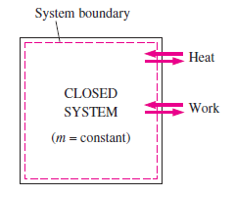
Ch.3 Energy-1a

Slide 7
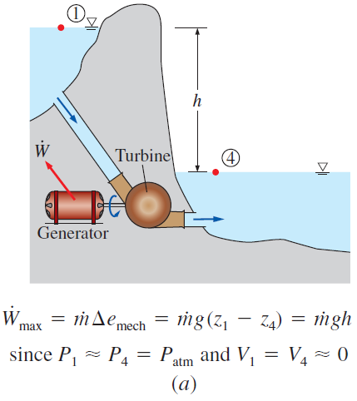
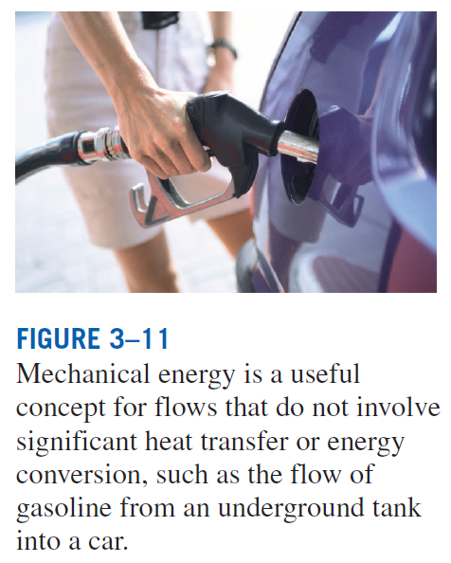
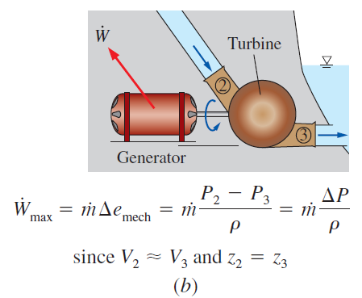
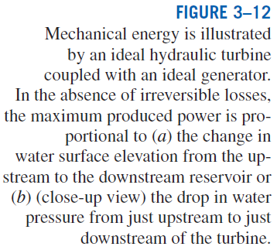

Slide 8
Ch.3 Energy-2
3-3 Energy transfer by heat
- Heat; a form of energy that is transferred between two systems by
virtue of a temperature difference
- heat=thermal energy
- heat means ‘heat transfer’ Fig. 3-16
- adiabatic process; process during which no heat transfer occurs, Fig. 3-17
- Heat , per unit mass
- heat transfer rate , per unit mass , Fig. 3-18
- conduction, convection, radiation,
- sign convention for heat;
+ if the system energy increases, - if decreases.
Notes:
Greek word: adiabatos; not to be passed → adiabatic

Slide 9
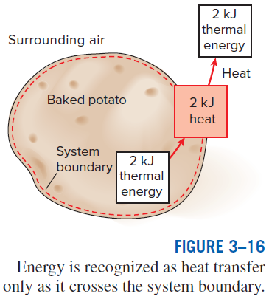
Ch.3 Energy-2a

Slide 10
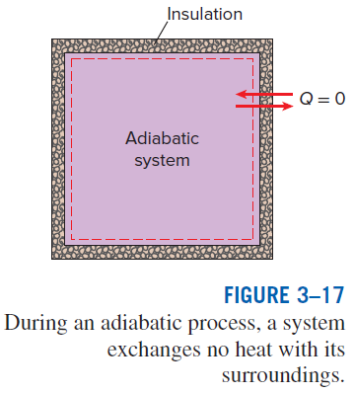
Ch.3 Energy-2b

Slide 11
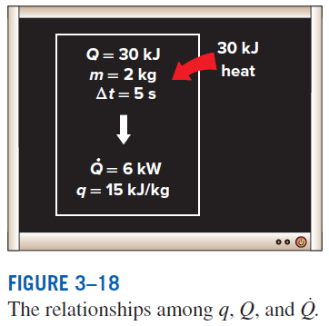
Ch.3 Energy-2c

Slide 12
Ch.3 Energy-3
3-4 Energy transfer by work
- Work; form of energy transferred other than heat
-
Fig. 3-20
- sign convention for work;
+ if the system energy decreases, - if increases. Fig. 3-21
- Similarities of heat and work; boundary and transfer phenomena,
process and path dependent quantities. Fig. 3-22
Ex. 3-3, 3-4, 3-5, 3-6
- Electrical work Fig. 3-27
Notes:
Greek word: adiabatos; not to be passed → adiabatic

Slide 13
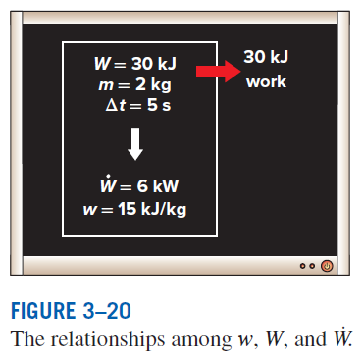
Ch.3 Energy-3a

Slide 14
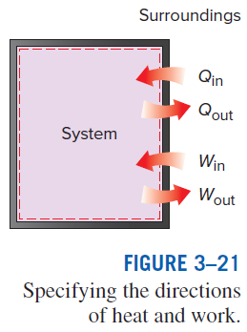
Ch.3 Energy-3b

Slide 15
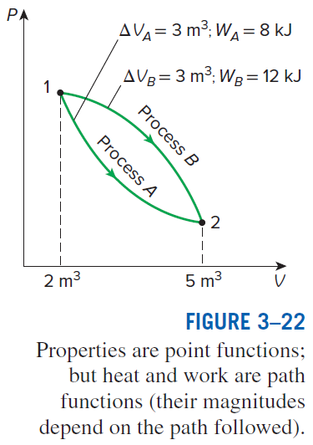
Ch.3 Energy-3c

Slide 16
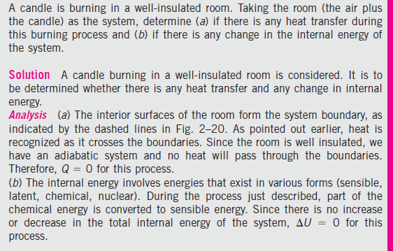
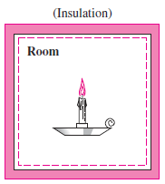
Ch.3 Energy-3d

Slide 17
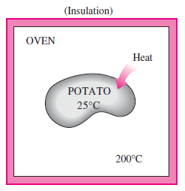
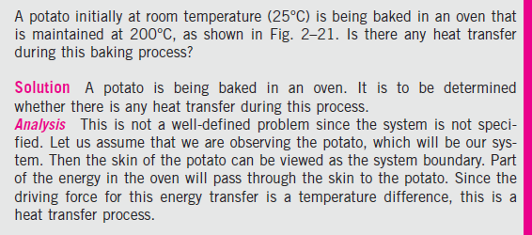
Ch.3 Energy-3e

Slide 18
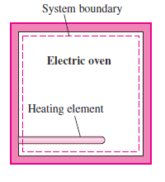

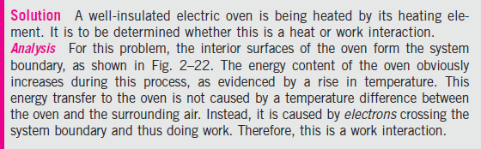
Ch.3 Energy-3f

Slide 19
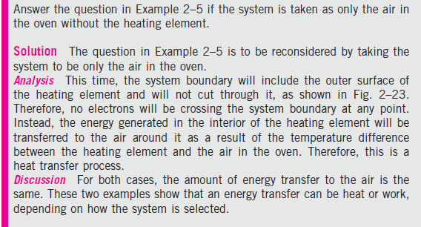
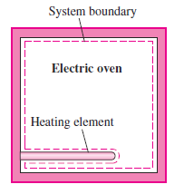
Ch.3 Energy-3g

Slide 20
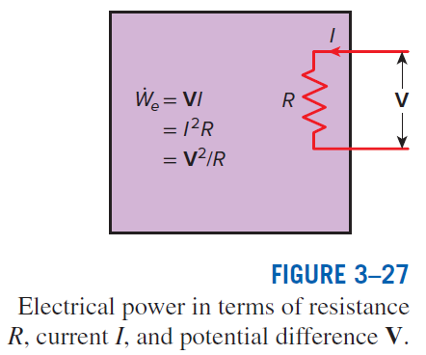
Ch.3 Energy-3h

Slide 21
Ch.3 Energy-4
3-5 Mechanical forms of work
- Moving boundary work; quasi-equilibrium process is assumed
Fig. 3-28, 3-b, 3-c, 3-d
- Shaft work; Fig. 3-29, -30
Ex. 3-7
- Spring work;
- Nonmechanical forms of work;
electrical work, magnetic work, electrical polarization work
Notes:
Greek word: adiabatos; not to be passed → adiabatic

Slide 22
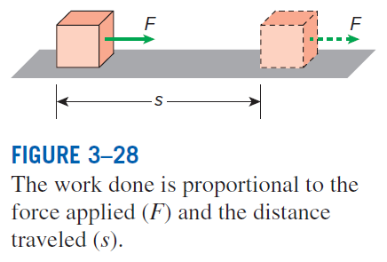
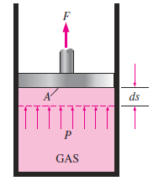
Ch.3 Energy-4a

Slide 23
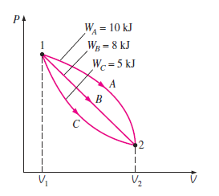
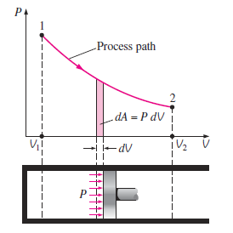
Ch.3 Energy-4b

Slide 24
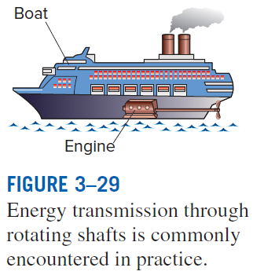
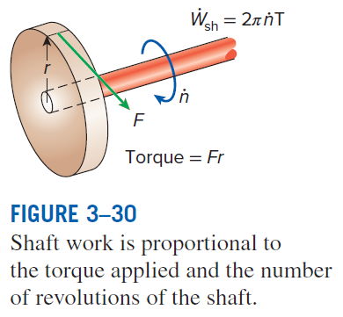
Ch.3 Energy-4c

Slide 25
Ch.3 Energy-4d

Slide 26
Ch.3 Energy-5
3-6 The first law of thermodynamics
Fig. 3-39
- For all adiabatic processes
between two specified states of a closed system,
the net work done is the same
regardless of the nature of the closed system
and the details of the process,
Fig. 3-42, 43, 44
- In the absence of any work interactions
between a system and its surrounding,
the amount of net heat transfer is
equal to the change of a closed system,
Fig. 3.-40, 41

Slide 27
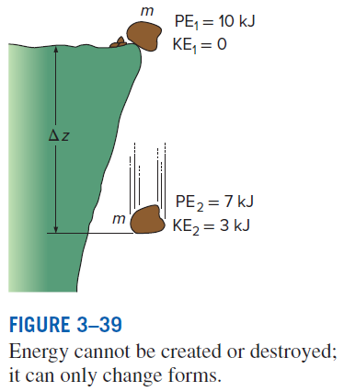
Ch.3 The first law of thermodynamics: Closed systems-5a

Slide 28
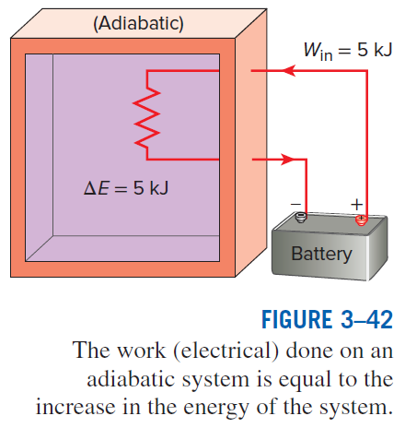
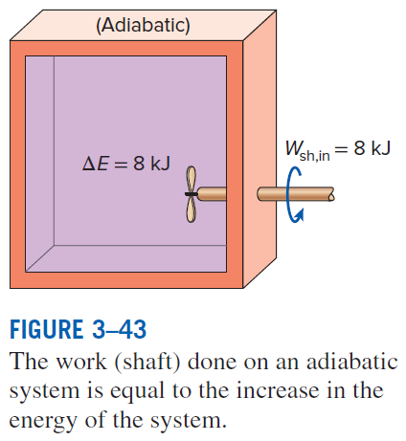
Ch.3 The first law of thermodynamics: Closed systems-5b

Slide 29
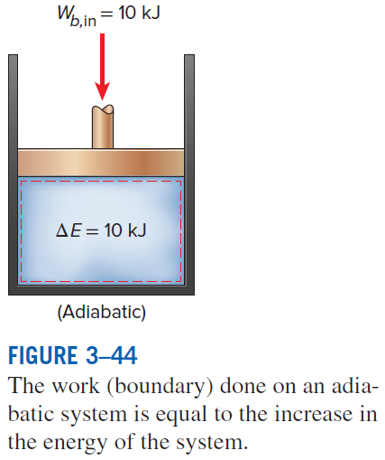
Ch.3 The first law of thermodynamics: Closed systems-5c

Slide 30
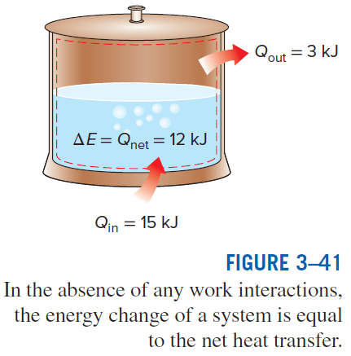
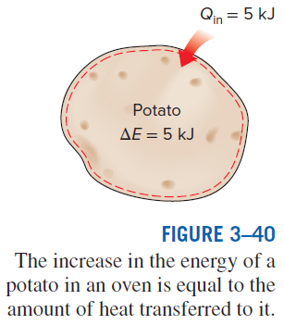
Ch.3 The first law of thermodynamics: Closed systems-5d

Slide 31
Ch.3 Energy-6
- Above gives for a closed system, Fig. 3-45
Notes;
Fig. 3-46
Fig. 3-48, Ex. 3-10

Slide 32
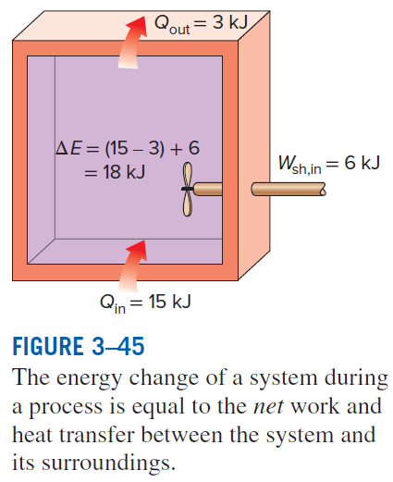
Ch.3 The first law of thermodynamics: Closed systems-6a

Slide 33
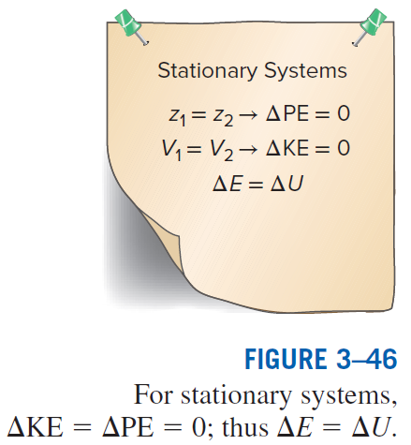
Ch.3 The first law of thermodynamics: Closed systems-6b

Slide 34
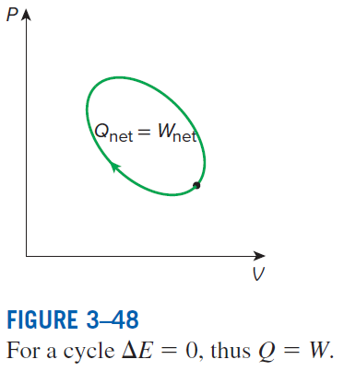
Ch.3 The first law of thermodynamics: Closed systems-6c

Slide 35
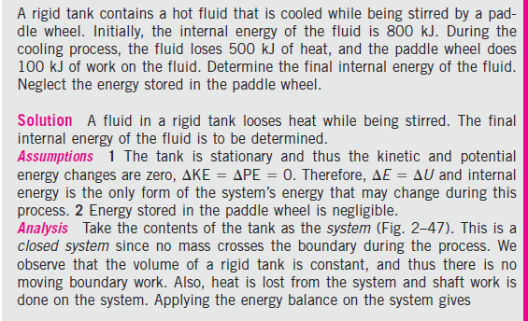
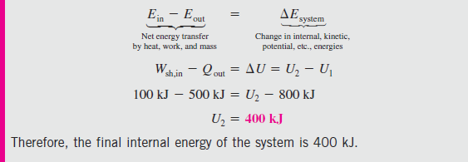
Ch.3 The first law of thermodynamics: Closed systems-6d

Slide 36
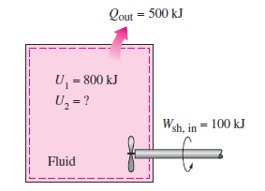
Ch.3 The first law of thermodynamics: Closed systems-6e

Slide 37
Ch.3 Energy-7
3-7 Energy conversion efficiencies

Slide 38
Ch.3 Energy-8
HW Ch.3 Problems 14, 31, 43, 61, 64, 65, 66, 77, 78, 79

Slide 39
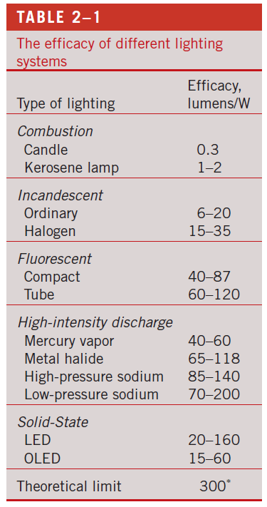
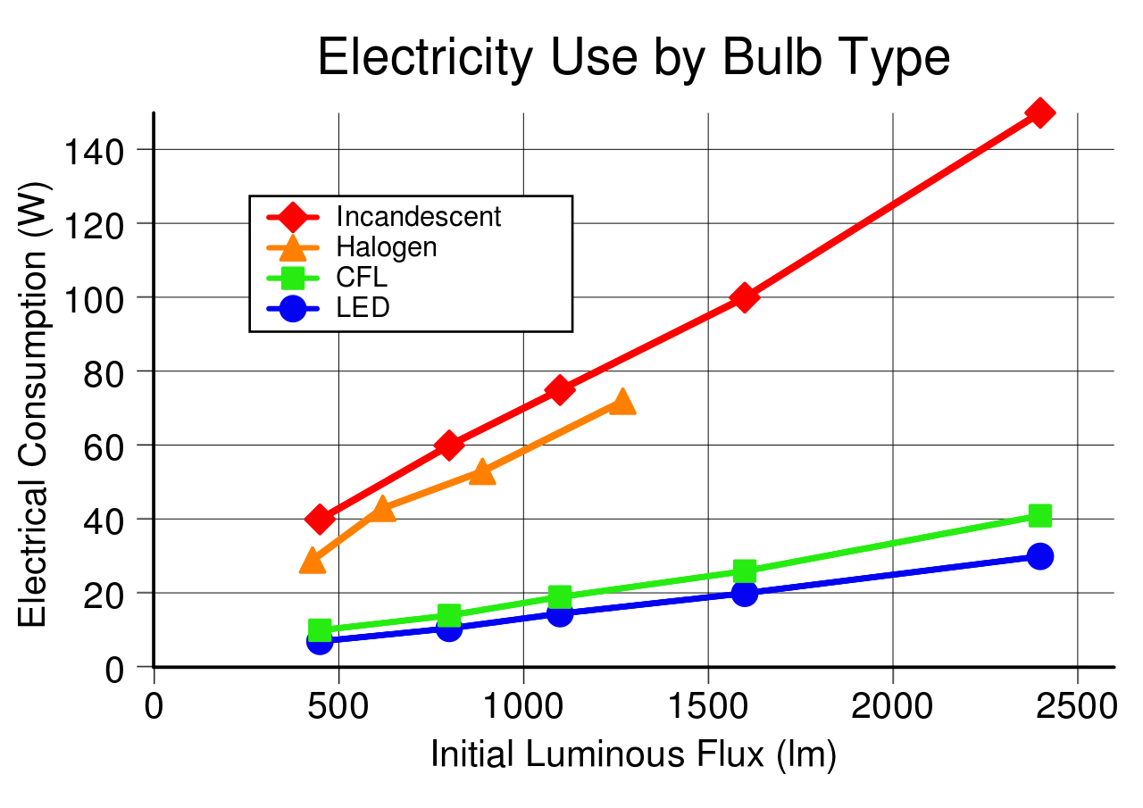
Ch.3 Energy-8a

Slide 40
Ch.3 Energy-8b
lux 20–50 | Surfaces Public areas with dark surroundings
50 | Family living room lights
80 | Office building hallway/toilet lighting
100 | Very dark overcast day
320–500 | Office lighting
400 | Sunrise or sunset on a clear day.
1000 | Overcast day; TV studio lighting
10,000–25,000 | Full daylight (not direct sun)
32,000–100,000 | Direct sunlight

Slide 41
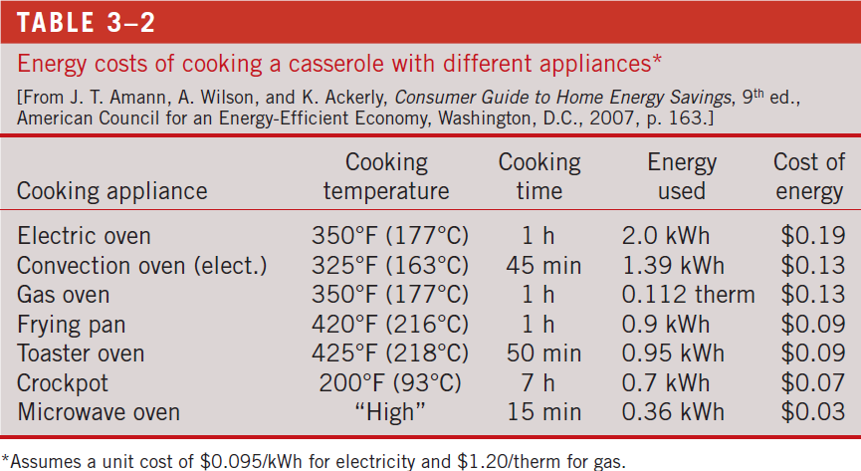
Ch.3 Energy-8c

