Slide 2
Text & references:
0. Fundamentals of thermal-fluid sciences, 5th Ed., Yunus A. Cengel, et al. McGraw-Hill, 2017.
1. Understanding Thermodynamics, H. C. Van Ness, Dover, 1983.
2. Understanding Energy, R. S. Berry, World Scientific, 1991.
3. Thermodynamics, E. Fermi, Dover, 1956.
4. From Watt to Clausius, D. S. L. Cardwell, Iowa State University Press, 1989.
절대평가와 상대평가의 혼합형
수시시험(30%), 기말시험(30%), 과제물(40%, 8회 각 5%)

Slide 3
W01. 열역학 입문; 온도, 에너지, 효율
W02. 미시적 및 거시적 기술, 차원과 단위(과제 1)
W03. 기본적인 개념들, 상태, 성질
W04. 상태의 기술에 대한 가정, 열역학 제0 법칙(과제 2)
W05. 열역학 제1 법칙; 에너지 보존 법칙(과제3)
W06. 순수 물질의 성질
W07. 상태 평면과 포화 상태(과제 4)
W08. 닫힌 계의 에너지 해석(과제 5)
W09. 유동이 있는 계의 에너지 해석(과제 6)
W10. 열역학 제2 법칙
W11. 엔트로피, Carnot 사이클
W12. 이상기체의 엔트로피 변화(과제 7)
W13. Otto 사이클, 디젤 사이클
W14. Rankine 사이클(과제 8)
W15. 냉동 사이클과 열 펌프

Slide 4
Ch.4 Properties of pure substances-0A
We start this chapter with the introduction of the concept of a pure
substance and a discussion of the physics of phase-change processes.
We then illustrate the various property diagrams and surfaces of
pure substances. After demonstrating the use of the property tables,
the hypothetical substance ideal gas and the ideal-gas equation of state are
discussed. The compressibility factor, which accounts for the deviation of real
gases from ideal-gas behavior, is introduced.

Slide 5
Ch.4 Properties of pure substances-1
4-1 Pure substance
pure; a fixed chemical composition
ex: mixture of ice and water; pure Fig. 4-1
mixture of gas and liquid air; not pure Fig. 4-2
4-2 Phases of a pure substance
3 principal phases; solid, liquid, gas
phase; distinct and homogeneous molecular arrangement,
solid: lattice, Fig. 4-3
liquid: a little farther apart, however,
water(shorter than ice, thus heavier) is a rare exception
gas: free motion Fig. 4-5

Slide 6
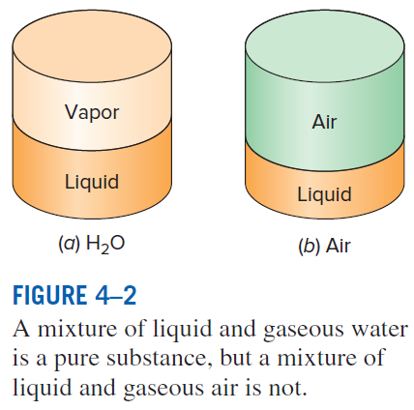
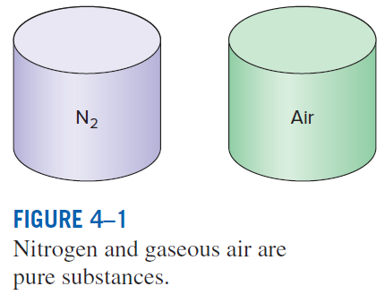
Ch.4 Properties of pure substances-1a

Slide 7
Ch.4 Properties of pure substances-1
4-1 Pure substance
pure; a fixed chemical composition
ex: mixture of ice and water; pure Fig. 4-1
mixture of gas and liquid air; not pure Fig. 4-2
4-2 Phases of a pure substance
3 principal phases; solid, liquid, gas
phase; distinct and homogeneous molecular arrangement,
solid: lattice, Fig. 4-3
liquid: a little farther apart, however,
water(shorter than ice, thus heavier) is a rare exception
gas: free motion Fig. 4-4

Slide 8
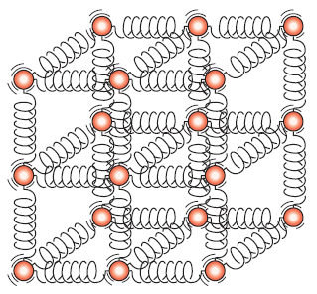
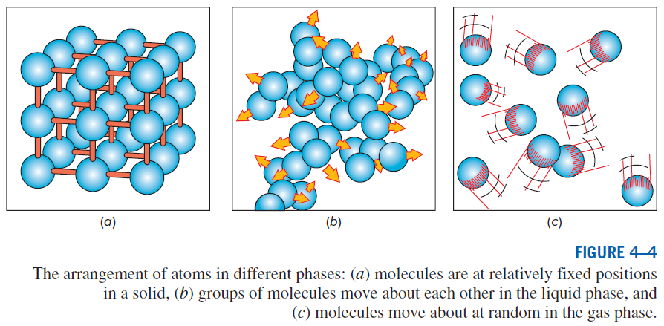
Ch.4 Properties of pure substances-1b

Slide 9
Ch.4 Properties of pure substances-2
4-3 Phase-change processes of pure substances
Ex: liquid and vapor mixture of water; under a constant pressure,
state 1; compressed liquid Fig. 4-5
state 2; saturated liquid Fig. 4-6
state 3; vaporization Fig. 4-7, saturated liquid-vapor mixture
state 4; saturated vapor Fig. 4-8,
state 5; superheated vapor Fig. 4-9
diagram, Fig. 4-10
saturation temperature and saturation pressure;
at a given pressure, → saturation temperature,
at a given temperature → saturation pressure Fig. 4-12
boiling temperature as pressure goes up; ex. pressure cooker, Table 4-1
in mountains, as pressure goes down, boiling temperature . Table 4-2

Slide 10
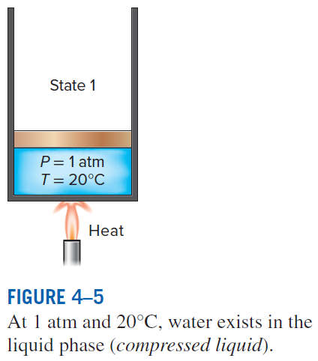
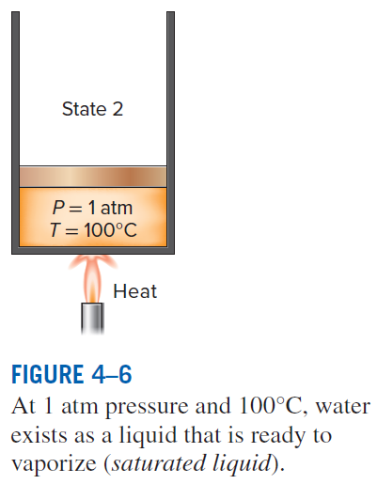
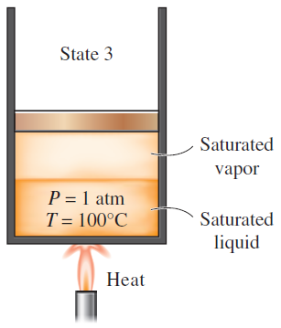
Ch.4 Properties of pure substances-2a
As more heat is transferred,
part of the saturated liquid
vaporizes (saturated liquid–
vapor mixture).

Slide 11
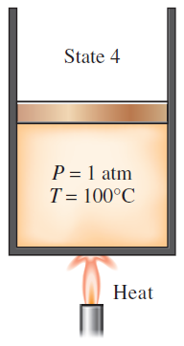
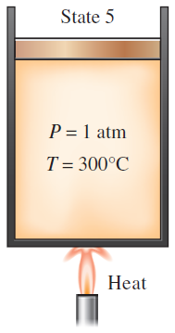
Ch.4 Properties of pure substances-2b
At 1 atm pressure, the temperature remains constant at 100°C until the last drop of liquid is vaporized
(saturated vapor).
As more heat is transferred, the temperature of the vapor starts to rise
(superheated vapor).

Slide 12
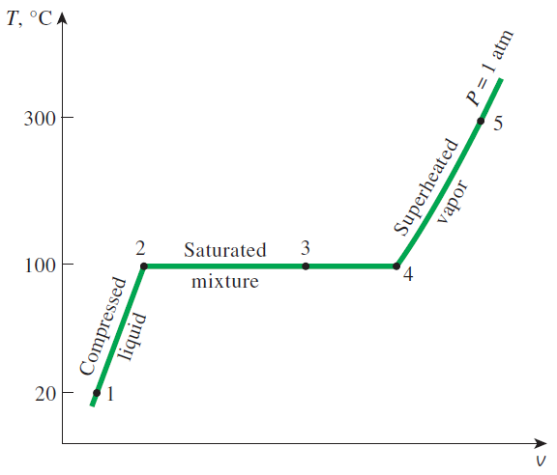
Ch.4 Properties of pure substances-2c
Fig. 4-10 T-v diagram for heating at a constant pressure

Slide 13
Ch.4 Properties of pure substances-2
4-3 Phase-change processes of pure substances
Ex: liquid and vapor mixture of water; under a constant pressure,
state 1; compressed liquid Fig. 4-5
state 2; saturated liquid Fig. 4-6
state 3; vaporization Fig. 4-7, saturated liquid-vapor mixture
state 4; saturated vapor Fig. 4-8,
state 5; superheated vapor Fig. 4-9
diagram, Fig. 4-10
saturation temperature and saturation pressure;
at a given pressure, → saturation temperature,
at a given temperature → saturation pressure Fig. 4-11
boiling temperature as pressure goes up; ex. pressure cooker, Table 4-1
in mountains, as pressure goes down, boiling temperature . Table 4-2

Slide 14
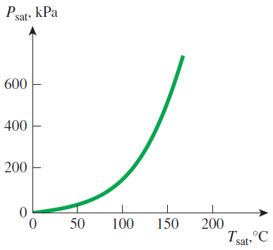
Ch.4 Properties of pure substances-2d
Fig. 4-11 Liquid-vapor saturation curve(water)

Slide 15
Ch.4 Properties of pure substances-2
4-3 Phase-change processes of pure substances
Ex: liquid and vapor mixture of water; under a constant pressure,
state 1; compressed liquid Fig. 4-5
state 2; saturated liquid Fig. 4-6
state 3; vaporization Fig. 4-7, saturated liquid-vapor mixture
state 4; saturated vapor Fig. 4-8,
state 5; superheated vapor Fig. 4-9
diagram, Fig. 4-10
saturation temperature and saturation pressure;
at a given pressure, → saturation temperature,
at a given temperature → saturation pressure Fig. 4-11
boiling temperature as pressure goes up; ex. pressure cooker, Table 4-1
in mountains, as pressure goes down, boiling temperature . Table 4-2

Slide 16
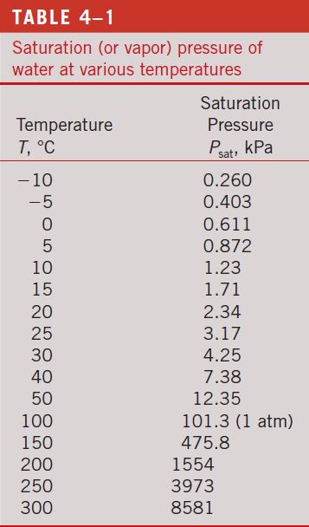
Ch.4 Properties of pure substances-2e

Slide 17
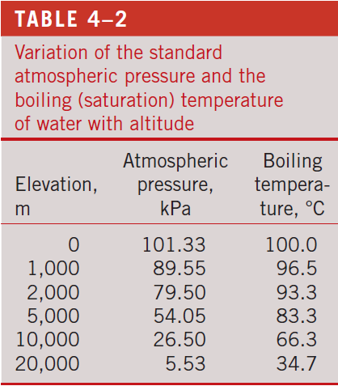
Ch.4 Properties of pure substances-2f

Slide 18
Ch.4 Properties of pure substances-3
4-4 Property diagrams for phase-change processes
1. diagram
Fig. 4-15 ; vaporization region gets shorter as
critical point; for water,
For , no distinction between liquid and vapor Fig. 4-16
Compressed liquid, superheated vapor, saturated mixture; 3 regions
Fig. 4-17a
2. diagram
Similar to diagram but w/ a difference, downward Fig. 4-17b
Including the solid phase, Fig. 4-18, triple line, Fig. 4-19a&b
3. diagram
Often called the phase diagram, Fig. 4-22, triple point Table 4-3
eg thus under atmospheric pressure, sublimation occurs;
ie dry ice.

Slide 19
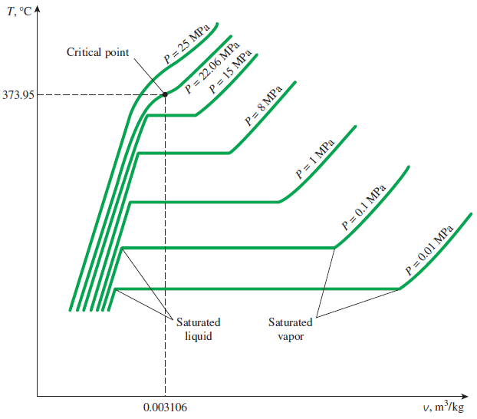
Ch.4 Properties of pure substances-3a
Fig. 4-15 T-v diagram of constant-pressure phase-change processes

Slide 20
Ch.4 Properties of pure substances-3
4-4 Property diagrams for phase-change processes
1. diagram
Fig. 4-15 ; vaporization region gets shorter as
critical point; for water,
For , no distinction between liquid and vapor Fig. 4-16
Compressed liquid, superheated vapor, saturated mixture; 3 regions
Fig. 4-17a
2. diagram
Similar to diagram but w/ a difference, downward Fig. 4-17b
Including the solid phase, Fig. 4-18, triple line, Fig. 4-19a&b
3. diagram
Often called the phase diagram, Fig. 4-22, triple point Table 4-3
eg thus under atmospheric pressure, sublimation occurs;
ie dry ice.

Slide 21
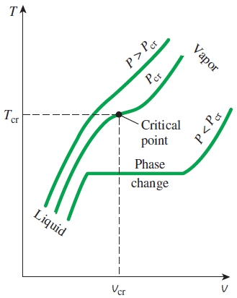
Ch.4 Properties of pure substances-3b

Slide 22
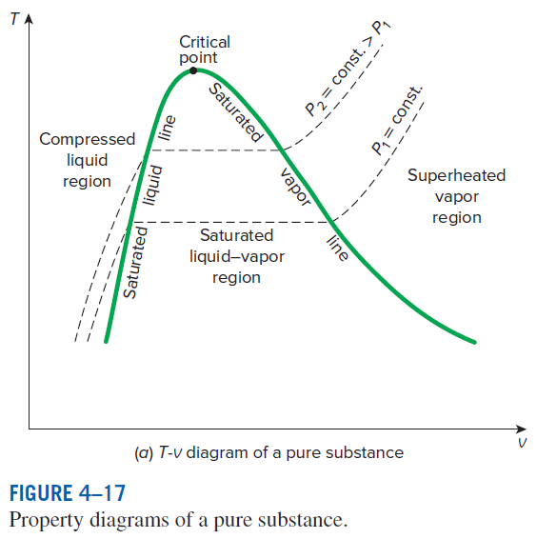
Ch.4 Properties of pure substances-3c

Slide 23
Ch.4 Properties of pure substances-3
4-4 Property diagrams for phase-change processes
1. diagram
Fig. 4-15 ; vaporization region gets shorter as
critical point; for water,
For , no distinction between liquid and vapor Fig. 4-16
Compressed liquid, superheated vapor, saturated mixture; 3 regions
Fig. 4-17a
2. diagram
Similar to diagram but w/ a difference, downward Fig. 4-17b
Including the solid phase, Fig. 4-18, triple line, Fig. 4-19a&b
3. diagram
Often called the phase diagram, Fig. 4-20, Fig. 4-21, triple point Table 4-3
eg thus under atmospheric pressure, sublimation occurs;
ie dry ice.

Slide 24
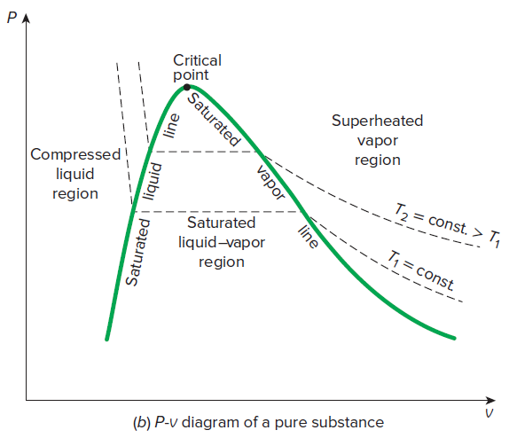
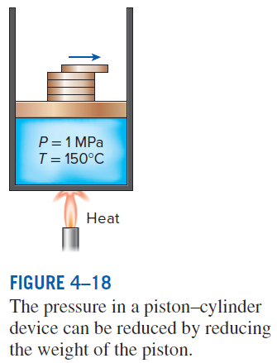
Ch.4 Properties of pure substances-3d

Slide 25
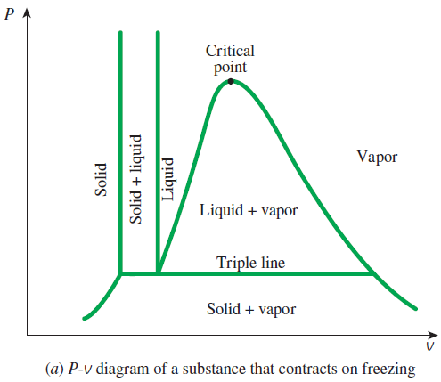
Ch.4 Properties of pure substances-3e

Slide 26
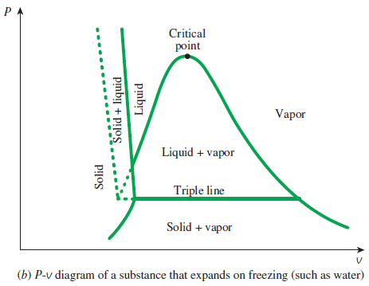
Ch.4 Properties of pure substances-3f

Slide 27
Ch.4 Properties of pure substances-3
4-4 Property diagrams for phase-change processes
1. diagram
Fig. 4-15 ; vaporization region gets shorter as
critical point; for water,
For , no distinction between liquid and vapor Fig. 4-16
Compressed liquid, superheated vapor, saturated mixture; 3 regions
Fig. 4-17a
2. diagram
Similar to diagram but w/ a difference, downward Fig. 4-17b
Including the solid phase, Fig. 4-18, triple line, Fig. 4-19a&b
3. diagram
Often called the phase diagram, Fig. 4-20, -21, -22, triple point Table 4-3
eg thus under atmospheric pressure, sublimation occurs;
ie dry ice.

Slide 28
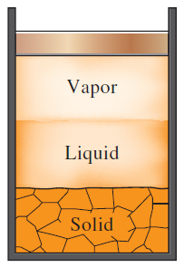
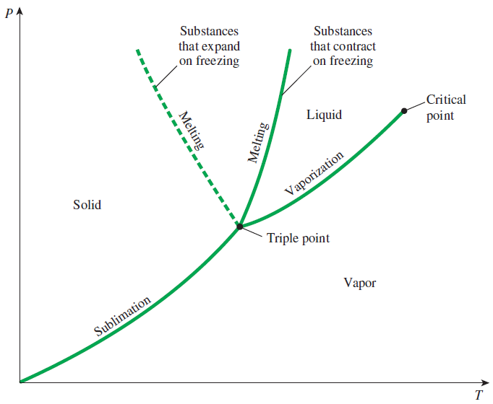
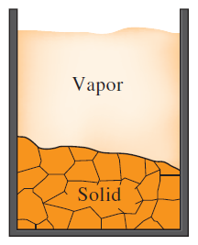
Ch.4 Properties of pure substances-3g
Fig. 4-22 p-T diagram

Slide 29
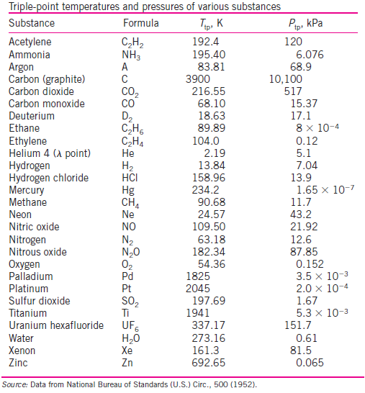
Ch.4 Properties of pure substances-3h

Slide 30
Ch.4 Properties of pure substances-4
4-4a surface
Fig. 4-23, -24, nice but hard to use
4.5 Property tables
Steam table; here, we first define enthalpy as
1. Saturated liquid and saturated vapor states
Table A-4, Fig. 4-25, -26 & -27; subscripts f, g, and fg
eg, is known as the enthalpy of vaporization, representing the
amount of energy needed to vaporize a unit mass of saturated liquid
Ex. 4-1, 4-3
-Saturated liquid-vapor mixture, Fig. 4-31 & -32
Definition of quality
Notes:
Enthalpy is from the Greek word enthalpien which means to heat, and was introduced around 1930s.
Subscripts f, g originated from German. f: Flussigkeit, g: Gas.

Slide 31
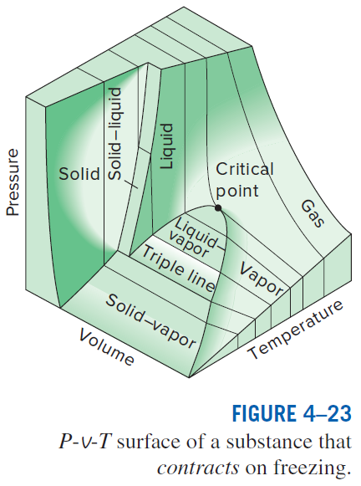
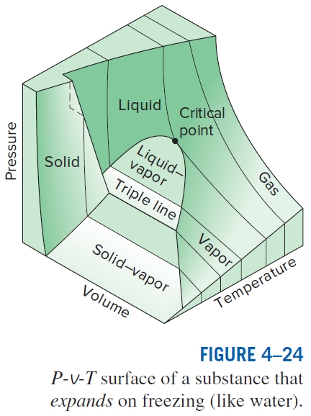
Ch.4 Properties of pure substances-4a

Slide 32
Ch.4 Properties of pure substances-4
4-4a surface
Fig. 4-23, -24, nice but hard to use
4.5 Property tables
Steam table; here, we first define enthalpy as
1. Saturated liquid and saturated vapor states
Table A-4, Fig. 4-25, -26 & -27; subscripts f, g, and fg
eg, is known as the enthalpy of vaporization, representing the
amount of energy needed to vaporize a unit mass of saturated liquid
Ex. 4-1, 4-3
-Saturated liquid-vapor mixture, Fig. 4-31 & -32
Definition of quality
Notes:
Enthalpy is from the Greek word enthalpien which means to heat, and was introduced around 1930s.
Subscripts f, g originated from German. f: Flussigkeit, g: Gas.

Slide 33
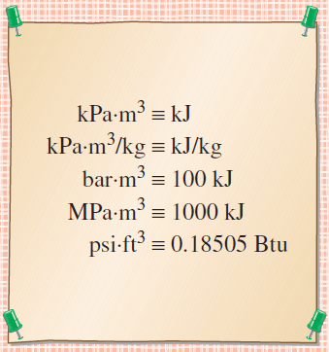
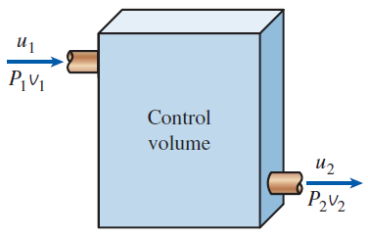
Ch.4 Properties of pure substances-4b

Slide 34
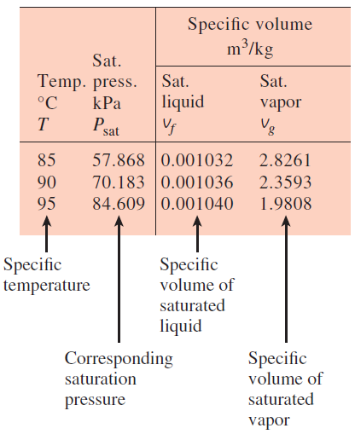
Ch.4 Properties of pure substances-4c

Slide 35
Ch.4 Properties of pure substances-4
4-4a surface
Fig. 4-23, -24, nice but hard to use
4.5 Property tables
Steam table; here, we first define enthalpy as
1. Saturated liquid and saturated vapor states
Table A-4, Fig. 4-25, -26 & -27; subscripts f, g, and fg
eg, is known as the enthalpy of vaporization, representing the
amount of energy needed to vaporize a unit mass of saturated liquid
Ex. 4-1, 4-3
-Saturated liquid-vapor mixture, Fig. 4-31 & -32
Definition of quality
Notes:
Enthalpy is from the Greek word enthalpien which means to heat, and was introduced around 1930s.
Subscripts f, g originated from German. f: Flussigkeit, g: Gas.

Slide 36
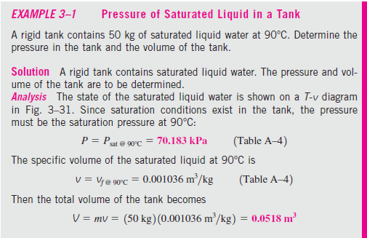
Ch.4 Properties of pure substances-4d

Slide 37
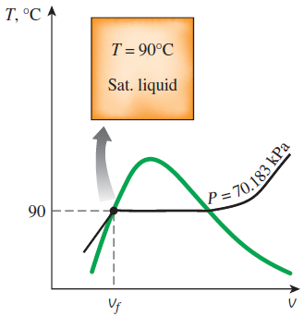
Ch.4 Properties of pure substances-4e

Slide 38
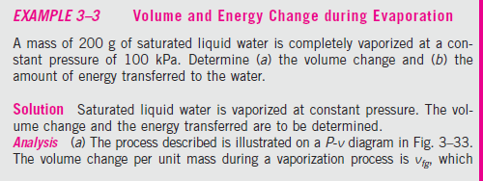
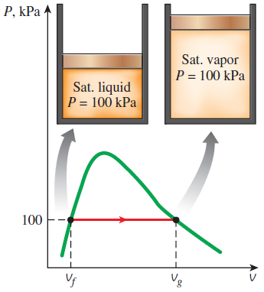
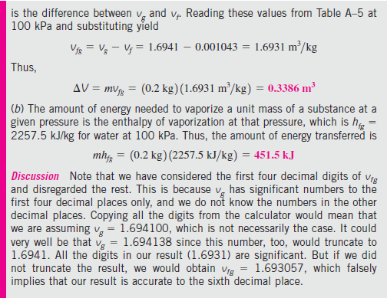
Ch.4 Properties of pure substances-4f

Slide 39
Ch.4 Properties of pure substances-4
4-4a surface
Fig. 4-23, -24, nice but hard to use
4.5 Property tables
Steam table; here, we first define enthalpy as
1. Saturated liquid and saturated vapor states
Table A-4, Fig. 4-25, -26 & -27; subscripts f, g, and fg
eg, is known as the enthalpy of vaporization, representing the
amount of energy needed to vaporize a unit mass of saturated liquid
Ex. 4-1, 4-3
-Saturated liquid-vapor mixture, Fig. 4-31 & -32
Definition of quality
Notes:
Enthalpy is from the Greek word enthalpien which means to heat, and was introduced around 1930s.
Subscripts f, g originated from German. f: Flussigkeit, g: Gas.

Slide 40
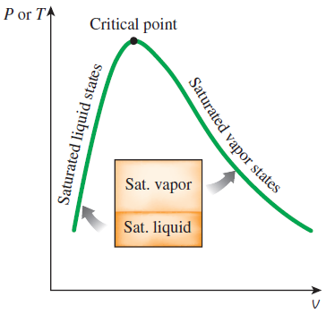
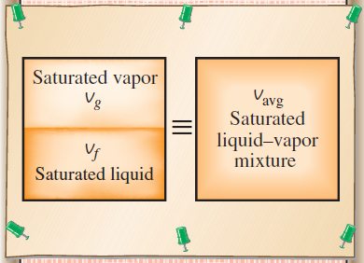
Ch.4 Properties of pure substances-4g

Slide 41
Ch.4 Properties of pure substances-5
2. Superheated vapor, Table A-6, Fig. 4-37, Ex. 4-7
3. Compressed liquid
When there is no data for compressed liquid, use
Fig. 4-33
Fig. 4-39

Slide 42
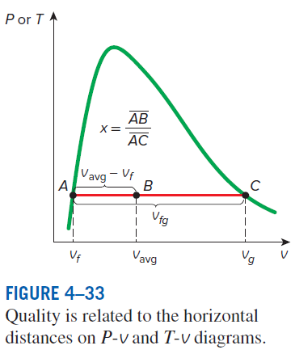
Ch.4 Properties of pure substances-5a

Slide 43
Ch.4 Properties of pure substances-5
2. Superheated vapor, Table A-6, Fig. 4-37, Ex. 4-7
3. Compressed liquid
When there is no data for compressed liquid, use
Fig. 4-33
Fig. 4-39

Slide 44
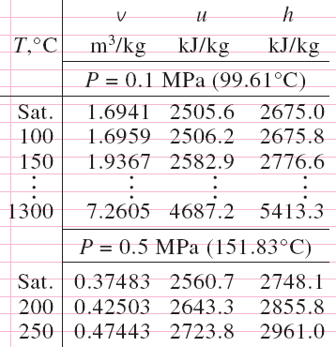
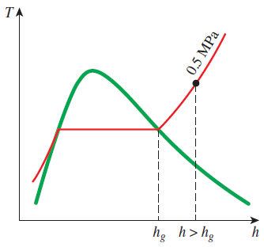
Ch.4 Properties of pure substances-5b

Slide 45
Ch.4 Properties of pure substances-5
2. Superheated vapor, Table A-6, Fig. 4-37, Ex. 4-7
3. Compressed liquid
When there is no data for compressed liquid, use
Fig. 4-33
Fig. 4-39

Slide 46
Ch.2 Properties of pure substances-5c

Slide 47
Ch.4 Properties of pure substances-5
2. Superheated vapor, Table A-6, Fig. 4-37, Ex. 4-7
3. Compressed liquid
When there is no data for compressed liquid, use
Fig. 4-33
Fig. 4-39

Slide 48
Ch.4 Properties of pure substances-6
4-6 The ideal-gas equation of state
- Real gas of low densities ideal-gas
- steam, refrigerants are dense, and cannot be regarded as ideal-gas.
→ Tables are necessary.
- For steam, refer to Fig. 4-45,
over 100kPa it cannot be regarded as ideal-gas.

Slide 49
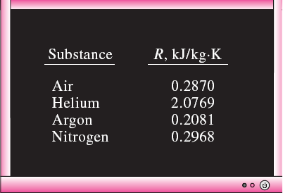
Ch.4 Properties of pure substances-6a

Slide 50
Ch.4 Properties of pure substances-6
4-6 The ideal-gas equation of state
- Real gas of low densities ideal-gas
- steam, refrigerants are dense, and cannot be regarded as ideal-gas.
→ Tables are necessary.
- For steam, refer to Fig. 4-45,
over 100kPa it cannot be regarded as ideal-gas.

Slide 51
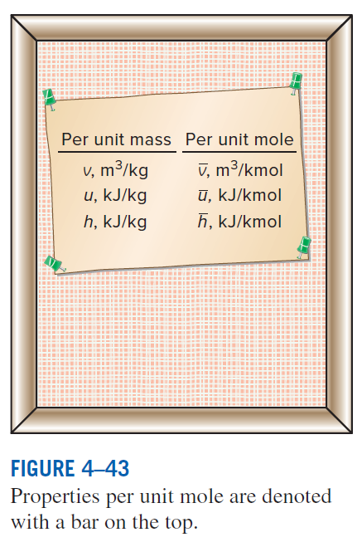
Ch.4 Properties of pure substances-6b

Slide 52
Ch.4 Properties of pure substances-6
4-6 The ideal-gas equation of state
- Real gas of low densities ideal-gas
- steam, refrigerants are dense, and cannot be regarded as ideal-gas.
→ Tables are necessary.
- For steam, refer to Fig. 4-45,
over 100kPa it cannot be regarded as ideal-gas.

Slide 53
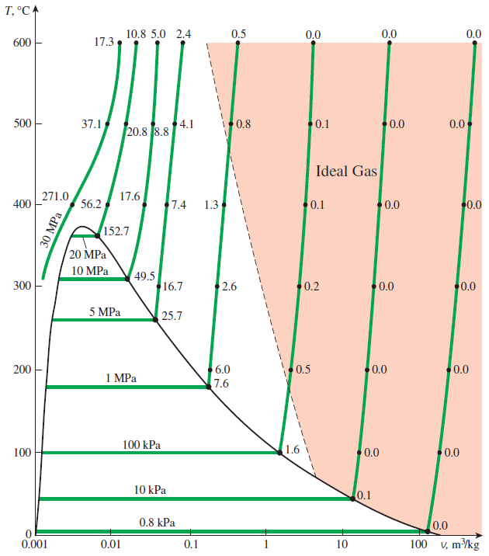
Ch.4 Properties of pure substances-6c

Slide 54
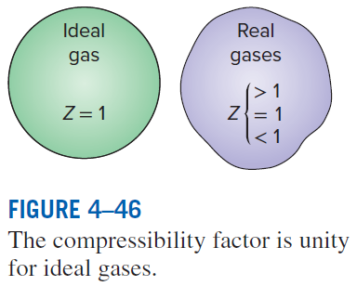
Ch.4 Properties of pure substances-7
4-7 Compressibility factor
- Normalization by critical pressure and temperature
- Fig. 4-48 & -49,
Ex. 4-11
HW Ch.4 Problems 18, 19, 23, 32, 35, 54, 70, 84, 88, 95, 99

Slide 55
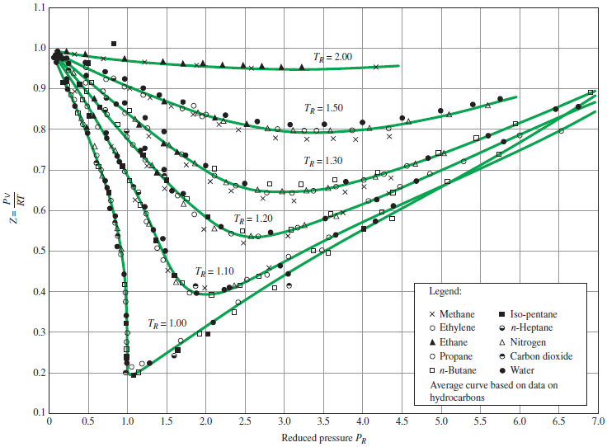
Ch.4 Properties of pure substances-7a

Slide 56
Ch.4 Properties of pure substances-7
4-7 Compressibility factor
- Normalization by critical pressure and temperature
- Fig. 4-48 & -49,
Ex. 4-11
HW Ch.4 Problems 18, 19, 23, 32, 35, 54, 70, 84, 88, 95, 99

Slide 57
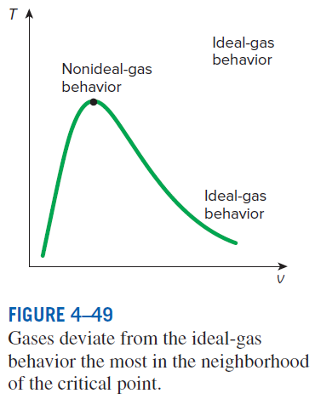
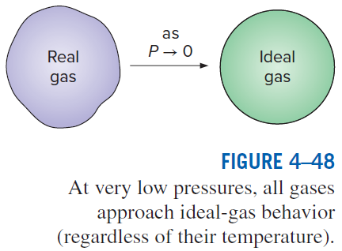
Ch.4 Properties of pure substances-7b

Slide 58
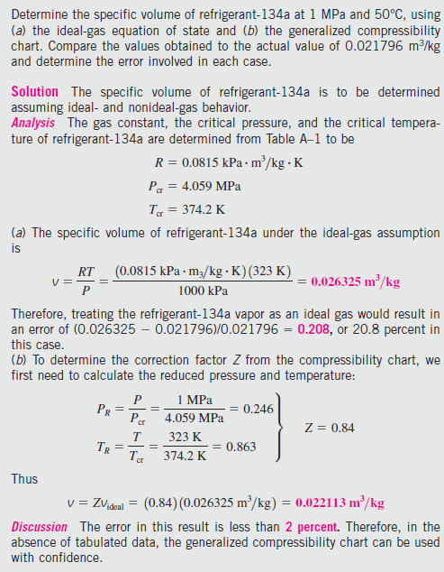
Ch.4 Properties of pure substances-7c
Ex. 4-11

Slide 59
Ch.4 Properties of pure substances-7
4-7 Compressibility factor
- Normalization by critical pressure and temperature
- Fig. 4-48 & -49,
Ex. 4-11
HW Ch.4 Problems 18, 19, 23, 32, 35, 54, 70, 84, 88, 95, 99

