Slide 1
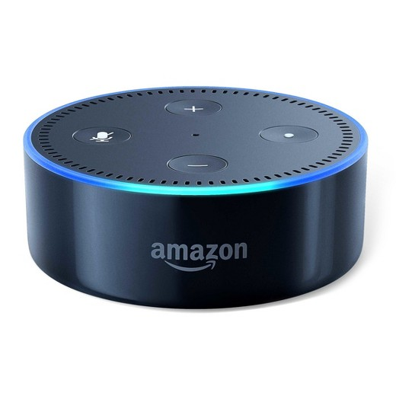
Enhanced Smart Home Assistant
Off-the-shelf smart home assistant
    Voice interface only. Is it enough?
    How can we make use of the devices with other interactive methods to make an easy-to-access smart home assistant？

Slide 2
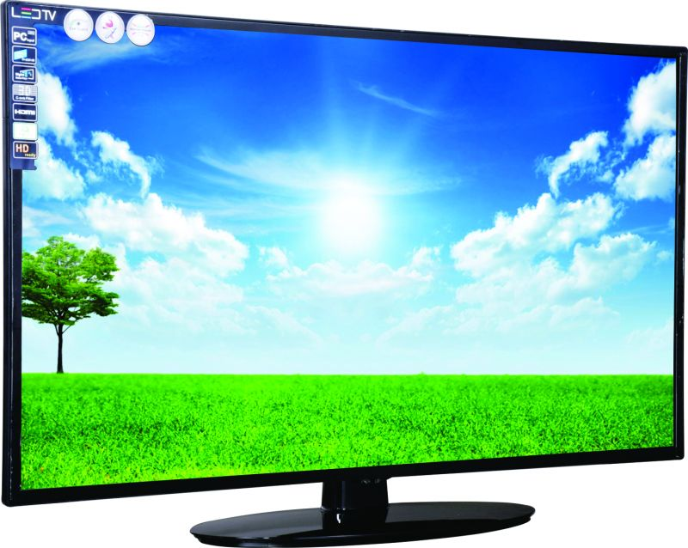
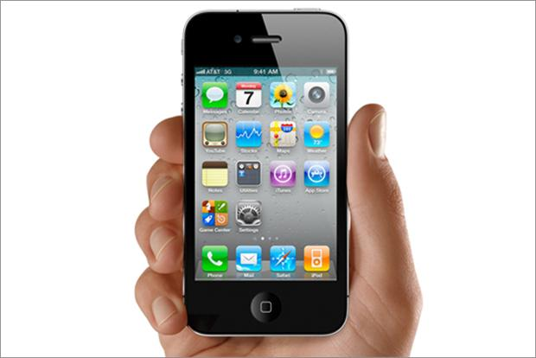
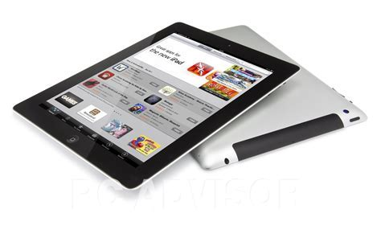
Enhanced Smart Home Assistant
A centralized smart home assistant design

Slide 3
Enhanced Smart Home Assistant
There are many mobile devices with rich HCIs like display, touch screen and keypad.
Take display for example, smart home assistant can use the display on mobile devices to show graphical information to the user.

Slide 4
Enhanced Smart Home Assistant
There are many mobile devices with rich HCIs like display, touch screen and keypad.
Take display for example, smart home assistant can use the display on mobile devices to show graphical information to the user.
How to choose between different display devices? ( The closet one to the voice command source)

Slide 5

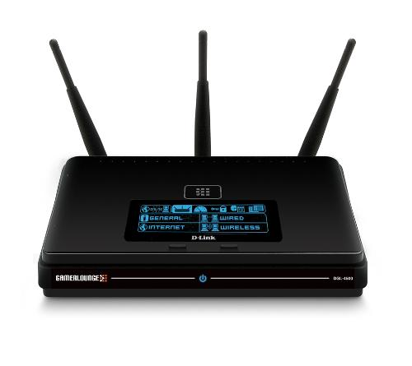
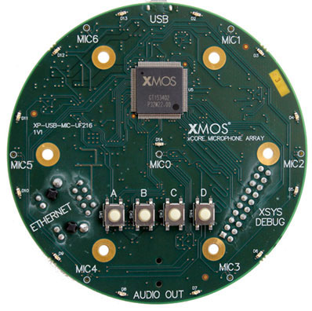
Enhanced Smart Home Assistant
How to estimate the proximity in a remote way?

Slide 6
Enhanced Smart Home Assistant
Challenges?
    Sound channels and RF channels enjoy different multipath characteristic due to different scattering, refracting, reflecting behavior.
    For line-of-sight scenario, the main paths of the two channels should have the same angle. How to detect line-of-sight? How to extract the main path?
    How about NLOS?

Slide 7
Rethinking Proximity Detection
State-of-the-art

Slide 8
Rethink the Design of the Addressing System for Networking
The original design consideration for naming system in networking
  “Principles of Computer Systems”
  Sharing illustrates one fundamental purpose for names: as a communication and an organization tool.
  A second fundamental purpose for a name is to allow a system designer to defer to a later time an important decision: to which object should this name refer?

Slide 9
Rethink the Design of the Addressing System for Networking
The original design consideration for naming system in networking
  A system designer creates a naming scheme, which consists of three elements:
      A name space
      A name-mapping algorithm
      A universe of values

Slide 10
Rethink the Design of the Addressing System for Networking
The original design consideration for naming system in networking
  A system designer creates a naming scheme, which consists of three elements:
      A name space
      A name-mapping algorithm
      A universe of values

Slide 11
Rethink the Local Area Network Structure
The original design consideration for naming system in networking
  A system designer creates a naming scheme, which consists of three elements:
      A name space
      A name-mapping algorithm
      A universe of values

