Slide 1
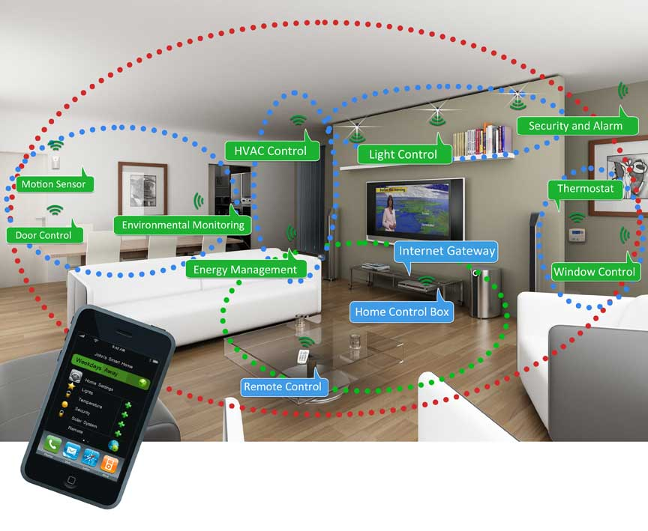
Smart Device Networking
What is the right structure for smart device wireless networks in an specific area (like home)?
– Centralized structure, all devices connected to an AP, connections between different devices are defined by upper layer applications or manually by a network manager.
– Hierarchical structure, different devices will connected to different wireless networks and use gateways to form a big network thus all things are connected.
Which one is better?

Slide 2
Smart Device Networking
How to reduce the human effort to manually set up those networks and defined the connections?
– Networks and Connections are defined naturally by functions and context. Devices that connected to a small networks and share data are always enjoy the same context and functions.
– One way is to use an agent to learn the context behind the connections and help setup connections to build small networks use different wireless technologies.
– another methods is change the traditional addressing system. By addressing different smart devices directly using their context or function, we can reduce the human effort to help devices to define their relationship and setup connections.

