Slide 1
Characteristic Mode Analysis of Parasitic Circularly Polarized IFA
Shawn 2023-01-03

Slide 2
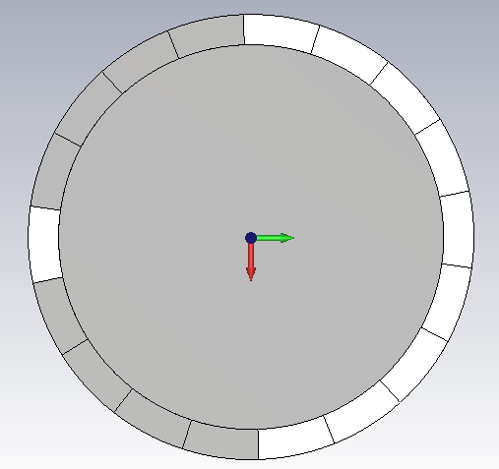
Single-Band: Asymmetric locations with the same length
2
Metal
1
1 and 2 are shorting pins or feeding pins
Structure

Slide 3
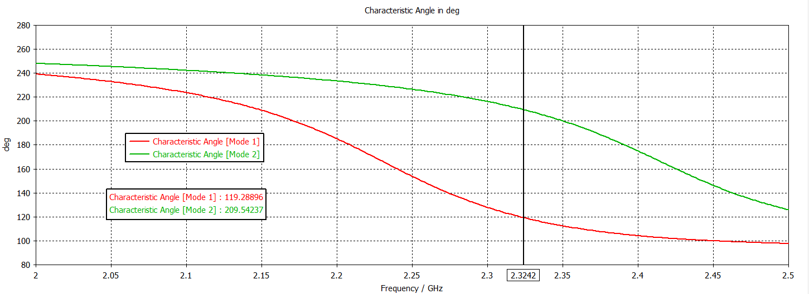
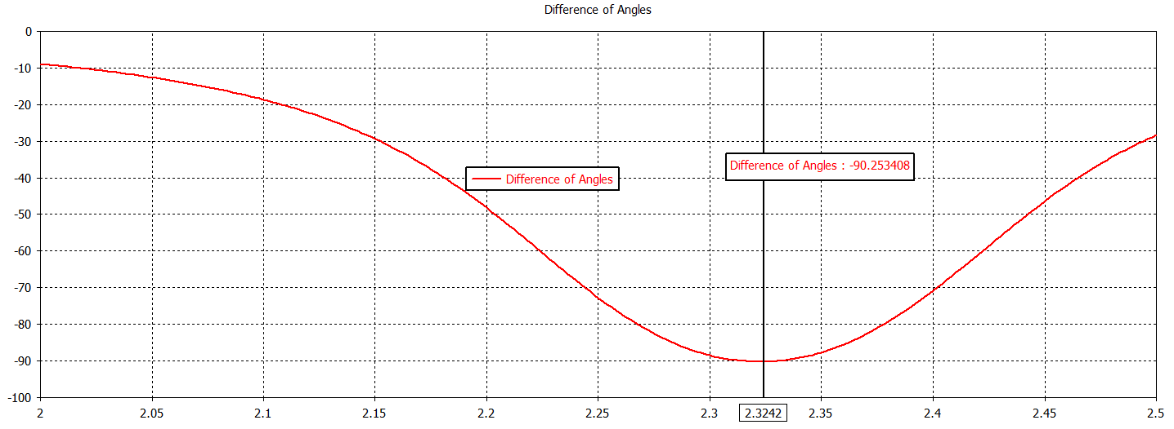
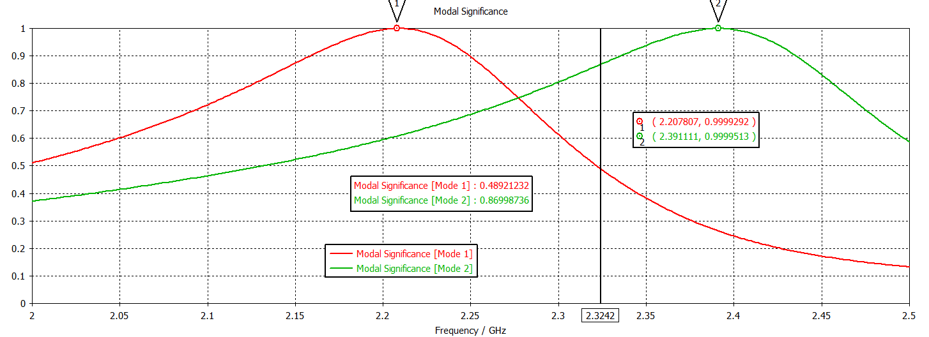
Single-Band: Asymmetric locations with the same length
2
1
Mode1: 2.2GHz
Mode2: 2.4GHz
90°difference: 2.32GHz
CMA

Slide 4
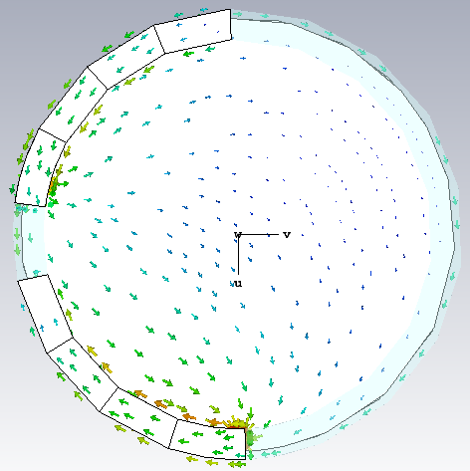
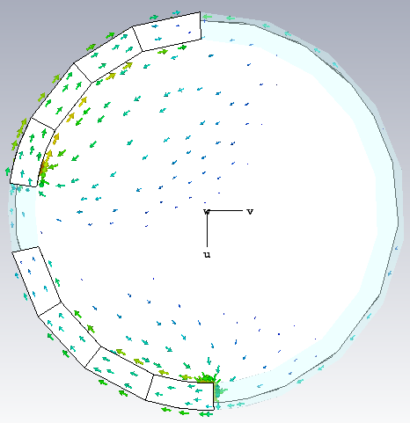
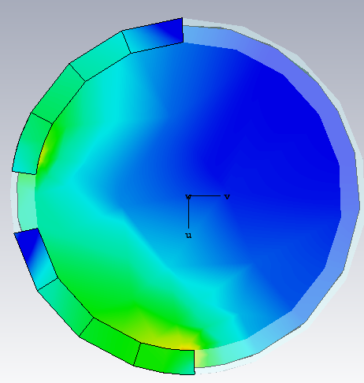
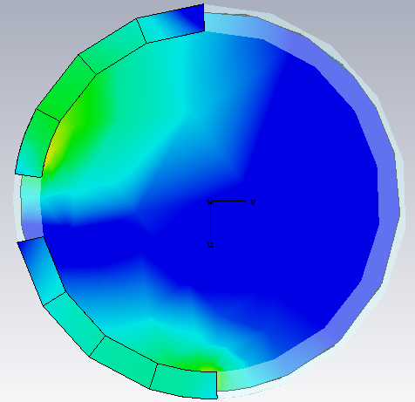
Single-Band: Asymmetric locations with the same length
2
1
Current of Mode1 @ 2.2GHz
Current of Mode2 @ 2.4GHz
Mode1: 2.2GHz
Mode2: 2.4GHz
90°difference: 2.32GHz
CMA

Slide 5
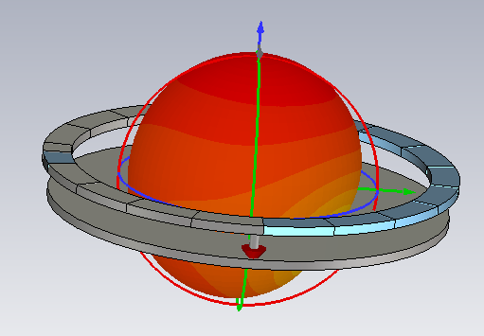

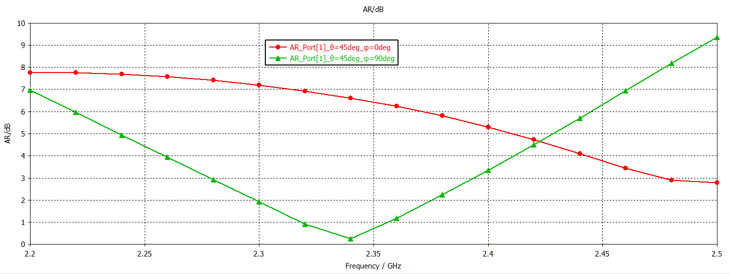
Single-Band: Asymmetric locations, port1 excited and port 2 shorted
2
RHCP
1
Excitation

Slide 6
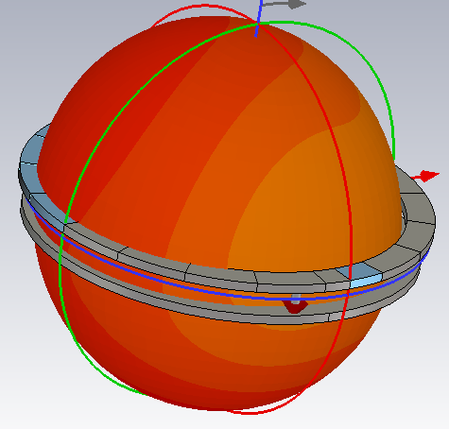

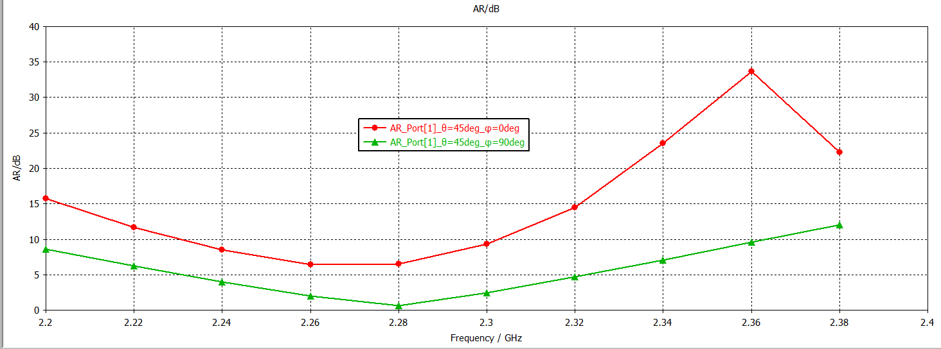
Single-Band: Asymmetric locations, port2 excited and port 1 shorted
2
LHCP
1
Excitation

Slide 7
Single-Band: Asymmetric locations, port1 excited and port 2 shorted
2
RHCP
1
With the same principle, when rotating two
Feed pins 90 degrees clockwise, the polarization
characteristics are as left
2
LHCP
1
Excitation

Slide 8
Single-Band: Symmetric locations with different length
2
2
1
Metal
Metal
1
Closely feed
loosely feed
Structure

Slide 9
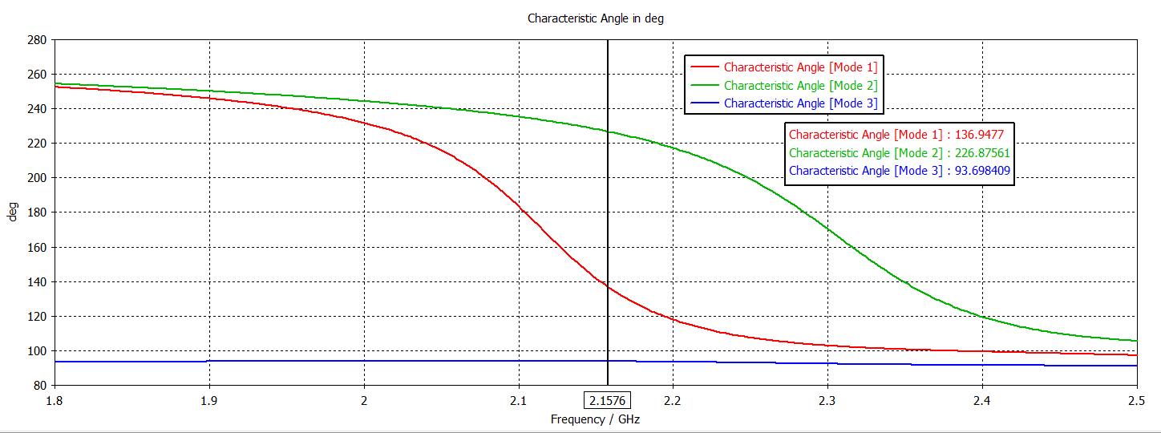
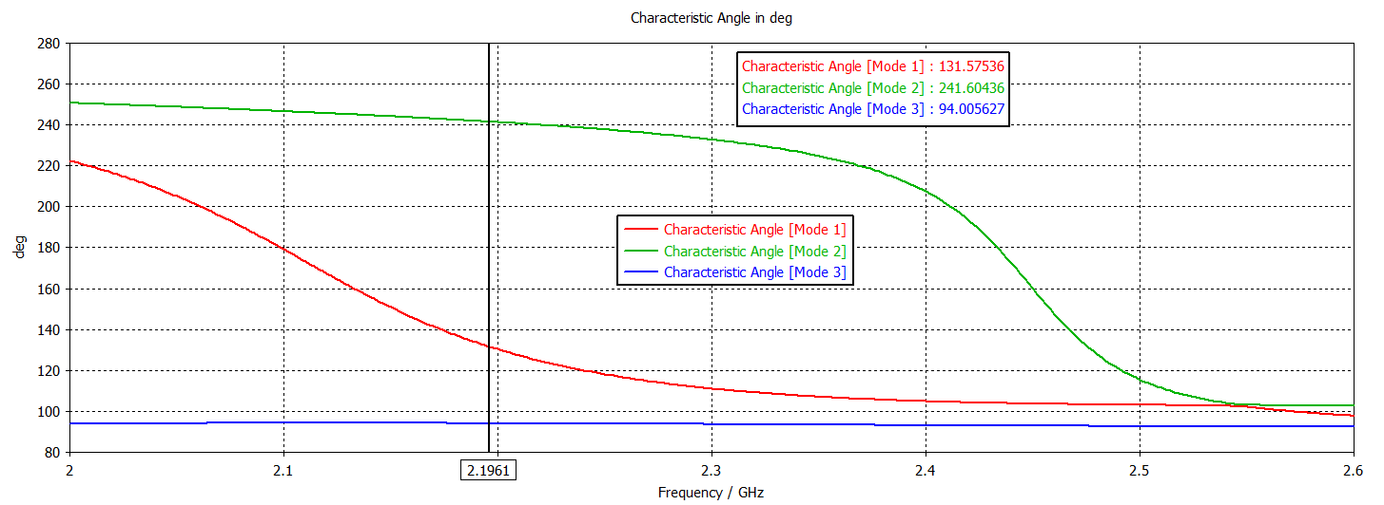
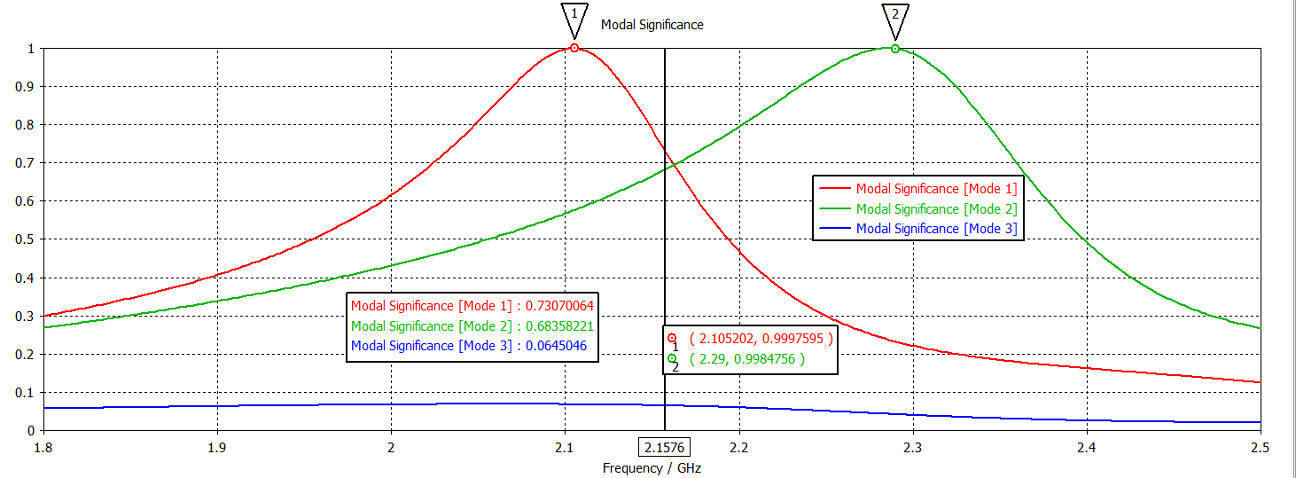
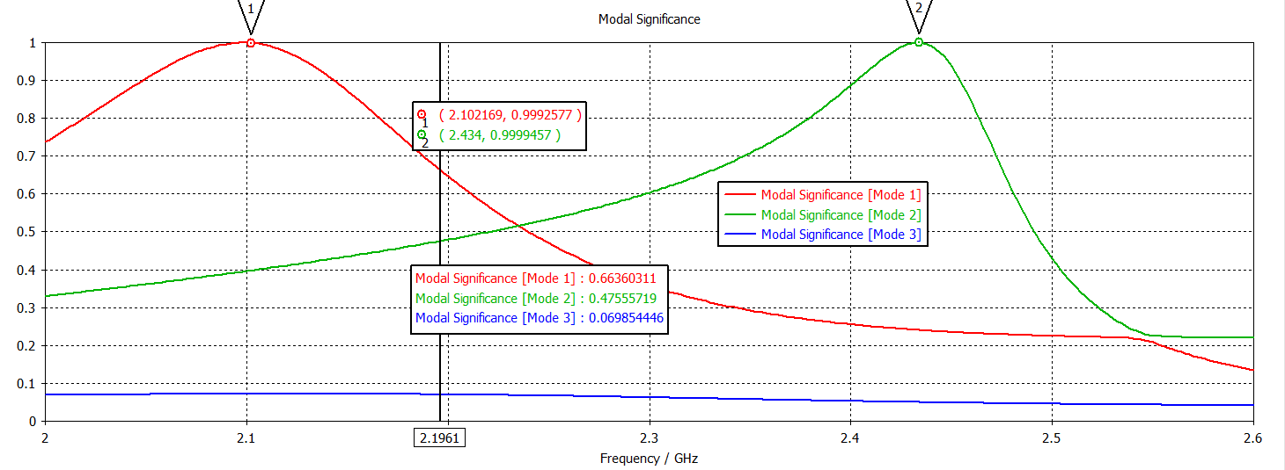
Single-Band: Symmetric locations
2
upper branch is slightly longer than lower branch
Metal
2
Metal
1
Closely feed
loosely feed
1
CMA

Slide 10
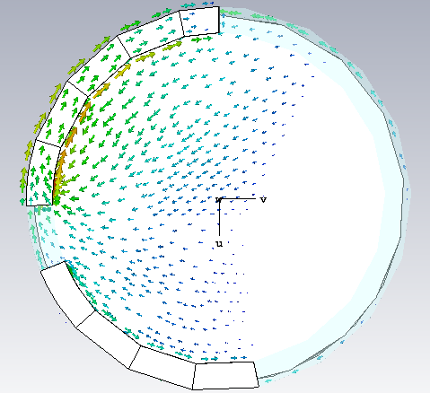
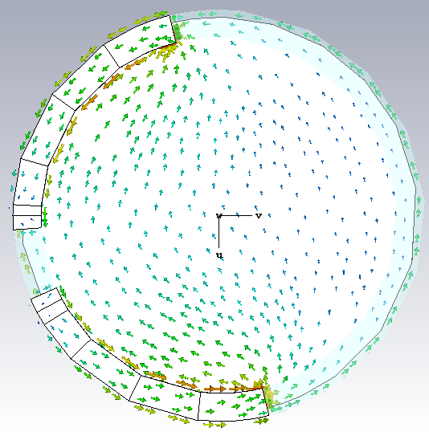
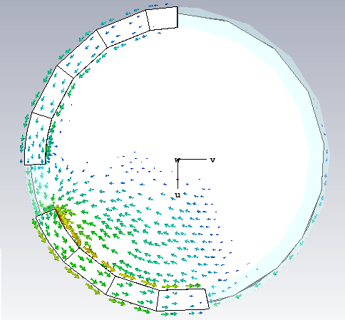
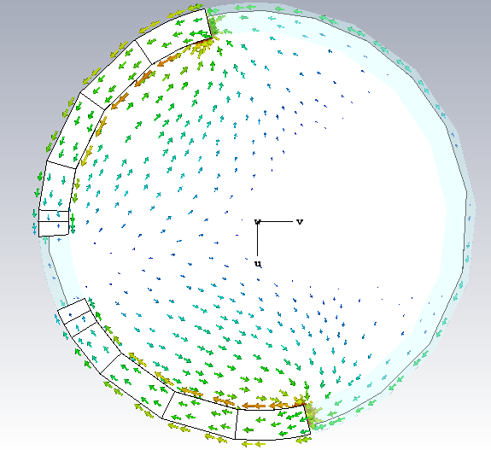
Single-Band: Symmetric locations
2
upper branch is slightly longer than lower branch
Metal
2
Metal
1
loosely feed
Closely feed
1
Mode1@2.1GHz
Mode1@2.1GHz
Mode2@2.3GHz
Mode2@2.4GHz
CMA

Slide 11


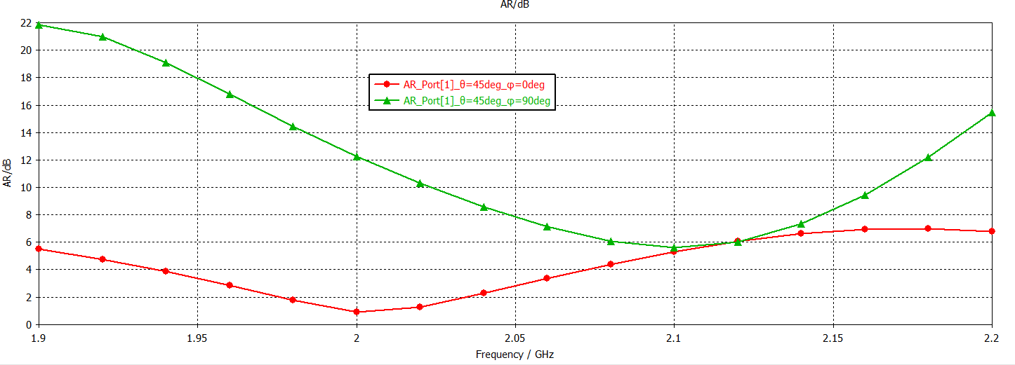
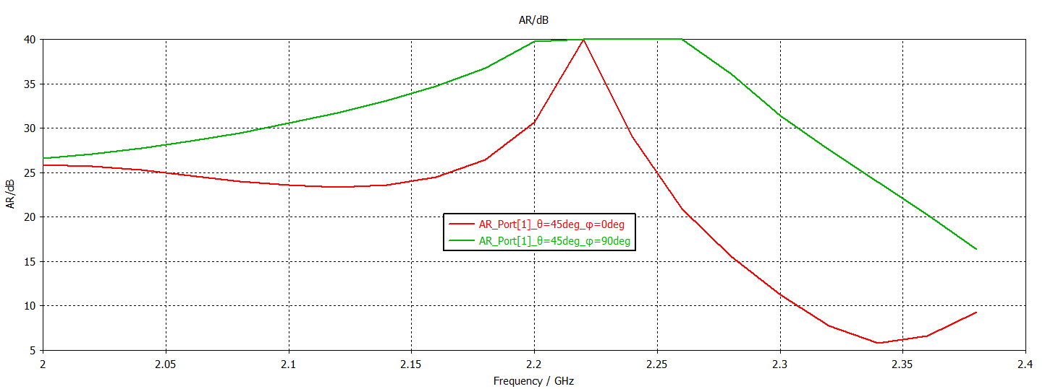


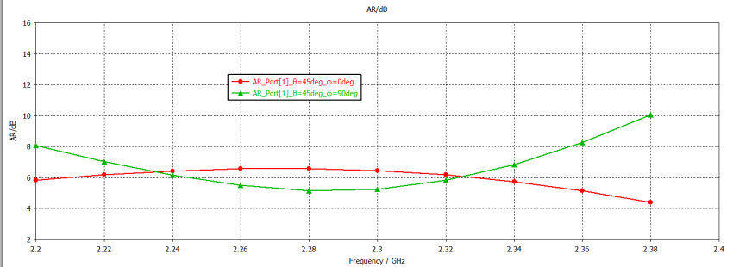
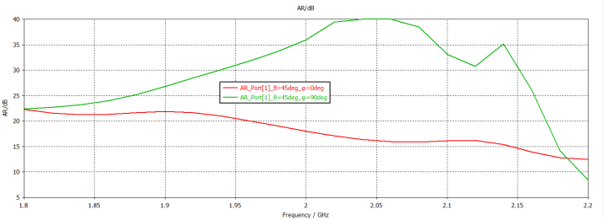
Single-Band: Symmetric locations
2
upper branch is slightly longer than lower branch
Metal
2
Metal
1
loosely feed
Closely feed
1
When feeding at 1:
When feeding at 1:
LHCP
When feeding at 2:
When feeding at 2:
RHCP
Excitation

Slide 12
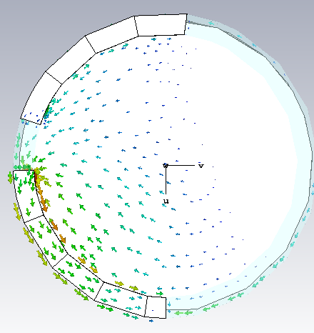
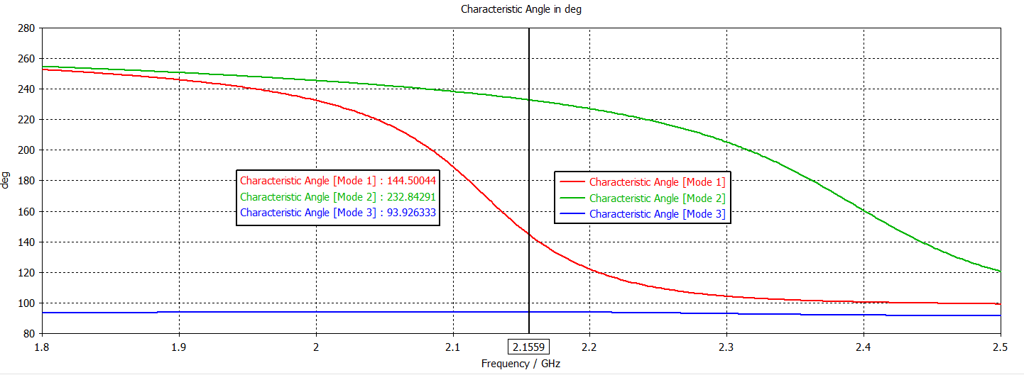
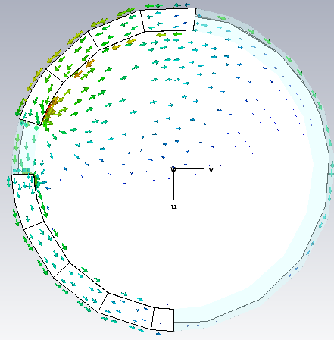
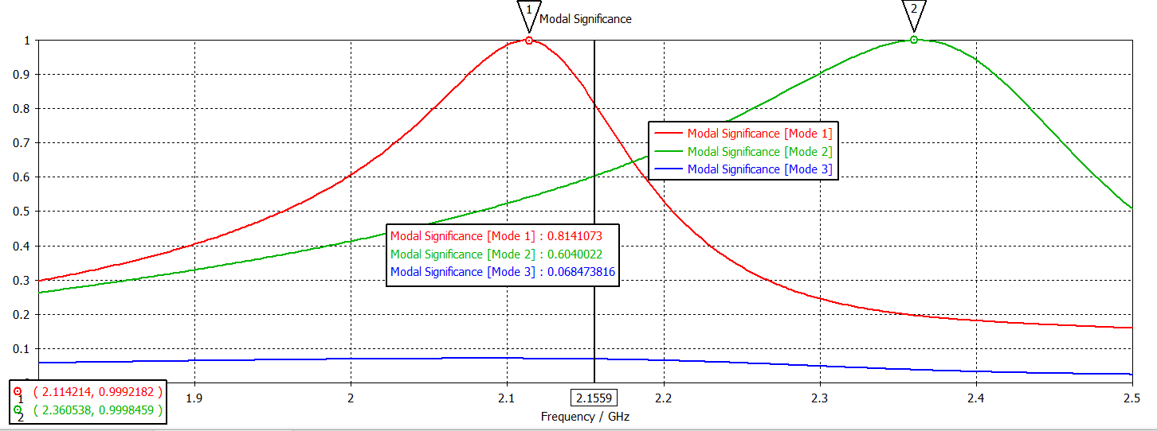
Single-Band: Symmetric locations
upper branch is slightly shorter than lower branch
2
Metal
1
Closely feed
Mode1@2.1GHz
Mode2@2.3GHz
CMA

Slide 13


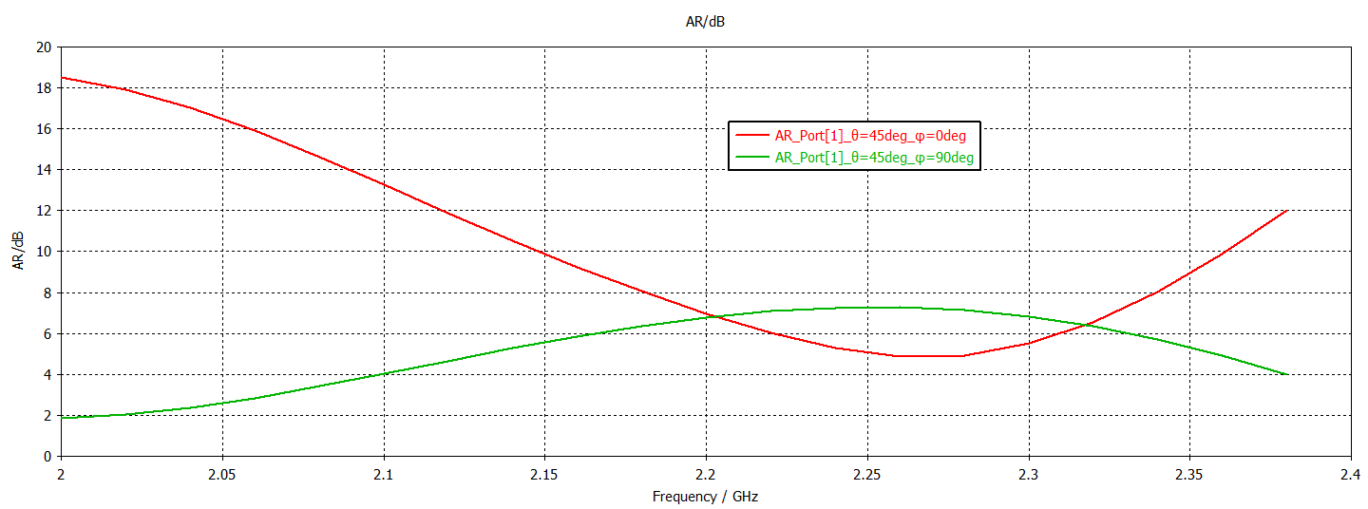
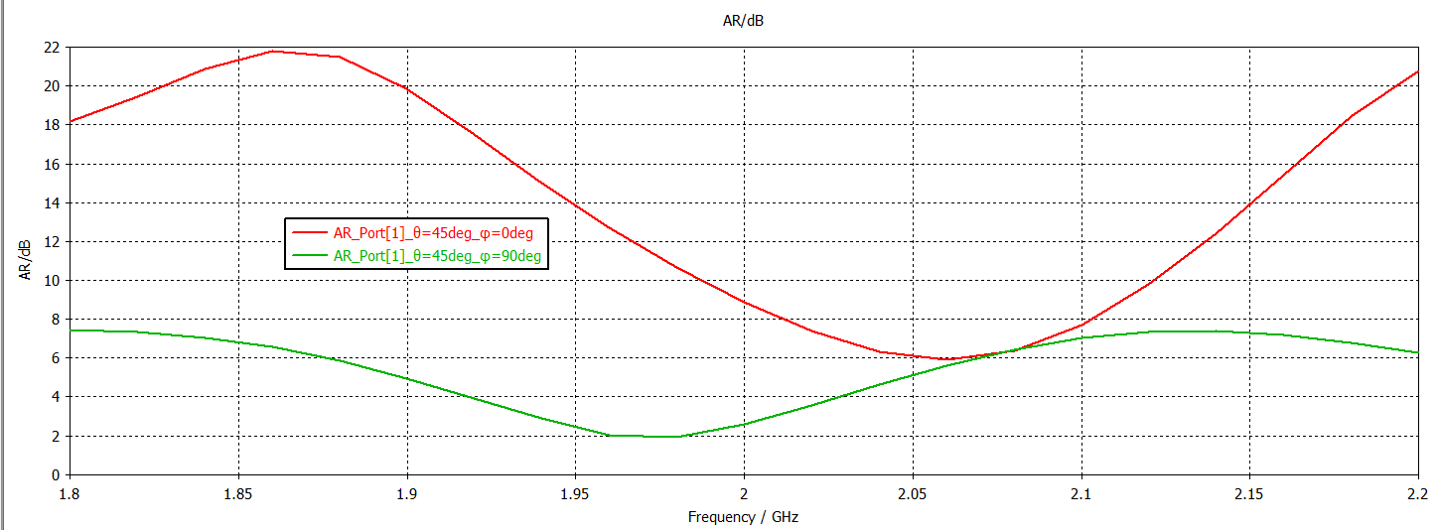
Single-Band: Symmetric locations
upper branch is slightly shorter than lower branch
Metal
upper branch is slightly shorter than lower branch
2
Metal
2
1
1
Closely feed
Closely feed
When feeding at 1:
When feeding at 2:
LHCP
RHCP
Excitation

Slide 14
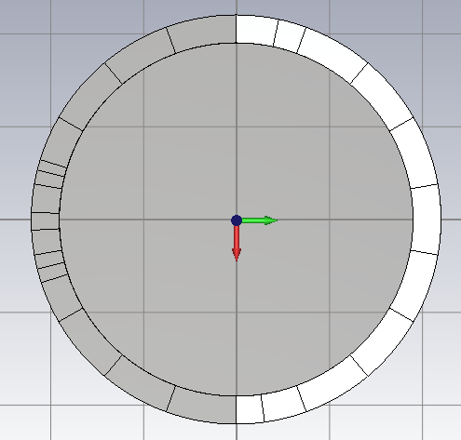
Single-Band: No parasitic structure with even-odd mode
Short point
1
Structure

Slide 15
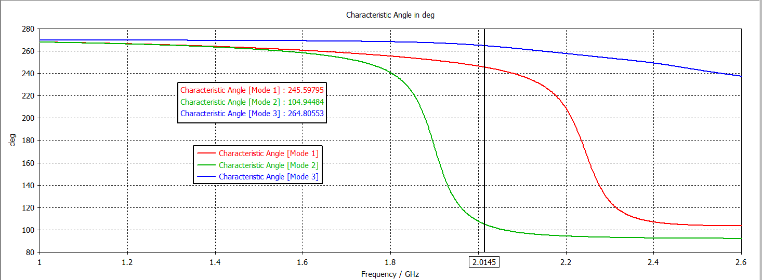
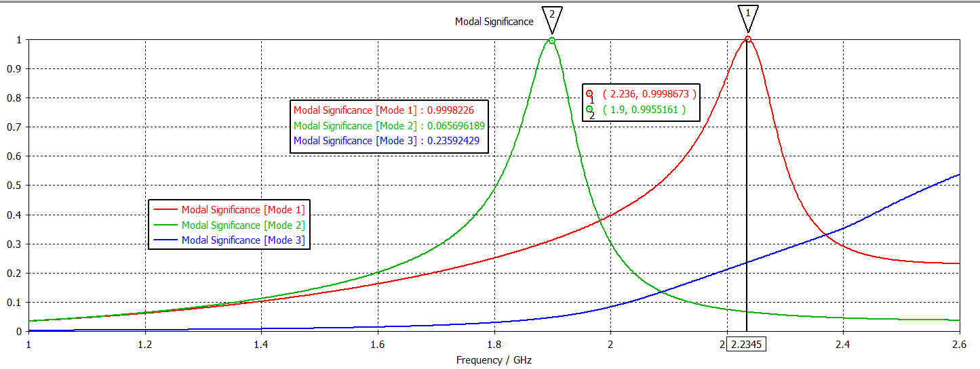
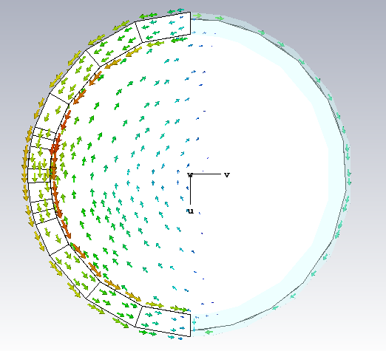
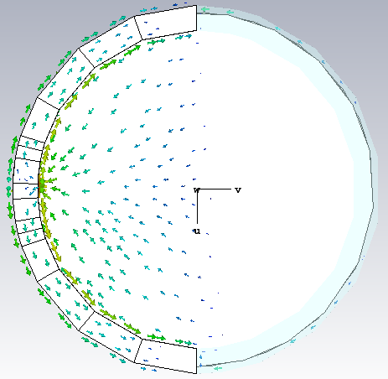
Single-Band: No parasitic structure with even-odd mode
1
Mode1@2.2GHz
Mode2@1.9GHz
CMA

Slide 16
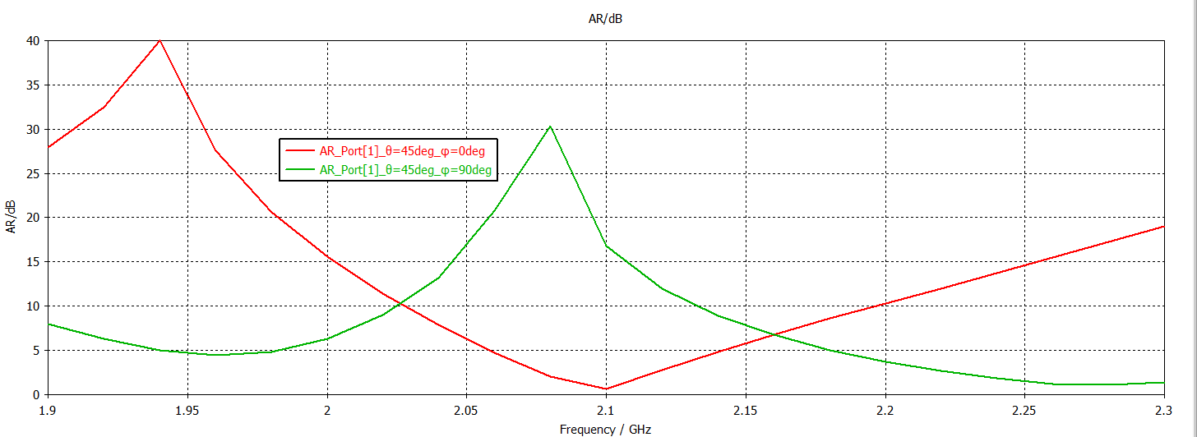

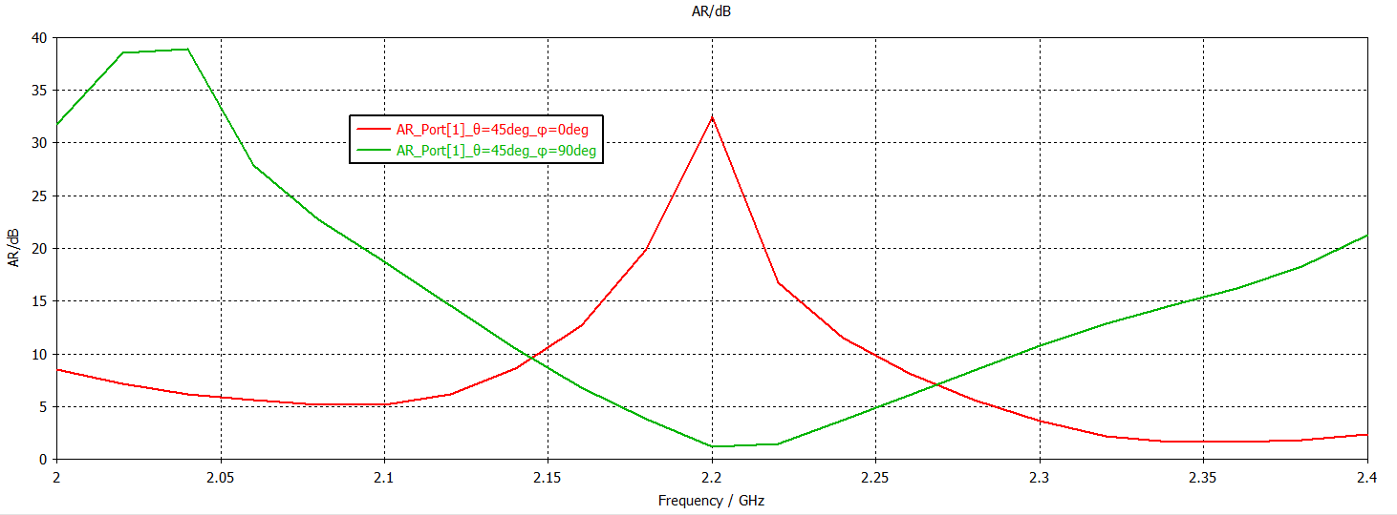

Single-Band: No parasitic structure with even-odd mode
RHCP
2
1
LHCP
1
2
Excitation

Slide 17
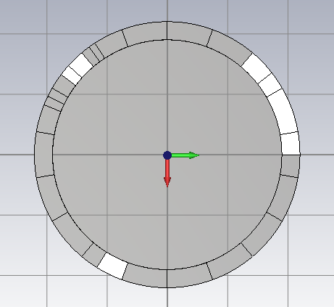
Dual-Band: 3 asymmetric branches
3
1
2
Structure

Slide 18
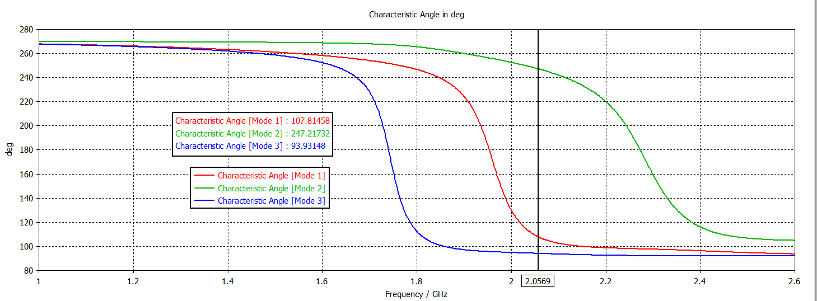
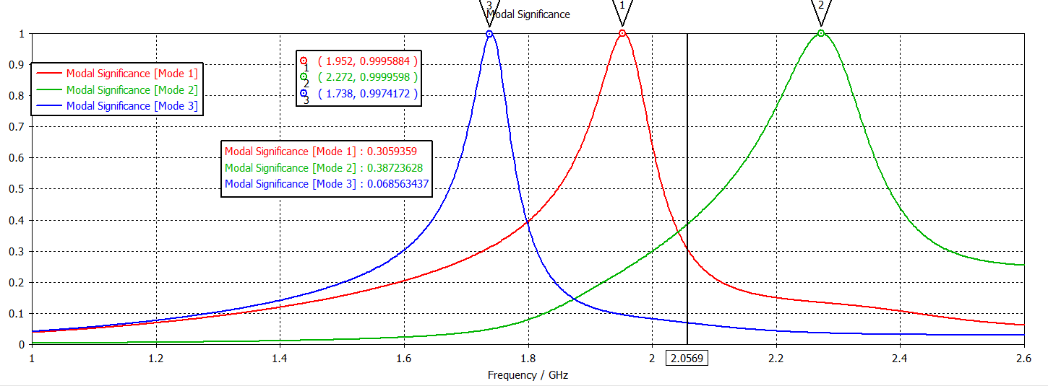
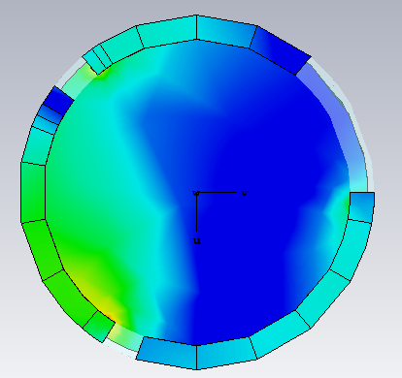
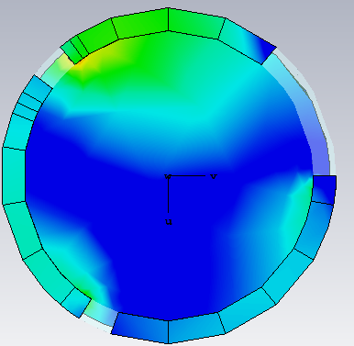
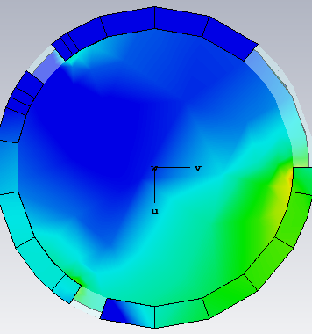
Dual-Band: No parasitic structure with even-odd mode
3
1
2
Mode1@1.95
Mode2@2.25
Mode3@1.75
CMA

Slide 19






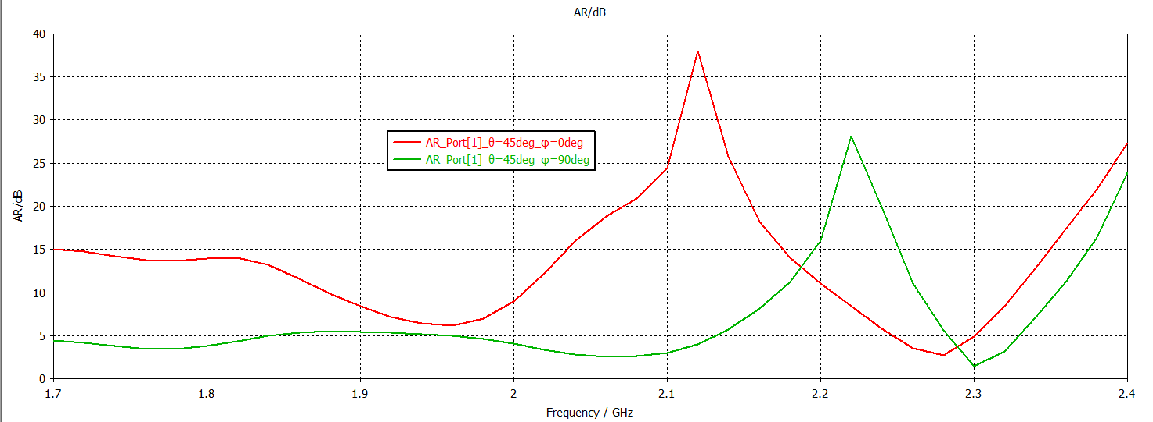
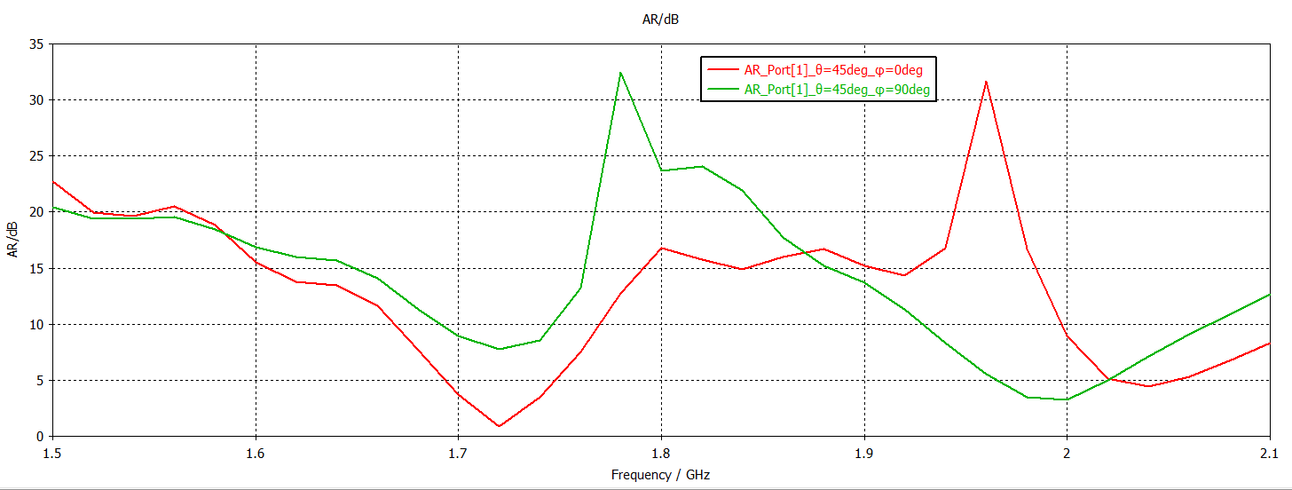
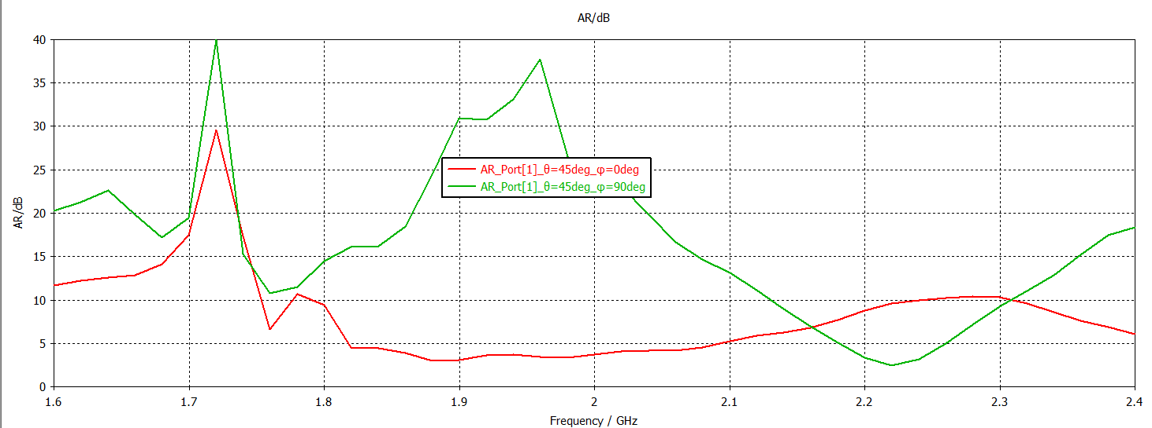
Dual-Band: parasitic structures with even-odd mode
3
3
3
1
1
1
RHCP
2
LHCP
2
2
RHCP
LHCP
RHCP
LHCP
Excitations

Slide 20
Dual-Band: two asymmetric and two symmetric structures
3
2
1
Structure

Slide 21
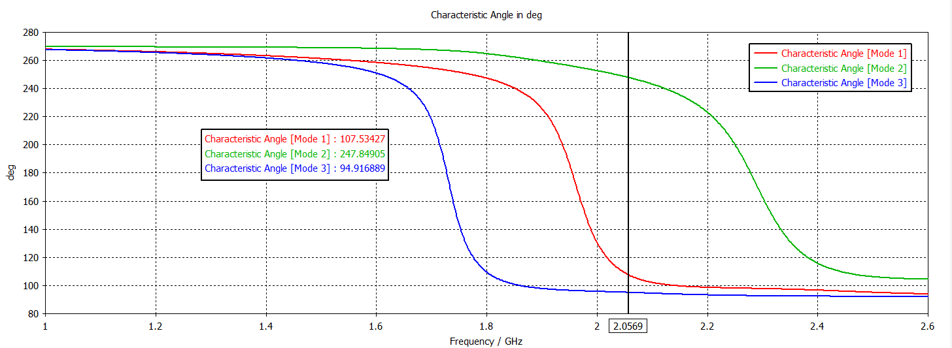
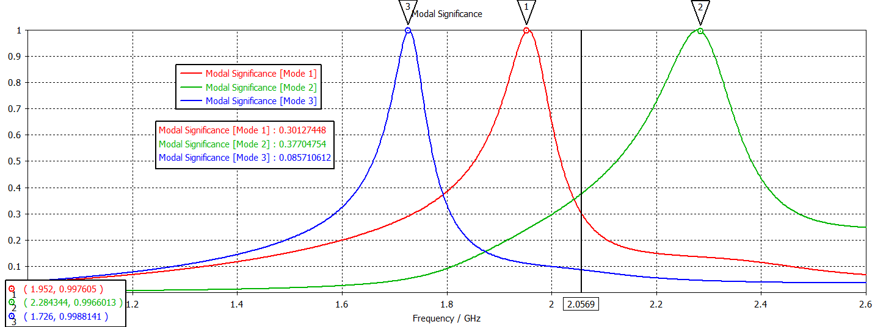
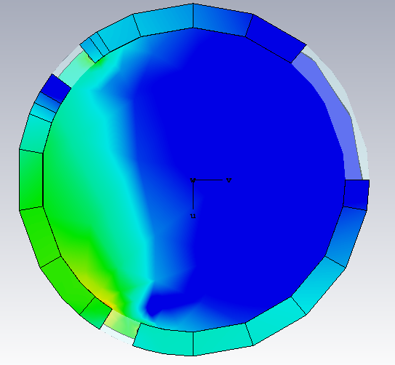
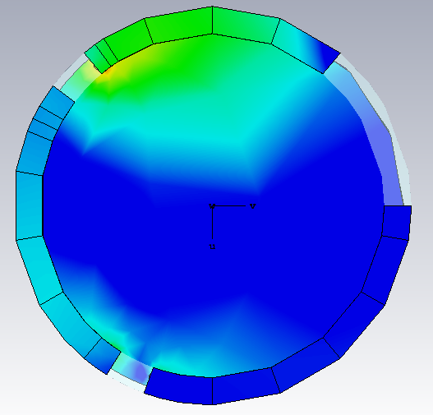

Dual-Band: two asymmetric and two symmetric structures
3
2
1
Mode1@1.95
Mode2@2.3
Mode3@1.75
CMA

Slide 22









Dual-Band: two asymmetric and two symmetric structures
3
3
3
LHCP
2
1
2
1
2
1
RHCP
RHCP
RHCP
RHCP
LHCP
Excitations

Slide 23

Dual-Band: one symmetric and two asymmetric structures
2
1
Structure

Slide 24





Dual-Band: one symmetric and two asymmetric structures
2
1
Mode1@2.05
Mode2@2.25
Mode3@1.75
CMA

Slide 25

Dual-Band: one symmetric and two asymmetric structures
2
f
1
Excitation

