Slide 1
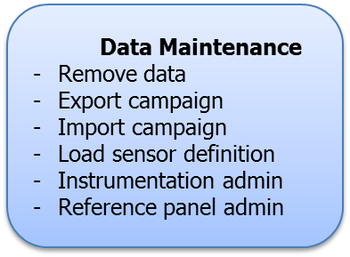
Data Maintenance
Remove data
Load sensor definition
Instrumentation admin
Reference panel admin

