Slide 1
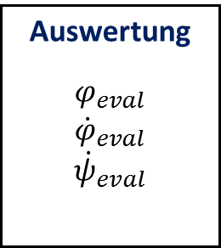
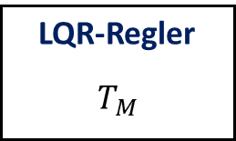
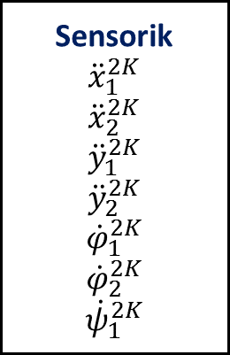
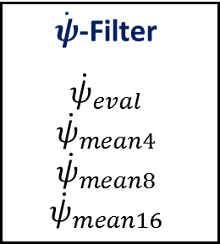

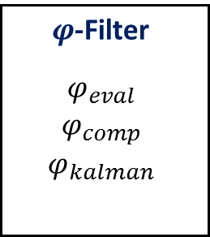
Sensorik
$${\ddot{x}}_{1}^{2K}$$
$${\ddot{x}}_{2}^{2K}$$
$${\ddot{y}}_{1}^{2K}$$
$${\ddot{y}}_{2}^{2K}$$
$${\dot{φ}}_{1}^{2K}$$
$${\dot{φ}}_{2}^{2K}$$
$${\dot{ψ}}_{1}^{2K}$$
Auswertung
$$φ_{eval}$$
$${\dot{φ}}_{eval}$$
$${\dot{ψ}}_{eval}$$
$φ$-Filter
$$φ_{eval}$$
$$φ_{comp}$$
$$φ_{kalman}$$
$\dot{φ}$-Filter
$${\dot{φ}}_{eval}$$
$${\dot{φ}}_{kalman}$$
$\dot{ψ}$-Filter
$${\dot{ψ}}_{eval}$$
$${\dot{ψ}}_{mean4}$$
$${\dot{ψ}}_{mean8}$$
$${\dot{ψ}}_{mean16}$$
HW-Schnittstelle
Aktorik
LQR-Regler
$$T_{M}$$

Slide 2
Timer-Task
Timer-Tick
BeagleBone Black
Steuerbefehle
Kommunikations-Komponente
Steuerbefehle
MATLAB
Start/Stopp
Timer-Tick
Proxy
Daten
Daten
Regelungs-Komponente
Daten
Steuerbefehle

Slide 3
SensorMeasurement
ADCMeasurement
CPsiIdentification
CPhiIdentification
CLIENT_DC
RUN_ADC_MEASUREMENT
RUN_CPSI_IDENTIFICATION
CLIENT_DC
CLIENT_DC
RUN_CPHI_IDENTIFICATION
CLIENT_DC
Standby
RUN_SENSOR_MEASURMENT
RUN_JUMP_TEST
CLIENT_DC
RUN_CONTROL_TEST
JumpTest
ControlTest
BRAKING_FINISHED
IN_BALANCE_AREA
Waiting
Braking
CLIENT_DC
Idle
Balancing
RESTING
IN_IDLE_AREA
JUMP_VEL_REACHED
MOVING
Accelerating

Slide 4
SensorMeasurement
ADCMeasurement
CPsiIdentification
CPhiIdentification
Standby
JumpTest
Waiting
Braking
Accelerating

Slide 5
<class>
CLQR
<class>
TKalmanFilter
<class>
CControlAction
Float32 calcTorque(Float32 phi, Float32 phi__d, Float32 psi__d)
void setPhiOffset(Float32 offset)
void setPhi__dOffset(Float32 offset)
void setPsi__dOffset(Float32 offset)
Float32 calcValue(Float32 x, Float32 x__d)
void sampleSensors()
void sampleADC()
void sampleCPsiIdentification()
void sampleCPhiIdentification()
void sampleControlTest()
void sampleJumpTest()
<class>
CSensorEvaluation
void calculateValues()
Float32 getPhi()
Float32 getPhi__d()
Float32 getPsi__d()
<class>
TFloatingMean
TKalmanFilter mPhiKalman
TKalmanFilter mPhi__dKalman
CComplementaryFilter mPhiComp
CSensorEvaluation mSensorEval
TFloatingMean mPsi__dMean4
TFloatingMean mPsi__dMean8
TFloatingMean mPsi__dMean16
CLQR mLQR
Float32 calcValue(Float32 x)
<class>
CHardware
<class>
CComplementaryFilter
void fetchValues()
CSensorData getData()
void enableMotor()
void disableMotor()
void setTorque(Float32 torque)
void closeBrake()
void openBrake()
Float32 calcTorque(Float32 phi, Float32 phi__d, Float32 psi__d)
void setPhiOffset(Float32 offset)
void setPhi__dOffset(Float32 offset)
void setPsi__dOffset(Float32 offset)

Slide 6
<struct>
CPhi
<struct>
CPhi__d
<struct>
CPsi__d
<struct>
CSensorData
Float32 mTime
Float32 mEstimate
Float32 mComp
Float32 mKalman
Float32 mTime
Float32 mEstimate
Float32 mKalman
Float32 mTime
Float32 mEstimate
Float32 mMean4
Float32 mMean8
Float32 mMean16
Float32 mTime
Int16 mX1_raw__dd
Int16 mX2_raw__dd
Int16 mY1_raw__dd
Int16 mY2_raw__dd
Int16 mPhi1_raw__d
Int16 mPhi2_raw__d
UInt16 mPsi_raw__d

