Slide 1
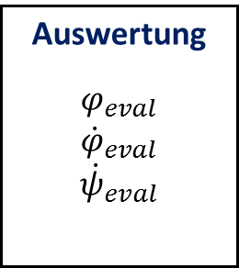
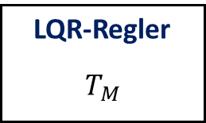
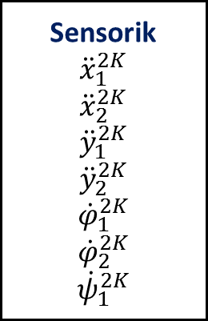
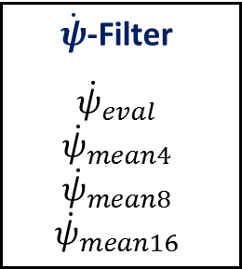

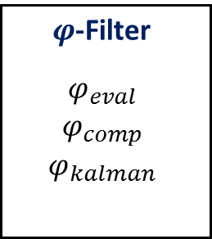
Sensorik
$${\ddot{x}}_{1}^{2K}$$
$${\ddot{x}}_{2}^{2K}$$
$${\ddot{y}}_{1}^{2K}$$
$${\ddot{y}}_{2}^{2K}$$
$${\dot{φ}}_{1}^{2K}$$
$${\dot{φ}}_{2}^{2K}$$
$${\dot{ψ}}_{1}^{2K}$$
Auswertung
$$φ_{eval}$$
$${\dot{φ}}_{eval}$$
$${\dot{ψ}}_{eval}$$
$φ$-Filter
$$φ_{eval}$$
$$φ_{comp}$$
$$φ_{kalman}$$
$\dot{φ}$-Filter
$${\dot{φ}}_{eval}$$
$${\dot{φ}}_{kalman}$$
$\dot{ψ}$-Filter
$${\dot{ψ}}_{eval}$$
$${\dot{ψ}}_{mean4}$$
$${\dot{ψ}}_{mean8}$$
$${\dot{ψ}}_{mean16}$$
HW-Schnittstelle
Aktorik
LQR-Regler
$$T_{M}$$

Slide 2
Timer-Task
Timer-Tick
BeagleBone Black
Steuerbefehle
Kommunikations-Komponente
Steuerbefehle
MATLAB
Start/Stopp
Timer-Tick
Proxy
Daten
Daten
Regelungs-Komponente
Daten
Steuerbefehle

Slide 3
SensorMeasurement
ADCMeasurement
CPsiIdentification
CPhiIdentification
CLIENT_DC
RUN_ADC_MEASUREMENT
RUN_CPSI_IDENTIFICATION
CLIENT_DC
CLIENT_DC
RUN_CPHI_IDENTIFICATION
CLIENT_DC
Standby
RUN_SENSOR_MEASURMENT
RUN_JUMP_TEST
CLIENT_DC
RUN_CONTROL_TEST
JumpTest
ControlTest
BRAKING_FINISHED
IN_BALANCE_AREA
Waiting
Braking
CLIENT_DC
Idle
Balancing
RESTING
IN_IDLE_AREA
JUMP_VEL_REACHED
MOVING
Accelerating

