Slide 1



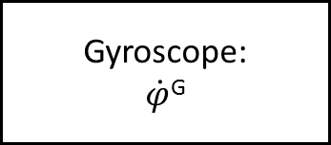
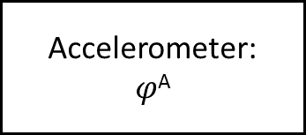

Komplementär-Filter
Accelerometer:
$$φ\text{A}$$
Tiefpass:
H^{TP}(s) = $\frac{1}{1+ τ\text{1}∙s}$
+
$$φ\text{C}$$
+
Gyroscope:
$$\dot{φ}\text{G}$$
Integrator:
H^{Int}(s) = $\frac{1}{s}$
Hochpass:
H^{HP}(s) = $\frac{τ\text{2}∙s}{1+ τ\text{2}∙s}$

Slide 2
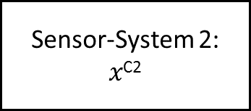




Richtiges?-Komp-Filter
Sensor-System 1:
$$x\text{C}\text{1}$$
Filter 1:
H^{F1}(s)
$$y\text{F}\text{1}$$
+
$y\text{C} _{=}^{ !}$ w
+
Sensor-System 2:
$$x\text{C}\text{2}$$
Filter 2:
H^{F2}(s)
$$y\text{F}\text{2}$$

Slide 3
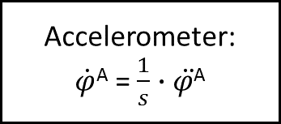




Richtiges?-Komp-Filter
Gyroscope:
$$\dot{φ}\text{G}$$
Hochpass:
H^{HP}(s) = $\frac{τ\text{1}∙s}{1+ τ\text{1}∙s}$
+
$$\dot{φ}\text{C}$$
+
Accelerometer:
$\dot{φ}\text{A}$ = $\frac{1}{s}$ $∙\ddot{φ\text{A}}$
Tiefpass:
H^{TP}(s) = $\frac{1}{1+ τ2∙s}$

