Slide 1
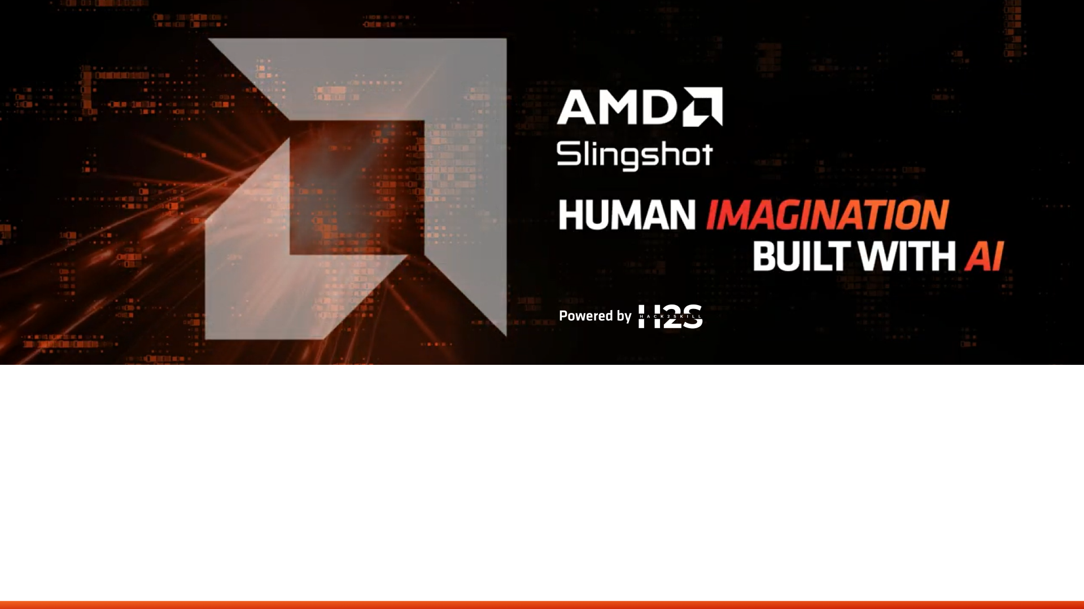
Team Details
Team name -DataNOtfOund
Team leader name -Hitesh Khare
Problem Statement - AI for Smart Cities

Slide 2

Brief About the Idea — Resonance Fault Detection Platform
⚠ THE PROBLEM
SIGNAL PIPELINE
Machines Fail Silently
🎵 Piezo Sensor
PHYSICAL
Bearing wear · misalignment · cavitation — detectable weeks before failure
35mm disc · contact microphone
1.2MΩ bias · JFET buffer
💀 A single undetected bearing failure stops an entire production line
⏱ Fault signatures appear weeks before catastrophic failure — undetected
⚙ DSP Engine
TIER 1
🏭 85% of industrial mechanical downtime comes from rotating machinery
C++17 · PortAudio · FFTW3
44.1kHz · IsolationFilter · ZMQ PUB
🚫 500,000+ Indian SME factories have zero predictive monitoring today
✓ THE SOLUTION
🧠 AMD Ryzen AI NPU
TIER 2
Resonance – Digital Stethoscope
ConvAutoencoder · ONNX · Vitis AI
50 TOPS · ~4.7ms inference
Physics-first · Edge AI · Zero cloud · Any language
🎯 Low-cost piezo sensors + C++ DSP — physics-first detection
TIER 3
🔔 Alert + Dashboard
🧠 Convolutional autoencoder on AMD Ryzen AI NPU — 4.7ms inference
Ollama LLM · any language · offline
React dashboard · ZMQ :5557
🌐 Ollama LLM alerts in any language — fully offline, no internet
🏭 Built for 500,000+ Indian SME factories incumbents cannot reach
₹3,499
85%
4.7ms
<1 week
ZERO
500,000+
PER SENSOR NODE
CHEAPER THAN SKF
NPU INFERENCE
DEPLOYMENT TIME
CLOUD DEPENDENCY
TARGET FACTORIES

Slide 3
Market Opportunity & Differentiation
Why Resonance exists — and why no existing solution can serve this market
Incumbents · SKF · Emerson · Schaeffler
Resonance · Built for SME India
Up to
₹15,000 – ₹80,000+
VS
₹3,499
85%
/sensor (industry deployment estimates)
per sensor node · plug-and-play
lower deployment cost
+ ₹5–20L/year software · mandatory cloud · 6–18 month deploy
Installs in <1 week · Zero cloud dependency
vs. incumbent solutions
500,000+
85%
<3%
₹2,491
Air-gapped
Indian SME factories
downtime from rotating machinery
currently using predictive maintenance
Per sensor node (Tier 1 BOM cost)
zero cloud · factory intranet only
WHAT IT TARGETS
HOW IT DETECTS
WHY NOW
⚙ Critical Rotating Machinery
📊 Physics-First Fault Detection
🛡 The Unserved 97% of Market
Compressors · Pumps · Motors · Bearings
Bearing wear · Misalignment · Imbalance · Looseness
SME India · <3% adoption today · Zero cloud needed
A single undetected failure stops entire production lines. Rotating machinery accounts for 85% of all industrial mechanical downtime.
Spectral signatures from FFTW3 FFT — ISO 10816 / ISO 13373 compliant. No black-box AI — physics validates every alert.
Incumbents target enterprise plants. 500,000+ SME factories remain completely unserved. Resonance is designed specifically for them.
"
First offline, physics-first vibration intelligence system built natively for AMD edge AI — designed for 500,000+ Indian SME factories ignored by existing solutions.
* Based on industry deployment ranges; varies by configuration and region.

Slide 4
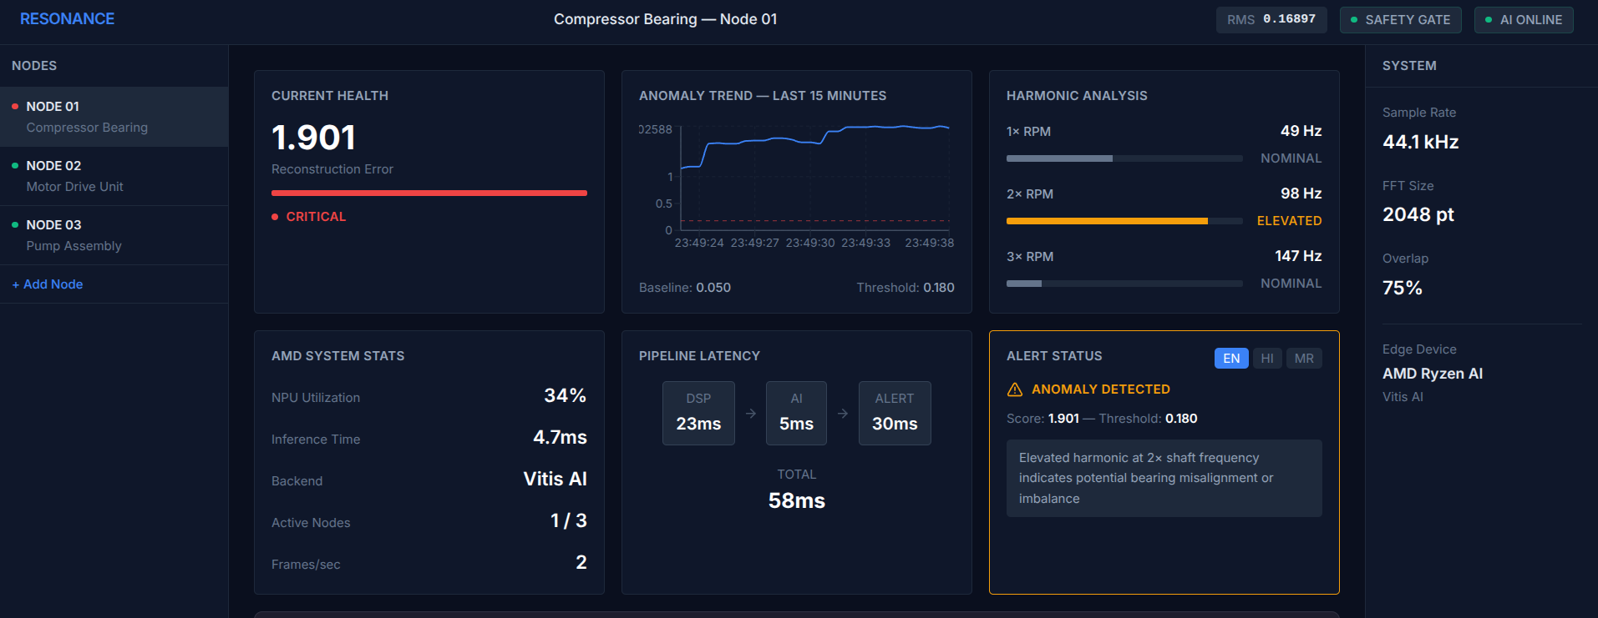
List of features offered by Resonance
Real system · Real data · Running on AMD Ryzen AI XDNA NPU
⚙ Signal Processing · Physics-First DSP
High-pass 100Hz + Low-pass 12kHz · C++17 IsolationFilter
TIER 1
2048-pt FFT · 75% overlap · 1024×64 log-magnitude spectrogram
⚡ Deterministic Safety Gate · Hardware Alarm
RMS threshold check — fires independently of AI, cannot be bypassed
<1ms
Sub-100ms end-to-end · <1ms gate response · ISO 10816
🧠 AI Fault Detection · ConvAutoencoder on AMD NPU
Trained exclusively on healthy data · MSE > 0.180
TIER 2
Bearing wear · misalignment · imbalance · looseness · 4.7ms
🌐 Human Interface · Multilingual LLM Alerts
Ollama local LLM · English · Hindi · Marathi · offline
TIER 3
LIVE PROTOTYPE · Resonance Dashboard v1.0
Live waterfall spectrogram · 1× 2× 3× harmonic analysis · React
<100ms
2048-pt
4.7ms
Any Language
ZERO
50 TOPS
SENSOR→ALERT
FFT SIZE
NPU INFERENCE
LLM ALERTS
CLOUD DEP
AMD XDNA NPU

Slide 5
Process Flow Diagram — Resonance Fault Detection Pipeline
⚙
START
⚡ HARDWARE ALARM
Vibration
Piezo ADC Capture
PortAudio Stream
↺ continuous
monitoring loop
MACHINE
Machine
running
Immediate · <1ms
Bypasses AI entirely
Bearing motion
→ piezo deflects
35mm disc · 1.2MΩ
Logitech USB dongle
44.1kHz · 16-bit PCM
Continuous buffer
Physical
YES
A
Isolation Filter
RMS >
thresh?
NO
FFTW3 · FFT
Spectrogram Ring
ZMQ PUB :5555
✓ NORMAL
High-pass 100Hz
Low-pass 12kHz
Remove noise
2048-point FFT
75% overlap
512-sample hop
Accumulate 64 frames
Log-magnitude scale
→ 1024×64 tensor
Frame 0: JSON header
{rms,bins,frames,ts}
Frame 1: float32 tensor
No fault detected
Loop back to start
keep monitoring
NODE A
~23ms
C++ DSP
Pi Zero 2W
NO
ZeroMQ PUB/SUB · PORT :5555 · Factory Intranet · 1024×64 float32 tensor + JSON header
B
Normalize
ConvAutoencoder
AMD Ryzen AI NPU
MSE >
0.180?
YES
Ollama LLM
ZMQ PUB :5557
Apply norm_stats.json
Map tensor to [0,1]
Match training dist.
Encoder: 3×Conv2d stride 2
Decoder: reconstruct input
Trained on HEALTHY only
Vitis AI Runtime
ONNX Exec. Provider
XDNA · 50 TOPS · 15W
Generate explanation
Any language · offline
EN · HI · MR · others
{mse, rms, severity
alert, spectrogram}
→ Node C
NODE B
~4.7ms
AMD NPU
Python AI
ZeroMQ PUB/SUB · PORT :5557 · {mse, rms, severity, alert} · Socket.IO → Browser
C
React Dashboard
Harmonic Analysis
⚠ WARNING STATE
Engineer Action
RESOLVED
NODE C
Node.js · Socket.IO
Live RMS spectrogram
1× 2× 3× shaft freq
ISO 10816 fault bands
Score + fault explanation
displayed to engineer
Reads cause · schedules
maintenance
Fault prevented
Downtime avoided
Engineer
<1ms
23ms
4.7ms
<100ms
0.180
OFFLINE
SAFETY GATE
FFT PROCESSING
NPU INFERENCE
SENSOR → ALERT
ANOMALY THRESHOLD
ZERO CLOUD

Slide 6
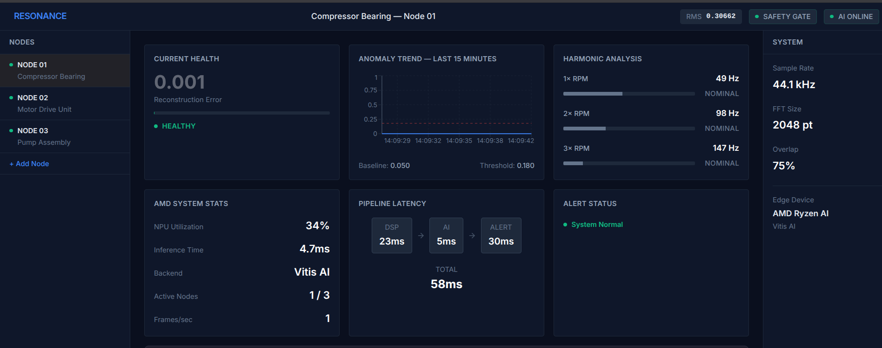
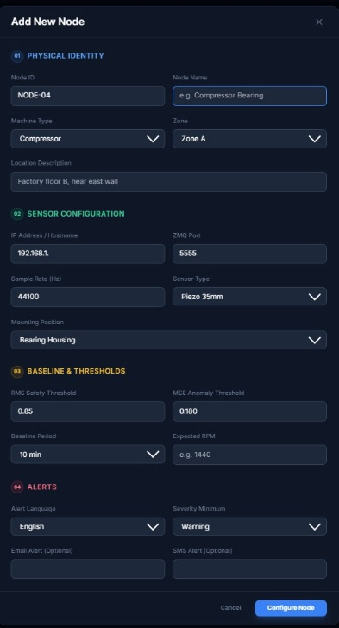
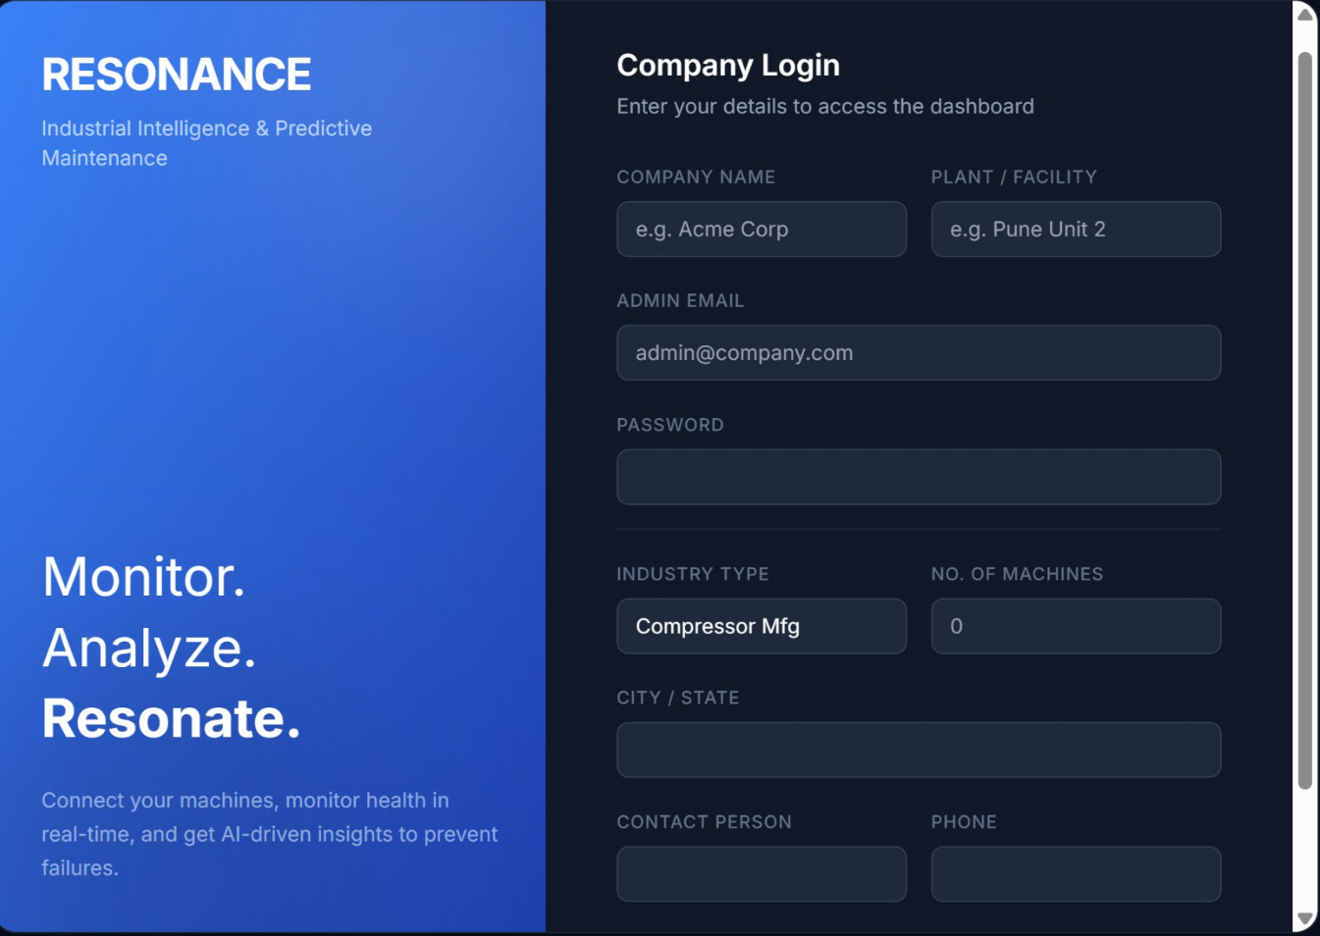
Wireframes/Mock diagrams of the proposed solution.
Login Screen · Live Dashboard · Node Configuration
● LIVE
RESONANCE · Compressor Bearing — Node 01
RMS: 0.168 · AI ONLINE
+ ADD NEW NODE
COMPANY LOGIN
▶
▶
LIVE PROTOTYPE · Real data · AMD Ryzen AI XDNA NPU
01 · LOGIN SCREEN
02 · LIVE DASHBOARD
03 · NODE SETUP MODAL
Live Demo
3 Nodes
50 / zone
Any Language
Zero Cloud
+ Add Node
PROTOTYPE
CONNECTED
CAPACITY
LLM ALERTS
DEPENDENCY
INSTANT SETUP

Slide 7
Architecture diagram
FACTORY INTRANET · AIR-GAPPED · ZERO CLOUD DEPENDENCY
TIER 1 · ZONE A · UP TO 50 SENSOR NODES
TIER 1 · ZONE B · UP TO 50 SENSOR NODES
TIER 1 · ZONE C · UP TO 50 SENSOR NODES
SCALE
Pi Zero 2W
Pi Zero 2W
Pi Zero 2W
Pi Zero 2W
Pi Zero 2W
Pi Zero 2W
Pi Zero 2W
Pi Zero 2W
Pi Zero 2W
↕
Piezo · ADC
Piezo · ADC
Piezo · ADC
Piezo · ADC
Piezo · ADC
Piezo · ADC
Piezo · ADC
Piezo · ADC
Piezo · ADC
ZMQ PUB :5555 · 1024×64 tensor · 5 Hz
ZMQ PUB :5555 · 1024×64 tensor · 5 Hz
ZMQ PUB :5555 · 1024×64 tensor · 5 Hz
C++17
FFTW3
PortAudio
ZMQ
C++17
FFTW3
PortAudio
ZMQ
C++17
FFTW3
PortAudio
ZMQ
Add zones
↕
Plug into
same master node
AMD HARDWARE · TIER 2
AMD HARDWARE · TIER 2
AMD HARDWARE · TIER 2
Ryzen™ AI NPU
Ryzen™ AI NPU
Ryzen™ AI NPU
Vitis AI · ONNX Runtime · ~4.7ms
Vitis AI · ONNX Runtime · ~4.7ms
Vitis AI · ONNX Runtime · ~4.7ms
ConvAutoencoder · MSE threshold: 0.180
ConvAutoencoder · MSE threshold: 0.180
ConvAutoencoder · MSE threshold: 0.180
Ollama LLM · any language · offline
Ollama LLM · any language · offline
Ollama LLM · any language · offline
ZMQ PUB :5557 · {mse, rms, severity, alert}
AMD HARDWARE · TIER 3 · PER FACTORY
NODE.JS + REACT · NODE C · BROWSER
Mini Server / Edge PC
Live Dashboard
ROCm — enterprise upgrade path only · Plant-wide health dashboard · Historical archive
Socket.IO
RMS spectrogram · Anomaly trend · Harmonic analysis · Health score
Ryzen 5 · 16GB RAM · 2.5 GbE backbone · UPS · ₹72,999 per factory
Ollama LLM multilingual alerts · Multi-node health map
₹ 72,999/ FACTORY
React
TypeScript
Recharts
Docker
<100ms
4.7ms
50×
₹3,499
ZERO
50 TOPS
SENSOR → ALERT
NPU INFERENCE
NODES PER ZONE
PER SENSOR NOPDE
CLOUD DEPENDENCY
AMD XDNA NPU

Slide 8

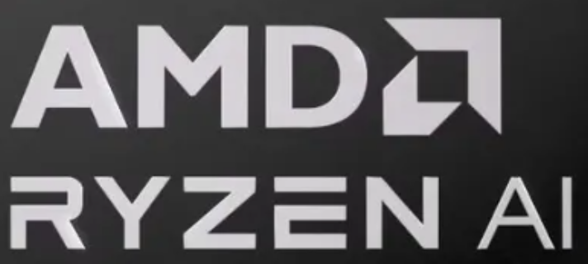
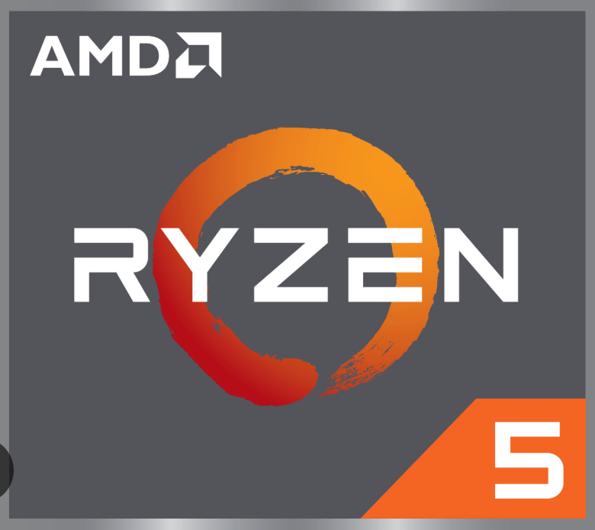










⊿
Powered by H2S
Technologies to be used in the solution
TIER 1 · SENSOR SLAVE
TIER 2 · AMD NPU INFERENCE
TIER 3 · MASTER CONTROL
SIGNAL PROCESSING STACK
AI & EDGE INFERENCE
BACKEND & VISUALIZATION
C++
C++17
AMD Ryzen™ AI NPU
Ryzen 5 Edge Mini PC
DSP core
50 TOPS · 15W
dashboard + aggregation
PA
PortAudio
VA
Vitis™ AI Runtime
Node.js
44.1kHz capture
NPU exec provider
Socket.IO relay
FFT
FFTW3
ONNX Runtime
React + TypeScript
2048-pt FFT
cross-platform infer
live dashboard
ZMQ
ZeroMQ PUB/SUB
PyTorch
Docker
intranet relay
Offline model training
containerized deploy
π
Raspberry Pi Zero
LM
Ollama (Local LLM)
ARM Cortex-A53
Multi-language · offline
Piezo → C++ DSP → ZeroMQ
ONNX → Vitis AI → NPU → Ollama
React Dashboard → Alerts
Raspberry Pi Zero 2W · ₹2,600/node
AMD Ryzen AI · 50 nodes per unit
Ryzen 5 Edge · dashboard + alerts

Slide 9
POWERED BY H2S
Strategic Usage of AMD Products/Solutions
Native Integration Across Inference and Aggregation Layers
EDGE AI · TIER 2
FULL-STACK AMD SOFTWARE
EDGE COMPUTE · TIER 3
AMD Ryzen™ AI (XDNA NPU)
AMD AI Software Ecosystem
Ryzen 5 Edge Mini PC (Dashboard)
ROLE IN RESONANCE
VITIS™ AI RUNTIME
ROLE IN RESONANCE
▸ Runs ConvAutoencoder inference on spectrograms
▸ 4–5ms anomaly detection latency per sample
▸ Serves 50 sensor nodes simultaneously
▸ 15–28W TDP — always-on industrial deployment
▸ ONNX execution provider for XDNA NPU
▸ Hardware-accelerated, deterministic inference
▸ Sub-5ms latency per spectrogram
▸ Aggregates anomaly data from all Tier 2 zones
▸ Hosts Node.js + React dashboard backend
▸ Stores historical vibration archives on NVMe SSD
▸ Triggers plant-level alerts — SMS, siren, email
ROCm · OPTIONAL / ENTERPRISE UPGRADE
▸ GPU compute fallback for batch analytics
▸ Historical spectrogram batch reprocessing
AMD SOFTWARE USED
AMD HARDWARE
Vitis™ AI Runtime + ONNX Runtime
Ryzen 5 7530U Mini PC
Vitis AI Runtime — NPU execution provider
ONNX Runtime — Vitis AI EP for inference
AMD NPU Driver Stack — XDNA management
AMD uPROF
6-core / 12-thread — Zen 3 architecture
16GB DDR4 — dashboard + ZMQ relay
256GB NVMe SSD — vibration archive
▸ Edge inference performance profiling
▸ NPU utilization & latency monitoring
WHY AMD vs ALTERNATIVES
WHY SEPARATE MASTER NODE
Ryzen AI
50 TOPS ✓
AMD SILICON DATA FLOW
▸ Dashboard isolation — dedicated UI + relay compute
▸ Always-on ZMQ relay — independent from inference node
▸ Fault isolation — NPU failure won't kill dashboard
▸ EPYC recommended for multi-factory · 50+ zones
Jetson Orin
ARM only
Pi Zero
▶
Ryzen AI
▶
Ryzen 5
Core Ultra
No Vitis AI
DSP+ZMQ
XDNA NPU
Dashboard
ZMQ PUB
JSON alert
AMD silicon appears exactly where performance matters — inference (Ryzen AI NPU) and aggregation (Ryzen 5 Edge) — EPYC reserved for multi-factory enterprise scale.
50 TOPS
4.7ms
15–28W
₹72,999
x86
ZERO
XDNA NPU
NPU INFERENCE
EDGE TDP
MASTER NODE
NO ARM REWRITE
CLOUD DEPENDENCY

Slide 10
Estimated Implementation Cost — Full Component BOM & SME Scenario
TIER 1 — SENSOR NODE
TIER 2 — AMD NPU NODE
TIER 3 — MASTER NODE
SME SCENARIO — ASIAN COMPRESSOR
Per machine · Pi Zero 2W
Per zone · up to 50 machines
Per factory · dashboard + DB
20 critical machines · 2 factory zones · 1 master
COMPONENT
SPEC
₹ COST
COMPONENT
SPEC
₹ COST
COMPONENT
SPEC
₹ COST
20 × Sensor Nodes
₹69,980
Raspberry Pi Zero 2W
Quad-core ARM @1GHz 512MB
₹1,299
Ryzen AI Mini PC
Ryzen AI 9 HX 370 16GB 512GB
₹74,999
★ Ryzen 5 Edge Mini PC
Ryzen 5 16GB 512GB fanless
₹49,999
Tier 1 @ ₹3,499 each
2 × AMD NPU Nodes
₹1,79,998
USB Audio Adapter
C-Media CM108 44.1kHz TRRS
₹299
└ AMD XDNA NPU
50 TOPS ONNX + Vitis AI RT
included
└ Role
Node.js + dashboard only
optimal
Tier 2 @ ₹89,999 each
1 × Master Node
₹72,999
Piezo Disc 35mm
PZT ceramic 35mm dia
₹80
└ 12-core CPU
Zen 5 up to 5.1GHz boost
included
└ EPYC upgrade
Multi-factory 50+ zones ROCm
₹1,50,000
Tier 3 Ryzen 5 Edge Mini PC
Installation
₹25,000
1.2MΩ Bias Resistor
1/4W carbon film ±5%
₹2
└ 16GB LPDDR5X
7500 MT/s dual-channel
included
2TB NVMe SSD
Historical anomaly archive
₹6,999
Wiring commissioning setup
TOTAL CAPEX
₹3,47,977
1µF Cap (DC block)
25V electrolytic
₹8
└ 512GB NVMe
PCIe 4.0 model storage
included
UPS (600VA)
APC BE600M1 12min runtime
₹4,499
2N3819 JFET Buffer
N-ch TO-92 impedance ↑
₹20
2.5GbE Switch
TP-Link 8-port factory LAN
₹3,499
2.5GbE Switch
Industrial ZMQ JSON payload
₹3,499
SKF equivalent (20 sensors): ₹9,00,000 + ₹2,00,000/yr cloud
TRRS 3.5mm Jack
Panel mount stereo+mic
₹25
DIN-rail mount kit
For industrial cabinet
₹999
Software: Node.js
Express Socket.IO ZMQ SUB
₹0 (OSS)
Savings: ₹5,52,023 hardware + ₹2,00,000/yr cloud = ₹7.52L Year 1
MicroSD 16GB
Class 10 OS + software
₹249
Power supply (IPC)
12V 5A industrial grade
₹999
Software: React
TypeScript Recharts Docker
₹0 (OSS)
REVENUE MODEL — PER 20-MACHINE SME
Hardware sale (one-time)
₹3,47,977
margin: ~20%
5V 2A USB PSU
10W continuous duty
₹249
Ethernet patch cables
Cat6 3m × 8 per zone
₹800
Database: PostgreSQL
Anomaly history trend data
₹0 (OSS)
Install & commission
₹25,000
margin: ~68%
Enclosure + mount
ABS box neodymium magnet
₹200
Software stack
Ubuntu 22.04 Python ZMQ ONNX
₹0 (OSS)
Ollama LLM (local)
Mistral 7B offline any lang
₹0 (OSS)
SaaS: ₹499/machine/month
₹1,19,760/yr
margin: ~85%
PCB + misc wiring
Perfboard solder jumpers
₹60
Vitis AI Runtime
AMD official ONNX execution prov.
₹0 (free)
Alert: Email / SMS
Nodemailer Twilio optional
₹0–₹999
Annual maintenance (AMC)
₹35,000/yr
margin: ~70%
Model retraining service
₹5,000/machine
margin: ~90%
BOM COST
₹2,491
BOM COST
₹81,296
BOM COST
₹64,996
YEAR 1 REVENUE
YEAR 2+ RECURRING
₹3,499
₹89,999
₹72,999
₹5.28 lakh
₹1.55 lakh/yr
OUR PRICE
OUR PRICE
OUR PRICE
₹3,499
₹89,999
₹72,999
₹3.48L
85%
₹0
SENSOR NODE (TIER 1)
NPU NODE (TIER 2)
MASTER NODE (TIER 3)
20-MACHINE SME CAPEX
SAAS MARGIN
CLOUD COST
AMD PRODUCT REFERENCES
Ryzen AI 9 HX 370 (Tier 2 NPU) :
amd.com/en/products/processors/laptop/ryzen-ai/300-series/amd-ryzen-ai-9-hx-370.html
AMD EPYC 9004 (Enterprise Tier 3):
amd.com/en/products/processors/server/epyc/9004-series.html
Minisforum AI X1 Pro (Mini PC OEM):
minisforum.com/pages/aix1pro
Vitis AI Runtime (NPU provider):
amd.com/en/developer/vitis-ai.html

Slide 11
Prototype Assets (Optional)
GitHub Public Repository Link : https://github.com/HSKCTA/Resonance
Demo Video Link (Max: 3 Minutes)

Slide 12
Powered by H2S
Standing on the
EVIDENCE FOUNDATION
Shoulders of Giants
⚙ PHYSICS VALIDATED
🧠 AI APPROACH PROVEN
ISO 10816-3:2009
Defines RMS vibration limits & spectral fault signatures for compressors, pumps & motors. Validates our safety gate.
ISO 13373-1:2002 FFT spectral analysis methods validating 1× 2× 3× harmonic approach.
Sakurada & Yairi (2014) · ACM · 500+ citations
Proves autoencoders on healthy data detect anomalies via MSE — exact basis of Resonance.
Principi et al. (2019) · IEEE/CAA
Validates ConvAutoencoder for rotating machinery.
Every claim is
verifiable.
The same fault signatures defined in ISO 10816 power SKF and Emerson sensors sold at ₹80,000 each. Resonance applies identical ISO-validated physics and peer-reviewed AI — at ₹6,100 per machine.
Randall, R.B. (2011)
SKF Application Notes
Market Evidence
Cambridge University Press
Competitor confirms our physics
FICCI 2023 · McKinsey 2022 · Deloitte 2017
THE definitive textbook on vibration-based condition monitoring. Defines all spectral fault signatures Resonance detects. SKF cites this directly.
World's #1 bearing manufacturer publishes identical spectral signatures in their ₹80,000 sensor docs. Same science. 85% lower cost.
500,000 SME manufacturers unserved. $50B/year unplanned downtime. 10× ROI on predictive maintenance. 85% rotating machinery downtime.
Proven science.
Accessible price.
3 ISO Standards
4 IEEE Papers
"We did not invent new science. We made proven, peer-reviewed, ISO-certified science accessible to 500,000 manufacturers who couldn't afford it."
3 Industry Reports
— Resonance · DataNotFound · AMD Slingshot 2026
10 verifiable sources on one slide.

Slide 13
Why Existing Solutions Don't Serve SME Manufacturing
Resonance Targets the Unserved 500,000+ Indian Factories
Feature
RESONANCE
SKF Enlight
Emerson AMS
Schaeffler Optime
MARKET GAP
Cost per sensor
₹3,499
₹45,000+
₹80,000+
₹25,000+
500,000+
Indian SME factories
Deployment time
<1 week
6–18 months
6–18 months
3–6 months
<3%
Cloud dependency
None
Mandatory
Mandatory
Mandatory
using predictive
maintenance today
Works offline
Always
No
No
No
97%
Retrainable AI
Yes
Black-box
Black-box
Black-box
addressable market
gap
SME accessible
Yes
Enterprise only
Enterprise only
Enterprise only
Incumbents
target enterprise.
We target the
Local language alerts
Any language
English only
English only
English only
other 97%.
Target market
SME India
Enterprise
Enterprise
Enterprise
Resonance does not compete with incumbents — it serves the manufacturers they cannot reach.

Slide 14
Product Roadmap — Resonance Fault Detection Platform
NOW · Q1 2026
Q2 2026 · 3 MONTHS
Q3 2026 · 6 MONTHS
Q4 2026+ · SCALE
LIVE
NEXT
PREMIUM
VISION
Batch Inference
& SME Launch
Fault Type
Classifier
Remaining Useful
Life Estimator
Multi-Factory
Enterprise Platform
"Is there a fault?"
"What kind of fault?"
"How long until failure?"
"Which plant needs attention?"
MODEL · ConvAutoencoder
MODEL · Supervised CNN Classifier
MODEL · LSTM on MSE Trend History
MODEL · Fleet-level Anomaly Network
NPU LOAD · ~20–30% NPU
NPU LOAD · ~50–60% NPU
NPU LOAD · ~70–80% NPU
NPU LOAD · Full NPU fleet
⚡ Batched NPU inference
🎯 Multi-class fault labels
⏱ Time-to-failure prediction
🌍 Cross-factory dashboard
50 sensors/zone · 5Hz simultaneous
Bearing wear · imbalance · looseness
"Bearing failure in ~72 hours"
Plant A vs B vs C · central command
🔍 ConvAutoencoder
🔬 Lab-simulated faults
📉 MSE drift tracking
🤖 AutoML retraining
Trained on healthy data · MSE threshold
Controlled motor obstruction dataset
Weeks of trend data → LSTM input
Models self-update from field data
📊 Harmonic analysis
🧠 2nd model on same NPU
🗓 Maintenance scheduling
🔗 ERP / SCADA integration
1× 2× 3× shaft freq · ISO 10816
Autoencoder + Classifier in parallel
Plan downtime before emergency shutdown
SAP · Siemens · Honeywell connectors
🌐 Ollama LLM alerts
📈 Severity grading
💎 Premium SaaS tier
☁ Optional cloud hybrid
Any language · offline · no cloud
LOW · MEDIUM · HIGH · CRITICAL
₹999/machine/month · enterprise pricing
Air-gapped by default · opt-in sync
💰 SME commercial launch
🏭 Mid-market expansion
🏢 Enterprise Tier 3 upgrade
📊 Industry 4.0 compliance
₹3,499/node · ₹499/machine/month SaaS
Up to 100 nodes/zone · larger factories
AMD EPYC 9004 · 50+ zones · ROCm batch
ISO 13373 · IEC 61511 · OPC-UA
HW · Tier 3: Ryzen 5 Edge Mini PC
HW · Tier 2: Same Ryzen AI NPU
HW · Tier 3 Enterprise: AMD EPYC 9004
HW · AMD EPYC + Ryzen AI Fleet
Dashboard + aggregation only
No hardware change · software update
Multi-factory · batch ROCm analytics
Full AMD silicon stack at scale
Q1 2026
50/zone
~80%
3 Models
₹999/mo
EPYC
SME LAUNCH · LIVE NOW
SENSORS BATCHED (NOW)
NPU LOAD AT ROADMAP END
FAULT DETECTION STACK
PREMIUM SAAS TIER
ENTERPRISE UPGRADE PATH

Slide 15
