Slide 1


Single Connect & Detection Of Anomaly
What are the Features of Single Connect?
How to detect Anomaly and to use on Security?

Slide 2

Sections
01
General Information
02
Benefits and Features Of Single Connect
03
Anomaly Detection Through Keystroke

Slide 3


General Information About Single Connect
Krontech's Single Connect™ as a Privileged Access Management (PAM) solution, supports wide range of features in one box and helps carriers/enterprises to establish a flexible, centrally managed and layered defense security architecture against insider threats.

Slide 4
Sections
01
General Information
02
Benefits and Features Of Single Connect
03
Anomaly Detection Through Keystroke

Slide 5

Privileged Session Manager (PSM)
Dynamic Password Controller
Dynamic Data Masking (DDM)
Products
Privileged Task Automation (PTA)
Unified Access Manager
Privileged Access Manager (PAM)
Two-Factor Authentication (2FA)

Slide 6
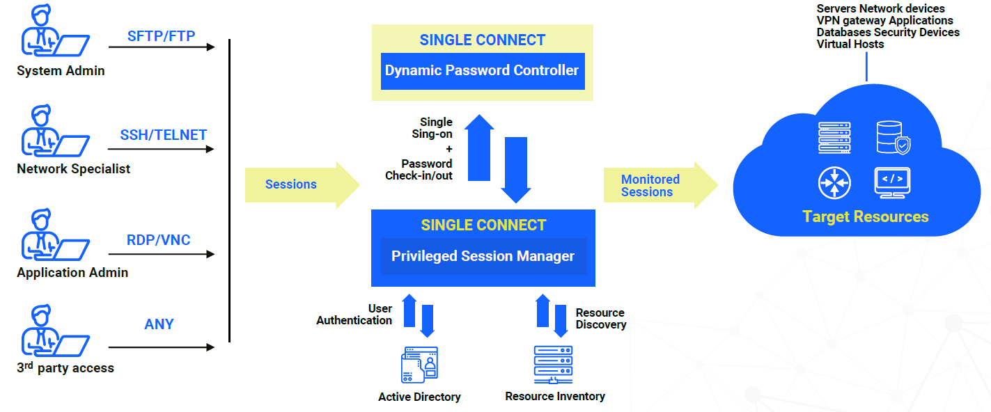
Privileged Session Management
(PSM)
Explain
Privileged Session Manager logs and records of all sessions for network and servers, including command and context-aware filtering.
Benefits
Real-Time Access Security
Full Visibility
Auto-login

Slide 7
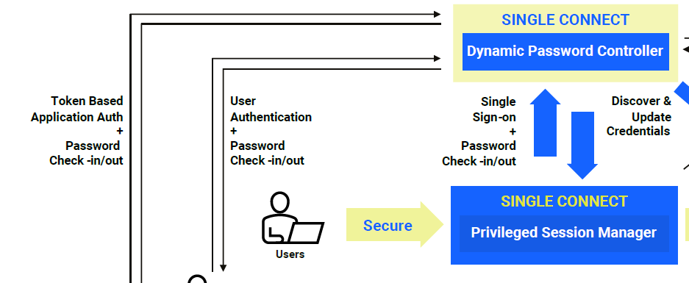
Dynamic Password Controller
Explain
Dynamic Password Controller takes control of device and database passwords, providing security while sustaining efficiency.
Benefits
One-Time Passwords (OTP)
Centralized Password Vault
Always Strong Password

Slide 8
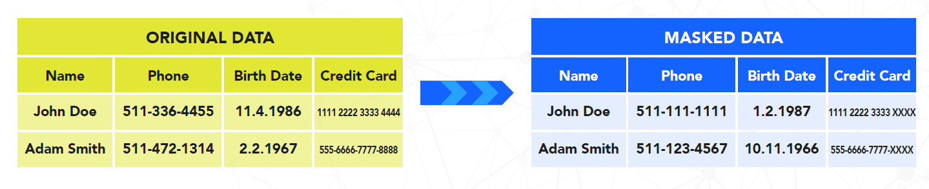
Dynamic Data Masking
(DDM)
Explain
Database Access Manager is a single point of access control management for database layer, secures data access with logging, policy enforcement, and masking.
Benefits
Security for Database Access
Visibility with Data Access Logging
Enhanced Masking Capability

Slide 9
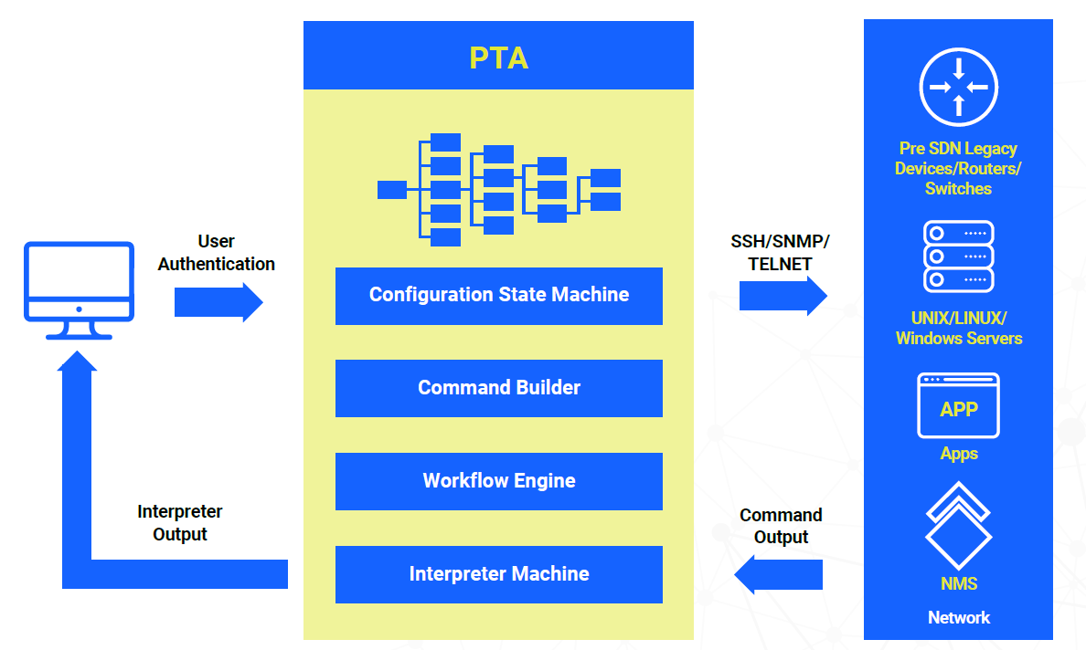
Privileged Task Automation
(PTA)
Explain
Privileged Task Automation provides single interface to configure the ability of network business flows with dynamic and extendable command sets.
Benefits
Granular Access Control
Adapter based Protocol Support

Slide 10
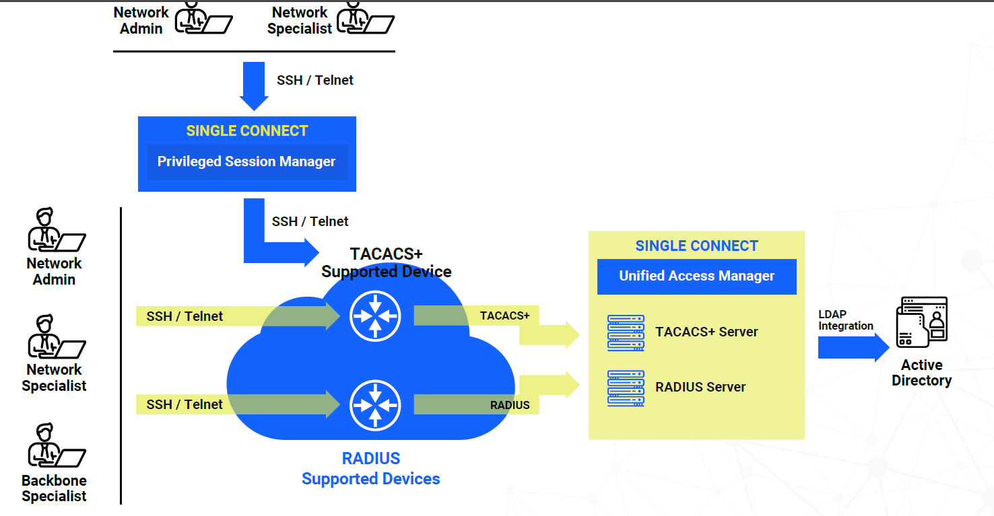
Unified Access Management
Explain
Unified Access Manager provides AAA services for network infrastructure and extends authentication and policy configurations of AD to network.
Benefits
Effective Control & Security
Simplified Administration

Slide 11
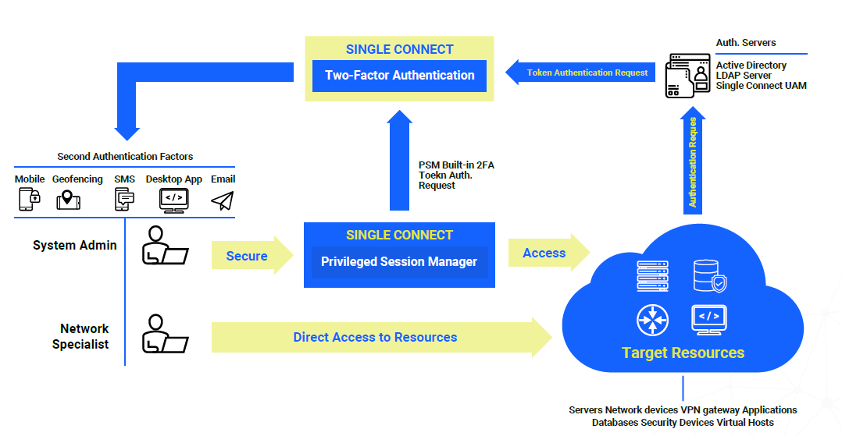
Two-Factor Authentication
(2FA)
Explain
Two-factor Authentication adds additional layers of authentication integrating mobile device, geo-location and time.
Benefits
Second-Layer Security
One-time passwords

Slide 12





Privileged Access Management
(PAM)
Explain
Privileged Access Management (PAM) is a cyber security domain within Identity and Access Management (IAM) that focuses on monitoring and controlling privileged users and privileged accounts within an organization. Single Connect™ product family strengthens, simplifies and secures the management of privileged accounts, for enterprises and network operators who serve them. Single Connect™ unifies multivendor environments with pre-integrated modules managing dozens of vendors and hundreds of network elements and servers with a single, universal system.

Slide 13
Sections
01
General Information
02
Benefits and Features Of Single Connect
03
Anomaly Detection Through Keystroke

Slide 14


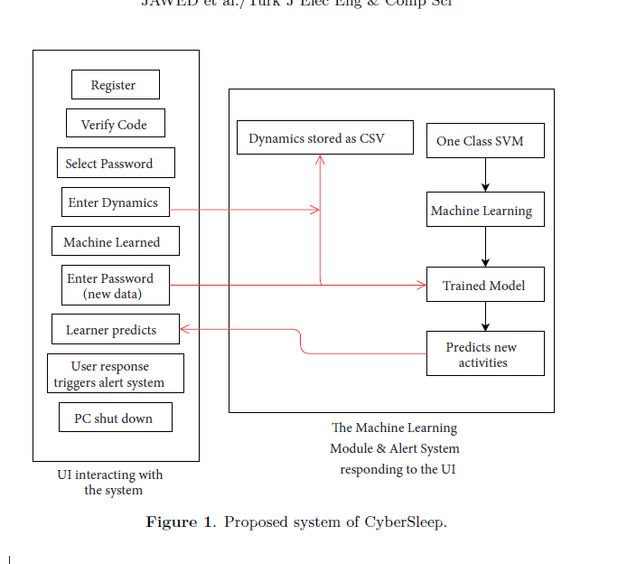
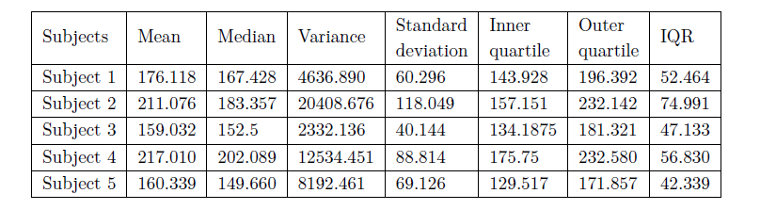
Anomaly detection through keystroke and tap dynamics implemented via
machine learning algorithms

Slide 15

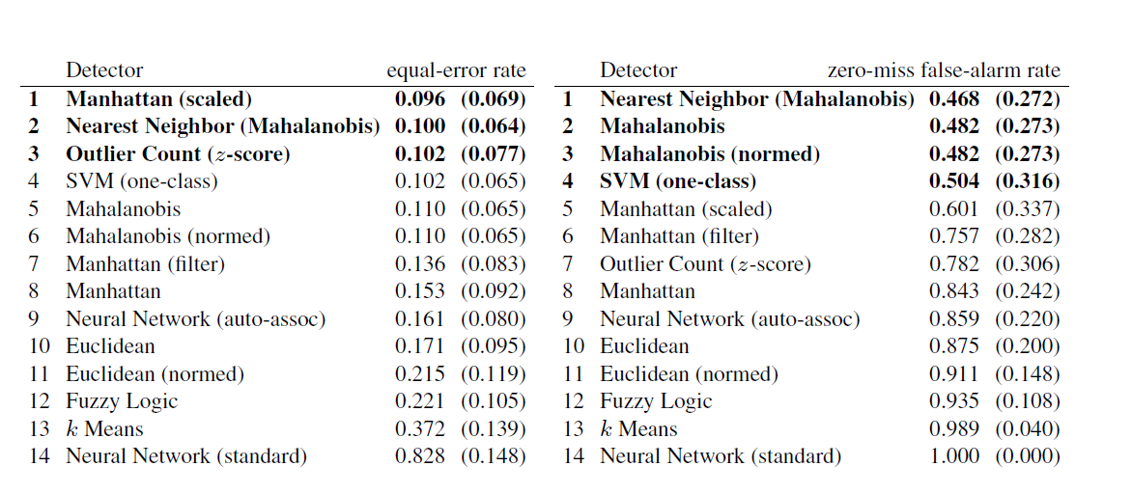
Comparing Anomaly-Detection Algorithms for Keystroke Dynamics

Slide 16
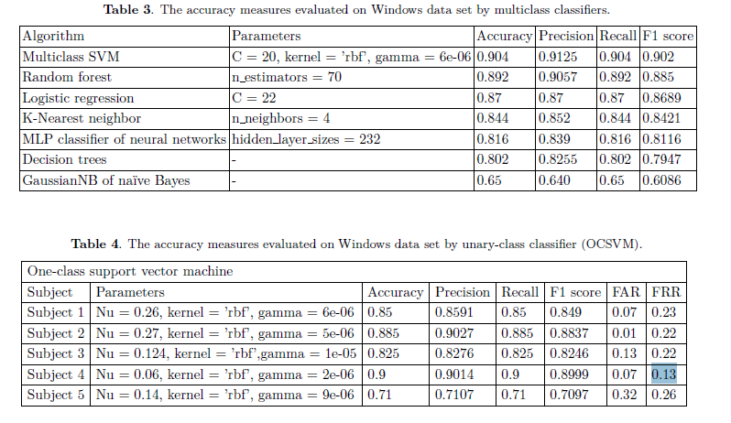

Slide 17



