Slide 2
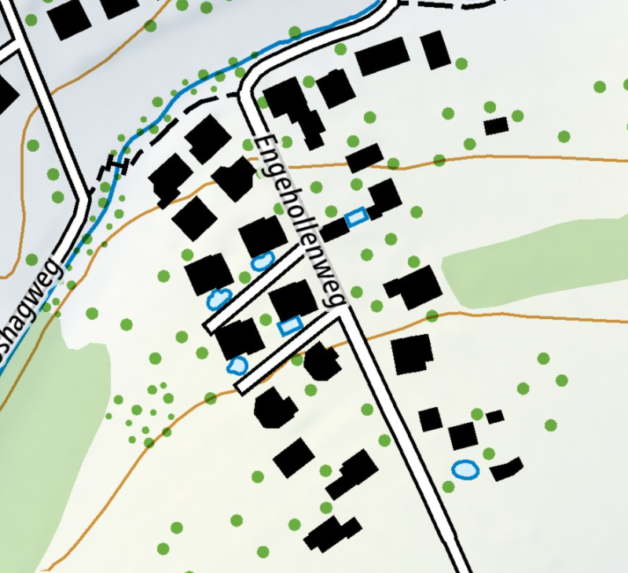

Slide 3
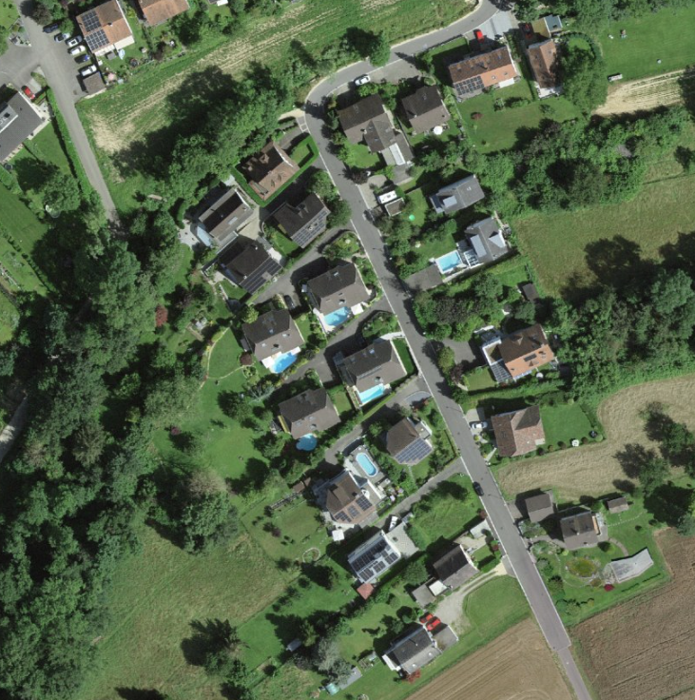
Adapted from: www.map.geo.admin.ch

Slide 5
https://map.geo.admin.ch/#/map?lang=de&center=2606682.85,1266444.54&z=11.853&topic=ech&layers=&bgLayer=ch.swisstopo.swissimage&featureInfo=default&catalogNodes=517,527,ech,696,457,491

