Slide 1
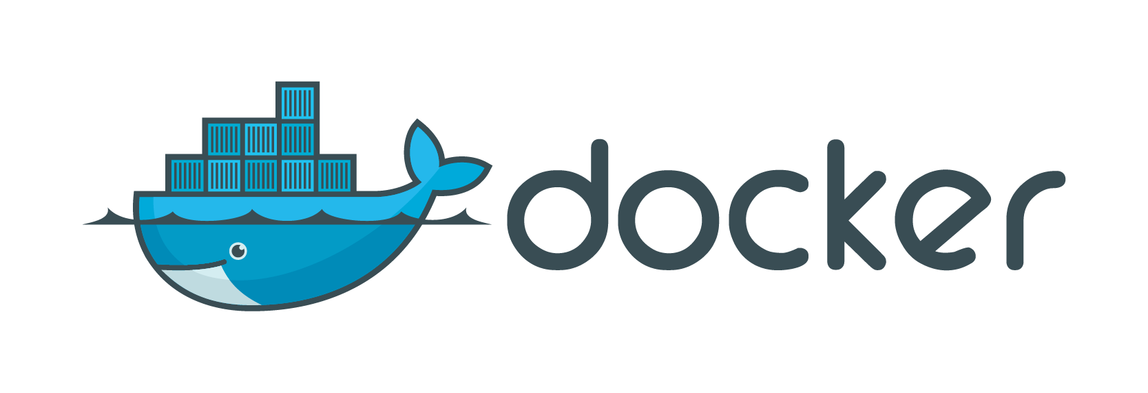






HTTP
Web Server
REST
Flux Load Balancer
App Server
App Server
Scaling
SQL
Docker Environment

Slide 2
HTTP
Web Server
REST
Flux Load Balancer
App Server
App Server
Scaling
SQL

