Slide 1

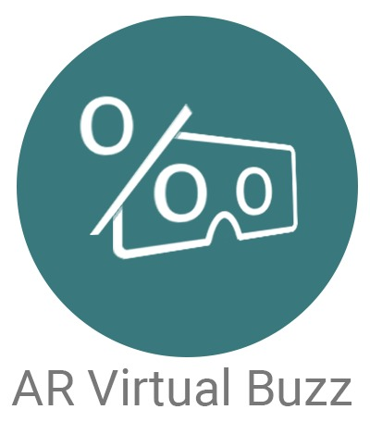
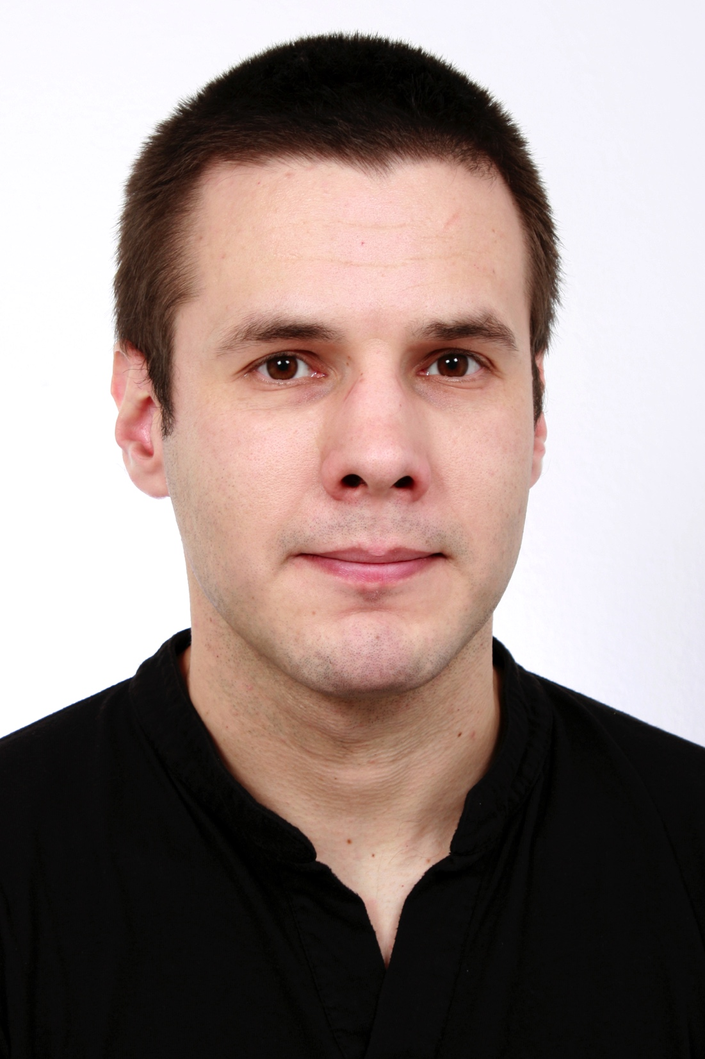


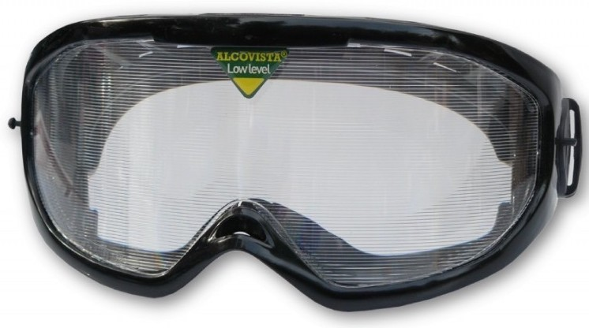
Virtual Buzz
Simulating the visual influences of alcohol in Augmented Reality
Advisor: Prof. Oliver Augenstein
Project Partner: Fachstelle ASN, Zürich
Term Project Fall Term 2016
Subject Area: Software
Foto
Konrad Höpli Roberto Cuervo Alvarez
The industrial partner ASN (which roughly translates to "never [drink] behind the wheel”) provides information regarding the influence of alcohol and other drugs on humans. To make adolescents aware of the impact of alcohol on the human brain, they use a variety of tools such as (drunk) driving simulators and glasses, which come with impairments, to provide the visual experience of being drunk. Due to the desire to appeal to their young target audience, ASN sees a lot of value in using leading edge technologies to communicate their message. In case of this project, the goal was to experiment with Google Cardboards and to investigate their current capabilities with regards to being able to simulate some of the visual disturbances caused by alcohol.
As a first step, we decided on using the Vuforia SDK for the game engine Unity. Vuforia was initially suggested for the augmented reality development and we chose the one made for Unity because both come with additional features this way. Especially the various image effects and filters provided by Unity looked very promising for our goal.
The second step was developing a first prototype of an AR app, which simply used the ‘blur’ component provided by Unity on the running smartphone camera and thereby proofed the plausibility of the project idea. We then went on to attempt implementing the other visual effects described by ASN. Based on the research nature of this project, the whole development process as well as the information gathered on the topic of both Unity and AR capabilities is supposed to be documented well. In a manner to not just give a good insight on the project itself, but the topic and used tools as well. It is aimed at both potential future contributors to this project as well as developers interested in testing the water of augmented reality with the tools used here.
This project resulted in a functional app which can be used by the attendees of ASN presentations to simulate the visual experience of being drunk. It serves as a proof of concept for the initially uncertain idea to simulate the visual effects caused by alcohol in AR.
The app also identified the currently still severe limitations of the processing power of smartphones regarding the used technologies. The documentation serves as introduction to the world of AR and Unity while also giving insight on the project itself, the encountered limitations and possible extensions or future projects this could lead to.

