Slide 1


D
$$x_{0}$$
y
u
B
$$\dot{x}$$
C
A

Slide 2



x(0)
y
r
$$K_{vf}$$
w
u
B
$$\dot{x}$$
C
_
A
$$u_{R}$$
K

Slide 3


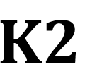

x(0)
$$\dot{x}$$
y
r
-e
$${K1}_{ }$$
u
B
C
_
_
A
$$u_{R}$$
$${K2}_{ }$$

Slide 4



Im
$$α$$
Re
$$σ_{2}$$
$$σ_{1}$$

Slide 5
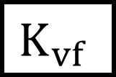






$$x_{0}$$
y
r
$$K_{vf}$$
u
B
$$\dot{x}$$
C
_
A
Regelstrecke
H
_
$$\dot{\hat{x}}$$
$$\hat{x}$$
$$\hat{y}$$
B
C
A
Beobachter
$$u_{R}$$
K

Slide 6




HC
$$x_{0}$$
$$\dot{\hat{x}}$$
y
w
e
-H
$$\hat{x}$$
-K
u
$$\dot{x}$$
_
B
C
A
A
Regelstrecke
B
Regler

Slide 7

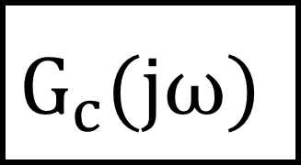



$$u(t)$$
$$G_{c}(jω)$$
$$y(t)$$
$$A sin (ω_{0}t)$$
$$B sin (ω_{0}t+φ)$$

Slide 8
















$$\left|G\right|$$
$$ω_{0}$$
$$ω$$
$$\left|G\right|$$
20 dB/dek
$$ω$$
$$ω_{0}$$
-20 dB/dek
40 dB/dek
$$\left|G\right|$$
$$ω_{0}$$
$$ω$$
$$ξ$$
$$\left|G\right|$$
$$ω$$
$$ξ$$
$$ω_{0}$$
$$\left|G\right|$$
-20 dB/dek
-40 dB/dek
$$ω_{0}$$

Slide 9



$$t_{t}$$
B
WP
A
t
$$t_{0}$$
$$t_{g}$$

Slide 10
Im
Im
1
Re
Re
1

Slide 11





Diskreter Bereich
Kontinuierlicher Bereich
d(s)
D(s)
r(s)
r(z)
e(z)
$$y(s)$$
S
$$C_{d}(z)$$
ZOH
P(s)
_
$$y_{m}(s)$$
S
$$F_{al}(s)$$
$$P_{m}(s)$$
w(s)

Slide 12
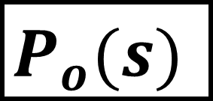
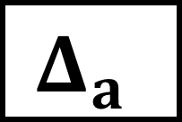

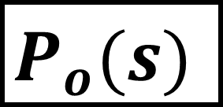

$$Δ_{a}$$
C(s)
$$P_{o}(s)$$
_
$$Δ_{m}$$
C(s)
$$I$$
$$P_{o}(s)$$
_

Slide 13
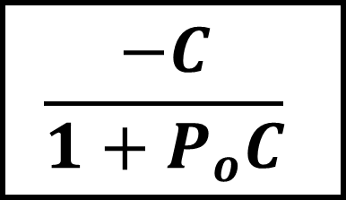
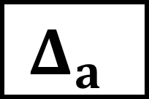
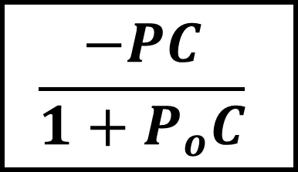
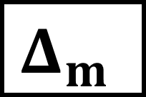
$$Δ_{a}$$
$$Δ_{m}$$
$$\frac{−C}{1+P_{o}C}$$
$$\frac{−PC}{1+P_{o}C}$$

Slide 14

$$\left|G\right|$$
A
$$ω$$

Slide 15




$$\frac{1}{A_{R}}$$
$$d_{crit}$$
$$φ_{R}$$
$$L(jω)$$

Slide 16

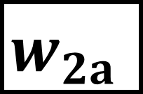

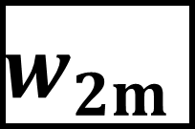


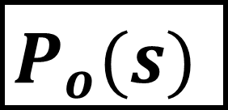
$$z_{0}$$
$$w_{1}$$
$$w_{2a}$$
$$z_{1}$$
r
e
C(s)
$$P_{o}(s)$$
$$w_{2m}$$
$$z_{2}$$
_
y

Slide 17







$$\left|G\right|$$
$$|w_{1}\left(jω\right)|$$
0 dB
$$ω$$
$$|s\left(jω\right)|$$
$$\left|G\right|$$
$$|s\left(jω\right)|$$
0 dB
$$ω$$
$ω$ Nicht logarithmisch

Slide 18




$$\left|G\right|$$
$$ω$$
$$\left|G\right|$$
$$ω$$

Slide 19






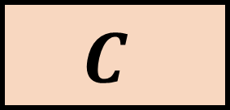
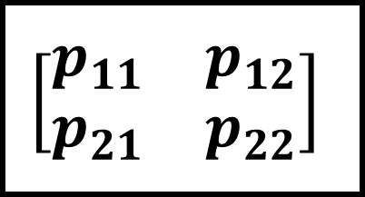

d
h
$$Δ$$
g
r
$$C_{1}$$
u
y
$$P$$
_
$$P(s)$$
$$C_{2}$$
w
z
r
y
w
$$\left[\begin{matrix}p_{11} & p_{12} \\ p_{21} & p_{22}\end{matrix}\right]$$
$$P$$
z
d
u
$$C$$
$$C$$

Slide 20
y
Steigung b
Steigung a
x

Slide 21



Im
$$G(s)$$
Re
$$−\frac{1}{b}$$
$$−\frac{1}{a}$$

Slide 22
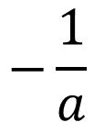
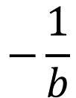

$$−\frac{1}{b}$$
Steigung a
$$−\frac{1}{a}$$
$$\frac{1}{b}$$
Steigung b

Slide 23
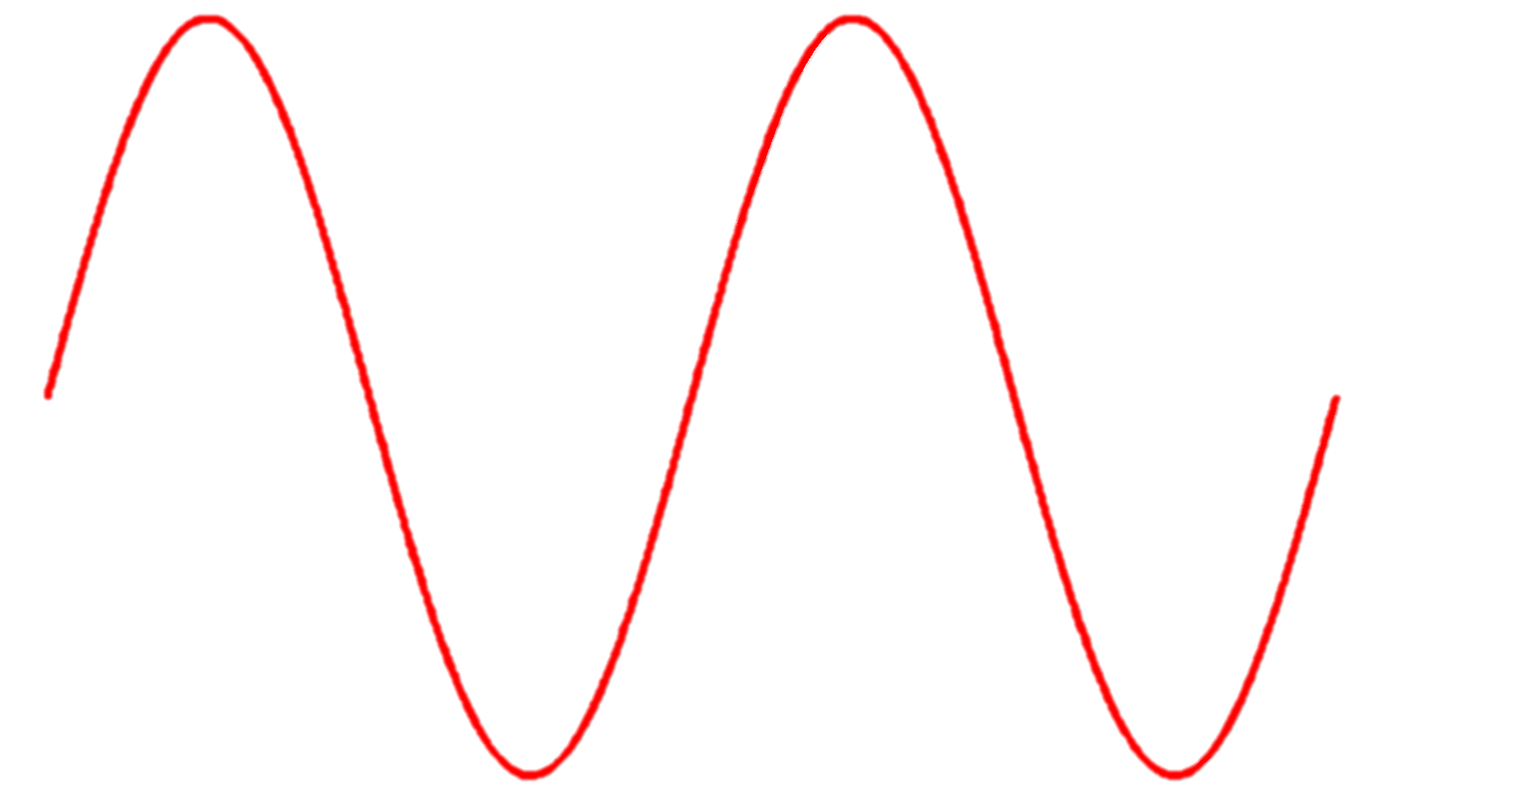
Eingang Totband
Ausgang Totband
e
b
b

Slide 24


Im
$$\frac{−1}{N\left(A\right)}$$
Re
$$G_{Ol}(jω)$$

