Slide 1

CAPSTONE PROJECT • 2026
Bluestock Mutual Fund
Analytics Capstone
End-to-End Mutual Fund Analytics and Business Intelligence Solution
Prepared By:
Hemant Singh Rajput
Technologies:
Python · Pandas · SQLite · SQL · Power BI · Plotly
Date:
12 June 2026
Notes:
1

Slide 2
PROBLEM STATEMENT & OBJECTIVES
PROBLEM STATEMENT
PROJECT OBJECTIVES
The mutual fund industry generates large volumes of data related to fund performance, investor transactions, SIP trends, portfolio allocations, and market benchmarks. Extracting meaningful insights from this data requires an integrated analytics solution.
Clean and validate mutual fund datasets
Build a centralized analytical database
Perform exploratory data analysis
Evaluate fund performance using financial metrics
Analyze investor behavior and SIP trends
Create an interactive Power BI dashboard
Generate actionable investment insights
Notes:
2

Slide 3
DATA SOURCES
1
Fund Master
2
NAV History
3
AUM by Fund House
4
Monthly SIP Inflows
5
Category Inflows
6
Industry Folio Count
7
Scheme Performance
8
Investor Transactions
9
Portfolio Holdings
10
Benchmark Indices
✦ 40 Mutual Fund Schemes
✦ 2022–2026 Historical Data
✦ Investor Demographics
✦ Benchmark Market Data
Notes:
3

Slide 4
SOLUTION ARCHITECTURE
Raw CSV Files
Data Cleaning & Validation
SQLite Database
EDA & Financial Analytics
Power BI Dashboard
Business Insights & Reporting
▶
▶
▶
▶
▶
Tools & Technologies
Python
Pandas
SQLAlchemy
SQLite
Power BI
Plotly
Matplotlib
Core Language
Data Processing
ORM Layer
Database Engine
BI Dashboard
Visualization
Static Charts
Notes:
4

Slide 5
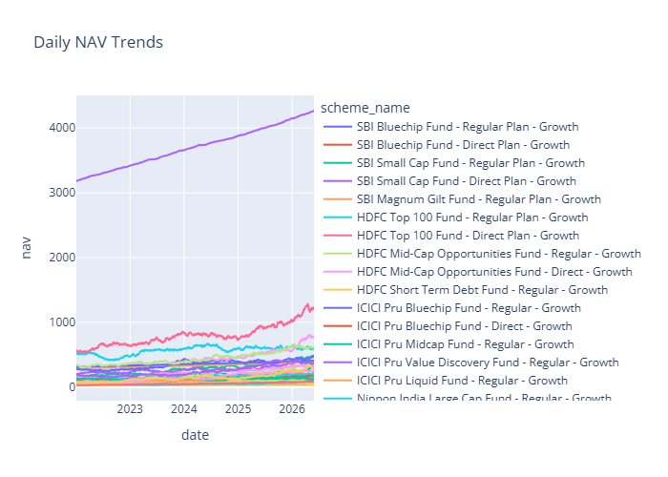
EDA Highlights – NAV Analysis
Objective: Analyze mutual fund NAV movement over time to identify growth trends and volatility patterns.
Most equity funds demonstrated consistent long-term growth
Significant market recovery observed after corrections
Large-cap funds exhibited relatively stable NAV trends
Small-cap funds showed higher volatility compared to large-cap peers
NAV Trend Chart
Notes:
5

Slide 6
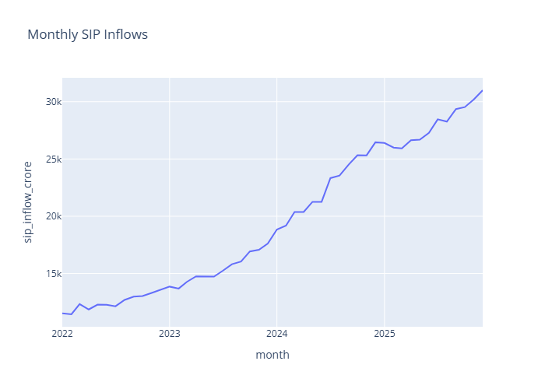
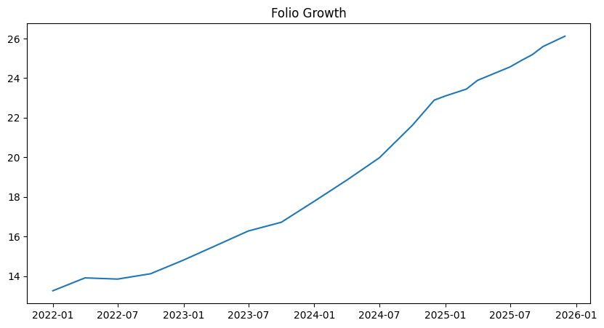
EDA Highlights – SIP & Industry Growth
Objective: Study investor participation and SIP growth trends from 2022 to 2026.
✦
SIP inflows increased significantly from 2022 to 2025
✦
Industry folio count nearly doubled during the analysis period
✦
Retail investor participation expanded rapidly
✦
Mutual fund penetration improved across India
SIP Trend Chart
Folio Growth Chart
Notes:
6

Slide 7
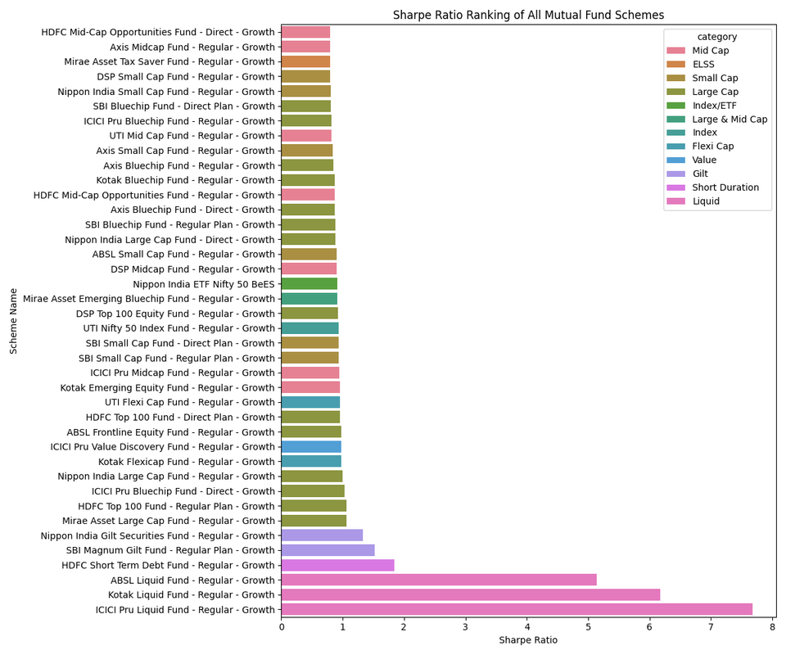
Performance Analytics
CAGR
Daily Returns
Sharpe Ratio
Sortino Ratio
Key Insights
1
High Sharpe ratio funds delivered superior risk-adjusted returns
2
Consistent performers outperformed peers across multiple periods
3
Risk-adjusted ranking provided a better evaluation than returns alone
Sharpe Ratio Ranking Table
Notes:
7

Slide 8
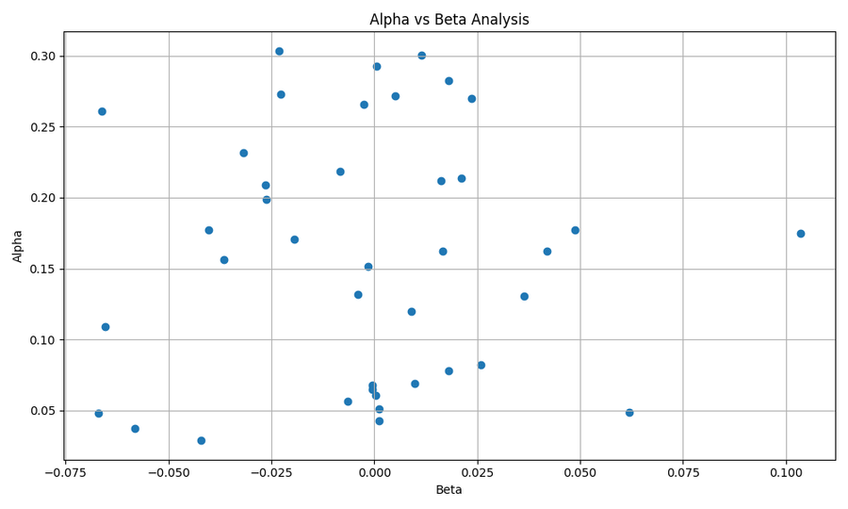
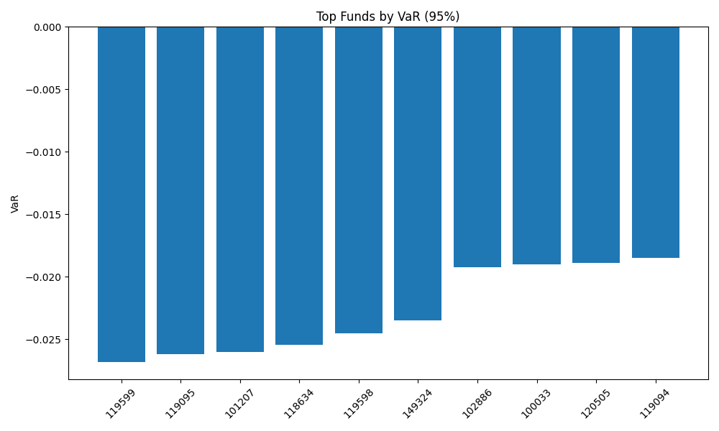
Advanced Performance Metrics
Alpha
Beta
Max Drawdown
VaR
CVaR
Key Insights
α
Positive Alpha funds consistently outperformed benchmarks
VaR
VaR and CVaR identified downside risk exposure accurately
β
Higher Beta funds exhibited stronger market sensitivity
▼
Maximum Drawdown highlighted worst historical losses
Notes:
8

Slide 9
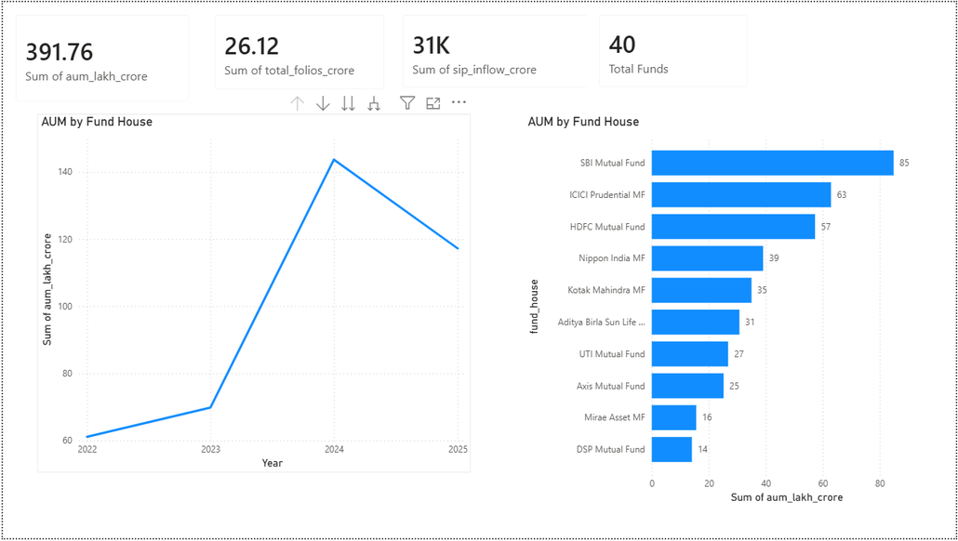
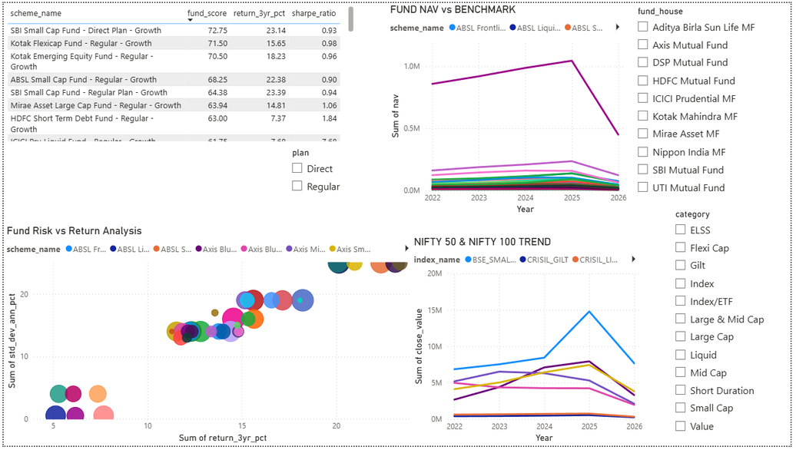
Dashboard Overview – Industry & Fund Analytics
Power BI Dashboard – Page 1 & 2
Business Value
Dashboard Features
Enables quick identification of top-performing funds
✦
Industry KPI Cards
✦
Fund Risk vs Return Visualization
Supports fund comparison and risk evaluation
✦
AUM Trend Analysis
✦
Fund Scorecard
Notes:
9

Slide 10
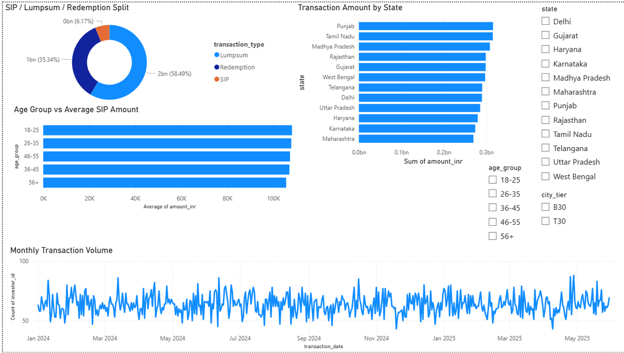
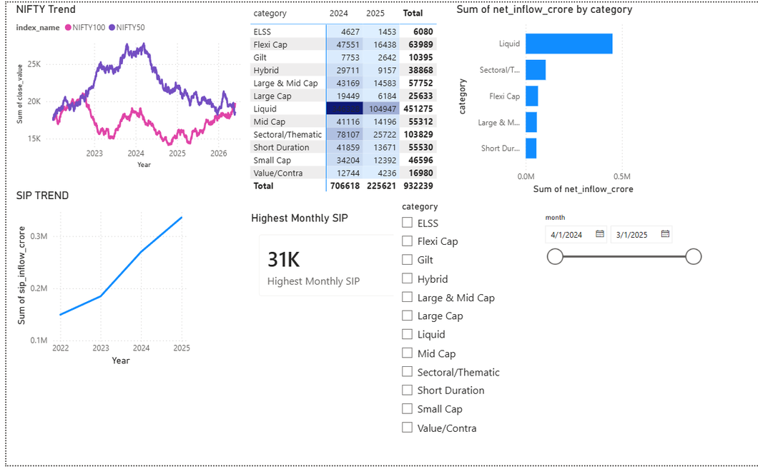
Dashboard Overview – Investor & Market Analytics
Power BI Dashboard – Page 3 & 4
Business Value
Dashboard Features
✦
Helps understand investor behavior patterns
✦
Investor Demographics
State-wise Investment Analysis
✦
Supports strategic decision-making
✦
Market Trend Monitoring
SIP vs Lumpsum Distribution
Notes:
10

Slide 11
Key Findings & Recommendations
🔍 Key Findings
💡 Recommendations
1. SIP inflows reached record highs by 2025
→
Focus on funds with strong Sharpe ratios and positive Alpha
2. Equity-oriented funds generated superior long-term returns
→
Monitor concentrated portfolios for sector-specific risks
3. Higher Sharpe ratio funds delivered better risk-adjusted performance
→
Improve investor engagement in underrepresented regions
4. Most investors maintained healthy SIP continuity
→
Promote SIP investing for long-term wealth creation
5. Portfolio concentration varied significantly across funds
Notes:
11

Slide 12
Conclusion
Successfully developed an end-to-end Mutual Fund Analytics platform covering:
Data Engineering
Financial Analytics
Risk Analytics
Business Intelligence
Dashboard Reporting
The solution provides actionable insights for investors, analysts, and fund managers.
Thank You
Hemant Singh Rajput • Bluestock Mutual Fund Analytics • June 2026
Notes:
12

