Slide 1

SMART INDIA HACKATHON 2026
SkyGuard AI: Split-Edge/Cloud Anomaly Detection for AWS
Problem Statement ID: [Insert PS ID]
Problem Statement Title: Split-Edge/Cloud Anomaly Detection, Dual-Model Confluence, and Predictive Maintenance for Automatic Weather Stations (AWS)
Theme: Disaster Management / Clean & Green Technology / Telemetry Quality
PS Category: Software / IoT / Hardware
Team ID: [Insert Team ID]
Team Name: [Insert Team Name] (Registered on portal)
* Transforming Remote Weather Sensing from Reactive Alarms to Deterministic AI Assurance

Slide 2
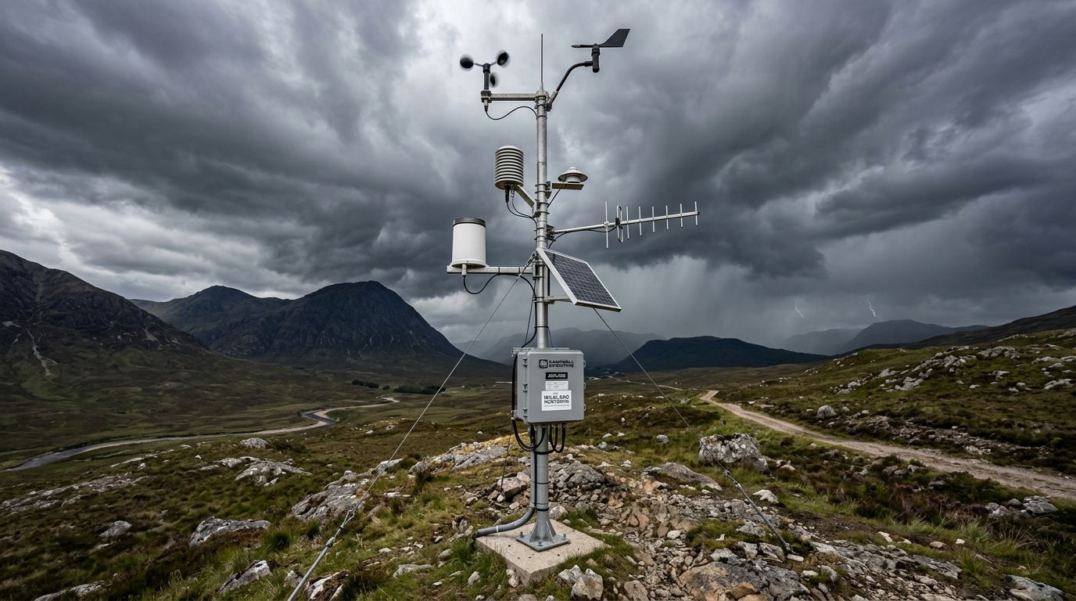
IDEA TITLE: SkyGuard AI
[Insert Team Name]
1. THE PROBLEM ADDRESSED (Univariate Blindness & Alarm Fatigue)
- Automatic Weather Stations (AWS) in remote, harsh terrain suffer silent sensor drift and decoupling.
- Static Single-Parameter Limits (e.g. RH > 100%) trigger severe alarm fatigue during storms while completely missing gradual calibration loss.
- 24/7 continuous cellular streaming saturates remote networks and drains battery power.
2. PROPOSED SOLUTION (Split-Edge/Cloud Pipeline)
- 1.0 Edge Layer (ESP32): Zero-cost IMD physical checks (<0.1ms) + INT8 Quantized PyOD (<15ms). Normal telemetry is buffered locally; anomalies trigger an MQTT Context Burst (trigger + 2-4 hr history), saving >90% bandwidth.
- 2.0 Cloud Layer (FastAPI): Multi-Scale Analyzer cross-checks dT/dt, dP/dt, dRH/dt and feeds Dual-Model Confluence (Model A Weather vs Model B Defect) with confidence scoring (0-100%).
- 3.0 Operational Assurance: SHAP XAI attributions, EWMA Predictive Maintenance (>=14 days notice), and Multivariate LSTM Imputation.
OPERATIONAL CONTEXT: AUTOMATIC WEATHER STATIONS
- Deployed in remote mountains, deserts, and coastal high-risk zones.
- Unattended battery & solar operation with strict power constraints.
- SkyGuard AI's Split Architecture cuts cellular data by >90% while providing continuous real-time diagnostic assurance.
3. INNOVATION & UNIQUENESS OF THE SOLUTION
- Synthetic Defect Generation: Overcomes the total scarcity of real-world failure data by training Model B on 5 mathematical fault archetypes (Freeze, Spike, Noise, Drift, Dropout).
- Deterministic Confluence Matrix: Auditable, reproducible AI reasoning truth table without LLM hallucinations in critical alerting loops.
- Interactive 3D Digital Twin: Live Three.js station AGRA-01 with camera auto-lerp to culprit sensor.

Slide 3
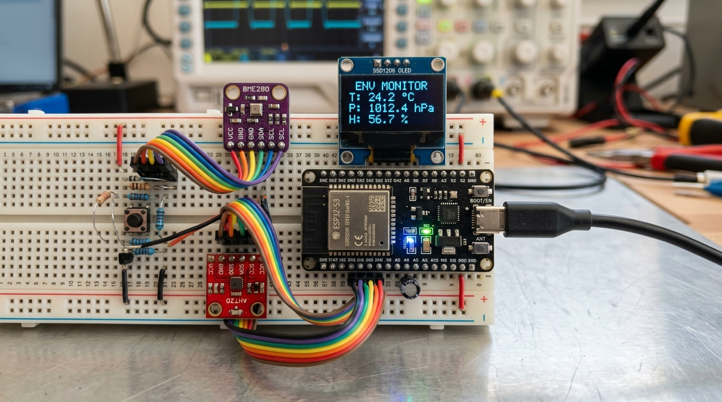
TECHNICAL APPROACH & ARCHITECTURE
[Insert Team Name]
1. TECHNOLOGIES USED ACROSS THE SPLIT STACK
- Edge Firmware & HW: ESP32-S3 (240 MHz Xtensa), C++/FreeRTOS, TensorFlow Lite for Microcontrollers (TFLite Micro INT8), PyOD.
- Cloud Core & ML: Python 3.11, FastAPI, LightGBM / 1D-CNN, PyTorch / ONNX, SHAP TreeExplainer, Mosquitto MQTT (TLS :8883), Docker.
- Dashboard & Persistence: Supabase PostgreSQL, Next.js 14, React Three Fiber (Three.js 3D Twin), Tailwind CSS, SSE 1 Hz streaming.
2. THREE-LAYER IMPLEMENTATION PIPELINE
- 1.0 Edge Device Layer: Zero-cost IMD limits (<0.1ms) + Quantized INT8 Autoencoder (<15ms, <48KB SRAM). Flags trigger MQTT context burst (incident + 2-4 hr pre-anomaly sliding buffer).
- 2.0 Cloud Analytics Core: Multi-Scale Analyzer computes dT/dt, dP/dt, dRH/dt and diurnal baselines. Dual-Model Confluence fuses Model A (Weather) and Model B (Defects) into an auditable confidence score (0-100%).
- 3.0 Operational Assurance: SHAP attributions (<35ms), EWMA daily drift tracking (calibration warnings), and Multivariate LSTM Imputation (95% CI).
HARDWARE PROTOTYPE: ESP32-S3 EDGE NODE
- Benchmarked Footprint: <120 KB Flash, <48 KB SRAM.
- Ultra-Fast Inference: <15 ms latency on 12-step sliding window.
- Multi-Sensor Acquisition: Real-time I2C polling of T, P, RH at 1 Hz with local circular Flash buffering.
3. WORKING PROTOTYPE & LIVE EVALUATION RIG
- Two-Laptop Live Demo: Laptop 1 (Hardware station emulator with keyboard chaos keys: [1] Spike, [2] Drift, [3] Squall Line, [0] Reset); Azure Cloud Core; Laptop 2 (Next.js 14 3D Twin & live ML pipeline monitor).
- Live Demonstration: Verified sub-15ms edge inference and zero false alarms during simulated squalls.

Slide 4
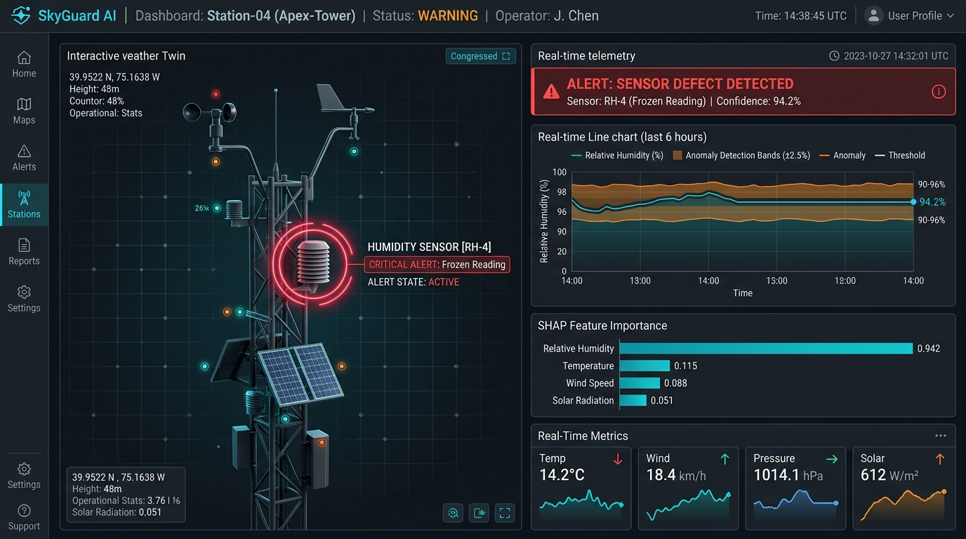
FEASIBILITY, VIABILITY & RISK MITIGATION
[Insert Team Name]
1. MULTI-DIMENSIONAL FEASIBILITY ANALYSIS
- Hardware Feasibility: Deploys on off-the-shelf ESP32-S3 (INR 450 / $5). No expensive edge GPUs or specialized accelerators required.
- Network & Telecom Feasibility: Context burst architecture cuts uplink transmissions by >90%, making AWS viable over 2G / NB-IoT / LoRaWAN in remote Himalayan and desert regions.
- Institutional & Standard Feasibility: Built strictly around IMD Climatological limits (-5 deg C to 55 deg C) and WMO-No. 8 standards for zero-friction integration into national meteorological networks.
2. COMPREHENSIVE RISK MITIGATION STRATEGIES
- Risk: Total scarcity of real-world labeled sensor defect data in meteorology.
-> Strategy: Mathematical Synthetic Fault Injections (Freeze, Spike, Noise Burst, Capacitive Drift, Packet Dropout) layered onto clean IMD weather series.
- Risk: High false alarms when severe storms (squall lines) mimic sensor failure.
-> Strategy: Dual-Model Confluence: Model A recognizes synchronized multi-sensor meteorological dynamics (>=96% recall) while Model B isolates decoupled hardware faults.
- Risk: Operator distrust of opaque black-box AI models.
-> Strategy: SHAP Feature Attribution bars (<35ms) + plain-English diagnostic justifications generated for every incident.
- Risk: Slow environmental degradation causing gradual calibration drift.
-> Strategy: EWMA Residual Drift Tracking (3.4) providing >=14 days notice before tolerance breach.
LIVE OPERATIONAL INTERFACE: 3D DIGITAL TWIN & XAI
- 3D Twin of Station AGRA-01: Camera automatically zooms and highlights culprit sensor shield upon confirmed defect.
- High-Confidence Diagnostics: Instant 94.2% confidence alert badge with natural-language text justification.
- SHAP Feature Attributions: Real-time bars explaining exactly why RH was flagged.

Slide 5
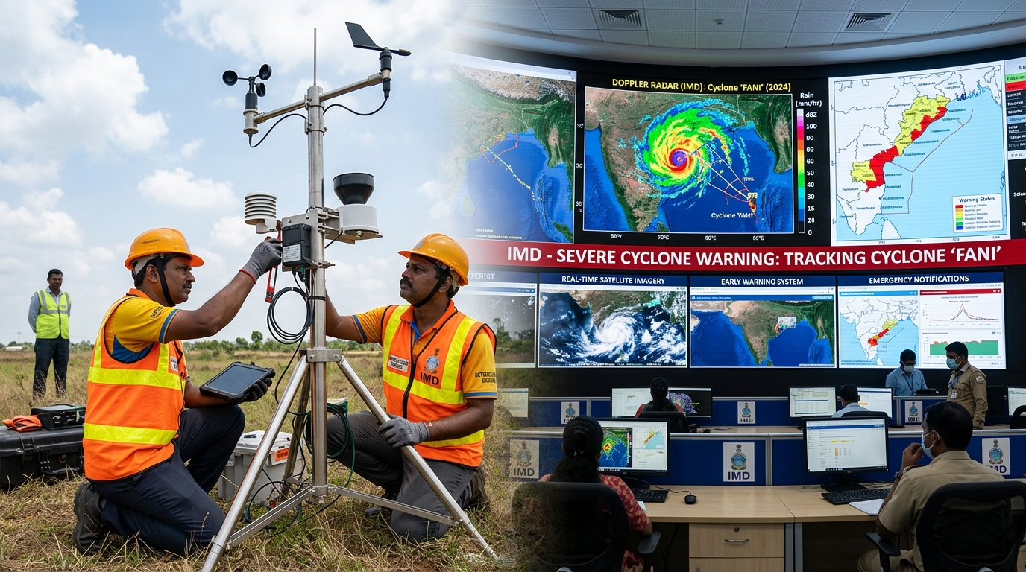
IMPACT AND BENEFITS
[Insert Team Name]
>= 85%
False Alarm Drop
Eliminates alarm fatigue during storms
> 90%
Bandwidth Saved
Local circular buffer; context burst uplink
< 15 ms
Edge Inference
Quantized INT8 autoencoder on ESP32
>= 14 Days
Drift Warning
Proactive EWMA recalibration schedule
1. IMPACT ON TARGET AUDIENCE & OPERATORS
- IMD Field Station Operators (Meera): Eliminates false alarm fatigue. Clear plain-English diagnostic cards and 3D camera auto-targeting tell operators exactly which sensor failed and why in <5s, avoiding wasted remote field trips.
- Systems & Telecom Engineers (Arjun): Conserves >90% bandwidth; robust MQTT buffering survives intermittent cellular dropouts; ultra-light microcontroller resource footprint (<48KB SRAM).
- Meteorologists & Climate Scientists (Dr. Rao): Multivariate LSTM Imputation reconstructs corrupt readings (MAE: T <= 0.6 deg C, RH <= 4.5%, P <= 0.8 hPa), maintaining unbroken time series for numerical weather prediction (NWP) models.
2. SOCIAL, ECONOMIC & NATIONAL SIGNIFICANCE
- Economic Savings (OpEx Reduction): Drastically cuts operational logistics costs for state weather networks. Proactive drift notice (>=14 days) prevents premature hardware replacement.
- National Disaster Preparedness: Real-time, uncorrupted weather telemetry ensures accurate early warnings for extreme cyclonic storms, cloudbursts, and heatwaves, protecting human lives.
- Agricultural Climate Resilience: Reliable micro-climate telemetry empowers precision agricultural advisories, drought forecasting, and crop insurance claim verification for Indian farmers.
FIELD CALIBRATION & DISASTER EARLY WARNING
Protects millions through trustworthy cyclone, cloudburst, and storm early warnings.

Slide 6
RESEARCH AND REFERENCES
[Insert Team Name]
1. METEOROLOGICAL STANDARDS
- India Meteorological Department (IMD):
Operational Guidelines for Automatic Weather Stations (AWS) & Quality Control Protocols for Surface Meteorological Telemetry.
- World Meteorological Organization (WMO):
Guide to Instruments and Methods of Observation (WMO-No. 8), Volume I: Measurement of Meteorological Variables; Chapter 12: Automated Weather Stations.
- Atmospheric Thermodynamics:
Magnus-Tetens Dew Point Formulation and thermodynamic consistency relations (T <-> P <-> RH).
- Climatological Quality Control:
Rigid physical limits (-5 deg C to 55 deg C, 900 to 1060 hPa) and step limits for instantaneous spike rejection.
2. MACHINE LEARNING & TIME-SERIES
- Explainable AI (SHAP):
Lundberg, S. M., & Lee, S.-I. (2017). 'A Unified Approach to Interpreting Model Predictions.' Advances in Neural Information Processing Systems (NeurIPS 2017).
- Edge Anomaly Detection:
Zhao, Y., et al. (2019). 'PyOD: A Python Toolbox for Scalable Outlier Detection.' Journal of Machine Learning Research (JMLR).
- TinyML / Embedded Machine Learning:
Warden, P., & Situnayake, D. (2019). 'TinyML: Machine Learning with TensorFlow Lite on Arduino and Ultra-Low-Power Microcontrollers.' O'Reilly Media.
- Multivariate Time-Series Imputation:
Cao, W., et al. (2018). 'BRITS: Bidirectional Recurrent Imputation for Time Series.' NeurIPS 2018.
3. SYSTEM ARTIFACTS & REPRODUCIBILITY
- Statistical Process Control (Drift Tracking):
Montgomery, D. C. (2009). 'Introduction to Statistical Quality Control', 6th Ed. John Wiley & Sons. (EWMA and CUSUM control limits for sensor calibration drift estimation).
- System Implementation Repository:
Modular Split-Edge/Cloud architecture implemented with FastAPI 0.100+, Next.js 14.2, Three.js, Mosquitto MQTT, and Supabase PostgreSQL.
- Synthetic Fault Generation Engine:
Mathematical formulation and injection framework for frozen flatlines, impulse spikes, noise bursts, and capacitive drift.
- Project Specifications:
PRD.md (v2.1), ML Strat.md (v2.0), and System Architechture.md.

