Slide 1
Deep Research
Google Gemini Deep Research
OpenAI Deep Research
Open-Source Deep Research

Slide 2

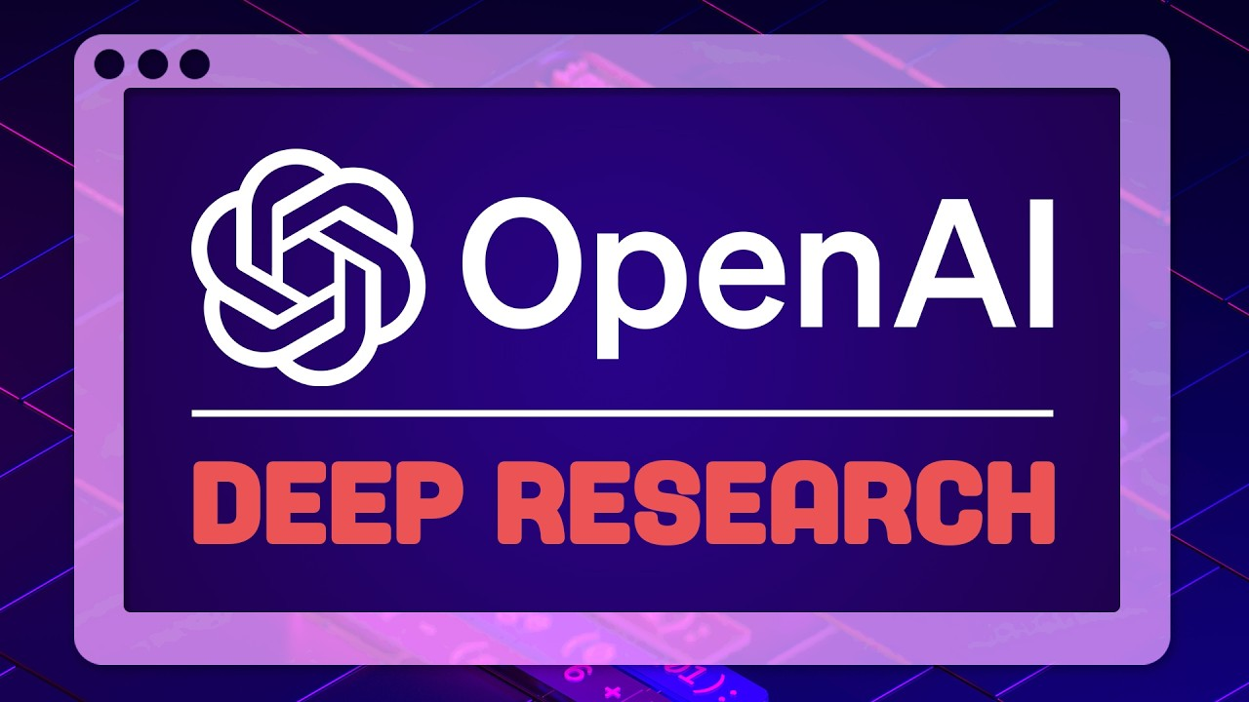
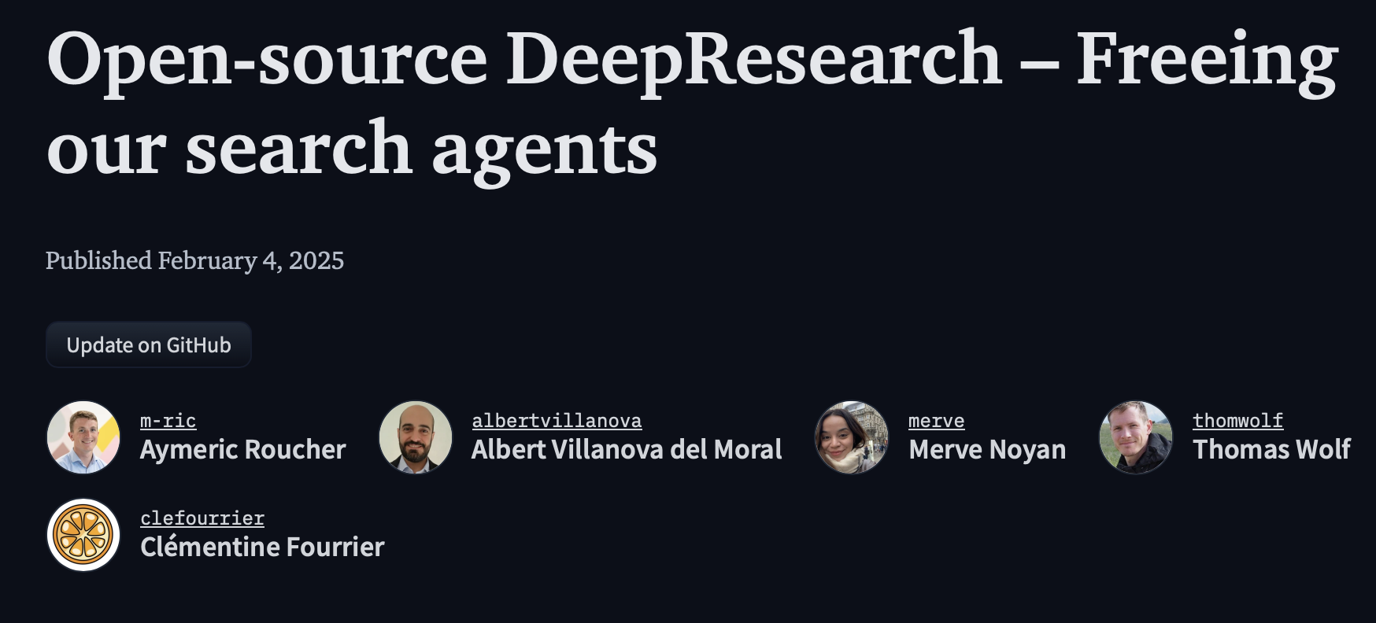
What is Deep Research?
Agentic, personal research assistant
Analyze hundreds of sources and generate a comprehensive research report
Timeline:
Google: 12/11/2024
OpenAI: 2/2/2025
Open-Source recreations: Ongoing

Slide 3
Let’s start with an example
Gemini.google.com

Slide 4
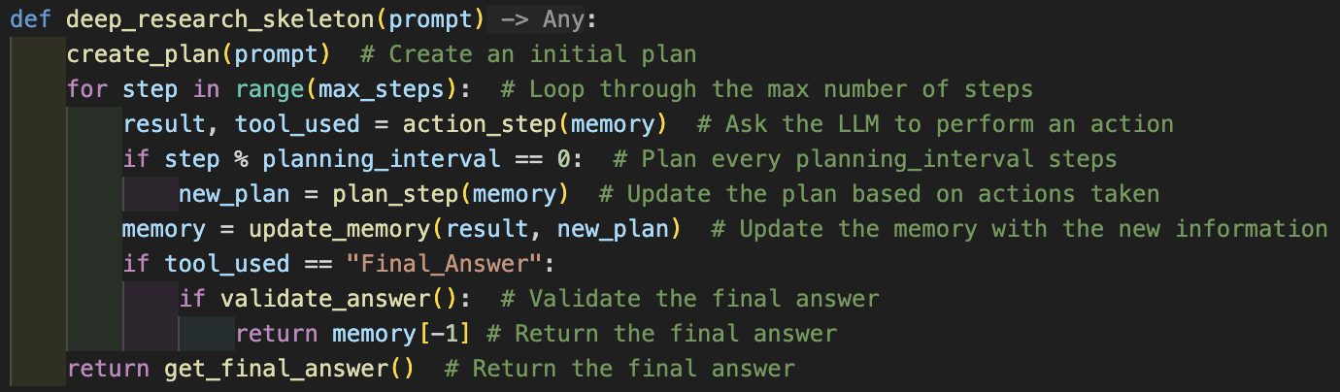
Deep Research -- How it works
Deep Research Agentic Framework
Available Tools: WebSearch, PageUp/Down, FinderTool, ArchiveTool, DownloadTool, Visualizer, PythonExecutor, TextBasedWeb, FinalAnswer
User Prompt
Response
Source: https://github.com/huggingface/smolagents/blob/main/examples/open_deep_research/run.py

Slide 5
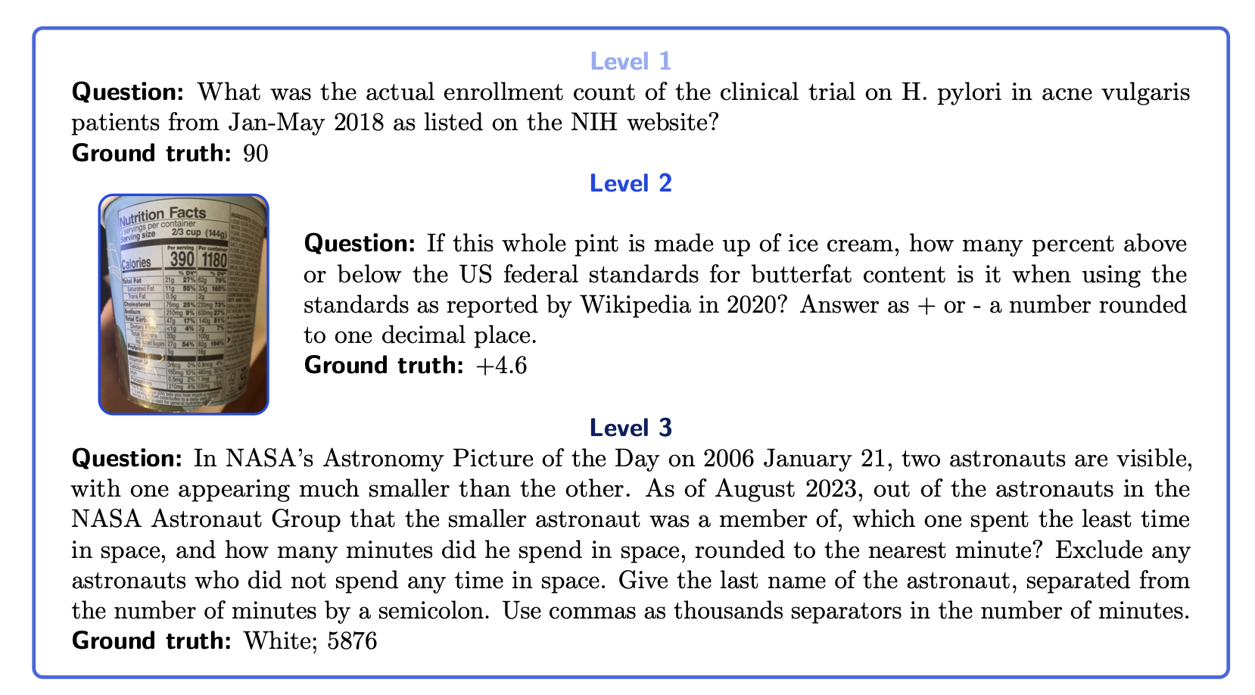
Benchmarks
GAIA (General AI Assistants)
OpenAI Deep Research: 67.36%,
Open-Source Deep Research: 55.15%
Gemini Deep Research: N/A
GPT-4o: 7%
GAIA Benchmark Leaderboard: https://huggingface.co/spaces/gaia-benchmark/leaderboard

Slide 6
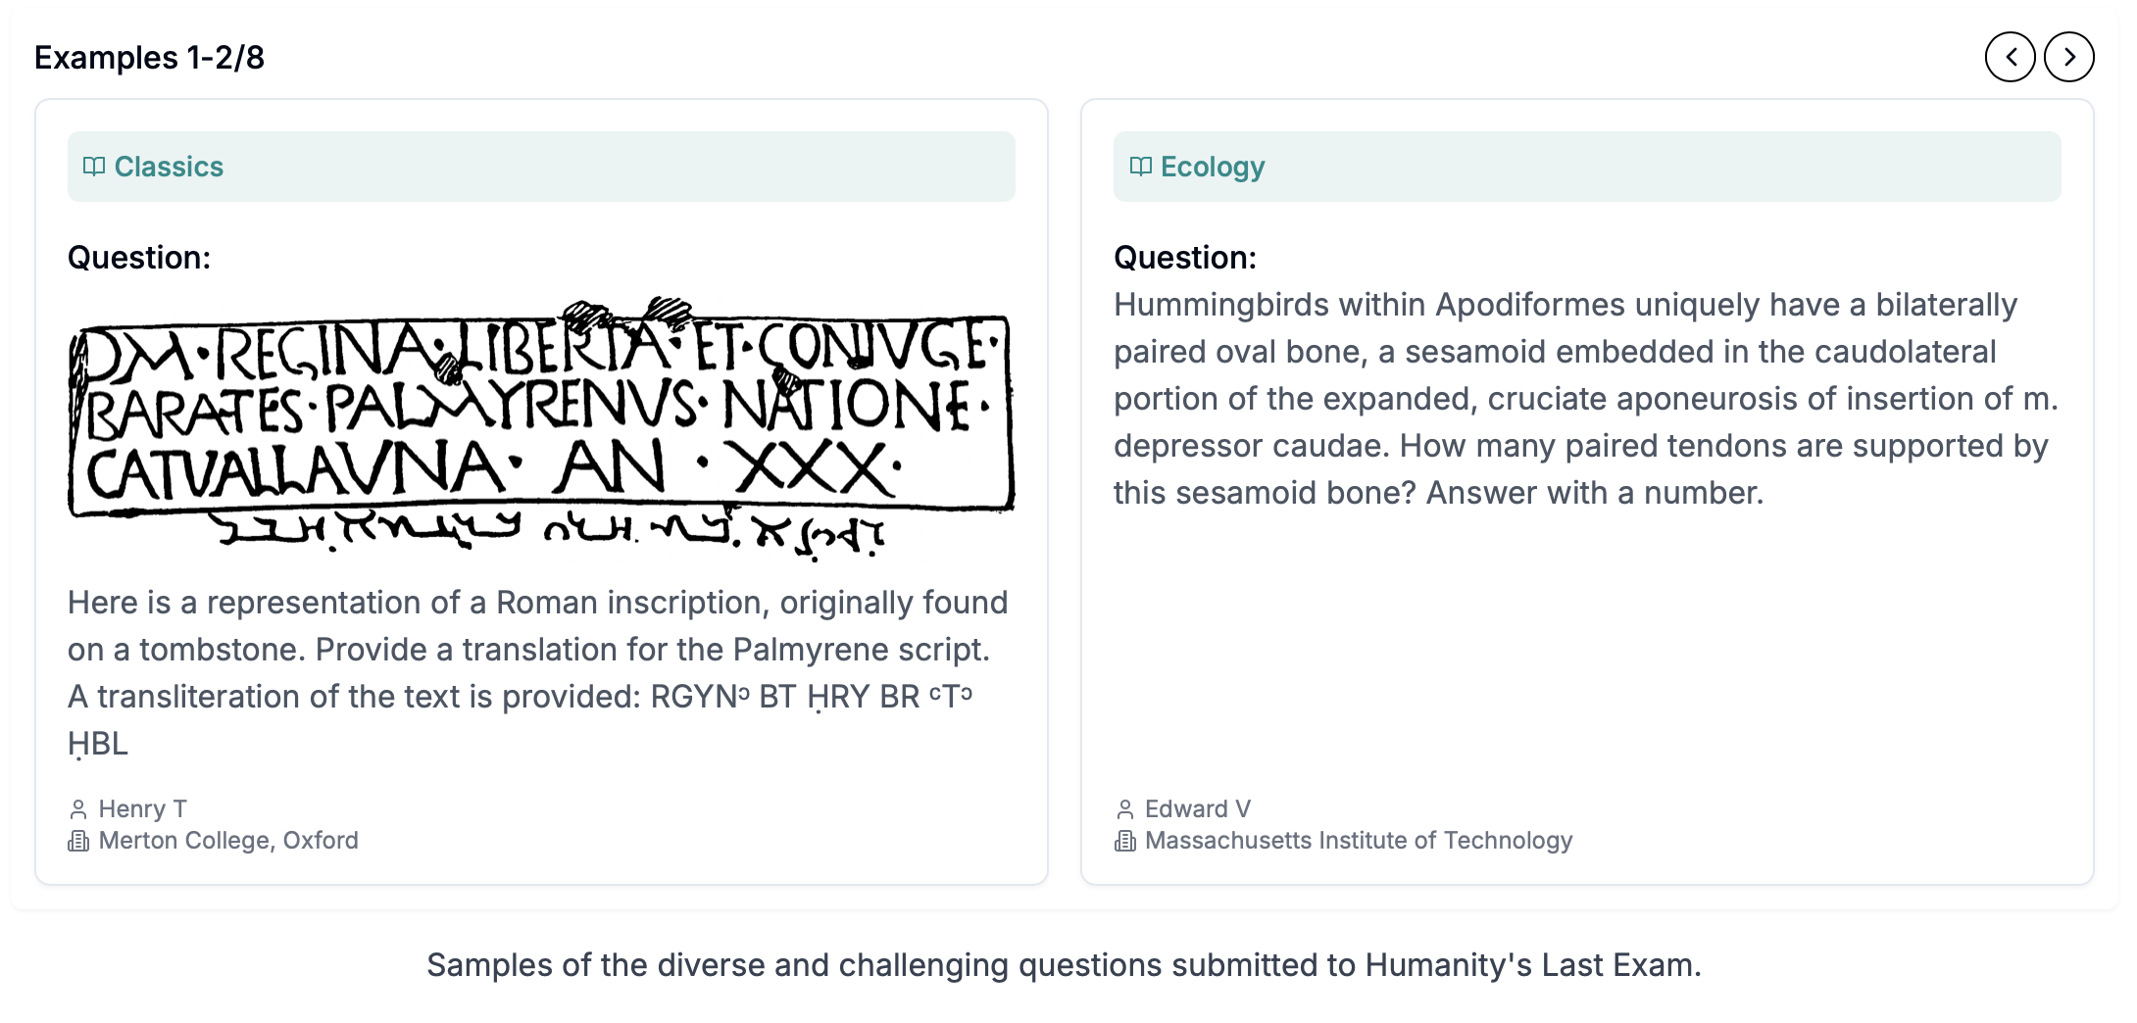
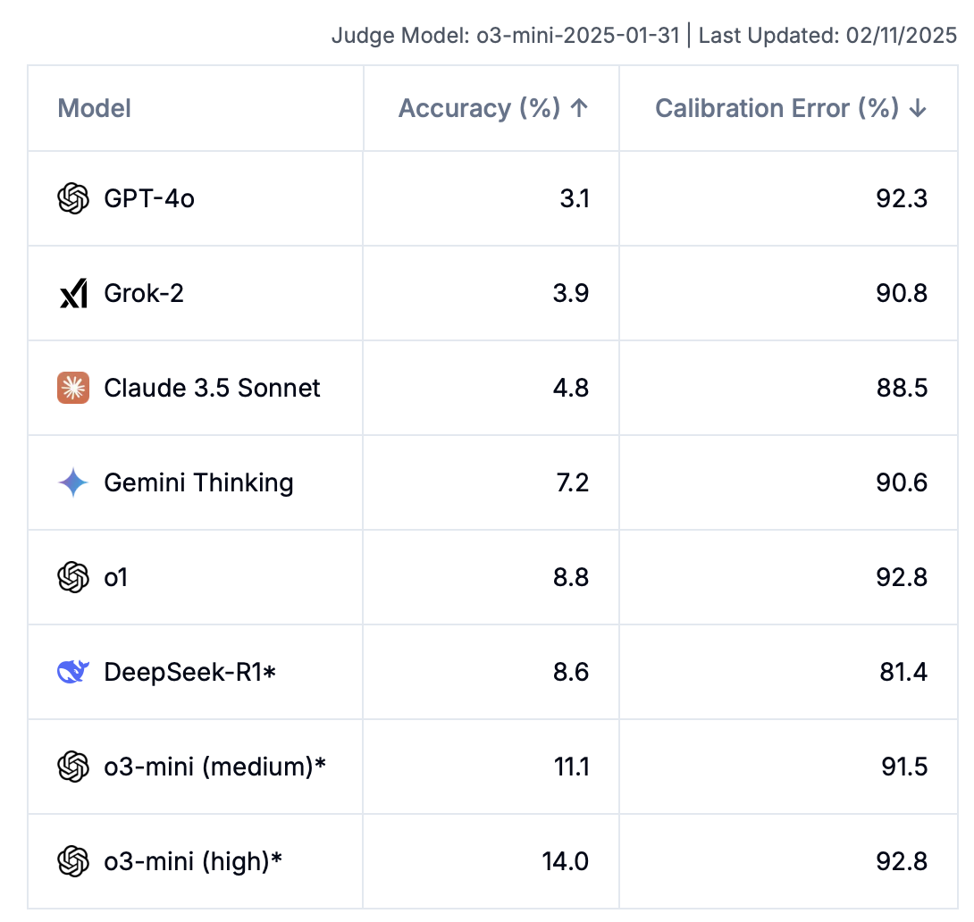
Benchmarks (Cont.)
Humanity’s Last Exam
OpenAI Deep Research: 26.6% accuracy
Humanity’s Last Exam: https://lastexam.ai

Slide 7
Google Gemini Deep Research
Workflow: Provide a prompt, then edit a research plan
Pricing: Included in $20/month Gemini Advanced
Rate Limits: None, 6 concurrent research tasks
Time to complete: Generally 3-5 minutes
Output Format: Text in browser, can open in Google Docs. 4-6 pages of output
Quirks/Bugs:
Roughly 5-10% of deep research prompts don’t finish and exit early
It can get confused on pages with a lot of content and assign things incorrectly
Currently uses the 1.5-Pro model instead of 2.0-Pro model

Slide 8
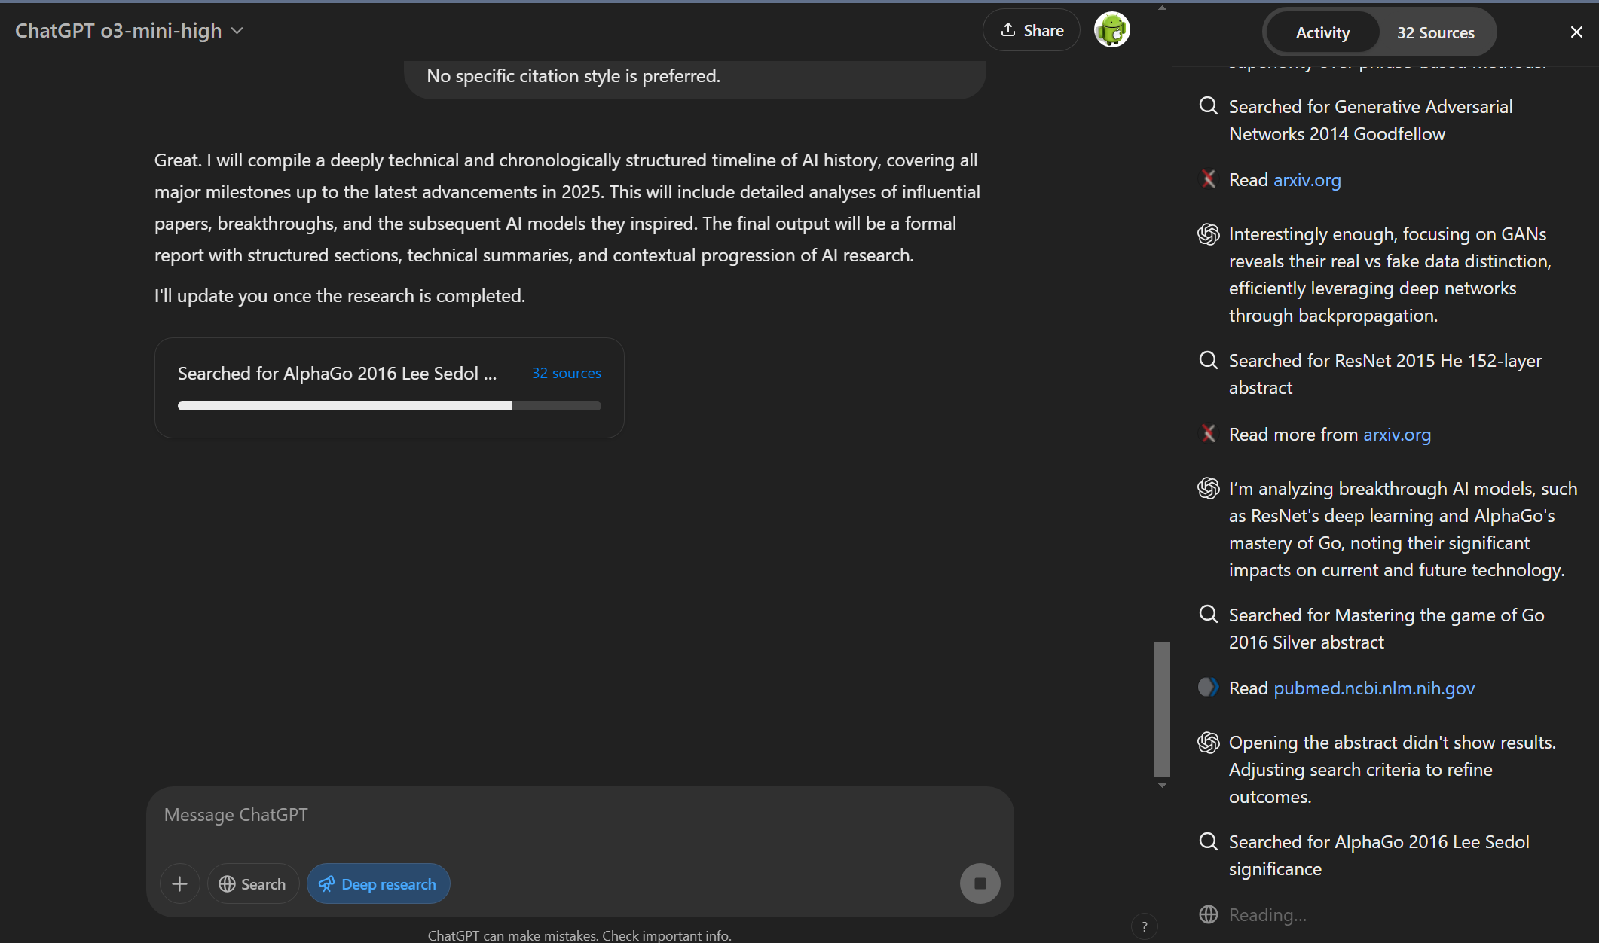
OpenAI Deep Research
Workflow: Provide a prompt, OpenAI Deep Research will ask follow up questions that you answer to provide more context

Slide 9
OpenAI Deep Research
Workflow: Provide a prompt, OpenAI Deep Research will ask follow up questions that you answer to provide more context
Pricing: Included in $200/month OpenAI Pro Tier
Rate Limits: 100 messages per month
Time to complete: Generally 5-30 minutes (can be longer)
Output Format: Text in browser, 8-40 pages of output.
Quirks/Bugs:
Make sure to use the GPT Copy button for consistent formatting
Have yet to see one fail to finish, but will sometimes fail to start
Hallucinates more often than other models, but most of output is useful
Unclear on model, seems to be a custom o3

Slide 10
Open-Source Deep Research
Workflow: Provide a prompt
Pricing: Free and open-source
Rate Limits: None
Time to complete: 1-5 minutes
Output Format: Text in browser, can integrate with apps locally
Quirks/Bugs:
Poorer performance compared to Gemini / OpenAI
Quality is heavily dependent on the base model you use, will likely require significant compute to perform well (i.e., GAIA results used o1)

Slide 11
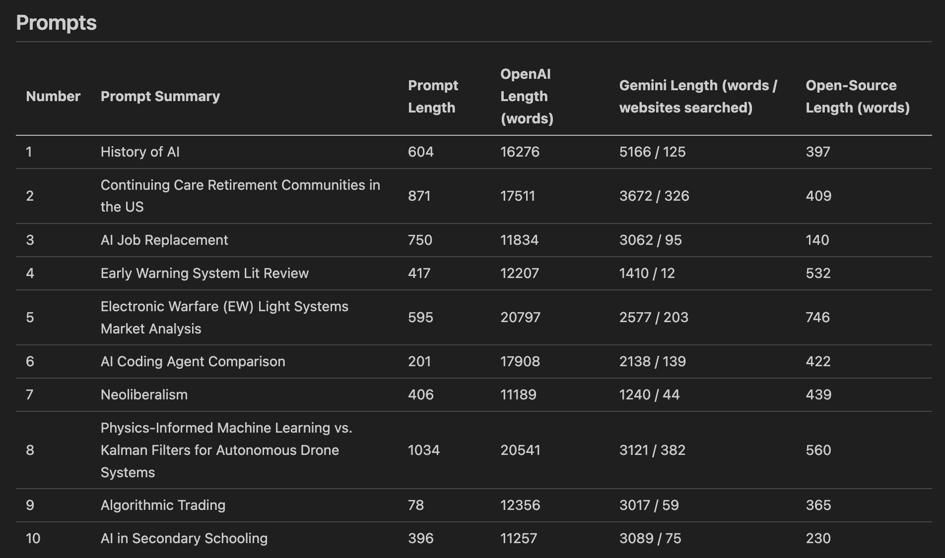
Comparison of Tools
Outputs are extremely long, so manually reviewing is not feasible during this meeting.
HSV.AI Github presentations repo has prompts and unedited outputs for each of these 10 prompts
https://github.com/HSV-AI/presentations/tree/master/2025
Rule of Thumb: 500 words = 1 page

Slide 12
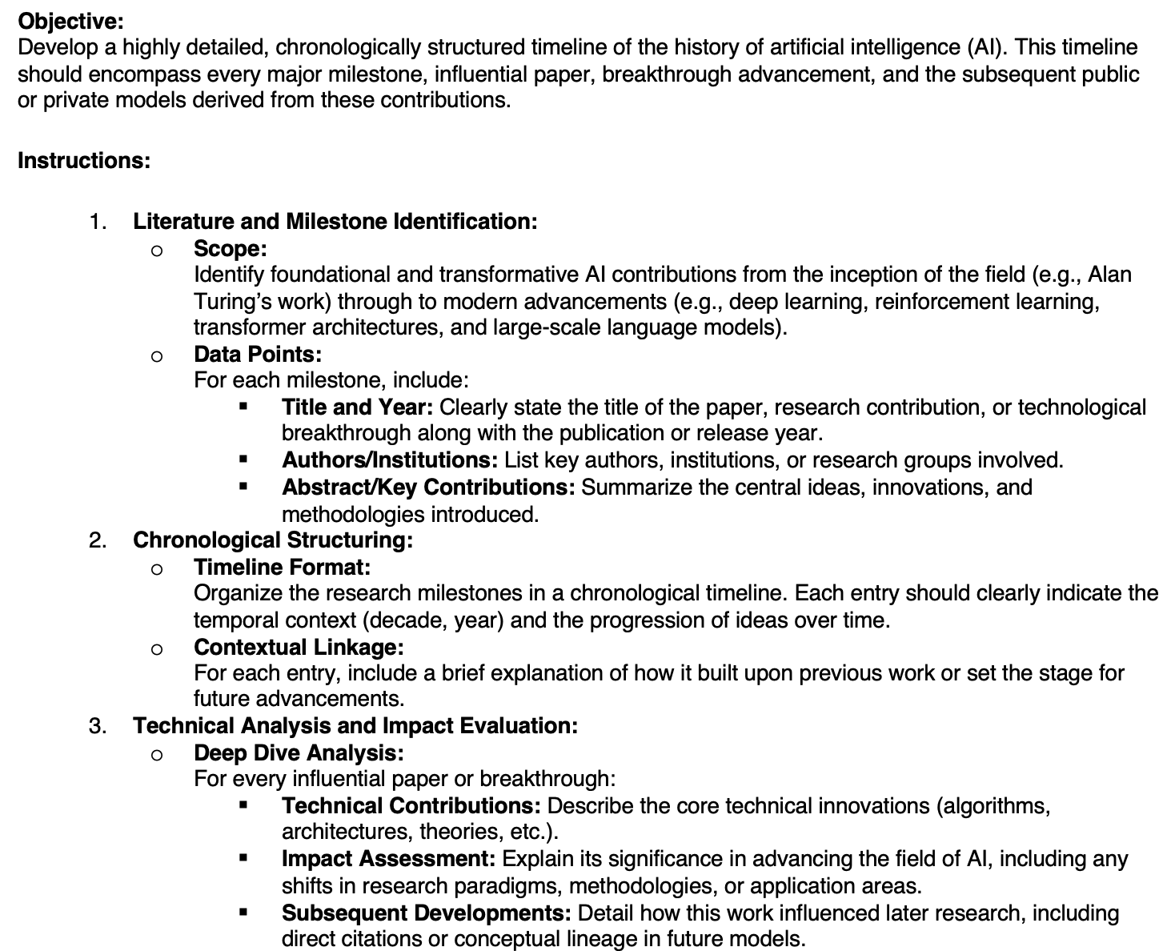
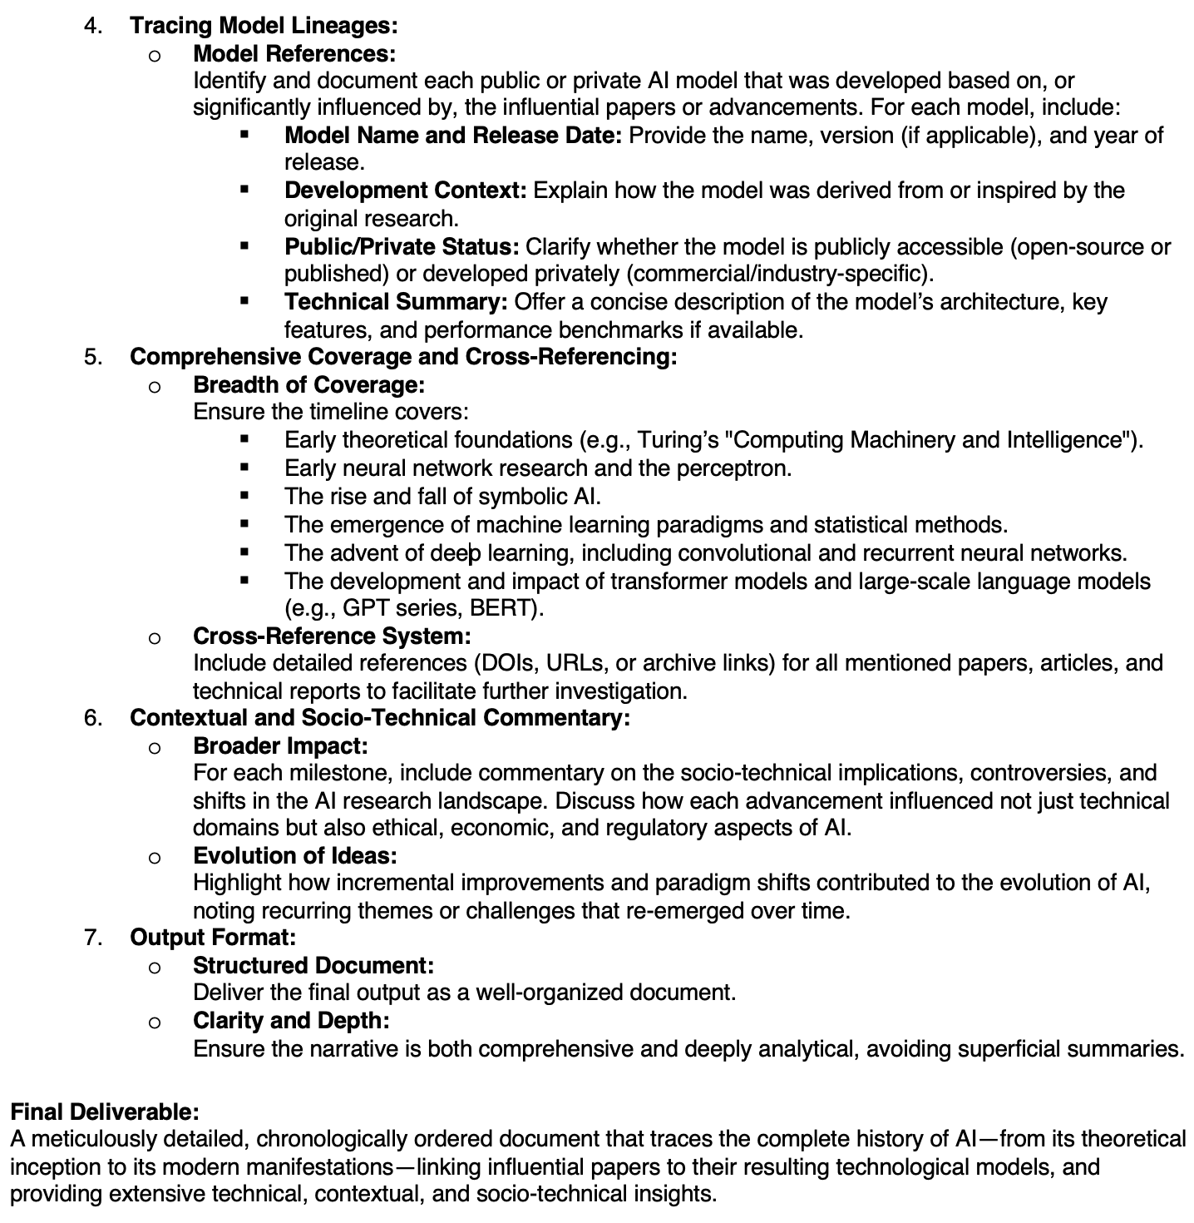
Comparison Findings – AI History Prompt

Slide 13
High Level Summary – AI History
Tool | Response Length (words) | Number of AI Topics in Timeline | Number of Sources cited in final report | Prompt Adherence | Interesting Findings
OpenAI | 16276 (~32 pages) | 48 | 27 | A+. Consistently followed the provided format for all topics. For general trends, specific papers/projects were provided along with overall impact. | In-text references point to specific paragraph used. When arxiv is cited, it appears to only reference the abstract
Gemini | 5166 (~10 pages) | 35 | 41 | B+. Followed the format for some topics, but regularly missed tech contributions / impact / lineage. Explanations were 1-2 sentences for each subtopic. | Did not cite arxiv.
Open-Source | 397 (~0.75 pages) | 12 | N/A | D. Each topic was a “headline”. Lot of missing steps in the timeline for AI History

Slide 14
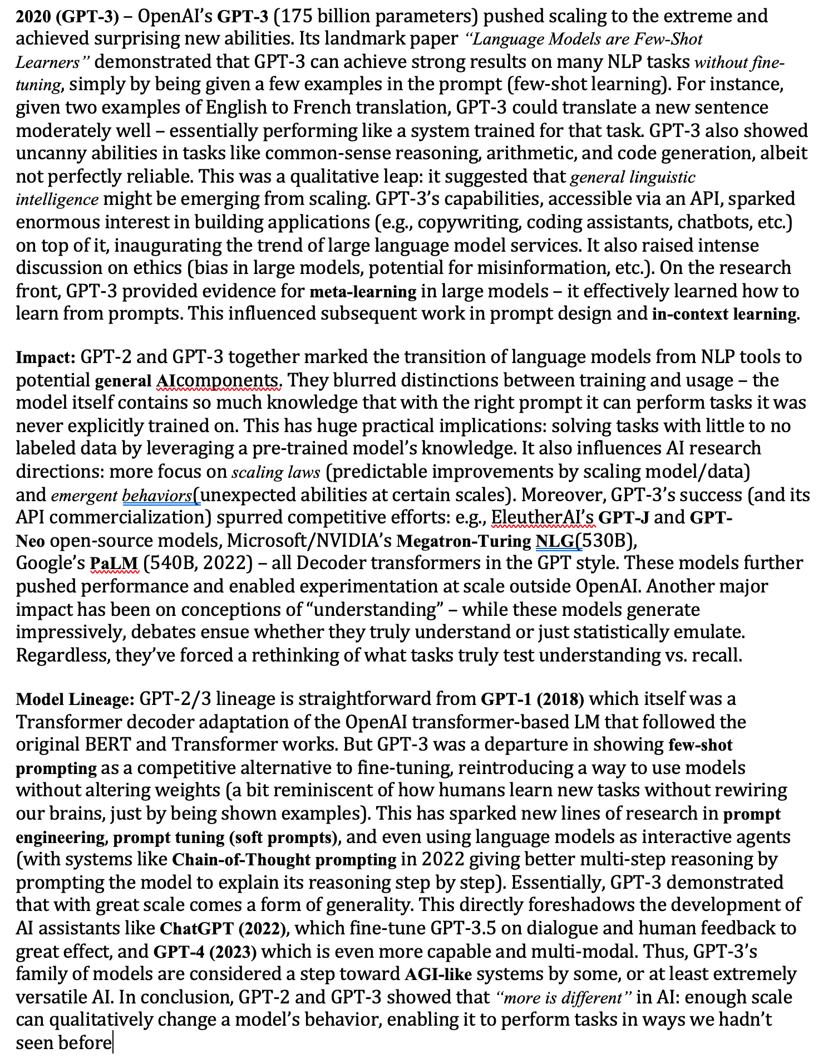
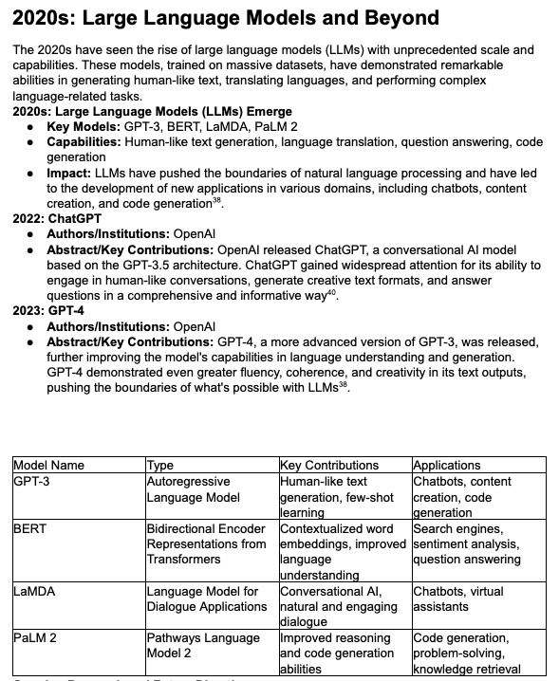
Gemini Deep Research
OpenAI Deep Research

Slide 15
Practical Tips on Using Deep Research
Deep Research approaches tend to do better with highly-structured, very detailed initial prompts
Recommendation: Paste your potential prompt into o3-mini, or other model and ask it to make it detailed, clear, and verbose. Provide specific sections/format you want your output to be in. Provide specific sources when available
Deep Research tends to provide a lot of information
Recommendation: Let Deep Research provide as much information as possible, then summarize the output using another model (gpt-4o, o1, 2.0-Flash) – Claude seems to do a great job of breaking down the info

Slide 16
Deep Research Use Cases
Market Research
Fantastic for identifying large number of relevant sources though initial “Googling”
Technical Topic Deep Dive
Can narrow the focus of Deep Research to certain topics / websites / organizations / paper titles / etc.
Personalized reports on making purchasing decisions
OpenAI demo using Deep Research to figure out best snowboard to purchase
In general, if your problem would benefit from multi-step context from the internet, Deep Research is probably a good fit.

Slide 17
What’s next for Deep Research?
Increased tool use effectiveness with tools like Anthropic’s Computer Use Agent, OpenAI’s Operator, and other browser manipulation tools
As reasoning models (o1, o3-mini, gemini-2.0-pro, deepseek, etc.) improve, expect the outputs of Deep Research to continue improving.
OpenAI plans to bring Deep Research to Plus and Free Tiers in coming months
Expect to see different “levels” of intelligence for deep research based on pricing tiers (potentially tied to time spent)

