Slide 1
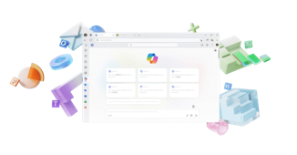
















Insert Partner Logo Here
Your plan just got
smarter with Copilot.
AI built for work.
      Unlock AI-powered productivity with built-in security
      All Microsoft 365 desktop apps and cloud services, now with built-in AI. Create faster, keep work flowing and stay secure everywhere with Copilot’s built-in protections
Best-in-class productivity
AI built for work
+ more
Microsoft 365 Business Standard
Microsoft 365 Copilot Business
Limited time offer - $33.5 $22 per user per month (35% off*)
      Summary for {{numberOfSeats}} licenses
Actual Cost
{{actualCost}}
Promo Pricing until March 31’26
{{promoPricing}}
Promo cost saving
{{promoCostSaving}}
* Purchase requirements: Qualified purchase of 10 to 300 licenses required during the promotion period of December 1, 2025 – March 31, 2026.
Ready to get started?
Contact the <Partner Name> team.
user.name@company.com
company.com
linkedin.com/username
© Microsoft 2025. All rights reserved.
MICROSOFT MAKES NO WARRANTIES, EXPRESS OR IMPLIED, IN THIS SUMMARY

