Slide 1


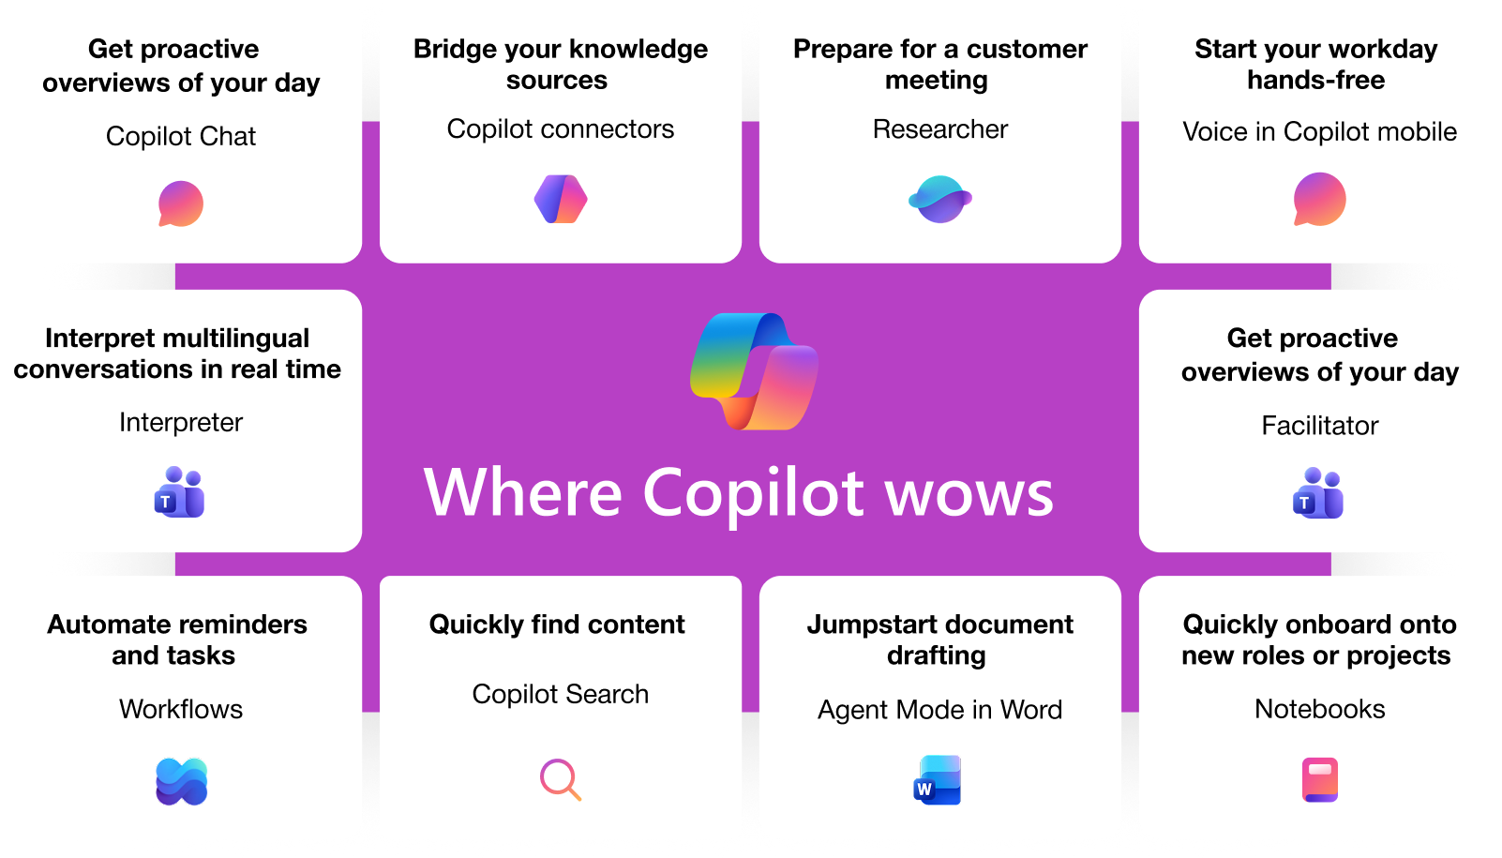
Microsoft 365 Copilot Business
Copilot is the UI for AI that combines the power of LLM with the web and work data and applications that supercharges productivity, unlocks value, transforms business processes with Agents and inherits existing security, privacy, identity enterprise ready policies.
Secure and compliant
Powered by Work IQ
Measurable business value
Honors existing Microsoft 365 permissions and policies for data access
Data is secure at rest and in transit
Your data is not used to train foundational model
You are protected against AI security and copyright risk
You control your data and your data’s location
Search queries are abstracted/ de identified from the user's prompt and grounding data
Work IQ is the intelligence layer that enables M365 Copilot and agents to know your work inside and out. It connects your context, workflows and relationships to deliver an experience that is built for you.
It includes three (3) components:
Data spanning your personal work data like files, emails, and messages, as well as your organizations data;
Memory from your work profile, custom instructions and saved preferences;
Inference, i.e. organizational relationships, work patterns, and workflows
77% of early adopters said they don’t want to give up Copilot
84% easier to actions after a meeting
75% users save time by finding whatever they need
3.8x faster to get caught up, identify decisions, and draft an email
85% users find it easier to get to a good first draft faster
Notes:
67% of all phishing attacks utilized some form of AI
292
days to identify and contain breaches involving stolen credentials

Slide 2
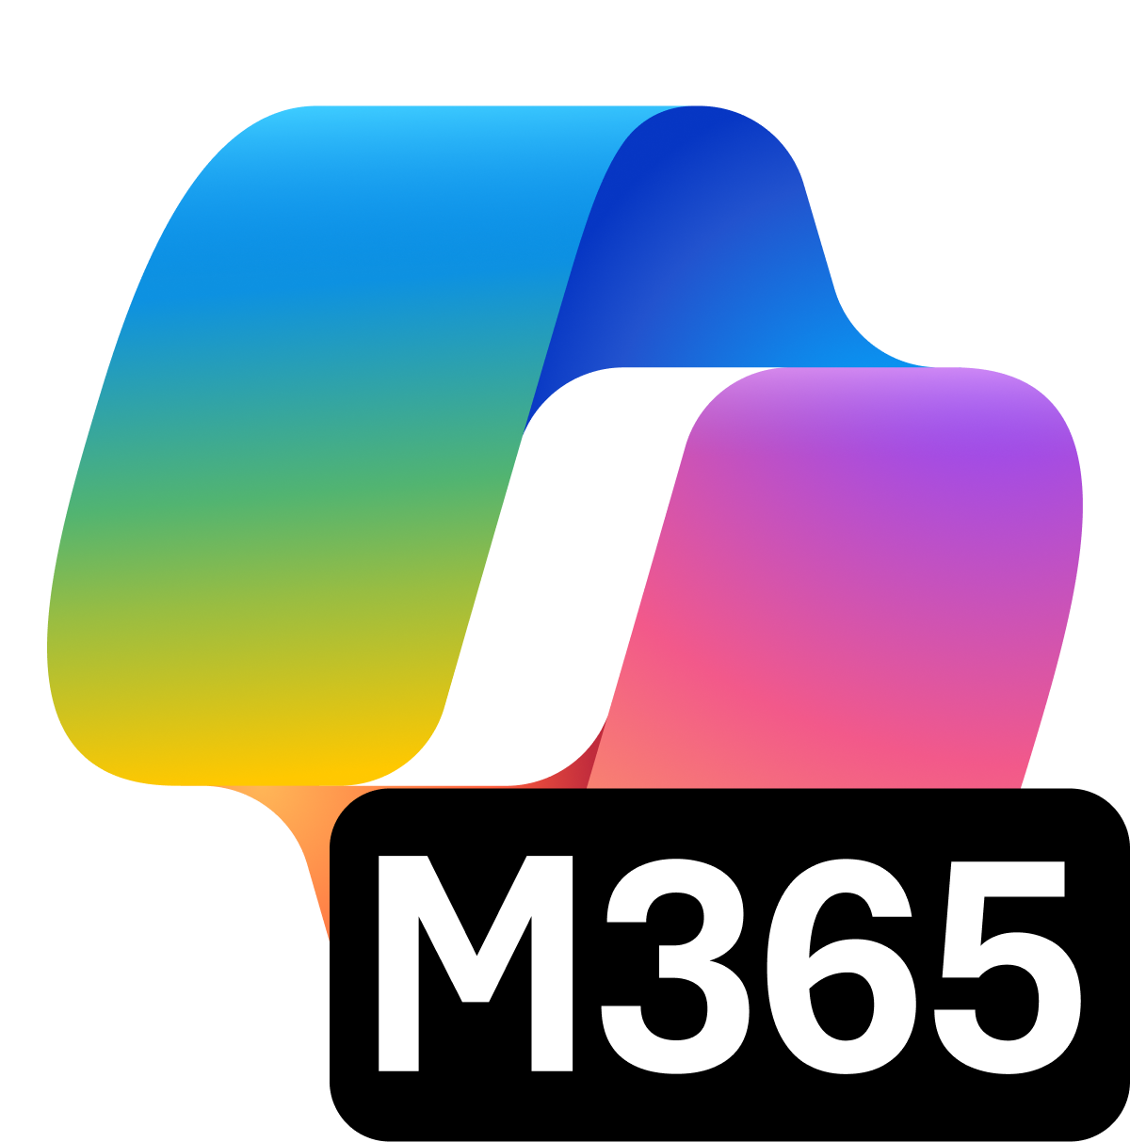
Microsoft Purview Suite for Microsoft 365 Business Premium
Intelligent compliance and risk management in the age of AI
AI transformation is happening now
Secure and govern your data estate and get ready for AI
Microsoft Purview Suite, now available as an add-on to Microsoft 365 Business Premium, providers integrated data security and compliance capabilities critical for organizations looking to adopt Gen AI technologies and minimize risks related to regulatory requirements.
Safeguard sensitive data across clouds, apps, and endpoints.
Identify and remediate critical risks within your organization.
Investigate and respond to legal requirements with relevant data.
Built-in assessments and actions for 350+ regional regulations
Save 47% per license with the Microsoft Purview Suite for Business Premium
Microsoft Purview
Standalone bundles
Information Protection + Governance $7
Data Loss Prevention Information Protection Data Lifecycle Management …and more
Insider Risk Mgmt. $6
Insider Risk Management Communication Compliance Privileged Access Mgmt …and more
eDiscovery + Audit $6
eDiscovery (Premium) Audit (Premium)
Per user, per month
Microsoft Purview Suite for Business Premium
Save ~47% per license
Prepare for Enable end-to-end data security + compliance
GenAI + regulatory requirements
$10
Microsoft Purview
Suite for Business
Premium*
>$19.00
value of individual licenses
1 First Annual Generative AI study: Business Rewards vs. Security Risks, Q3 2023, ISMG, N=400
2 Microsoft data security index 2024 report.
3 Microsoft FY25 Q1 Earnings Conference Call, October 2024

Slide 3
Comparison of key features between Copilot licenses
zzz
Copilot Chat (eligible license)
vs
Copilot Business
(add-on license)
AI-powered chat
AI-powered chat
Securely interact with Chat using web data
Securely interact with Chat using web and work data
Agents
Agents
Access to agents that use web data, work data agents are pay-as-you-go
Includes access to agents that use web and work data
Controls
Controls
Basic usage management controls and reporting for admins
Adds advanced management controls and analytics for admins

