Slide 1


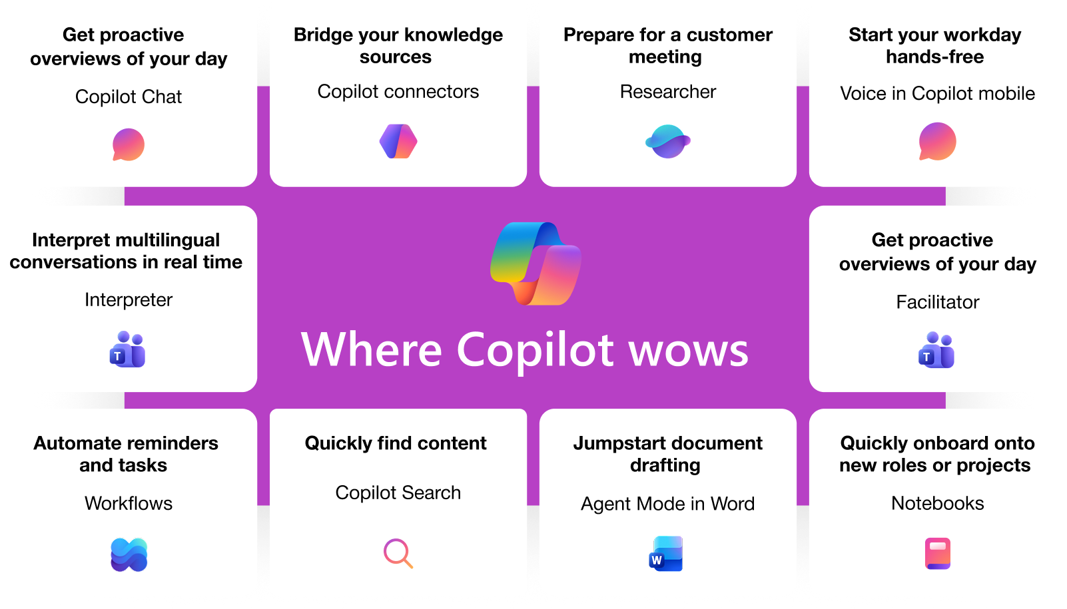
Microsoft 365 Copilot Business
Copilot is the UI for AI that combines the power of LLM with the web and work data and applications that supercharges productivity, unlocks value, transforms business processes with Agents and inherits existing security, privacy, identity enterprise ready policies.
Secure and compliant
Powered by Work IQ
Measurable business value
Honors existing Microsoft 365 permissions and policies for data access
Data is secure at rest and in transit
Your data is not used to train foundational model
You are protected against AI security and copyright risk
You control your data and your data’s location
Search queries are abstracted/ de identified from the user's prompt and grounding data
Work IQ is the intelligence layer that enables M365 Copilot and agents to know your work inside and out. It connects your context, workflows and relationships to deliver an experience that is built for you.
It includes three (3) components:
Data spanning your personal work data like files, emails, and messages, as well as your organizations data;
Memory from your work profile, custom instructions and saved preferences;
Inference, i.e. organizational relationships, work patterns, and workflows
77% of early adopters said they don’t want to give up Copilot
84% easier to actions after a meeting
75% users save time by finding whatever they need
3.8x faster to get caught up, identify decisions, and draft an email
85% users find it easier to get to a good first draft faster
Notes:
67% of all phishing attacks utilized some form of AI
292
days to identify and contain breaches involving stolen credentials

Slide 2
Comparison of key features between Copilot licenses
zzz
Copilot Chat (eligible license)
vs
Copilot Business
(add-on license)
AI-powered chat
AI-powered chat
Securely interact with Chat using web data
Securely interact with Chat using web and work data
Agents
Agents
Access to agents that use web data, work data agents are pay-as-you-go
Includes access to agents that use web and work data
Controls
Controls
Basic usage management controls and reporting for admins
Adds advanced management controls and analytics for admins

