Slide 1


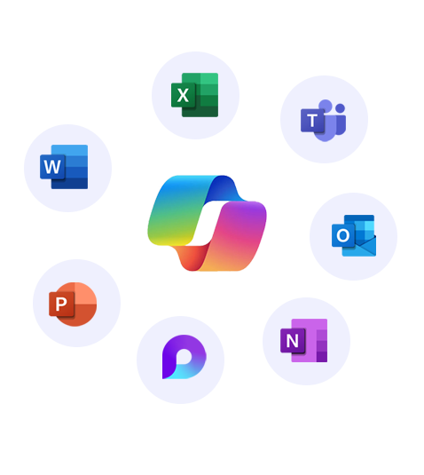


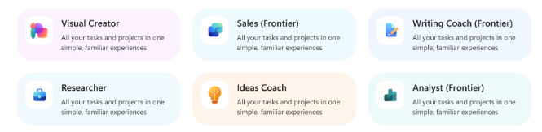
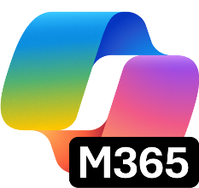


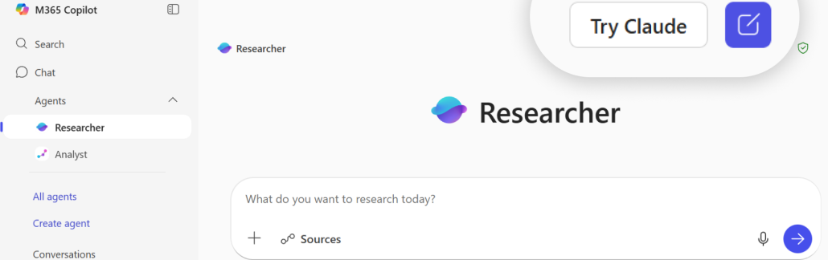
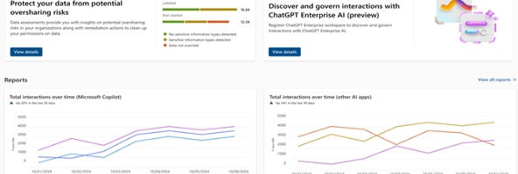
Transform your business with one AI solution – Copilot Business
Move beyond the basics. Unlock even more power of AI at work with Copilot Business. Work with Work IQ to surface insights, power market research, and strengthen strategic planning—reasoning across your meetings, emails, and documents.
All-in-1 AI productivity app
Integrated into existing apps
Secure AI chat
AI search enhanced by Work IQ
Ecosystem of pre-built agents
AI-generated multi-media
Centralize content of various types
Analytics, governance, and compliance
Embedded in Microsoft 365 apps you already use every day, with advanced AI skills like Agent Mode and Teams Mode
Powered by Work IQ
Agent platform
Memory​
Inference
You at work
Data
Ecosystem of pre-built Microsoft agents like Researcher, Analyst, and Facilitator, along with trusted agents from partners and custom agents
Intelligence that makes Microsoft 365 Copilot uniquely built for work
Model choice
Copilot Control system
Flexibility to choose between OpenAI and Anthropic models starting in Researcher, Agent Mode in Excel and when building agents in Copilot Studio
Robust security, management, measurement and reporting to understand impact and ensure standardized governance

Slide 2
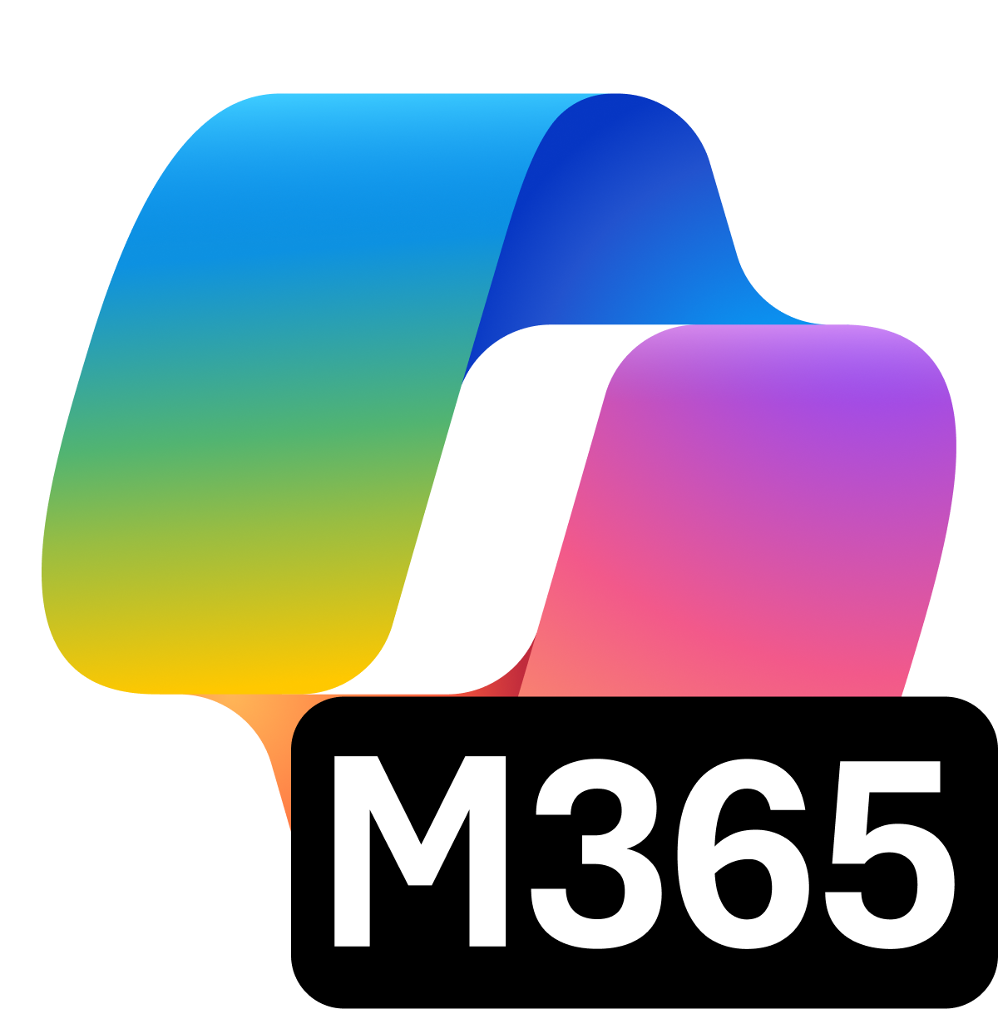
Microsoft Purview Suite for Microsoft 365 Business Premium
Intelligent compliance and risk management in the age of AI
AI transformation is happening now.
Secure and govern your data estate and get ready for AI
Microsoft Purview Suite, now available as an add-on to Microsoft 365 Business Premium, providers integrated data security and compliance capabilities critical for organizations looking to adopt Gen AI technologies and minimize risks related to regulatory requirements.
Safeguard sensitive data across clouds, apps, and endpoints.
Identify and remediate critical risks within your organization.
Investigate and respond to legal requirements with relevant data.
Built-in assessments and actions for 350+ regional regulations
Unified solutions to secure and govern data for the era of AI
Address oversharing concerns
Protect against data loss and insider risks
Govern AI use to meet regulations & policies
Gain visibility into overshared content.
Remediate excessive permissions.
Prevent Generative AI from processing sensitive files.
Get alerts and reports of risky behavior and AI use.
Protect sensitive files and Copilot interactions.
Dynamically apply security policies based on risky actions.
Inspect interaction content and audit logs.
Investigate for compliance and ethical violations.
Enforce lifecycle policies and legal holds.

Slide 3



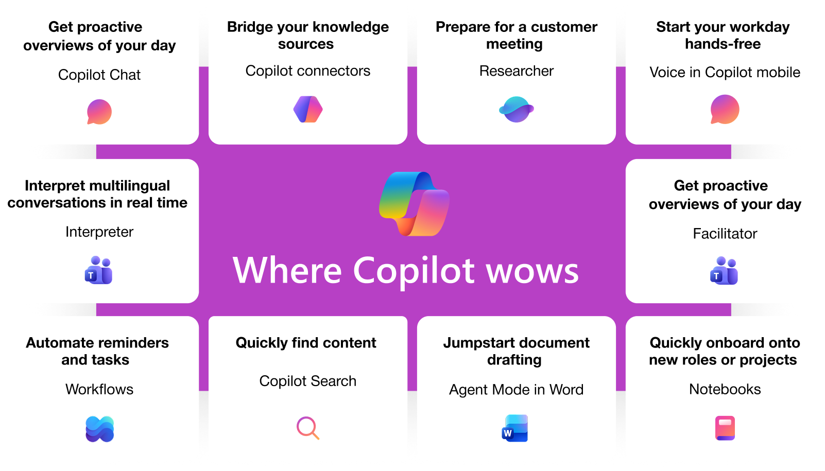
Incremental capabilities from Business Basic to Business Premium, Copilot Business, and Purview
Business Basic
Business Premium, Copilot Business, and Purview
Web and mobile versions of Word, Excel, PowerPoint, and Outlook​
AI grounded in web data and accessible across apps you use every day with additional content awareness of your open file
Custom agents with pricing on a metered basis
Foundational identity and access management
Automatic spam and malware filtering​
Web, mobile, and desktop versions of Word, Excel, PowerPoint, and Outlook​
AI that understands your work with access to Microsoft Graph data - files, email, chat, meetings, people, etc.
Advanced Chat and Office skills, including functionality like Agent mode in apps, Copilot Search and Copilot Notebooks
Model Choice with Anthropic’s Claude models in both Researcher and Copilot Studio to fit business needs and use cases
Strongest security with conditional access, automatic sensitivity and retention labels, advanced data security and compliance controls, and discovery and evaluation of risk across 400+ AI apps

Slide 4
Comparison of key features between Copilot licenses
zzz
Copilot Chat (eligible license)
vs
Copilot Business
(add-on license)
AI-powered chat
AI-powered chat
Securely interact with Chat using web data
Securely interact with Chat using web and work data
Agents
Agents
Access to agents that use web data, work data agents are pay-as-you-go
Includes access to agents that use web and work data
Controls
Controls
Basic usage management controls and reporting for admins
Adds advanced management controls and analytics for admins

Slide 5
Upgrade investment snapshot
Current SKU | {start_sku}​
# Seats | {seats}​
Current investment​ | {expiring_arr}
Upgrade solution​ | {target_sku}
# Proposed seats for upgrade​ | {add_proposed_seat}
Actual cost of the solution per user | {actual_price_per_user}
Savings from promo price | {promo_savings_per_user}
Cost per user after adjusting promo price | {per_user_after_promo_price}
Incremental cost per user​ | {incremental_cost_per_user}​
Total incremental annual investment for {seats} seats | {overall_incremental_cost}
Take advantage of the limited time offer on Copilot Business, Business Premium, and Purview Suite
Actual cost per user
Cost after promo
~30%
$53
$37
Savings from the promo
[NOTE - PLEASE DELETE BEFORE SENDING TO THE CUSTOMER]
The calculation above is based on active promos, partner MAICPP status, Microsoft Commercial Incentives, and Microsoft list price, and assumes additional information on margins. This is for reference only and subject to change. Please review the calculation, and adjust before sending it to the customer. Microsoft would not be responsible for the content or accuracy of any information/claim made in this document, or for any decisions made based on such information.

Slide 6
Accelerate your Secure AI transformation with [PARTNER NAME]
[INSTRUCTION FOR THE PARTNER] Partner to insert their personalized information on: Value proposition and methodology, experience, Microsoft services, advanced specializations, and past awards.
You can leverage Copilot Chat to customize this section! Add your website URL, upload this flyer on Copilot Chat, and prompt it to write a draft for this section.

