Slide 1


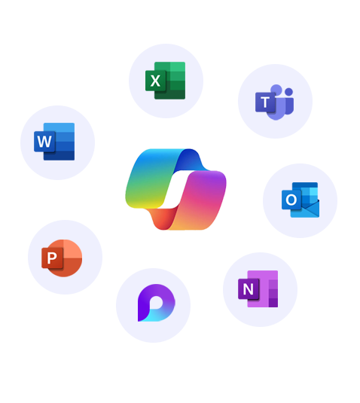


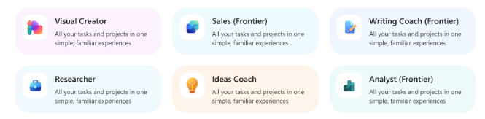
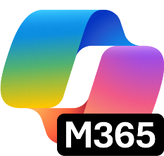


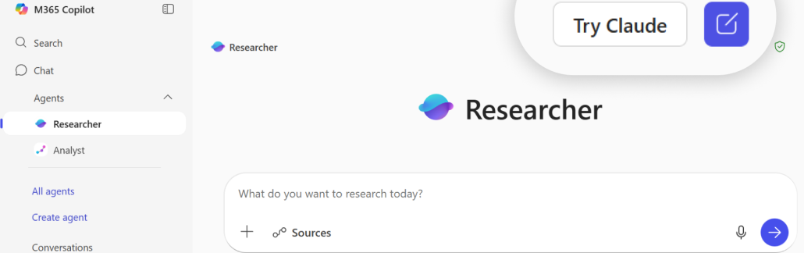
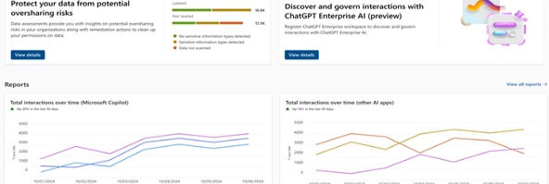
Transform your business with one AI solution – Copilot Business
Move beyond the basics. Unlock even more power of AI at work with Copilot Business. Work with Work IQ to surface insights, power market research, and strengthen strategic planning—reasoning across your meetings, emails, and documents.
All-in-1 AI productivity app
Integrated into existing apps
Secure AI chat
AI search enhanced by Work IQ
Ecosystem of pre-built agents
AI-generated multi-media
Centralize content of various types
Analytics, governance, and compliance
Embedded in Microsoft 365 apps you already use every day, with advanced AI skills like Agent Mode and Teams Mode
Powered by Work IQ
Agent platform
Memory​
Inference
You at work
Data
Ecosystem of pre-built Microsoft agents like Researcher, Analyst, and Facilitator, along with trusted agents from partners and custom agents
Intelligence that makes Microsoft 365 Copilot uniquely built for work
Model choice
Copilot Control system
Flexibility to choose between OpenAI and Anthropic models starting in Researcher, Agent Mode in Excel and when building agents in Copilot Studio
Robust security, management, measurement and reporting to understand impact and ensure standardized governance

Slide 2



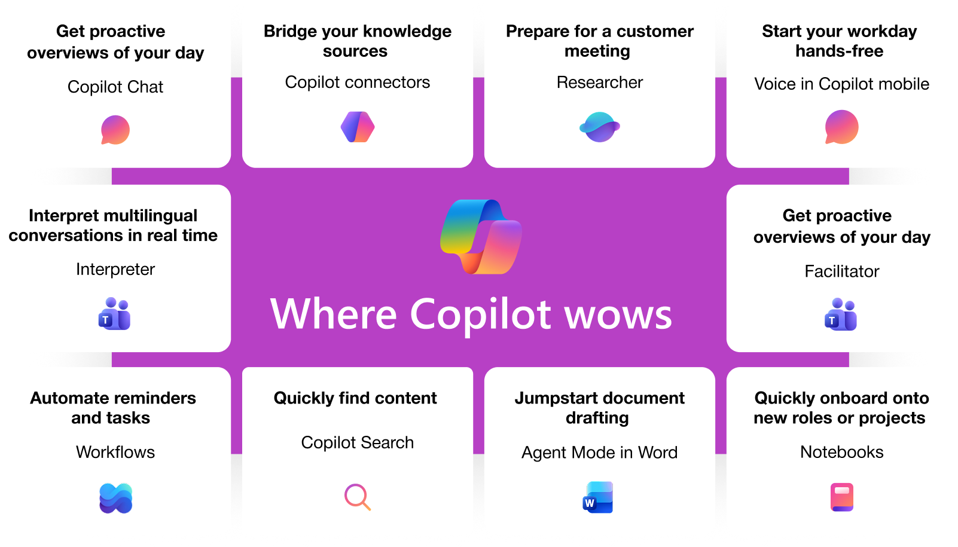
Incremental capabilities from Business Basic to Business Standard and Copilot Business
Business Basic
Business Standard and Copilot Business
Web and mobile versions of Word, Excel, PowerPoint, and Outlook​
AI grounded in web data and accessible across apps you use every day with additional content awareness of your open file
Custom agents with pricing on a metered basis
Foundational identity and access management
Automatic spam and malware filtering​
Web, mobile, and desktop versions of Word, Excel, PowerPoint, and Outlook​
AI that understands your work with access to Microsoft Graph data - files, email, chat, meetings, people, etc.
Advanced Chat skills, including functionality like Copilot Search and Copilot Notebooks
Advanced Office skills such as Agent mode directly into the apps, helping to analyze data, build models, and refine documents
Collaborative agents such as Facilitator, Knowledge agent, Agent in Teams Channels, etc. to power you to build human-AI teams
Model Choice with Anthropic’s Claude models in both Researcher and Copilot Studio to fit business needs and use cases

Slide 3
Comparison of key features between Copilot licenses
zzz
Copilot Chat (eligible license)
vs
Copilot Business
(add-on license)
AI-powered chat
AI-powered chat
Securely interact with Chat using web data
Securely interact with Chat using web and work data
Agents
Agents
Access to agents that use web data, work data agents are pay-as-you-go
Includes access to agents that use web and work data
Controls
Controls
Basic usage management controls and reporting for admins
Adds advanced management controls and analytics for admins

Slide 4
Upgrade investment snapshot
Current SKU | {start_sku}​
# Seats | {seats}​
Current investment​ | {expiring_arr}
Upgrade solution​ | {target_sku}
# Proposed seats for upgrade​ | {add_proposed_seat}
Actual cost of the solution per user | {actual_price_per_user}
Savings from promo price | {promo_savings_per_user}
Cost per user after adjusting promo price | {per_user_after_promo_price}
Incremental cost per user​ | {incremental_cost_per_user}​
Total incremental annual investment for {seats} seats | {overall_incremental_cost}
Take advantage of the limited time offer on Copilot Business + Business Standard bundle
Actual cost per user
Cost after promo
~35%
$33.5
$22
Savings from the promo
[NOTE - PLEASE DELETE BEFORE SENDING TO THE CUSTOMER]
The calculation above is based on active promos, partner MAICPP status, Microsoft Commercial Incentives, and Microsoft list price, and assumes additional information on margins. This is for reference only and subject to change. Please review the calculation, and adjust before sending it to the customer. Microsoft would not be responsible for the content or accuracy of any information/claim made in this document, or for any decisions made based on such information.

Slide 5
Accelerate your Secure AI transformation with [PARTNER NAME]
[INSTRUCTION FOR THE PARTNER] Partner to insert their personalized information on: Value proposition and methodology, experience, Microsoft services, advanced specializations, and past awards.
You can leverage Copilot Chat to customize this section! Add your website URL, upload this flyer on Copilot Chat, and prompt it to write a draft for this section.

