Slide 1
Efficient Estimation of Word Representations in Vector Space
Paper by Tomas Mikolov, Kai Chen, Greg Corrado, Jeffrey Dean

Slide 2
Introduction
Published by Google researchers in 2013
Introduced the word2vec architecture for generating word vector embeddings
Word embeddings meet neural networks

Slide 3
Word Embeddings
(and subword)

Slide 4
The Motivation
We have an intuition that words can be “close”
“baby” and “infant” are closer than “baby” and “perimeter”
Can we put them in a space where the distance between words matches our notion of closeness?
Let’s try it!

Slide 5
Which two of these words are most alike?
Pebble
Boulder
City

Slide 6
(1, -1)
(1, 0.5)
City
Boulder
(0.5, -0.5)
Pebble

Slide 7
Analogies
We can represent analogies in our vector space as
A is to B as C is to D ⬄ B – A = D – C
Boulder is to pebble as city is to…?
Village

Slide 8
(1, -1)
(1, 0.5)
City
Boulder
(0.5, -0.5)
Pebble

Slide 9
(1, -1)
(1, 0.5)
City
Boulder
(0.5, -0.5)
Pebble

Slide 10
(-1, 1)
(1, 0.5)
City
(-1.5,0)
Boulder
(0.5, -0.5)
Pebble
Village

Slide 11
word2vec

Slide 12
Overview
Construct word-context pairs of vectors from the data
Train a neural network made of 2 dense layers
Interpret the neuron activations as word vectors!

Slide 13
Word Context Pairs
A word’s context is the distribution of words around it.
Leans on the distributional hypothesis
“You shall know a word by the company it keeps” – John Rupert Firth

Slide 14
Example
Creating a word-context pair for “kibble” from the sentence “Dogs like eating kibble”
Word vector: OHE of “kibble”
Context vector: OHE of “Dogs” + OHE of “like” + OHE of “eating”

Slide 15
word2vec Architecture
2 Flavors:
Continuous Bag of Words: predict word vector from context vector
Skip-gram: predict context vector from word vector

Slide 16
word2vec Architecture
http://mbenhaddou.com/2019/12/14/word2vec-concepts-from-scratch/

Slide 17
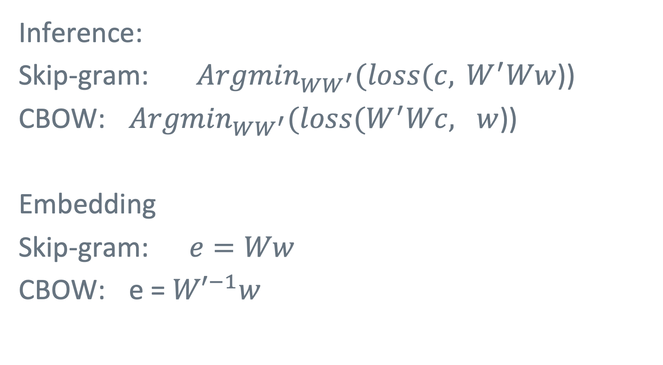
Inference:
Skip-gram: ${Argmin}_{WW^{′}}(loss(c, { W}^{′}Ww$))
CBOW: ${Argmin}_{WW^{′}}(loss(W^{′}Wc, w$))
Embedding
Skip-gram: $e=Ww$
CBOW: e = ${W′}^{−1}w$

Slide 18
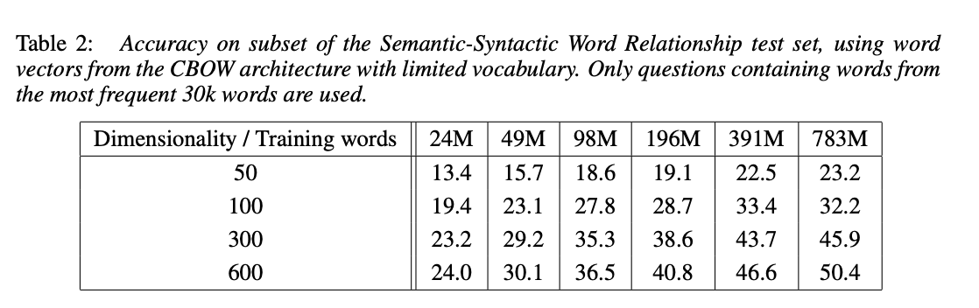
Results

Slide 19
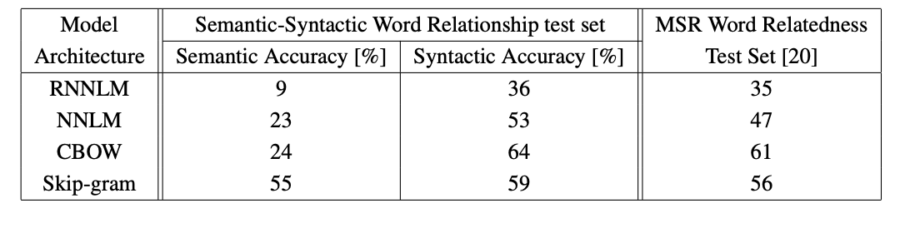
Results

Slide 20
W.R.T. Transformers
Neural networks still generate word embeddings through back-prop
Masked language modeling is a lot like CBOW.
Transformers rely on distributional semantics, so they share many of the same problems as word2vec

Slide 21
See also:
Neural Word Embeddings as Implicit Matrix Factorization
https://papers.nips.cc/paper/2014/file/feab05aa91085b7a8012516bc3533958-Paper.pdf
Distributed Representations of Sentences and Documents
https://cs.stanford.edu/~quocle/paragraph_vector.pdf
E-commerce in Your Inbox: Product Recommendations at Scale
https://arxiv.org/abs/1606.07154
Deep Contextualized Word Embeddings
https://paperswithcode.com/paper/deep-contextualized-word-representations
What the Vec? Towards Probabilistically Grounded Embeddings
https://arxiv.org/abs/1805.12164

