Slide 1
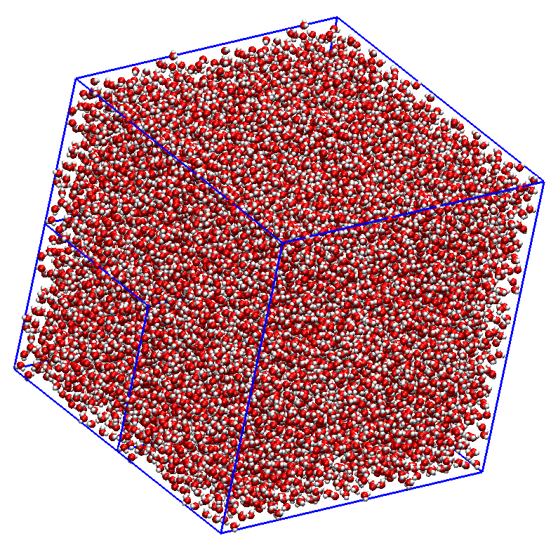
ALMO AIMD
100Å
AIMD
Notes:
32k to 40k
ZZZ: PNAS THG

